Slide 1
FA25ProgressReport_Lucas
2025/11/17

Slide 2
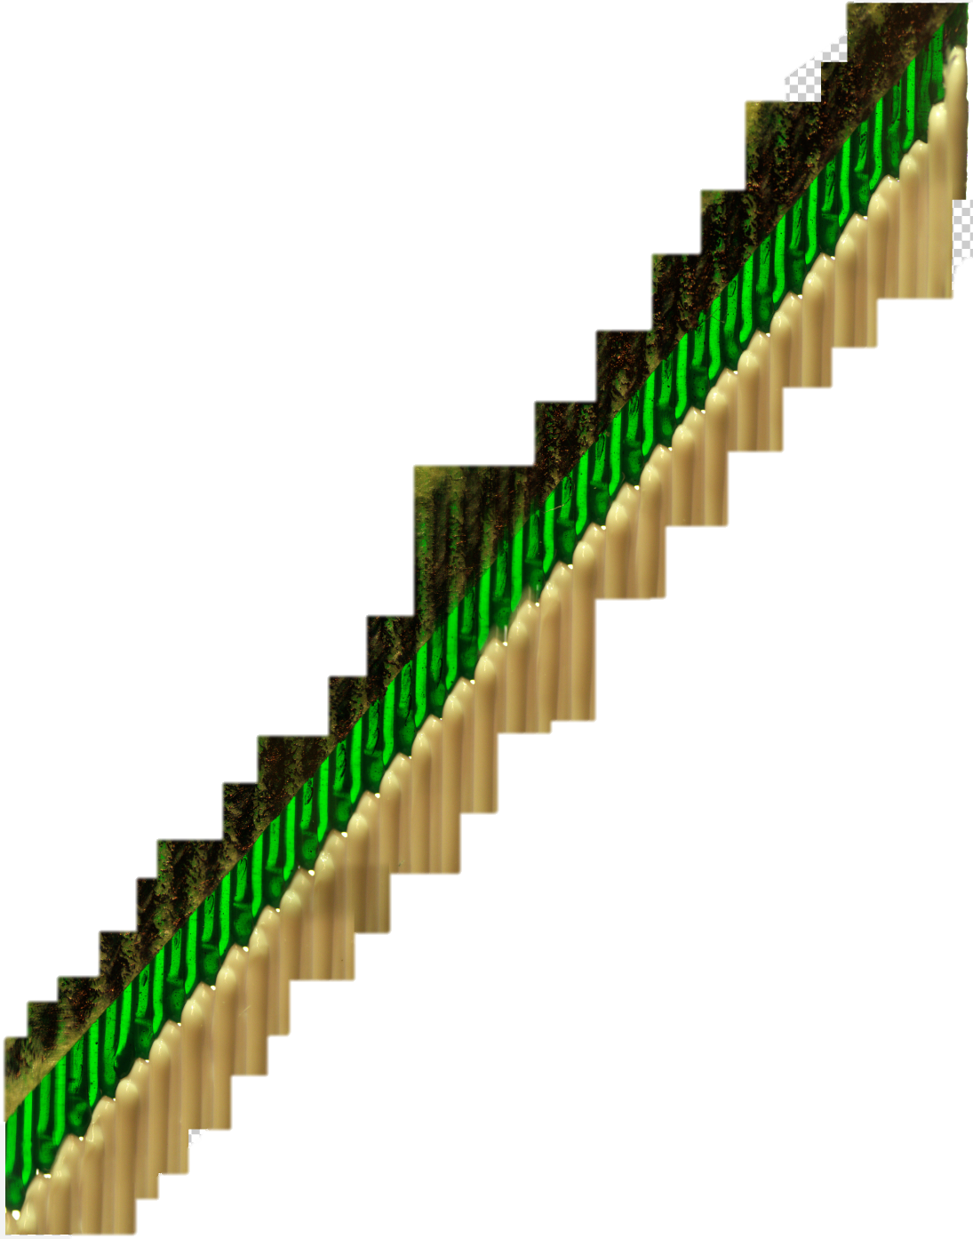
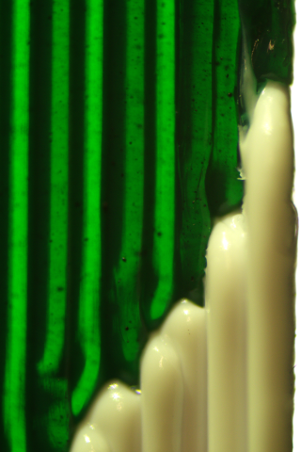
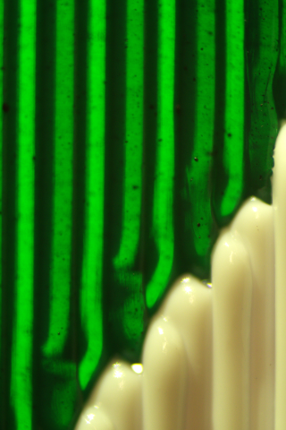
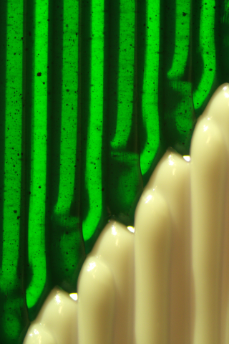
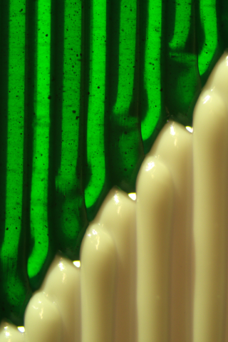
Interlocking Topology
Challenge: Image Stitching
Printed specimens have recurring patterns near the seam. When attempting to synthesize multiple images, the presence of similar feature vectors within the overlapping regions caused ambiguity for the algorithm. Portions of the input data are disappeared as a result, and noticeable geometric distortions appear. The outputs are unsuitable for reliable boundary detection.
…

Slide 3
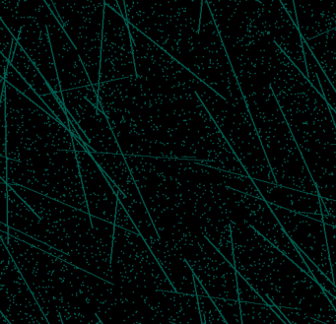
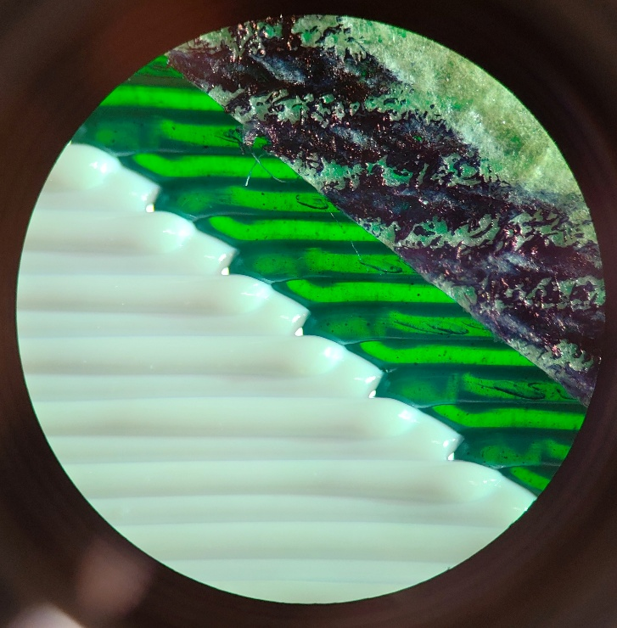
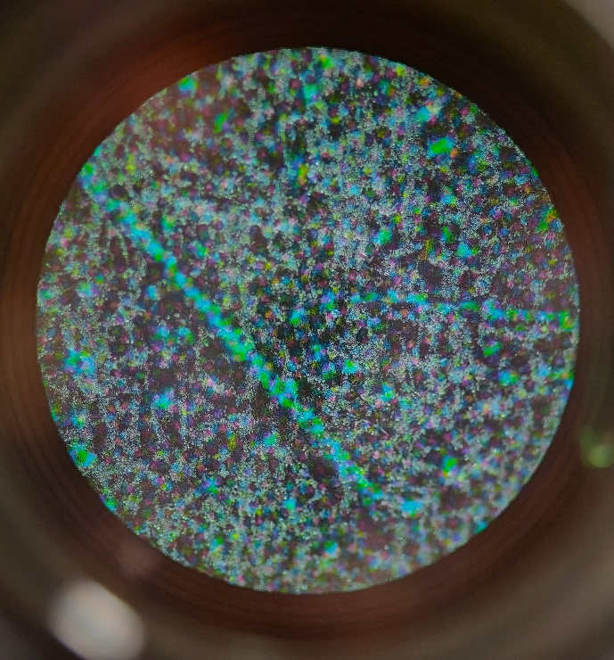
Potential Solutions
Masking tape covered by ballpen oil-based ink, random texture helps with locating.
Valleys can not be completely covered, bright region interferes with detection
Random dark teal colour dots and line ‘noise’ pattern on black background, printed on paper.
Difficult to completely adhere to the sample surface, floating paper don’t stay in the focus plane. Tiny highlight spots can be observed when illuminated from the side.

Slide 4
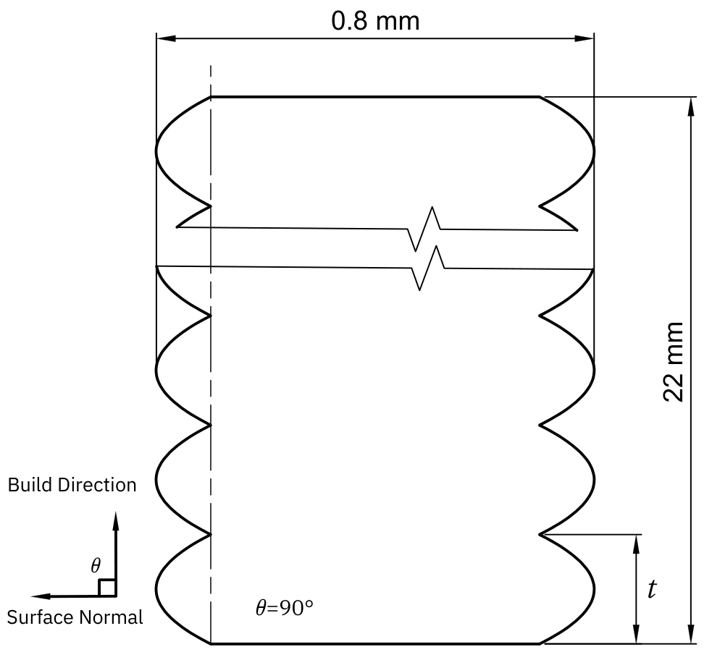
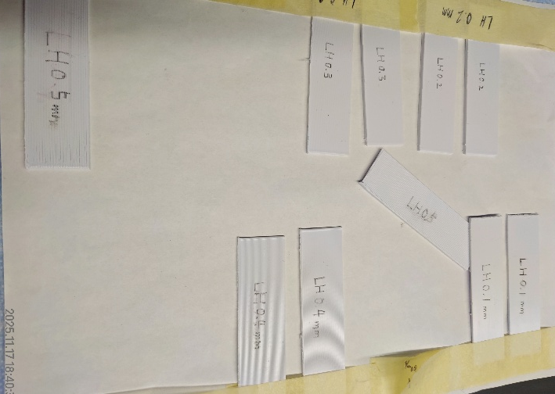
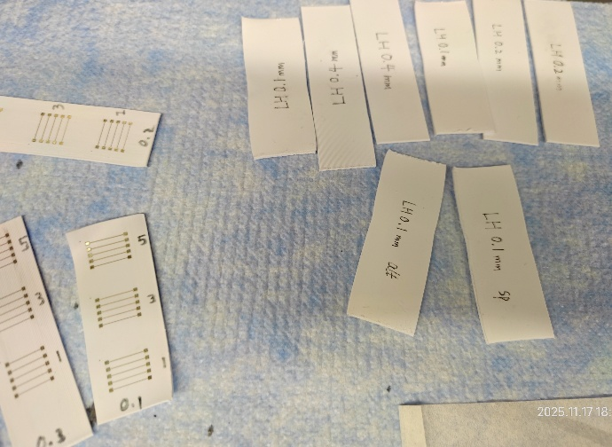
FDM Roughness samples (for aerosol)
These substrates were printed in vertical orientation. The layer height was identified as the principal parameter for controlling the surface roughness of the sidewalls, which subsequently served as the printing surface for the AJP process. Layer heights varied from 0.1 mm to 0.5 mm, with increments of 0.1 mm. All other printing parameters were maintained constant throughout the process.
5 samples for each layer height (two groups from which were consumed in 100 °C annealing testing)

Slide 5
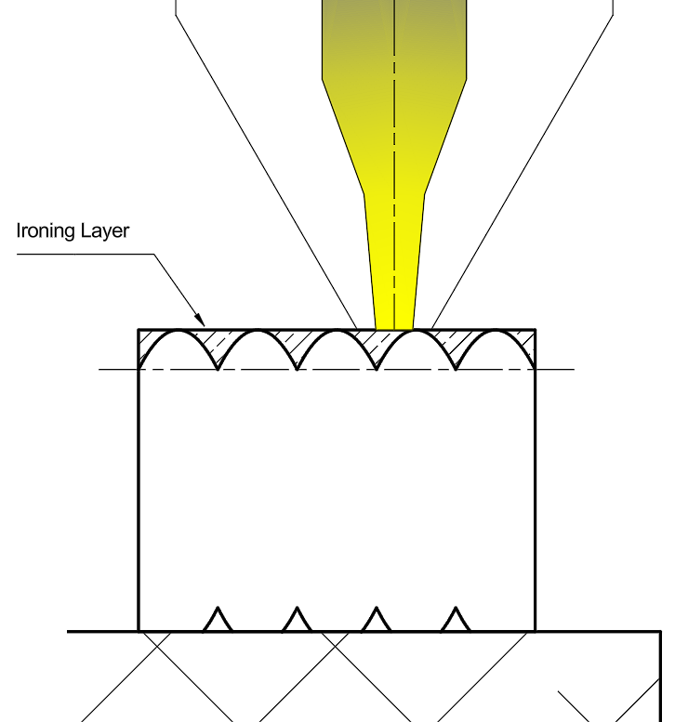
For comparison, a group of substrates with smooth top surface was fabricated in alternative printing orientation. To further enhance surface uniformity and minimize roughness, additional ironed skin layer was applied to this top surface. This post-processing step involved repeatedly passing a heated nozzle over the printed top layer, at the exact height of model's top surface, with a reduced line spacing of 0.1 mm and significantly low material extrusion rate ~14% to precisely fill inter-line gaps and achieve a planar smooth surface. Concentric filling pattern was selected for its even linear pattern in the centre region.
After we found the adequate combination of flow rate, scan line distances and overflow offset, 3 samples were prepared.

Slide 6
SMLP
Drafting the following sections:
┌─ Methodology
│ ├─ Materials and Equipment
│ ├─ Specimen Design
│ ├─ Experimental Design and Parameter Matrix
│ │ └─ Slicing Configuration
│ ├─ Printing Procedure and Techniques
│ └─ Characterization (Testing)

