Slide 2
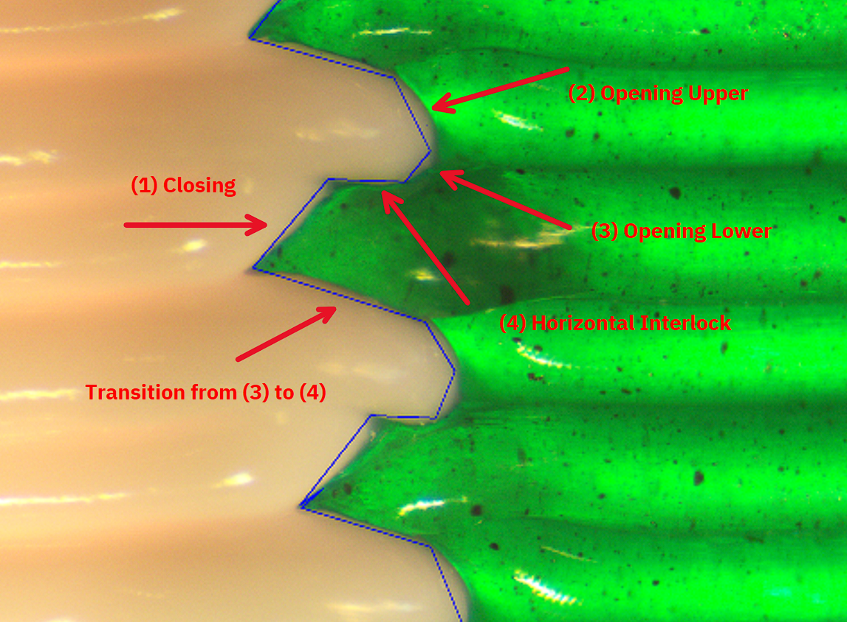
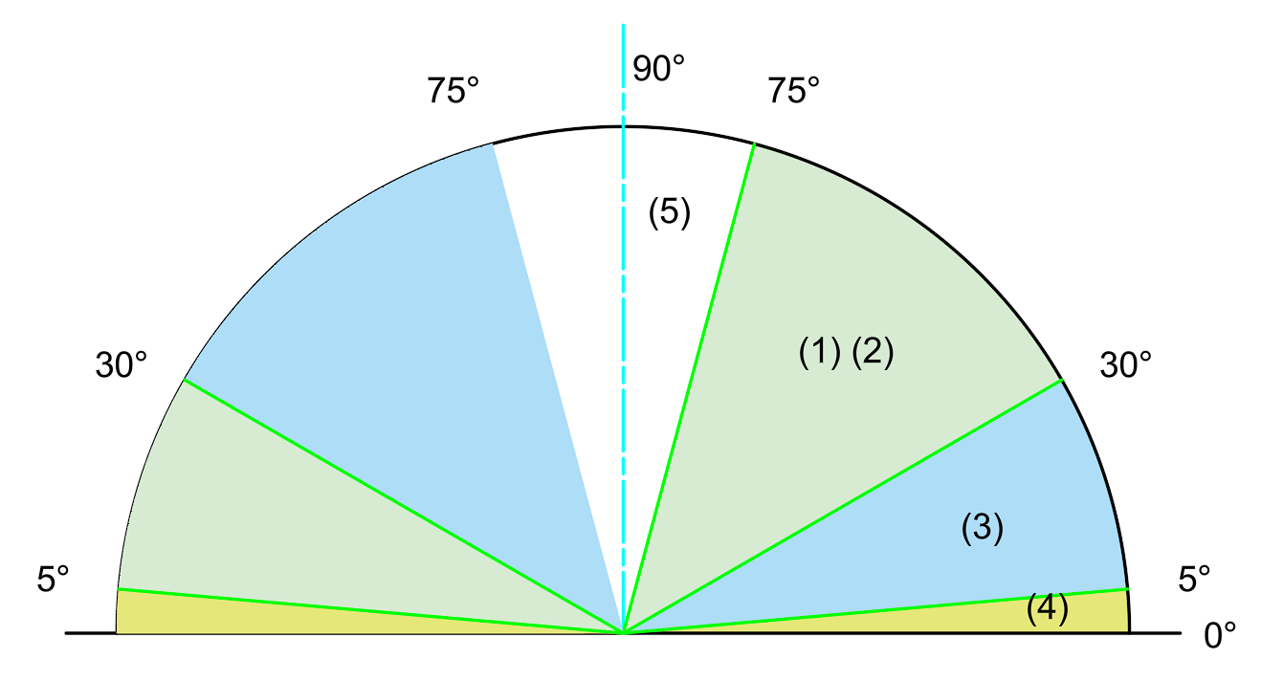
Segment Classification

Slide 3
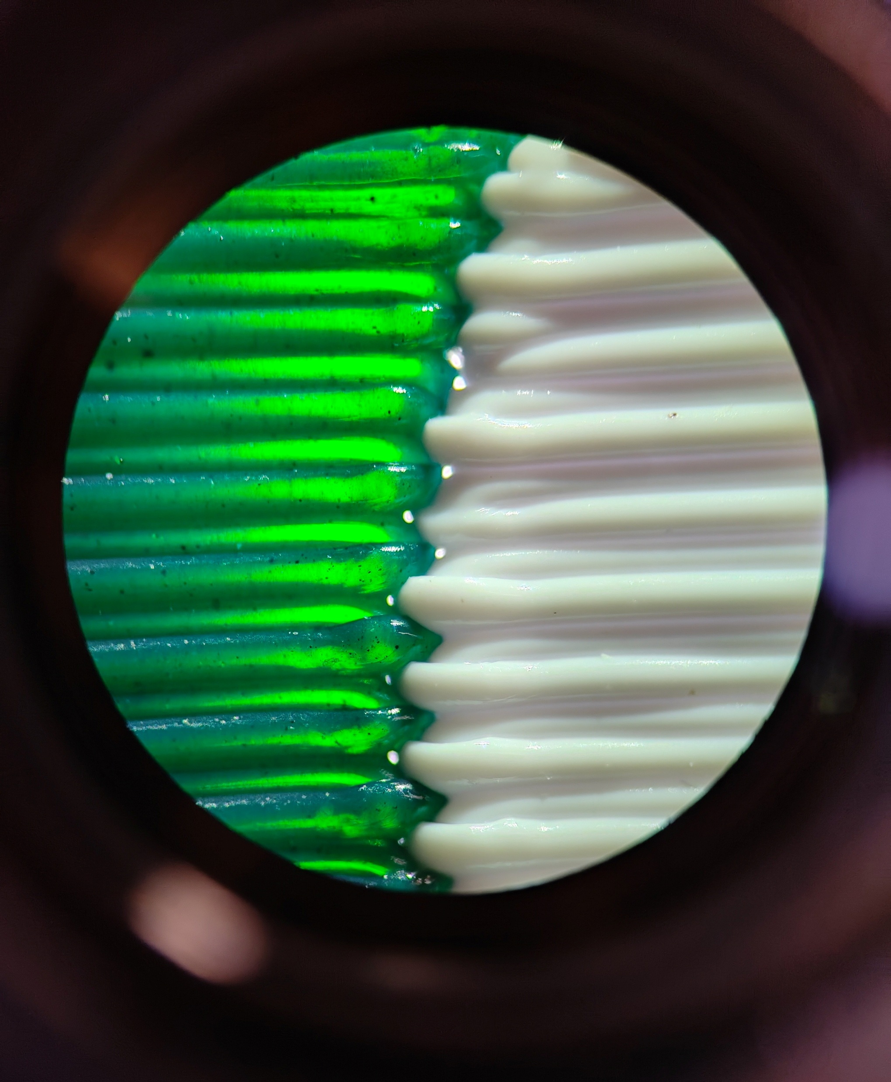
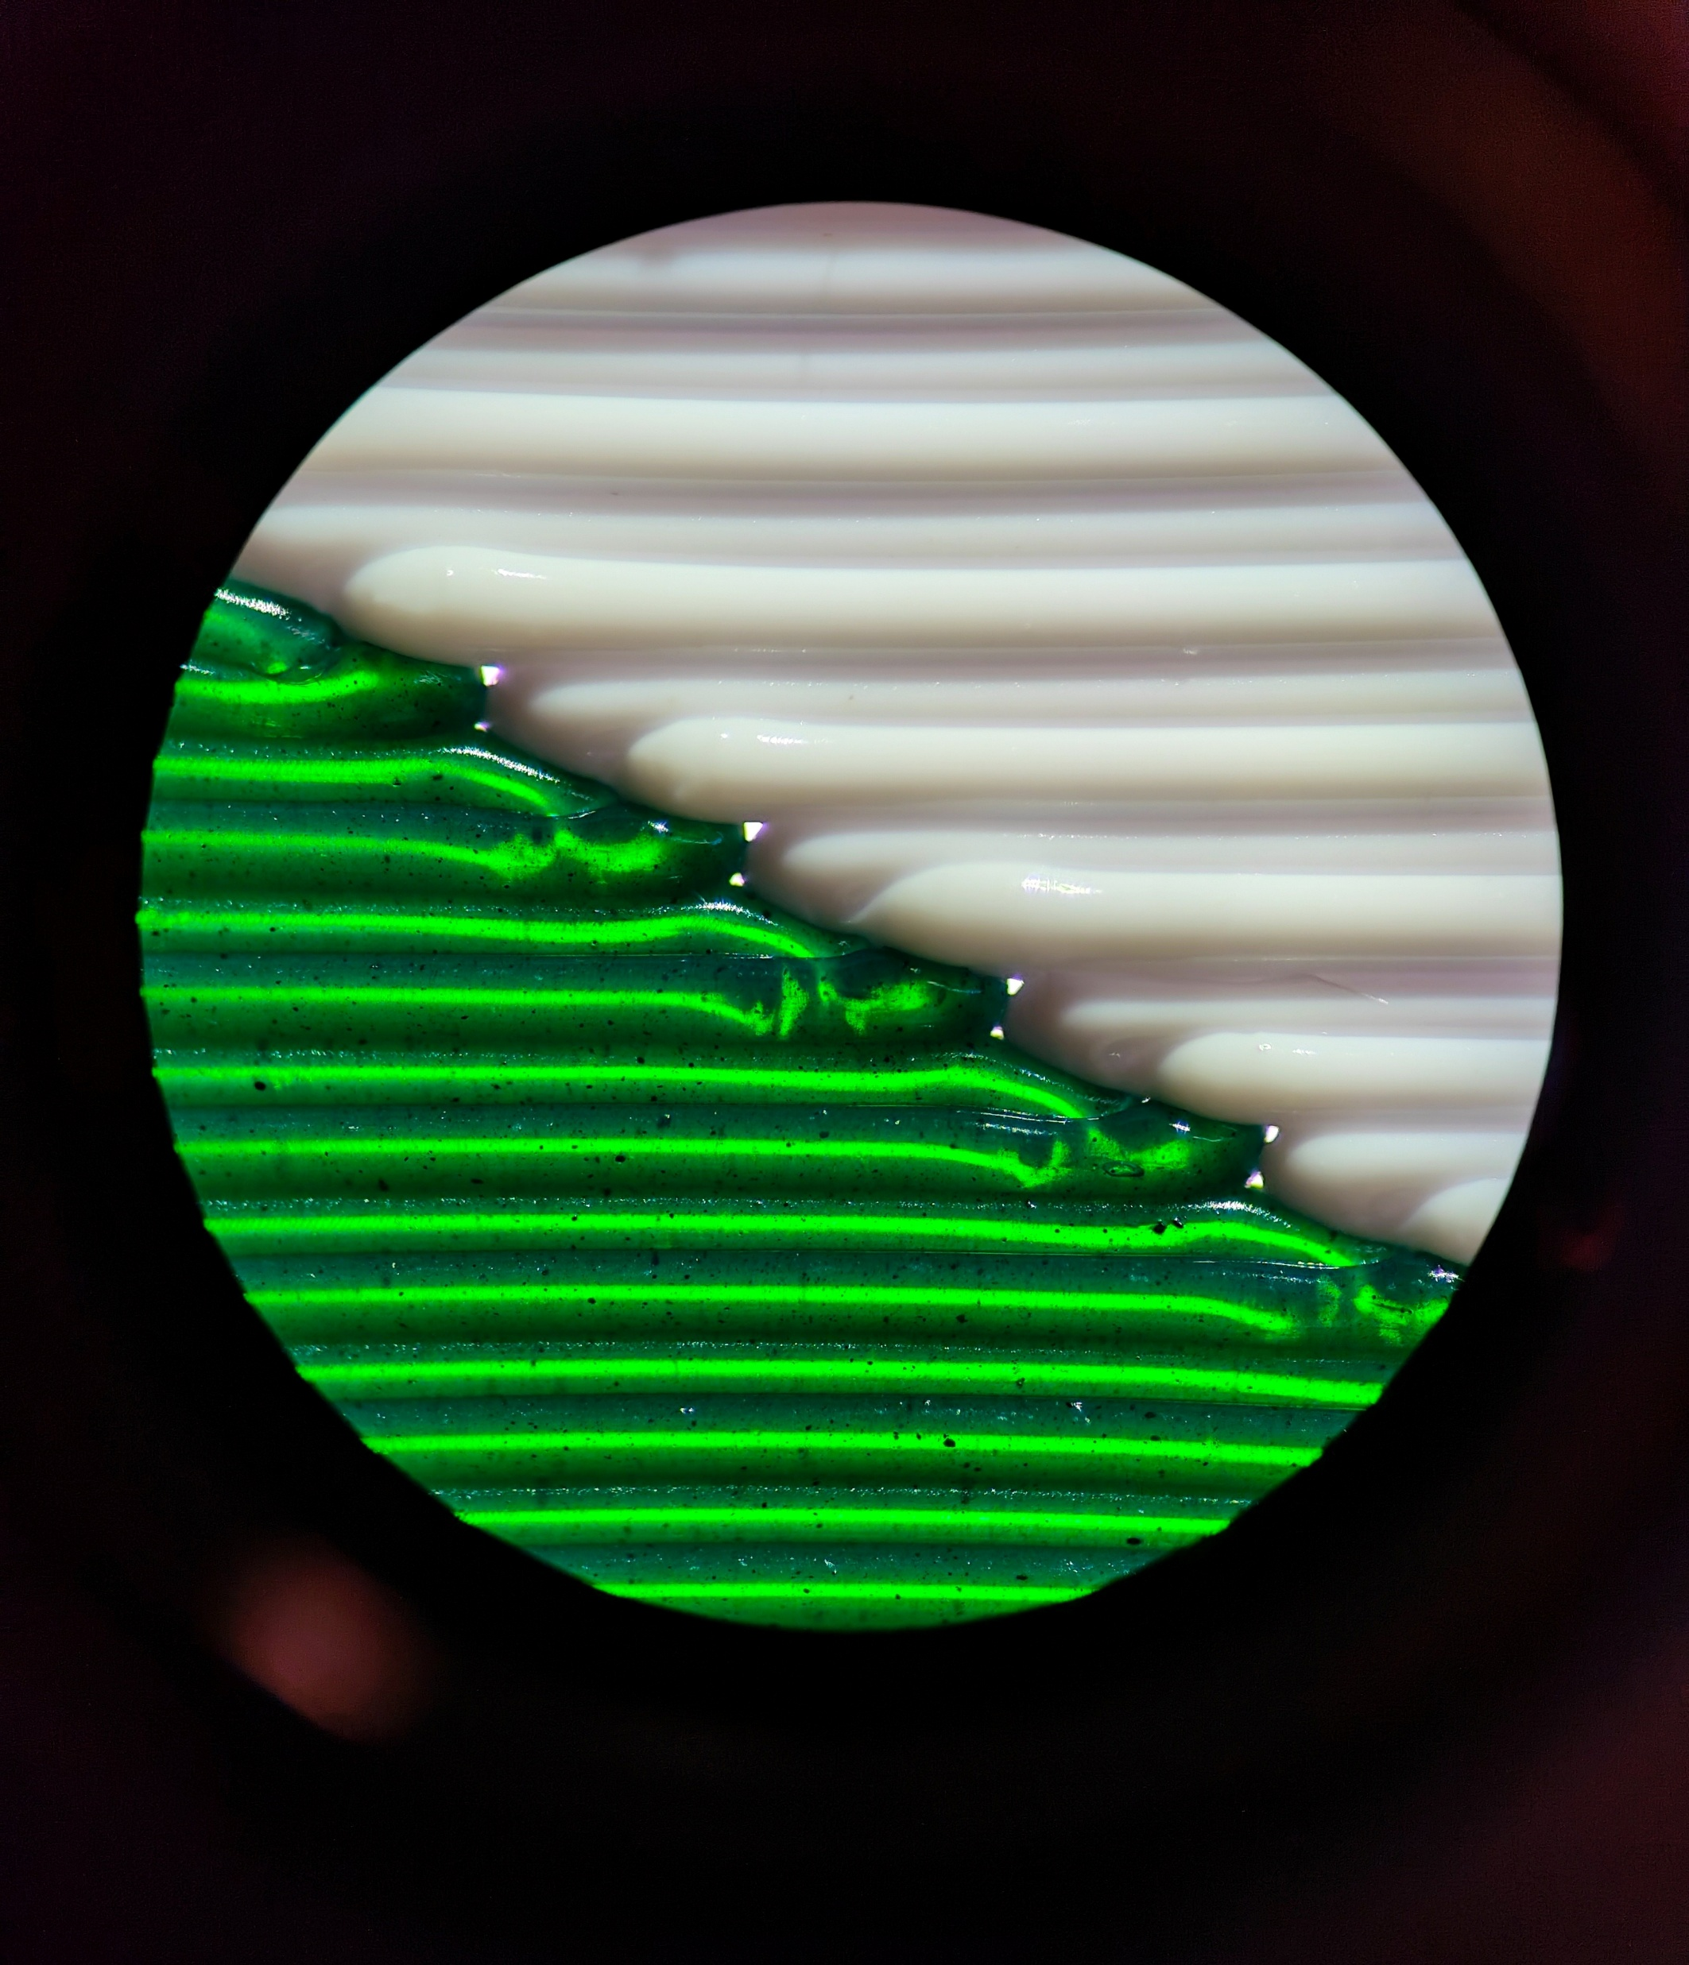

Slide 4
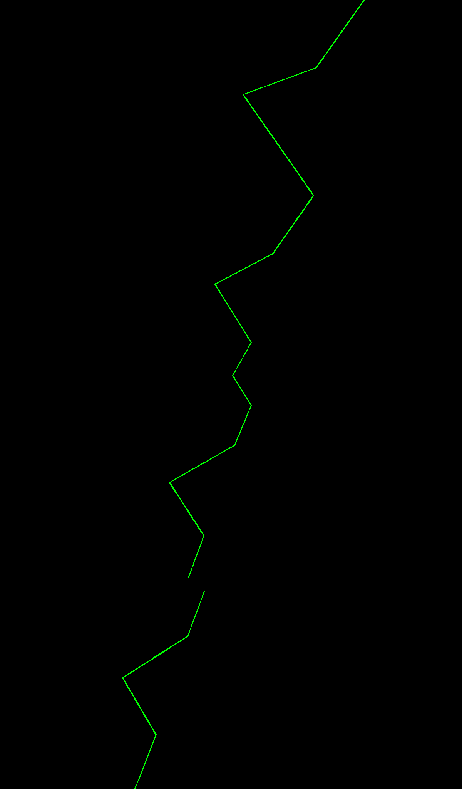
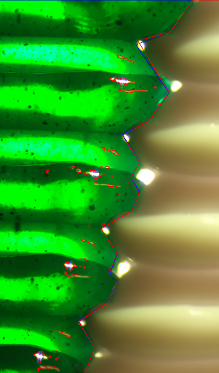
Image Processing
To ensure capturing consistency
Illumination from below, from top
Camera exposure settings
Focus depth
Panning movement(for multi-image stitching)

Slide 5
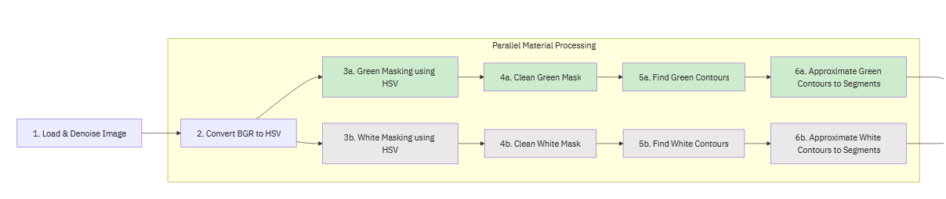
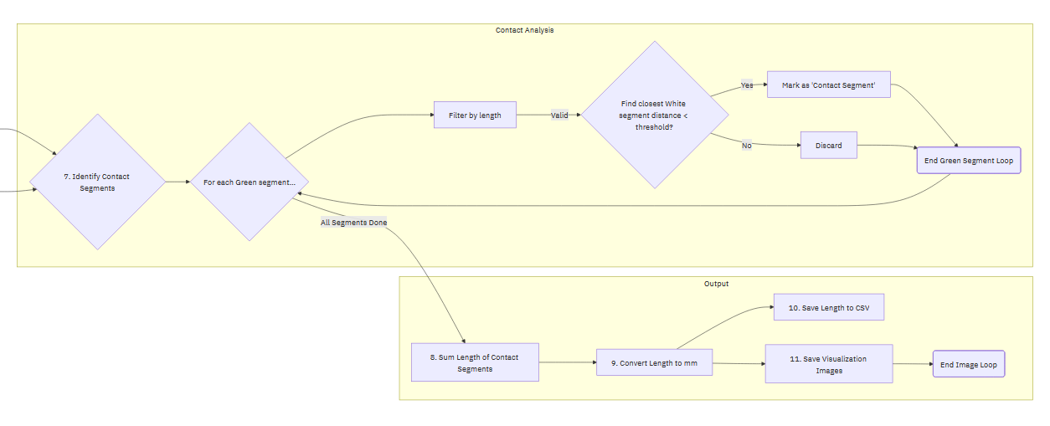

Slide 6






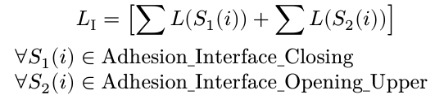



Parametric Modelling
Segment Length
Segment Angle
Derivation of Segmental Parameters for each class
Horizontal bonding length
Inclined segment length
Transition length, will be decomposed
Geometric Descriptors
Bonding Surface Coefficient
Average Interlocking Depth
Volumetric Interlock Ratio

Slide 7
Process–Structure–Property (PSP) Modeling
Predictors
Process: print speed, bonding interval, overlap distance, extrusion multiplier, cooling rate.
Structure (Aggregate): kₛ, d_inter, R_IV.
Structure (Segmental): total lengths of specific segment classes (closing, opening, horizontal).
Response Variable: Tensile strength (σ_T), Tear resistance.
Modelling Approach:
Multivariate Regression (MLR).
Advances to tree-based ensemble models (Random Forest, XGBoost) to capture nonlinear dependencies between parameters and joint strength.

