Slide 1
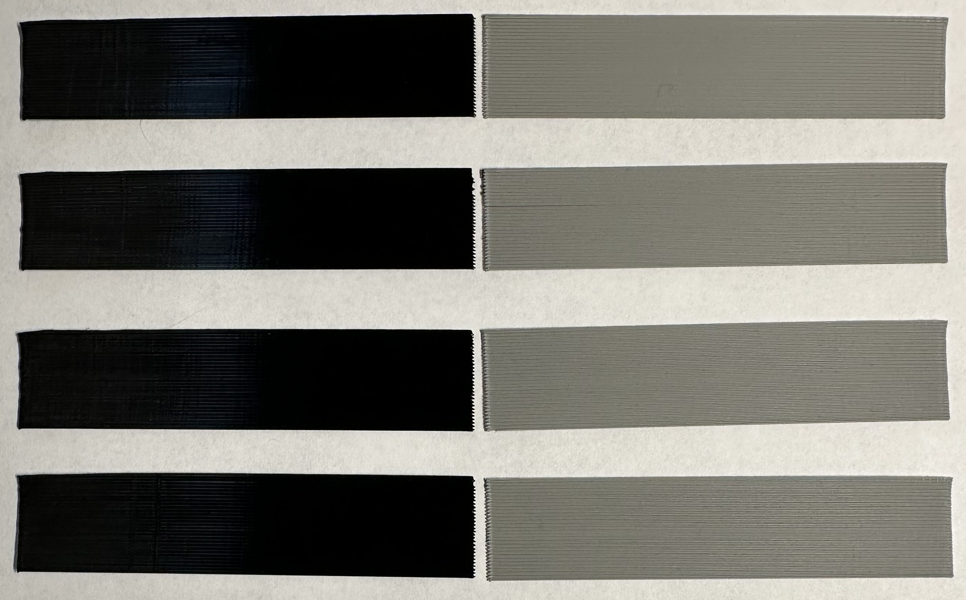
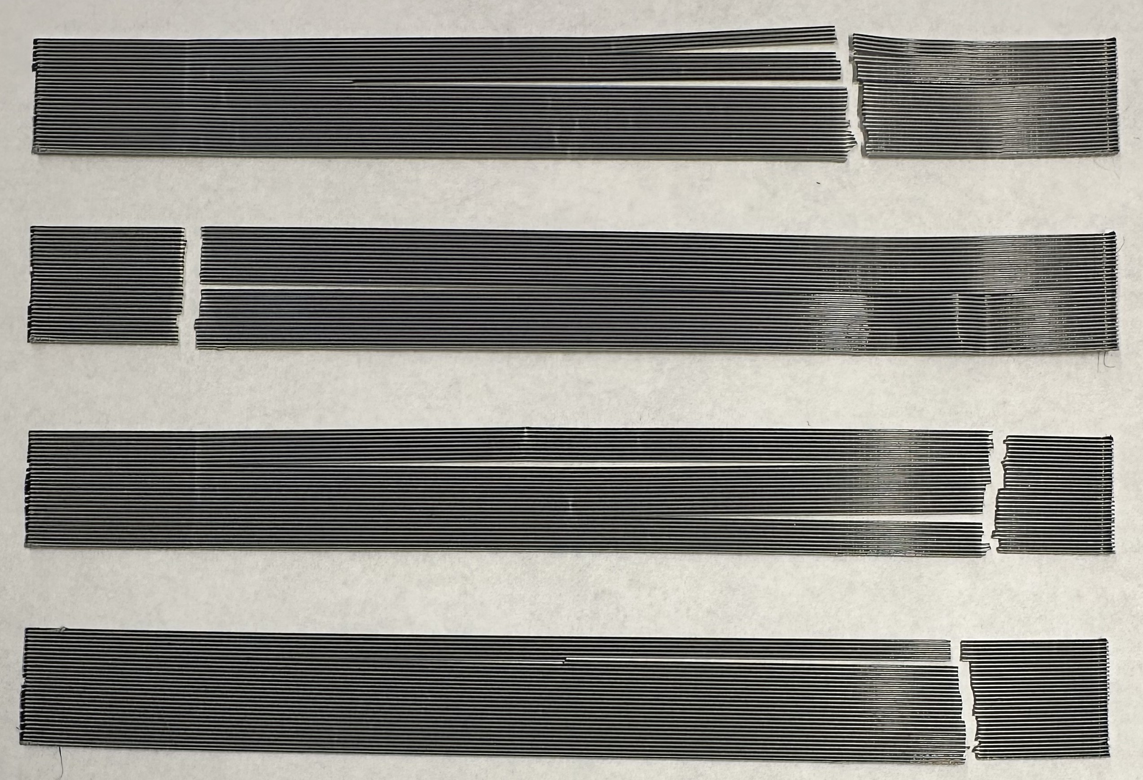

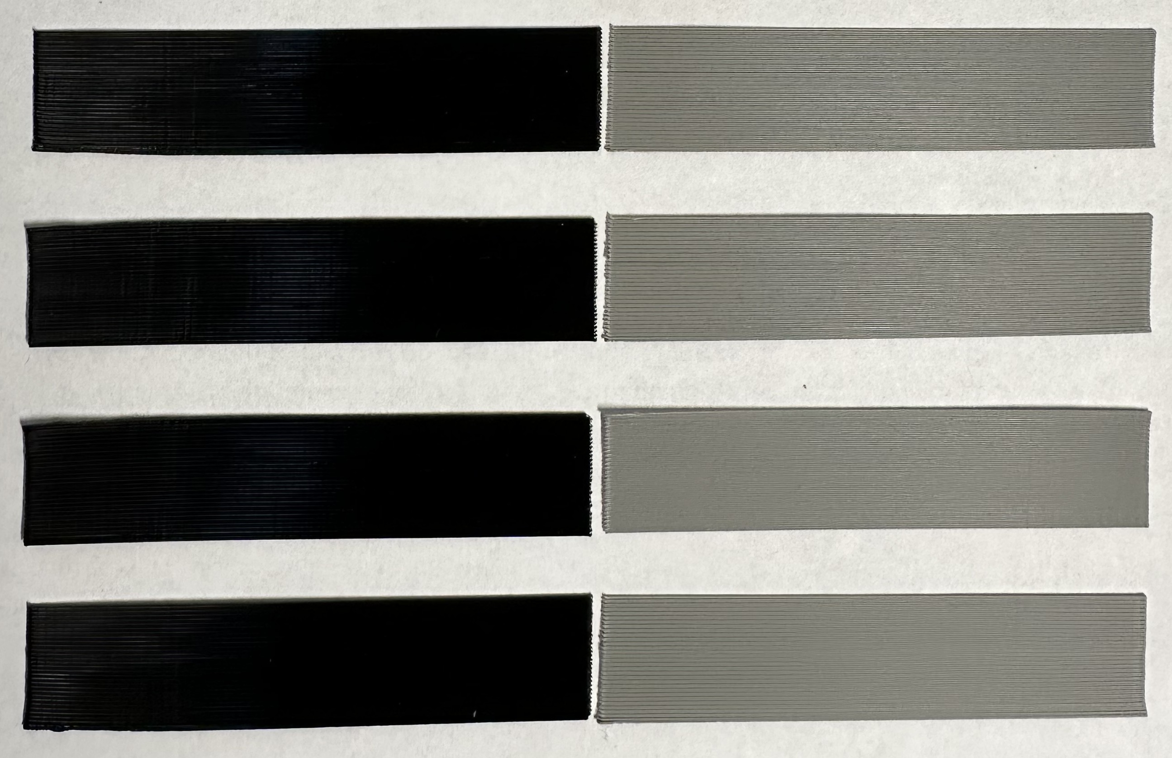
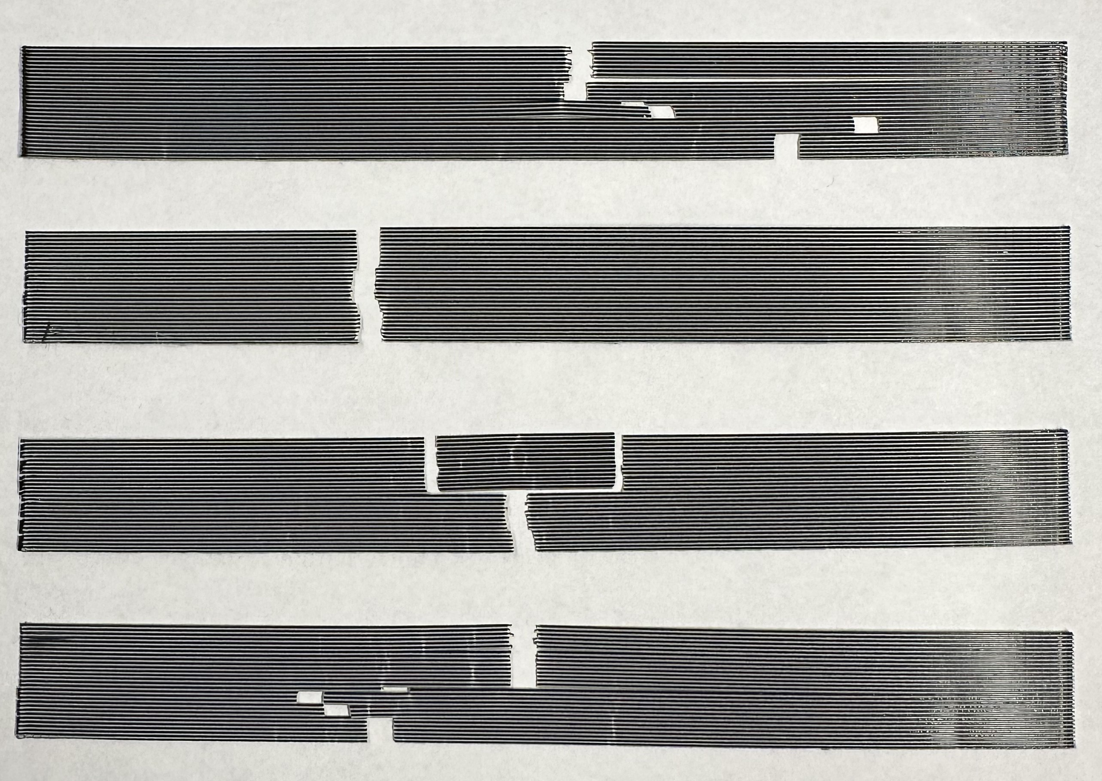
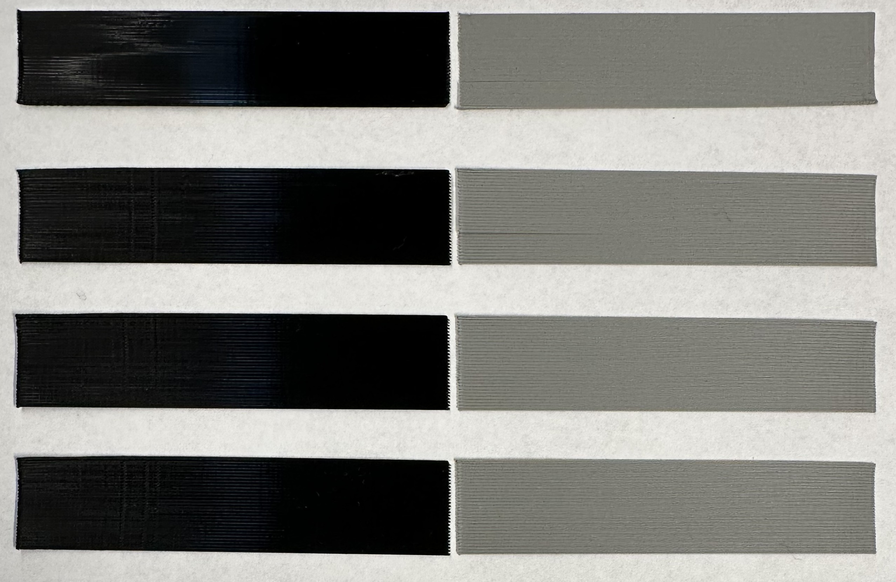

150 mm
150 mm
60 mm/s
55 mm/s
50 mm/s
45 mm/s
40 mm/s
35 mm/s
30 mm/s
25 mm/s
20 mm/s
15 mm/s
10 mm/s
5 mm/s
a.
Ⅹ — Initial failure points where cracks begin to develop
b.

