Slide 1
FA25ProgressReport_Lucas
2025/11/24

Slide 2
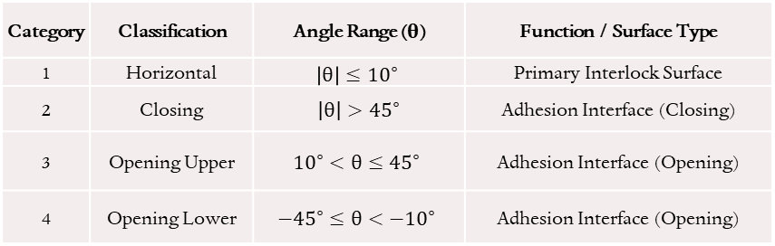
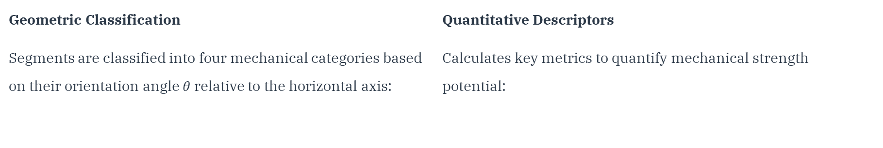
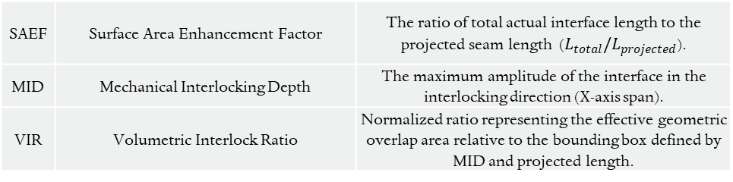
Interlocking Topology
Coded an automated process that used a traversal method from top to bottom to classify and label segments, calculates the sum of the segment lengths in each image, and uses this to compute three Geometric Descriptors.
Geometric Classification
Segments are classified into four mechanical categories based on their orientation angle $θ$relative to the horizontal axis:
Quantitative Descriptors
Calculates key metrics to quantify mechanical strength potential:
Category | Classification | Angle Range (θ) | Function / Surface Type
1 | Horizontal | $$\left|θ\right|≤{10}^{∘}$$ | Primary Interlock Surface
2 | Closing | $\left|θ\right|>{45}^{∘}$ | Adhesion Interface (Closing)
3 | Opening Upper | $${10}^{∘}<θ≤{45}^{∘}$$ | Adhesion Interface (Opening)
4 | Opening Lower | $$−{45}^{∘}≤θ<−{10}^{∘}$$ | Adhesion Interface (Opening)
SAEF | Surface Area Enhancement Factor | The ratio of total actual interface length to the projected seam length ($L_{total}/L_{projected}$).
MID | Mechanical Interlocking Depth | The maximum amplitude of the interface in the interlocking direction (X-axis span).
VIR | Volumetric Interlock Ratio | Normalized ratio representing the effective geometric overlap area relative to the bounding box defined by MID and projected length.

Slide 3
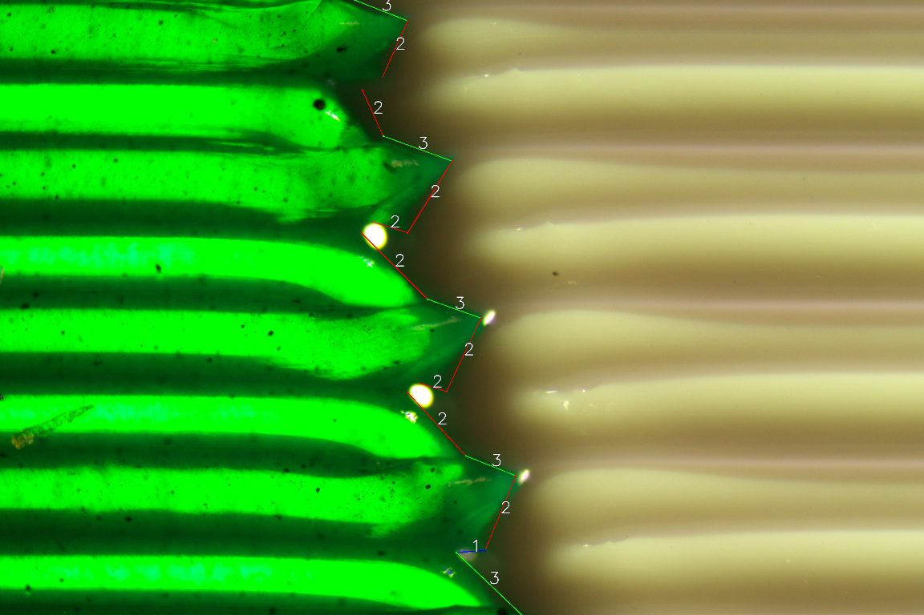
Interlocking Topology
Found 15 valid segments.
--- Segment Statistics (mm) ---
Total CAT_HORIZONTAL Length: 0.1093
Total CAT_CLOSING Length: 2.2933
Total CAT_OPENING_UPPER Length: 1.2516
Total CAT_OPENING_LOWER Length: 0.0000
--- Geometric Descriptors ---
SAEF: 1.5709
MID: 0.6307 mm
VIR: 0.2299
Categorized and Labeled Segments
Statistics Output

Slide 4
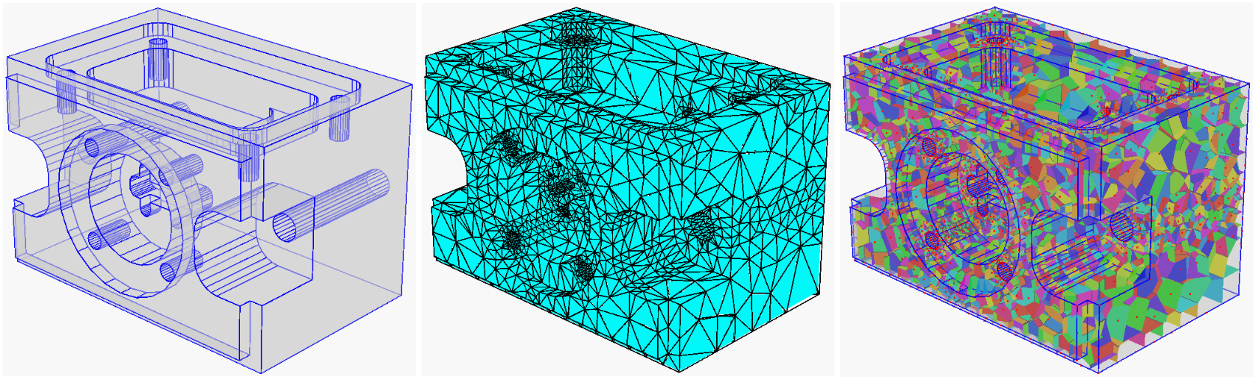
Learning FEA Workflow — Mixed mesh model Simulation and Optimisation
Mesh generation and combination
{
Geometry Input
(Piecewise Linear Complex)
Triangular Surface Mesh
Volumetric Tetrahedral Mesh

Slide 5
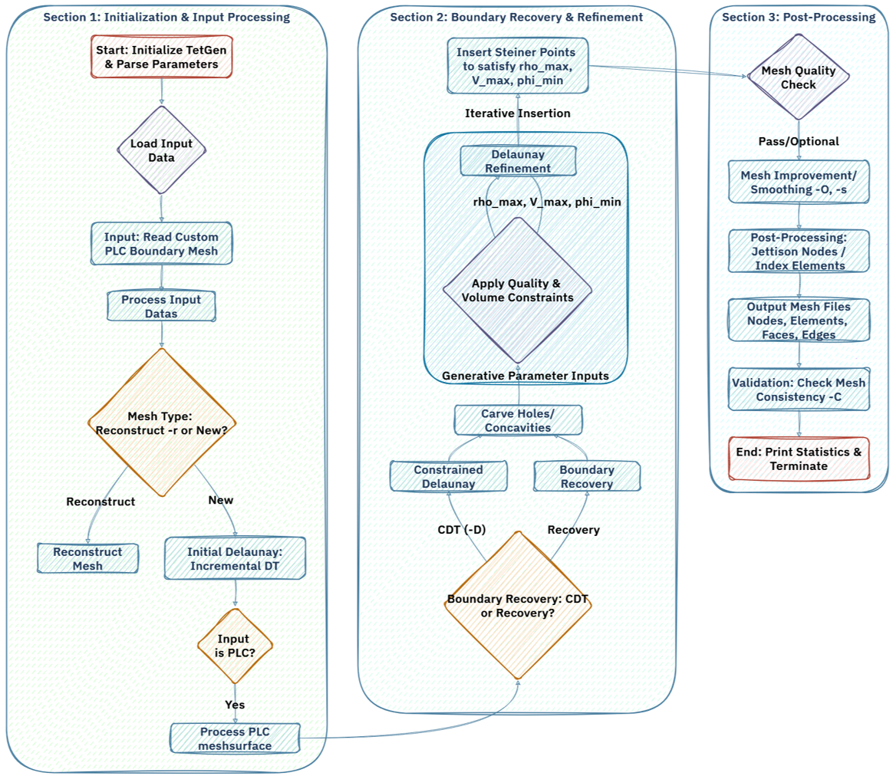
Tetrahedral Mesh Workflow

Slide 6
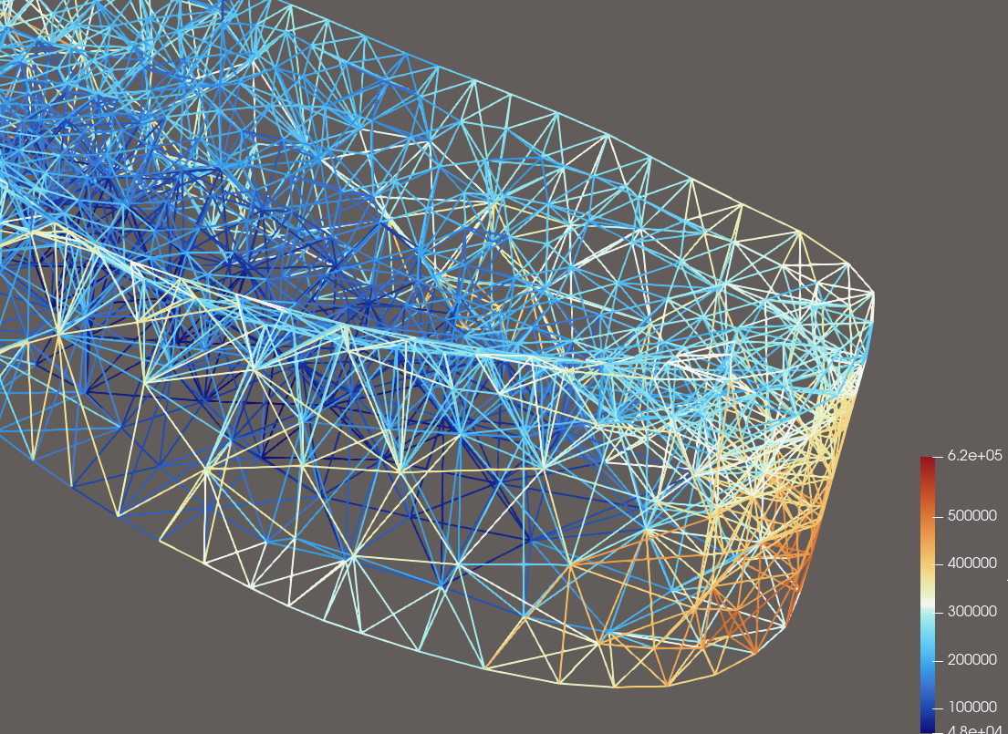
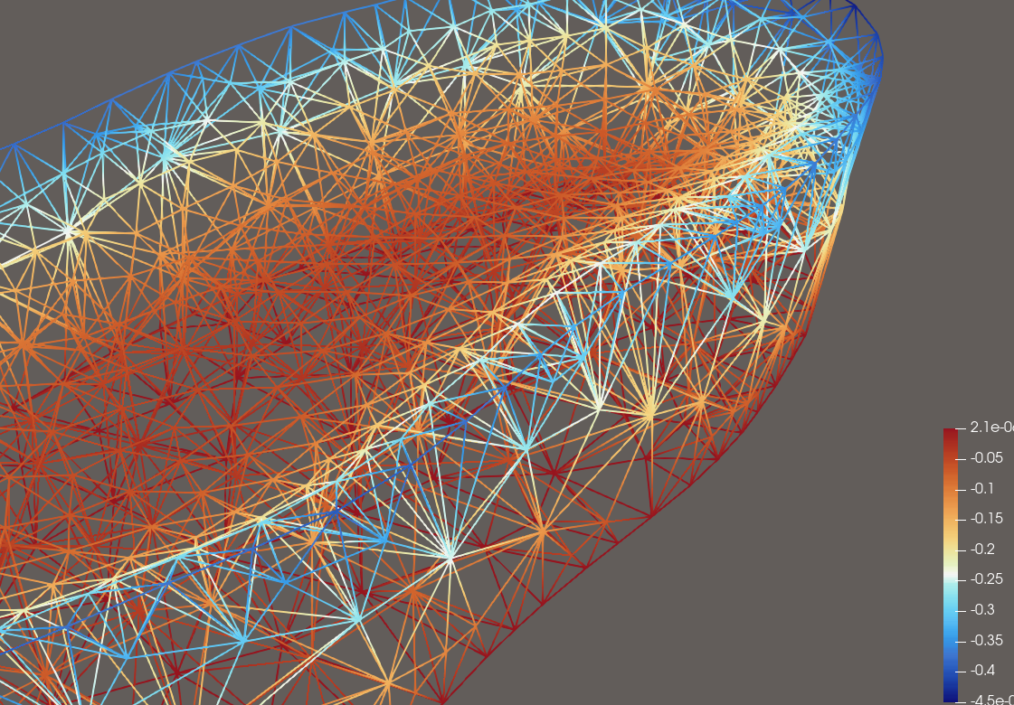
Pyvista – Tetgen – gmsh – FEniCS Toolchain Result Visualisation in Paraview
Von Mises stress plot
Displacement (Z) plot

