Slide 1
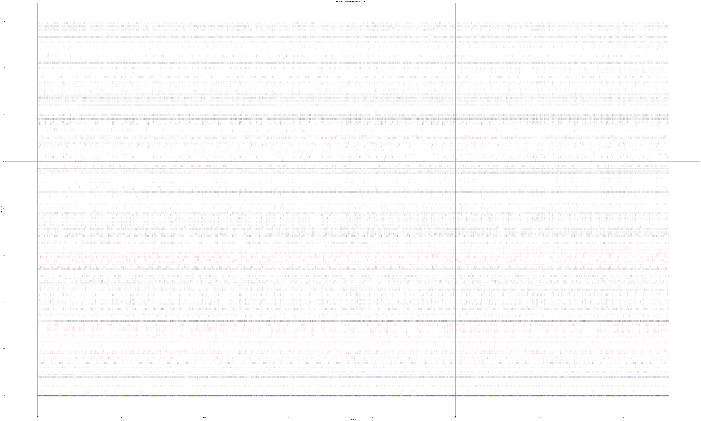
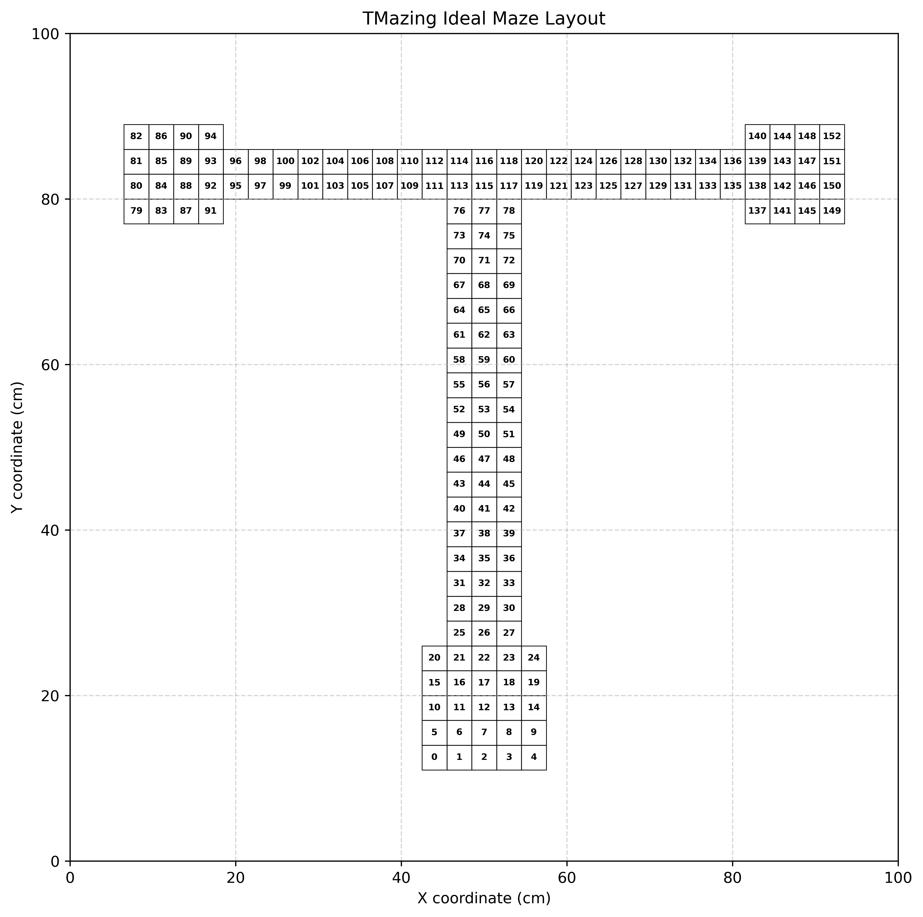

10 × 50ms
PV
Trajectory
Matrix
Data Augmentation
Unit
Time
Embedding Layer
Attention Gating
Batch Norm Layer
2 Layer MLP
Residual Connection
Elementwise Multiplication
Softmax
Unpacking
Residual Connection
LSTM
Final Hidden State
Layer Norm
6 LayerMLP
Relu Nonlinearity
Residual
Connection
Output
Restriction

Slide 2


Task
Sample

Slide 4

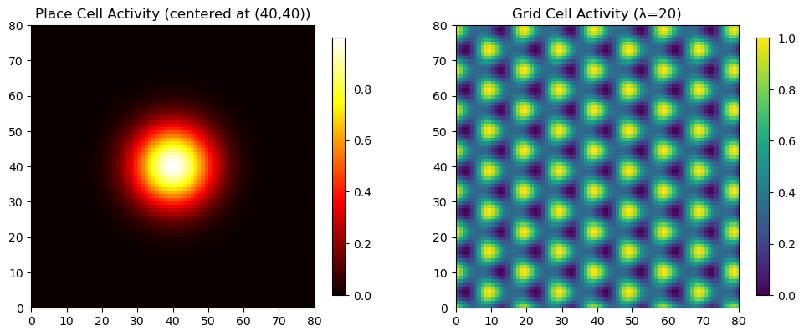




TMazing PO-MDP Simulation
Taste Perception
Place Cell / Grid Cell Simulation
Audio Perception
Spatial Perception
State t
Observation Space
O_{t-1}
O_{t}
A_{t}
History of Observations
Agent/Policy
Action
Space
State t+1

Slide 5


A PO-MDP is defined by the tuple (S, A, T, R, Ω, O, γ)
Agent gets observation
Action a_{t} ~ π(s_{t})
Dynamics is Markovian on State
State s_{t+1} ~ P(s_{t} , a_{t})
Agent Policy π
Observation o_{t} ~ O(s_{t} , a_{t})
Reward r_{t} ~ R(s_{t} , a_{t})
Environment
An MDP is defined by the tuple (S, A, P, R, γ)
Agent gets full state
Action a_{t} ~ π(s_{t})
Dynamics is Markovian on State
State s_{t+1} ~ P(s_{t} , a_{t})
Agent Policy π
Reward r_{t} ~ R(s_{t} , a_{t})
Environment

Slide 6
TMazing PO-MDP Simulation
Taste Perception
Place Cell / Grid Cell Simulation
Audio Perception
Spatial Perception
State t
Observation Space
O_{t-1}
O_{t}
A_{t}
History of Observations
Agent/Policy
Action
Space
State t+1

Slide 7
10 × 50ms
PV
Trajectory
Matrix
Unit
Time
10 × 50ms
PV
Trajectory
Matrix
Unit
Time

Slide 8
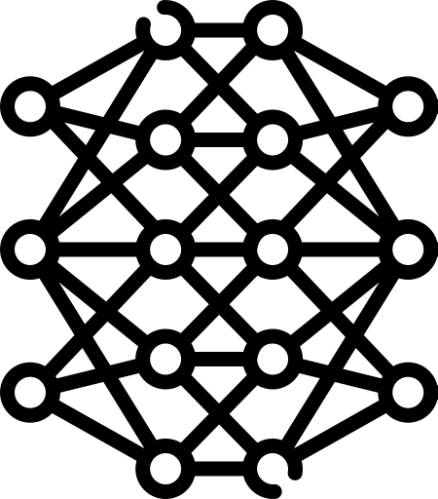
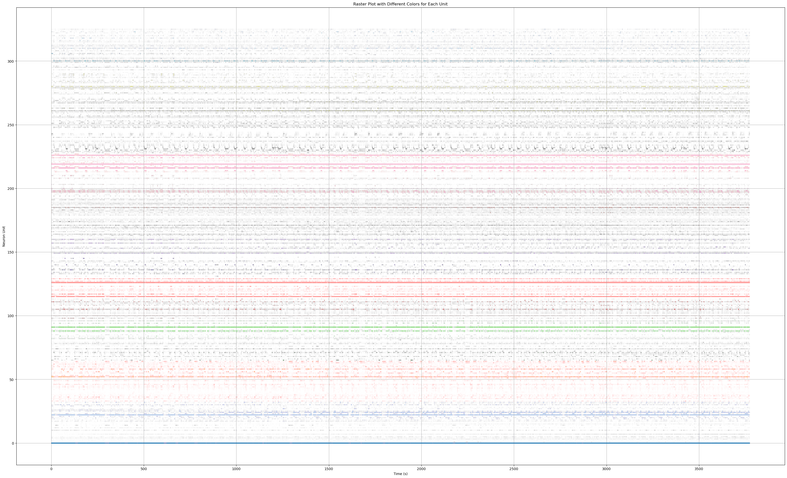
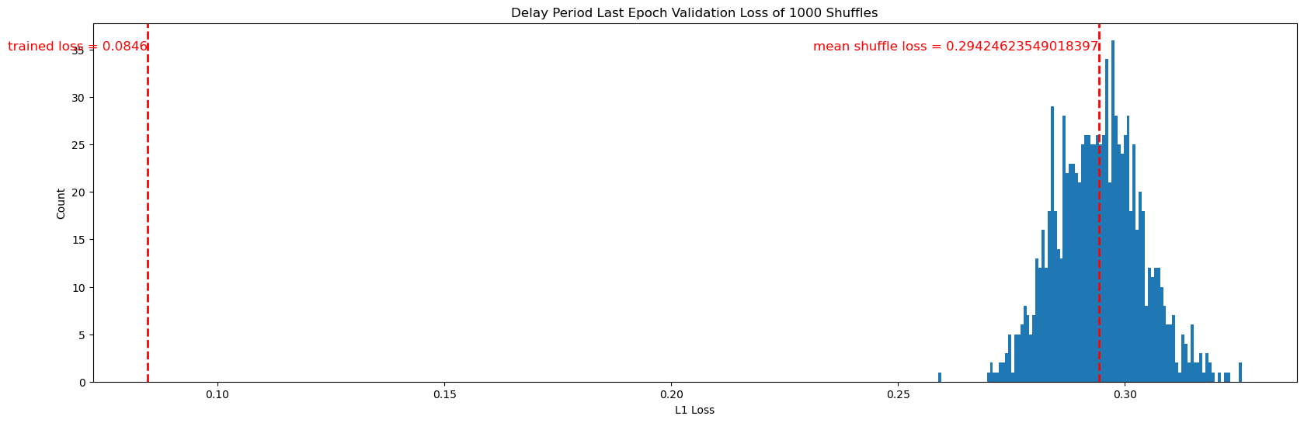
HPC PV
MLP Model
mPFC PV
Comparing mapping loss against shuffle reveals correlation in the activity patterns of the two regions during delay phase.

