Slide 1

EECS151T Proj
Shikai shen
April 2025

Slide 2
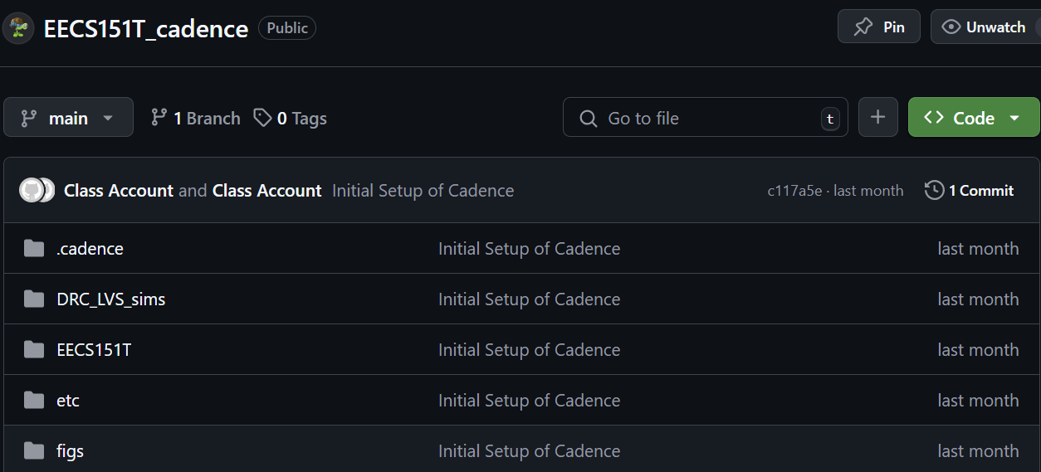
Disclaimer
The project is not strictly what EECS151T has taught us. I am using Cadence Virtuoso to do the schematic and layout based on what I am used to.

Slide 3
The design shall achieve:
1. The logic gates: AND, OR, INV
2. 6bit-Full-Adder, 5x6 Multiplier, 11bit-Full-Adder
3. the basic function of a DSP chip (because I am familiar with the functionality)
4. The DRC and LVS of the layout
I am familiar with some of the basic layout before (like AND OR INV, Full-Adder…)

Slide 4
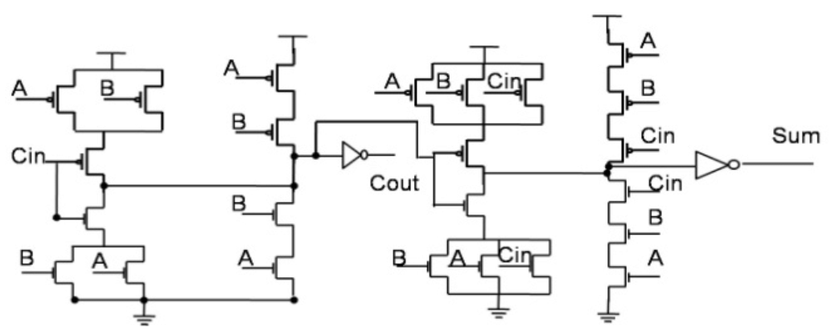
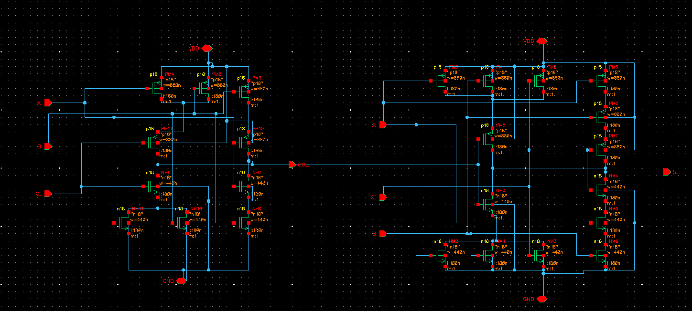
28T-Full Adder (done)

Slide 5
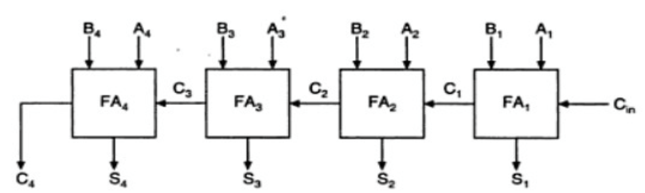
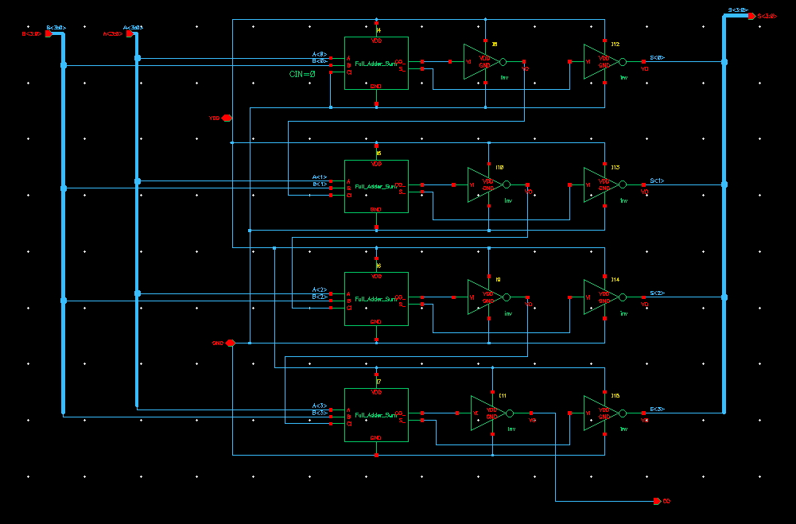
Ripple-Carry Full Adder (4-bit done)
4bit Full Adder

Slide 6
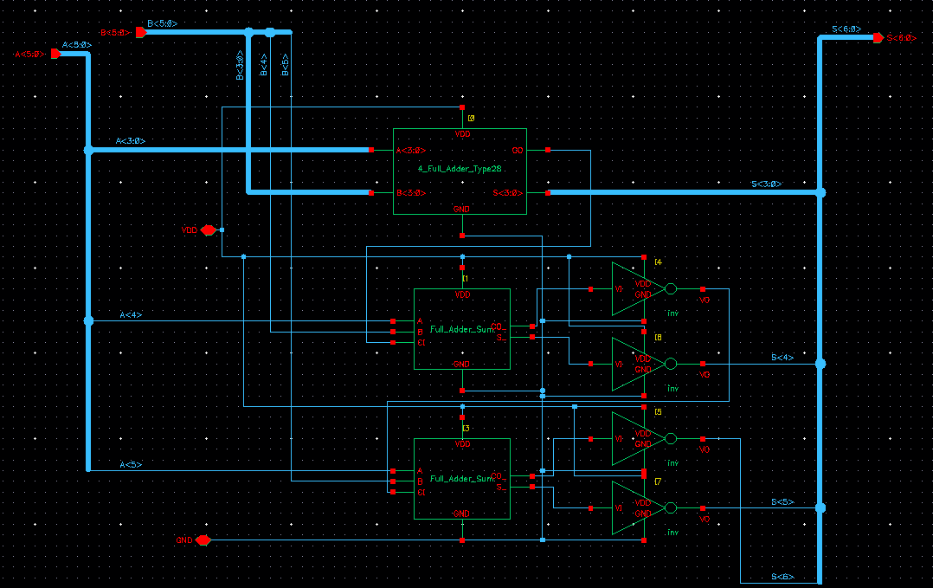
Ripple-Carry Full Adder (6-bit)
Same as before, only difference of the number of bits

Slide 7
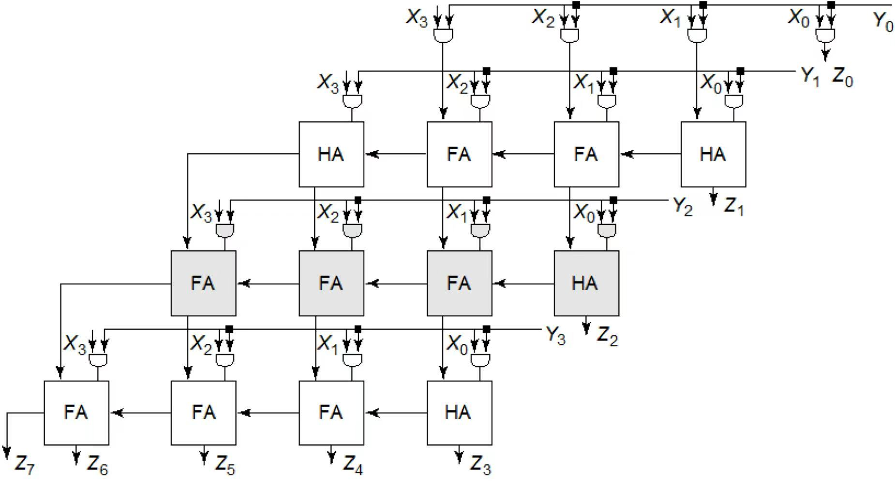
5x6 Array Multiplier
Credit: CNBlogs

Slide 8
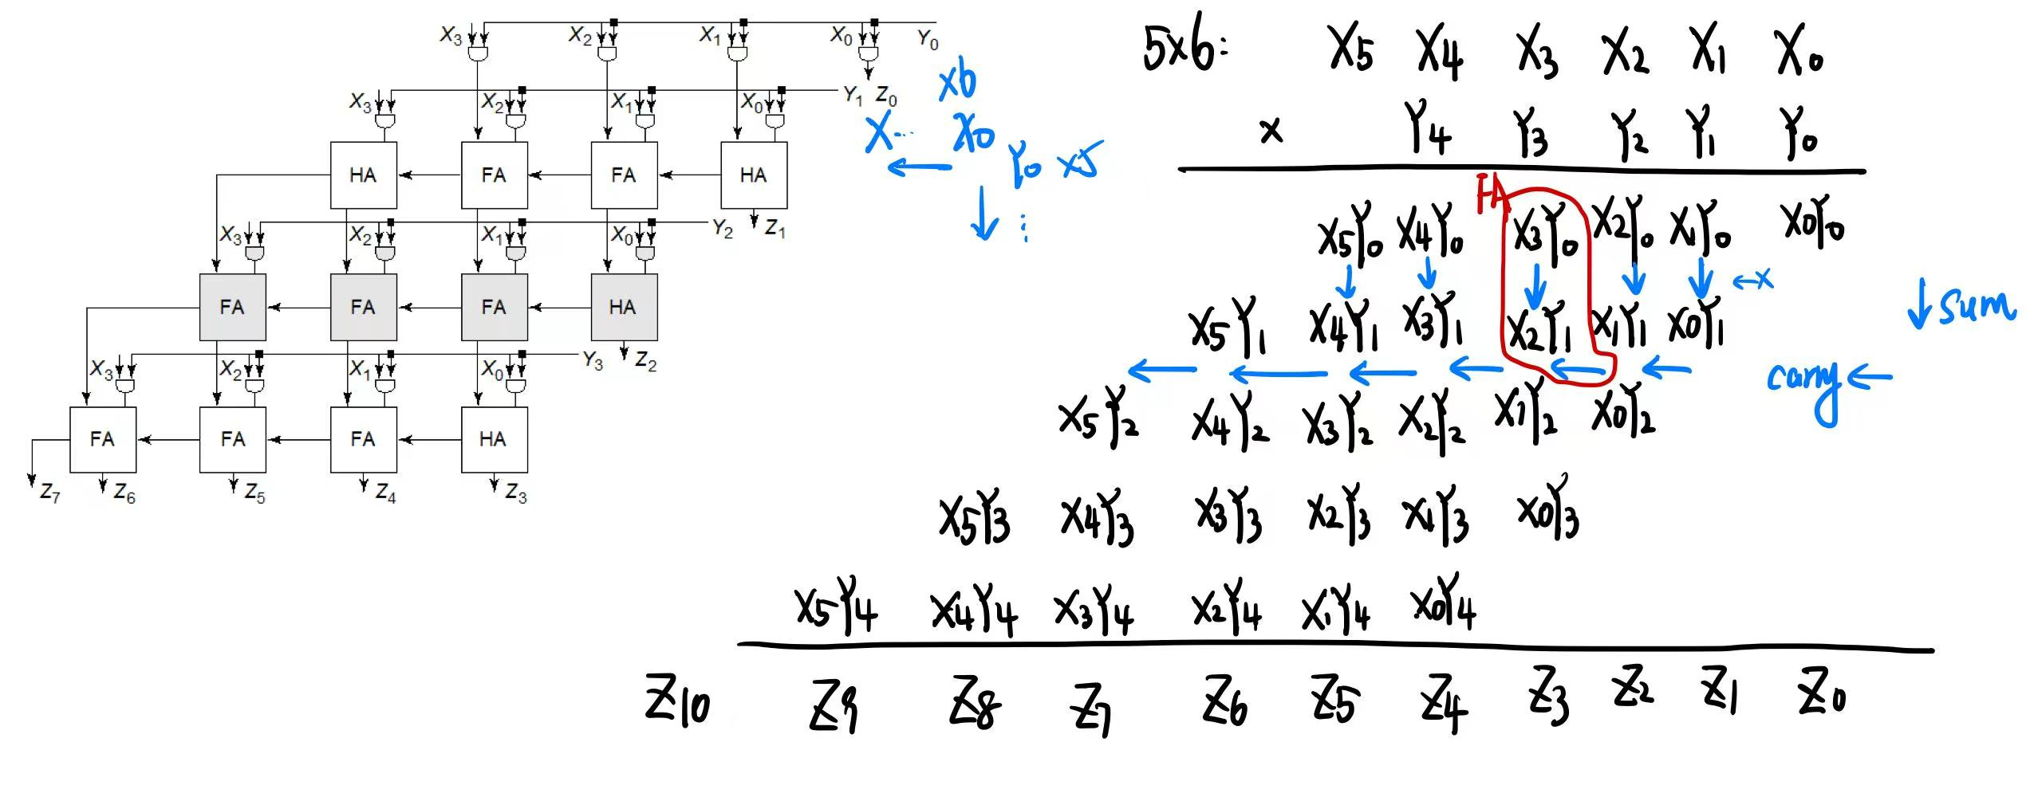
Similar to long multiplication

Slide 9
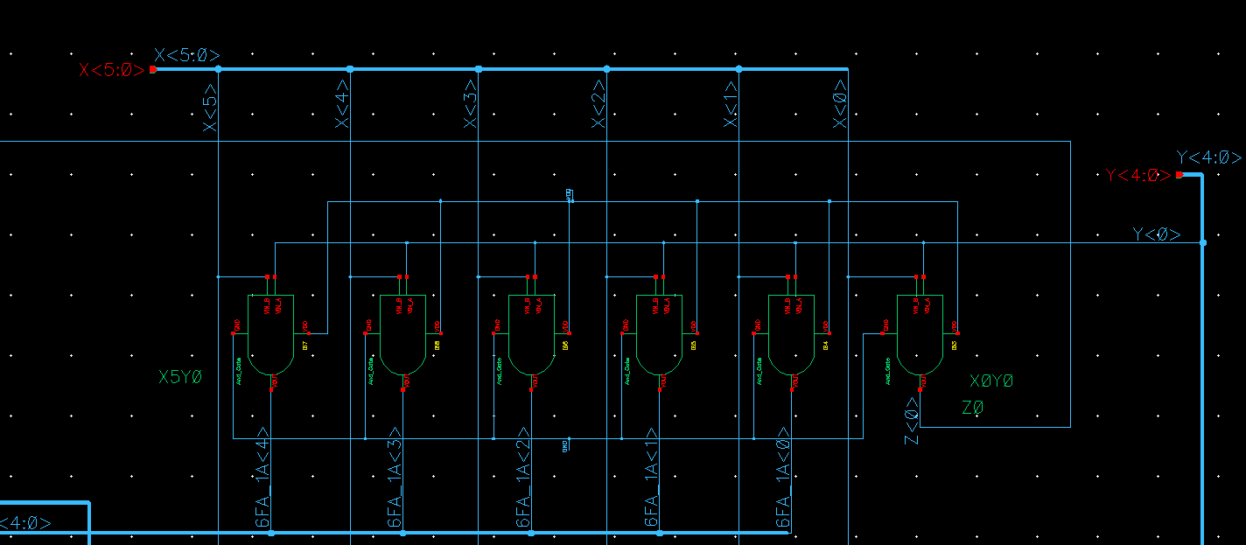
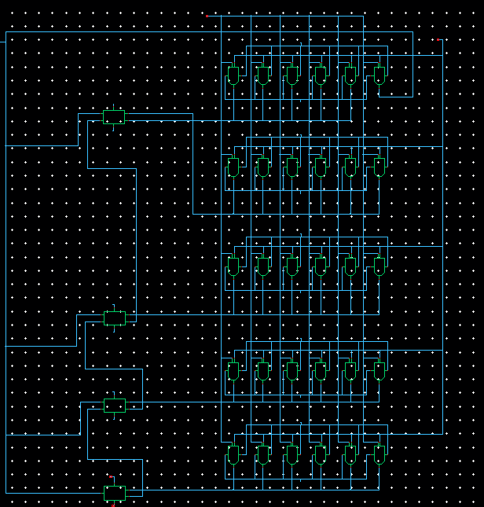
one block of Multiplier
5x6 Multiplier

Slide 10
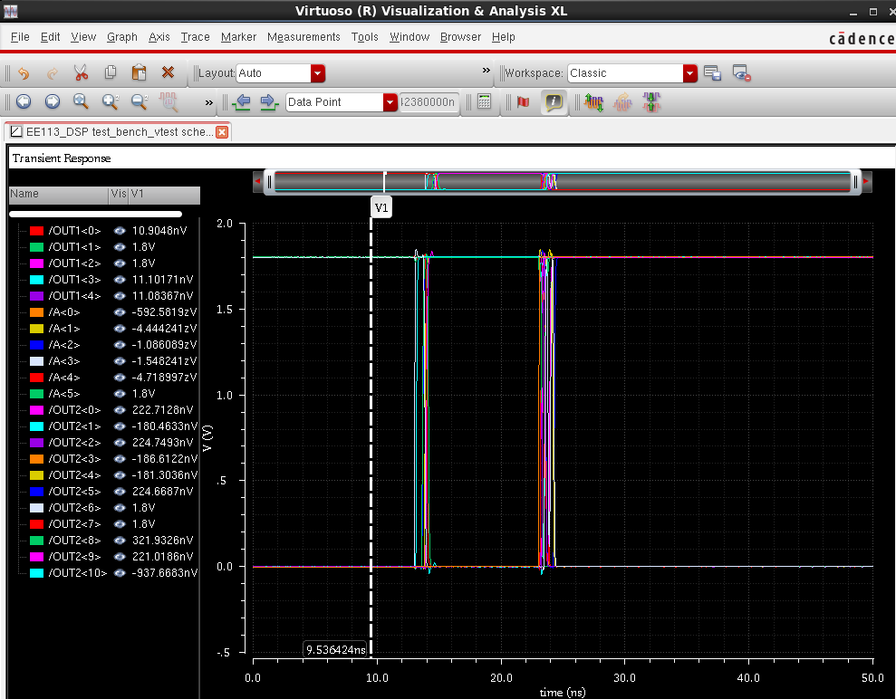
Testbench for Multiplier
OUT1 * A = OUT2
00110 * 100000 = 00011000000
6 * 32 = 192
Multiplier works

Slide 11
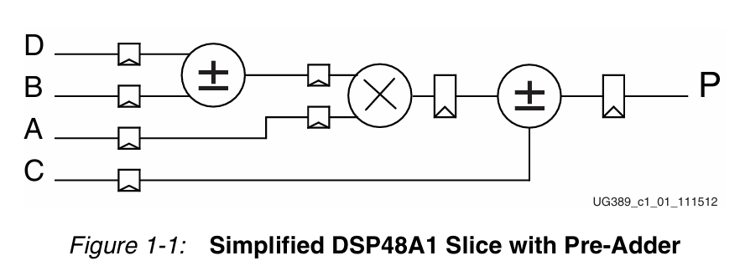
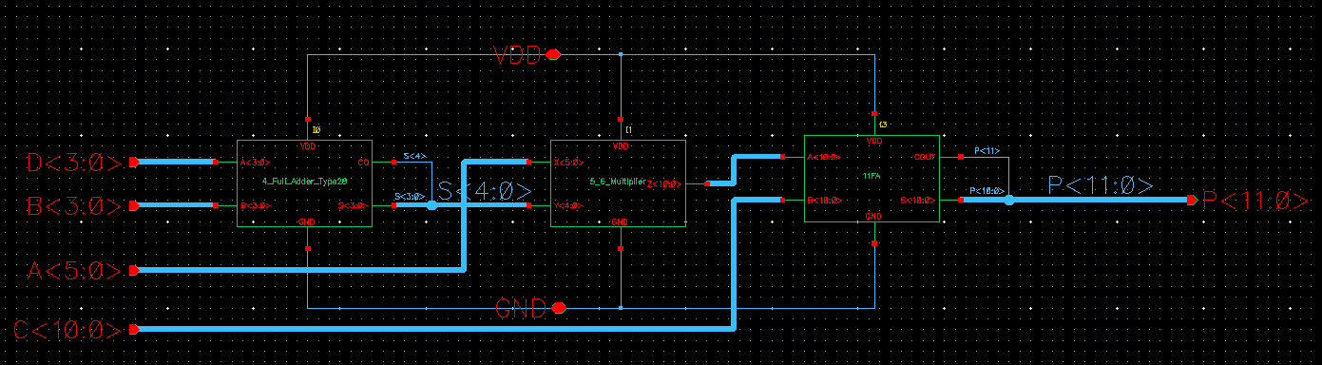
Circuit Diagram of DSP48A1
Input: B, D: 4 bits; A: 6 bits; C: 11 bits
Output: P: 12bits

Slide 12
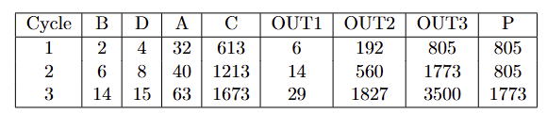
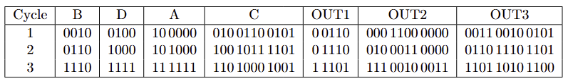
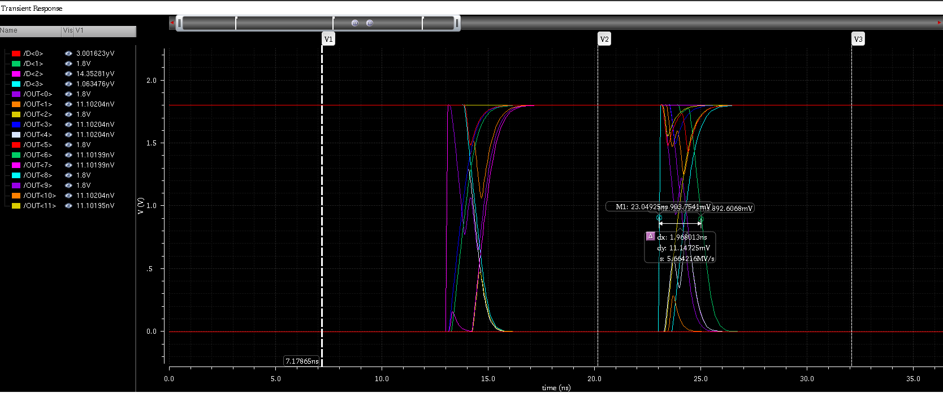
Testbench for DSP48A1

Slide 13
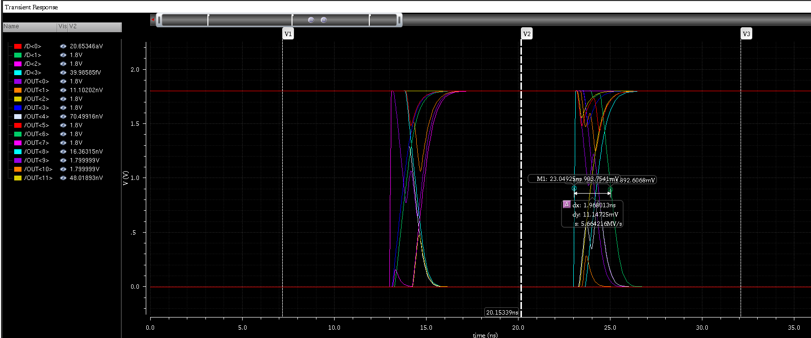
Testbench for DSP48A1

Slide 14
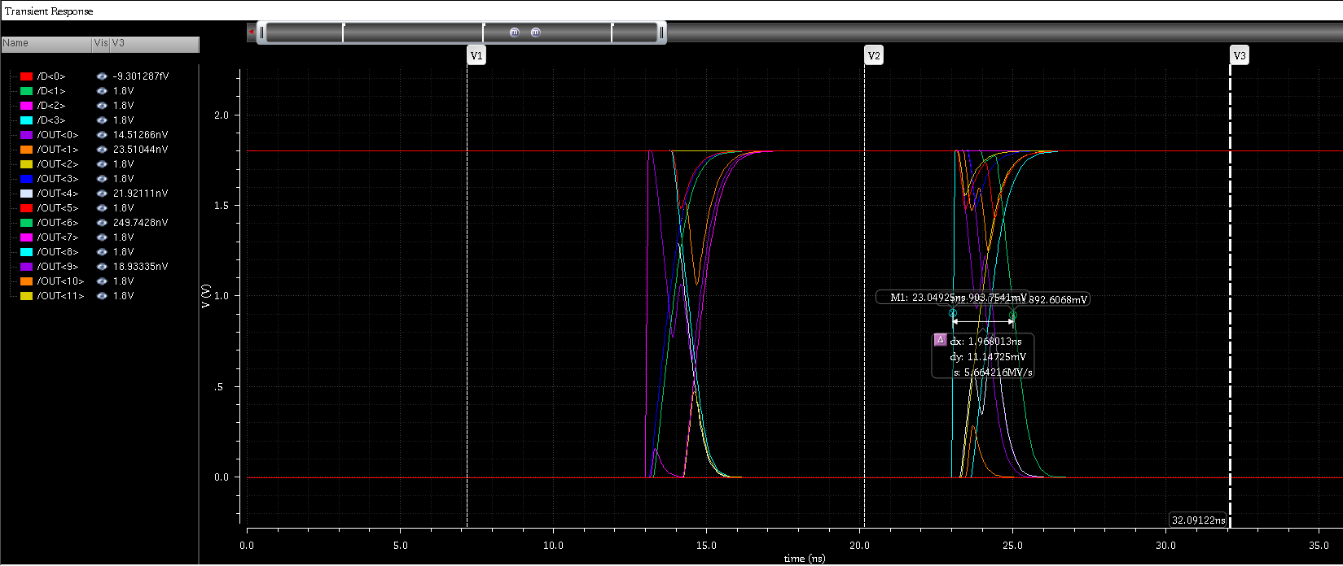
Testbench for DSP48A1

Slide 15
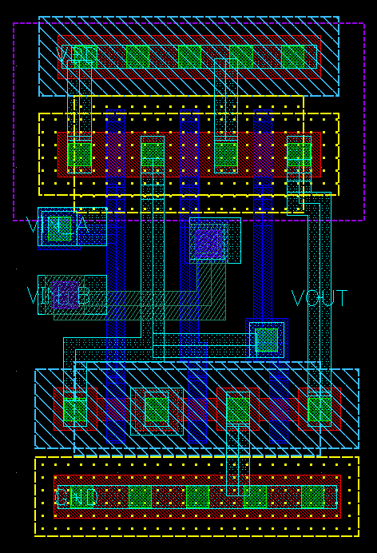
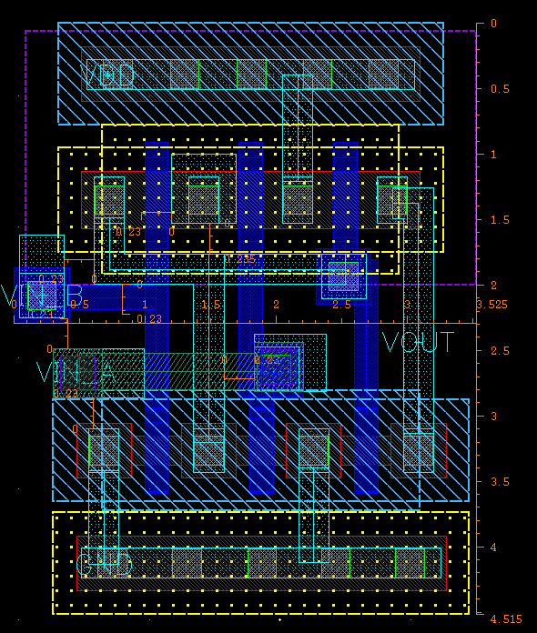
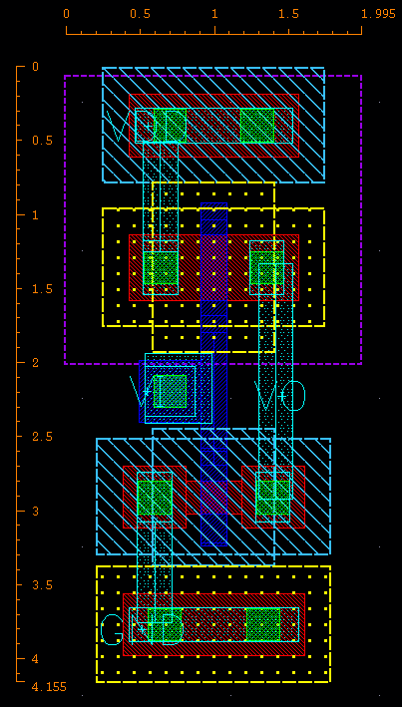
Layout Part (SO DIFFICULT…)
AND
OR
INV

Slide 16
Layout workload… (huge)
Layout by hand is astonishingly tiring!
I’ve finished the schematic of some arithmetic functionality, but the layout…
THANK YOU!

