Slide 1



1

Slide 2
Introduction
Linux Diagnostics and Troubleshooting provides system administrators with the tools and techniques they need to successfully diagnose, and fix, a variety of issues that can present
themselves. Students will work through problems in various subsystems to diagnose and fix common issues.
This approach is then used troubleshooting various types of problems, including boot issues, hardware issues, storage issues, RPM issues, network issues, third-party application issues, security issues, and kernel issues. At the end of the course students can complete various comprehensive review labs to test their skills.

Slide 3
What is troubleshooting?
Troubleshooting is a systematic approach to problem solving that is often used to find and correct issues with complex machines, electronics, computers and software systems.
Troubleshooting is the art of taking a problem, gathering information about it, analyzing it, and finally solving it.
While fixing a problem is one of the major parts of troubleshooting, there are other parts that cannot be neglected: documenting the problem (and fix), and performing a root cause analysis (RCA).

Slide 4
Practice Lab Session
Troubleshoot a login issue
Lab Setup
servera.example.com
workstation.example.com

Slide 5
Collecting Information
When approaching a troubleshooting problem, there are various pieces of information that need to be collected before a hypothesis can be formed.
USING THE SYSTEM JOURNAL
There are two logging services for the system logs:
Systemd-journald – which keeps the logs in memory
Rsyslogd - which gets messages sent to it by systemd-journald (and others) and stores them on disk.

Slide 6
Collecting Information
Using journalctl
Like systemctl, journalctl is also a systemd utility. It’s used for querying and displaying messages from the journal. Since the journal comprises of one or more binary files, journalctl is the standard way to read messages from it.

Slide 7
Collecting Information
Boot Messages
To see boot-related messages from the current boot, use the -b switch:
journalctl -b
To see messages from the last boot, use the -1 modifier; to see boot messages from two boots ago, use -2; and so on. Here, we are trying to see messages from the last boot:
journalctl -b -1

Slide 8
Collecting Information
Boot Messages
To list the boots of the system, use the following command:
journalctl --list-boots
It will show a tabular result like this:
-1 fs5755558e5043d093cd74162d38989h Thu 2015-06-25 00:34:38 EDT-Sat 2015-06-27 21:41:27 EDT
0 8jh49ca98fcf55c59806b2b6f890aert Sat 2015-06-27 21:41:30 EDT-Sun 2015-06-28 21:10:00 EDT

Slide 9
Collecting Information
Troubleshoot a web server issue using the log files.
Here, servera machine is running a web server, serving the file http://servera.example.com/abc.html

Slide 10
Use Red Hat Resources
COLLECTING INFORMATION WITH SOSREPORT
Sosreport is a command in linux (RHEL / CentOS) which collects system configuration and diagnostic information of your linux box like running kernel version, loaded modules, and system and service configuration files. This command also runs external programs to collect further information, and stores this output in the resulting archive.
Sosreport is required when you have open a case with redhat for technical support. Redhat support Engineers will require sosreport of your server for troubleshooting purpose.
To run sosreport , sos package should be installed. Sos package is part of default installation in most of linux. If for any reason this package is no installed , then use below yum command to install sos package

Slide 11
Use Red Hat Resources
The Red Hat Support Tool utility redhat-support-tool provides a text-console interface to the subscription-based Red Hat Access services. Internet access is required to reach the Red Hat Customer Portal. The redhat-support-tool is text-based for use from any terminal or SSH connection; no graphical interface is provided.
The redhat-support-tool command may be used as an interactive shell or invoked as individually executed commands with options and arguments.

Slide 12

Use Red Hat Resources
How to use redhat-support-tool to search the Knowledgebase
When first invoked, redhat-support-tool prompts for required Red Hat Access subscriber login information. To avoid repetitively supplying this information, the tool asks to store account information in the user’s home directory (~/.redhat-support-tool/redhat-supporttool.conf).

Slide 13
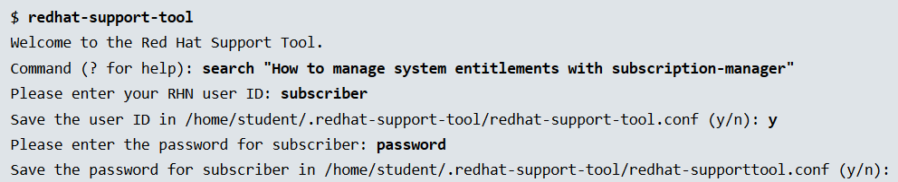
Use Red Hat Resources
How to use redhat-support-tool to search the Knowledgebase

Slide 14
Use Red Hat Resources
How to use redhat-support-tool to search the Knowledgebase
Type the number of the solution to view or 'e' to return to the previous menu.
1 [ 453287:VER] How to register and subscribe a system to Red Hat Network (RHN) using Red Hat Subscription Manager (RHSM)?
2 [ 87639:VER] What are Flex Guest Entitlements in Red Hat Network?
3 [ 459865:VER] How to register machines and manage subscriptions using Red Hat Subscription Manager through an invisible HTTP proxy / Firewall?
3 of 43 solutions displayed. Type 'm' to see more, 'r' to start from the beginning again, or '?' for help with the codes displayed in the above output.
Select a Solution:

Slide 15
Use Red Hat Resources
Select a Solution: 1
Type the number of the section to view or 'e' to return to the previous menu.
1 Title
2 Issue
3 Environment
4 Resolution
5 Display all sections
End of options.
Section: 1
Title
===============================================================================
How to register and subscribe a system to Red Hat Network (RHN) using Red Hat
Subscription Manager (RHSM)?
URL: https://access.redhat.com/site/solutions/ 453287
(END) q

Slide 16
Directly access Knowledgebase articles by document ID
$ redhat-support-tool kb 453287 | less
Title: How to register and subscribe a system to Red Hat Network (RHN) using Red Hat
Subscription Manager (RHSM)?
ID: 453287
State: Verified: This solution has been verified to work by Red Hat Customers and
Support Engineers for the specified product version(s).
URL: https://access.redhat.com/site/solutions/ 453287
:

Slide 17
Using redhat-support-tool to manage support cases
$ redhat-support-tool
Welcome to the Red Hat Support Tool.
Command (? for help): opencase --product="Red Hat Enterprise Linux" --version="7.0"
Please enter a summary (or 'q' to exit): System fails to run without power
Please enter a description (Ctrl-D on an empty line when complete):
When the server is unplugged, the operating system fails to continue.
1 Low
2 Normal
3 High
4 Urgent
Please select a severity (or 'q' to exit): 4
Would you like to assign a case group to this case (y/N)? N
Would see if there is a solution to this problem before opening a support case? (y/N) N
Support case 03043444 has successfully been opened.

Slide 18
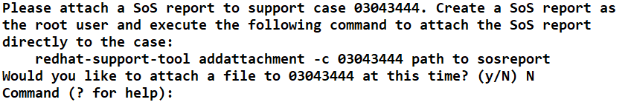
Use Red Hat Resources
Including diagnostic information by attaching a SoS report archive

Slide 19
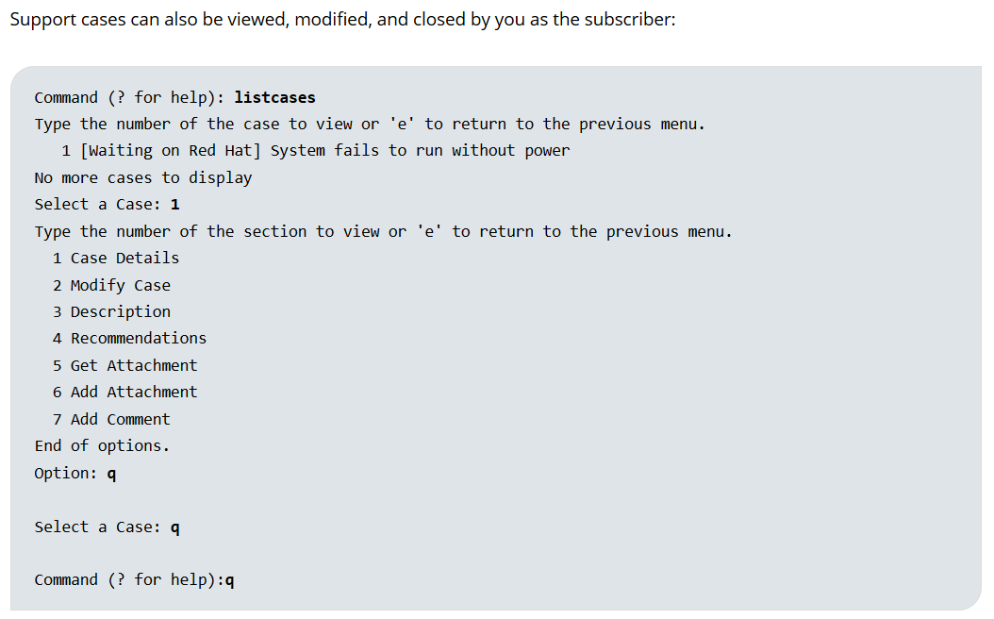

Slide 20
Use Red Hat Resources
$ redhat-support-tool modifycase --status=Closed 03043444
Successfully updated case 03043444

Slide 21
Practice Lab Session
Learn how to generate a sosreport to aid Red Hat Support in resolving an issue.

Slide 22
Practice Lab Session
You should be able to solve a FTP connectivity and file transfer problem.

Slide 23
Monitoring Systems
Cockpit is free, open source Server administration tool that allows you to easily monitor and administer Linux servers (single or multiple) via a web browser. It helps the system admins to do simple administration tasks, such as starting containers, administrating storage, configuring network, inspecting logs and so on.
Cockpit is software developed by Red Hat.

Slide 24
Monitoring Systems
Practice Lab Session : Installation of Cockpit

Slide 25
Monitoring Systems
USING PERFORMANCE CO-PILOT
Red Hat Enterprise Linux 7 includes a program called Performance Co-Pilot, provided by the pcp RPM package. Performance Co-Pilot, or pcp for short, allows administrators to collect and query data from various subsystems. Performance Co-Pilot has also been backported into Red Hat Enterprise Linux 6, and is available in 6.6 and later.

Slide 26
Centralized Log Server with Rsyslog in CentOS/RHEL 7
In order for system administrator to identify or troubleshoot a problem on a CentOS 7 or RHEL 7 server system, it must know and view the events that happened on the system in a specific period of time from log files stored in the system in the /var/log directory.
On a CentOS/RHEL 7 system, Rsyslog daemon is the main log server preinstalled, followed by Systemd Journal Daemon (journald).
Rsyslog server in build as a client/server architecture service and can achieve both roles simultaneous. It can run as a server and collect all logs transmitted by other devices in the network or it can run as a client by sending all internal system events logged to a remote endpoint syslog server.

Slide 27
Centralized Log Server with Rsyslog in CentOS/RHEL 7
When rsyslog is configured as a client, the logs can be stored locally in files on the local filesystem or can be send remotely rather than write them in files stored on the machine or write events log files locally and send them to a remote syslog server at the same time.
Syslog server operates any log message using the following scheme:
type (facility).priority (severity) destination(where to send the log)

Slide 28
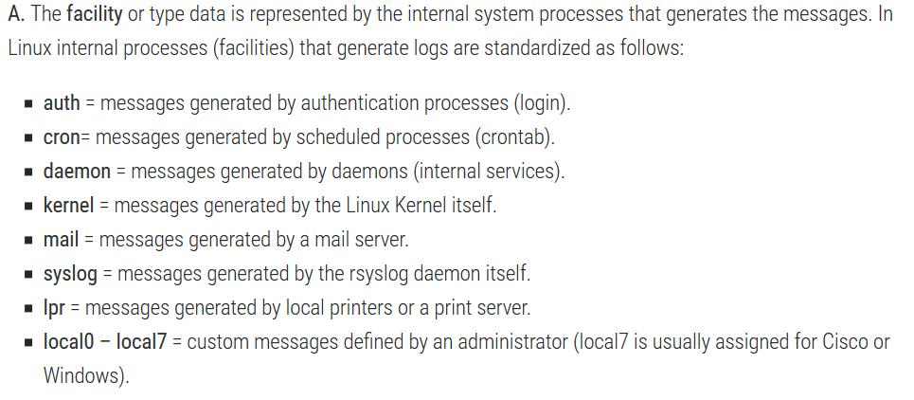
Centralized Log Server with Rsyslog in CentOS/RHEL 7

Slide 29
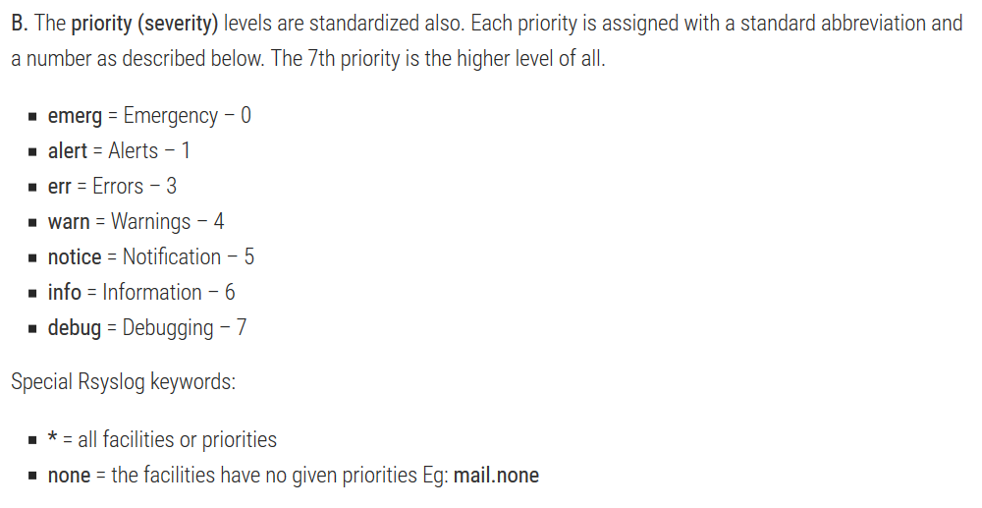
Centralized Log Server with Rsyslog in CentOS/RHEL 7

Slide 30
Install and Configure Puppet
Puppet is a configuration automation platform that simplifies various system administrator tasks. Puppet uses a client/server model where the managed servers, called Puppet agents, talk to and pull down configuration profiles from the Puppet master.
Puppet is written in its own custom language, meant to be accessible to system administrators. A module, located on the Puppet master, describes the desired system. The Puppet software then translates the module into code and alters the agent servers as needed when the puppet agent command is run on an agent node or automatically at designated intervals.

Slide 31
Practice Lab Session
Puppet master ➔ servera.example.com
Puppet agent ➔ workstation.example.com

Slide 32
Check Integrity of File & Directory Using “AIDE”
AIDE (Advanced Intrusion Detection Environment) is a small yet powerful, free open source intrusion detection tool, that uses predefined rules to check file and directory integrity in Unix-like operating systems such as Linux. It is an independent static binary for simplified client/server monitoring configurations.
System stability is put at risk when configuration files are deleted or modified without authorization or careful supervision. How can a change to an important file or directory be detected? This problem can be solved by using intrusion detection software to monitor files for changes.

Slide 33
Check Integrity of File & Directory Using “AIDE”
Aide works by creating a database (which is simply a snapshot of selected parts of the file system), from the regular expression rules defined in the configuration file(s). Once this database is initialized, you can verify the integrity of the system files against it.

Slide 34
Check Integrity of File & Directory Using “AIDE”
LAB SESSION

Slide 35
System Auditing With auditd
Linux audit allows you to comprehensively log and track access to files, directories, and resources of your system, as well as trace system calls. It enables you to monitor your system for application misbehavior or code malfunctions.
By default the Linux audit framework logs all data in the /var/log/audit directory. Usually this file is named audit.log (/var/log/audit/audit.log)

Slide 36
Identifying Hardware Issues
Identifying various hardware connected on your system and their related problems.
Manage kernel modules, drivers & their parameters
Managing Virtualization Issues.

Slide 37
Identifying Hardware Issues
Identifying various hardware connected on your system and their related problems.
Practice Lab Session

Slide 38
Identifying Hardware Issues
mcelog
mcelog logs and accounts machine checks (in particular memory, IO, and CPU hardware errors) on modern x86 Linux systems.
mcelog is required by both 32bit x86 Linux kernels (since 2.6.30) and 64bit Linux kernels (since early 2.6 kernel releases) to log machine checks and should run on all Linux systems that need error handling.
All errors are logged to /var/log/mcelog or syslog or the journal.
For memory errors it supports modern x86 systems with integrated memory controllers; for CPU errors all modern x86 systems are supported.

Slide 39
Identifying Hardware Issues
Identifying various hardware connected on your system and their related problems.
How do I view error logs?
Use tail or grep command:
# tail -f /var/log/mcelog
OR
# grep -i "hardware error" /var/log/mcelog
OR
# grep -c "hardware error" /var/log/mcelog

Slide 40
Identifying Hardware Issues
Identifying various hardware connected on your system and their related problems.
An example mce from an x86_64 system may appear in a console or messages file. Here is an example:
CPU 0: Machine Check Exception: 4 Bank 0: b65e800000000175 TSC 3693553e69c81

Slide 41
Identifying Hardware Issues
Identifying various hardware connected on your system and their related problems.
rasdaemon
rasdaemon is a more modern replacement for mcelog that hooks into the kernel trace subsystem. RAS stands for Reliability, Availability, and Serviceability. rasdaemon hooks into the Error Detection And Correction (EDAC) mechanism for DIMM modules and reports them to user space, and also the RAS messages that come from the kernel tracing subsystem.

Slide 42
Identifying Hardware Issues
Identifying various hardware connected on your system and their related problems.
rasdaemon
yum install rasdaemon
systemctl enable rasdaemon
systemctl start rasdaemon
ras-mc-ctl --status
ras-mc-ctl --errors

Slide 43
Identifying Hardware Issues
Identifying various hardware connected on your system and their related problems.
Memory Testing
When a physical memory error is suspected, an administrator might want to run an exhaustive memory test. In these cases, the memtest86+ package can be installed.

Slide 44
MANAGING KERNEL MODULES
The Linux kernel has large parts of its functionality split out into modules, small pieces of code that can be loaded and unloaded at will. This helps keeps the base kernel image smaller, so that only code that is actually needed is loaded in memory.
Module options

Slide 45
MANAGING KERNEL MODULES
Practice Lab Session

Slide 46
Troubleshooting Storage Issues
Linux Storage Stack
Troubleshooting storage issues in Red Hat Enterprise Linux should start with an understanding of how I/O is passed from applications through the Linux storage stack to storage devices.

Slide 47
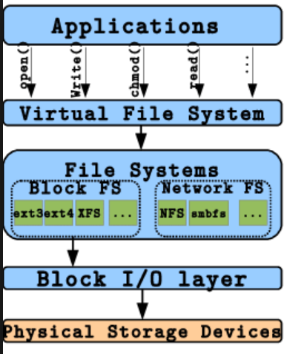


Slide 48
Troubleshooting Storage Issues
A virtual file system (VFS) is an abstraction layer that resides above a file system and provides an interface between the kernel and file system. Through a VFS, client applications can access different file systems.
A VFS is also known as a virtual file system switch (VFS).
Virtual file system (VFS) as a manageable container that virtually provides the functionality of a file system.
During each file system initialization, the file system registers itself with the VFS. This occurs as the operating system (OS) initializes itself at startup. The real file systems are generally built as loadable modules or built directly into the kernel.

Slide 49
Troubleshooting Storage Issues
FILESYSTEMS
A filesystem is the methods and data structures that an operating system uses to keep track of files on a disk or partition; that is, the way the files are organized on the disk. The word is also used to refer to a partition or disk that is used to store the files or the type of the filesystem.

Slide 50
Troubleshooting Storage Issues
DEVICE MAPPER
Device mapper is a powerful mechanism in the kernel to create 1:1 mappings of blocks in one block device to blocks in another, logical block device.

Slide 51
Troubleshooting Storage Issues
DEVICE MAPPER MULTIPATH
Device Mapper Multipathing (or DM-multipathing) is a Linux native multipath tool, which allows you to configure multiple I/O paths between server nodes and storage arrays into a single device. These I/O paths are physical SAN connections that can include separate cables, switches, and controllers. Multipathing aggregates the I/O paths, creating a new device that consists of the aggregated paths. Regardless of the vendor hardware in use, device mapper creates a block device under /dev/mapper/ for each LUN attached to the system.

Slide 52
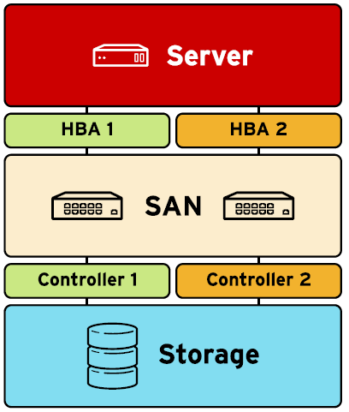

Slide 53
multipath -ll
mpath15 (3600a0b8000473abc0000bafc52fac127) dm-14 SUN,STK6580_6780
[size=10G][features=0][hwhandler=0][rw]
_ round-robin 0 [prio=1][enabled]
_ 8:0:0:2 sds 65:32 [active][ready]
_ round-robin 0 [prio=0][enabled]
_ 9:0:0:2 sdu 65:64 [active][faulty]
mpath13 (3600a0b8000473abc0000bb74530aa7da) dm-12 SUN,STK6580_6780
[size=931G][features=0][hwhandler=0][rw]
_ round-robin 0 [prio=1][enabled]
_ 9:0:0:0 sdp 8:240 [active][ready]
_ round-robin 0 [prio=0][enabled]

Slide 54
Recovering from File System Corruption
File System Selection
Linux offers system administrators a choice of several file systems as the workload requirements like ext2, ext3, ext4 & xfs
In RHEL 6 ➔ ext4 (default file system) and xfs was offered as another option.
In RHEL7 ➔ xfs as the default file system selection.
File System Journalising was introduced with ext3. A journaling filesystem is a filesystem that maintains a special file called a journal that is used to repair any inconsistencies that occur as the result of an improper shutdown of a computer. Such shutdowns are usually due to an interruption of the power supply or to a software problem that cannot be resolved without a rebooting.

Slide 55
Recovering from File System Corruption
Identifying File System Corruption
System administrator can use file system checking tools to perform the consistency check when file system corruption is suspected.
Once the issues has been identified then system admin can run the file system repair and try to repair it.

Slide 56
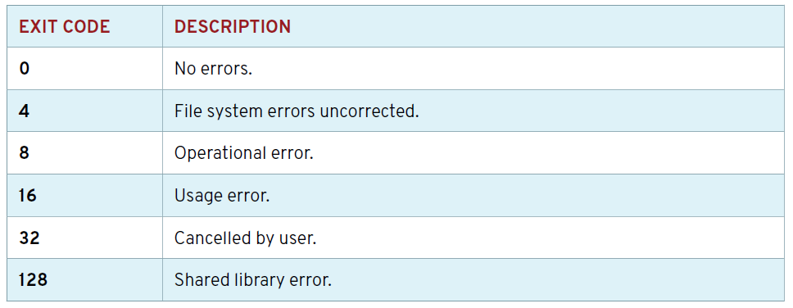

Slide 57
Identify & Fix RPM Issues
Resolve package dependencies
When an RPM Package requires functionality and that is provided by another package then one package gets dependent on other. The rpm command does not resolve these dependencies. The yum command resolves dependencies and uses rpm to install or erase a package.
When diagnosing RPM dependency issues, the system logs are not very helpful. In addition to the RPM database, the /var/log/yum.log log contains a history of installed and erased packages.
Displaying package dependencies
yum deplist yum

Slide 58
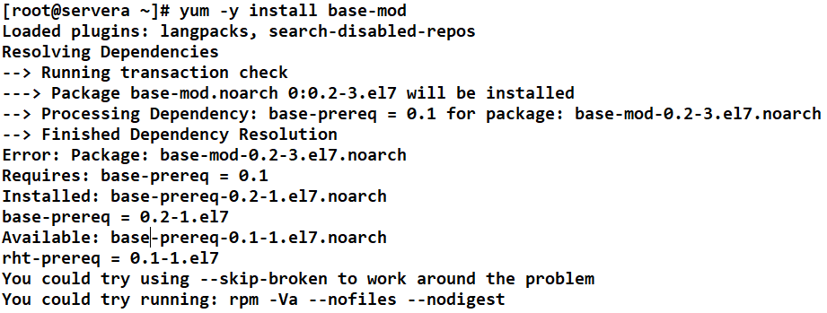
Identify & Fix RPM Issues
Resolve package dependencies

Slide 59
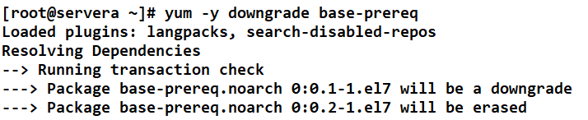
Identify & Fix RPM Issues
Resolve package dependencies

Slide 60
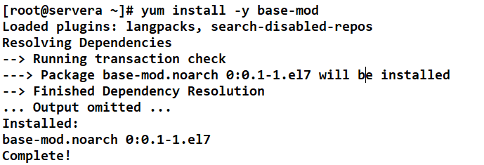
Identify & Fix RPM Issues
Resolve package dependencies

Slide 61
Identify & Fix RPM Issues
Recovering a Corrupt RPM Database

Slide 62
Troubleshooting Network Issues
Identify & resolve network connectivity issues.

Slide 63
Troubleshooting Network Issues
Scanning Network Ports
Nmap is a tool used for determining the hosts that are running and what services the hosts are running. Nmap can be a valuable diagnostic tool for network administrators.
The Nmap is an open source and a very versatile tool for Linux system/network administrators. Nmap is used for exploring networks, perform security scans, network audit and finding open ports on remote machine. It scans for Live hosts, Operating systems, packet filters and open ports running on remote hosts.

Slide 64
Troubleshooting Network Issues
COMMUNICATING WITH A REMOTE SERVICE
NCAT
A troubleshooting tool that allows an administrator to communicate with a service directly is Ncat. Ncat can use either TCP and UDP to communicate with a network service, and it also supports SSL communication. Ncat is invoked as either the nc or ncat commands. The nmap-ncat package of Red Hat Enterprise Linux provides the Ncat utility.

Slide 65
Troubleshooting Network Issues
Network Monitoring Utility (iptraf-ng)

Slide 66
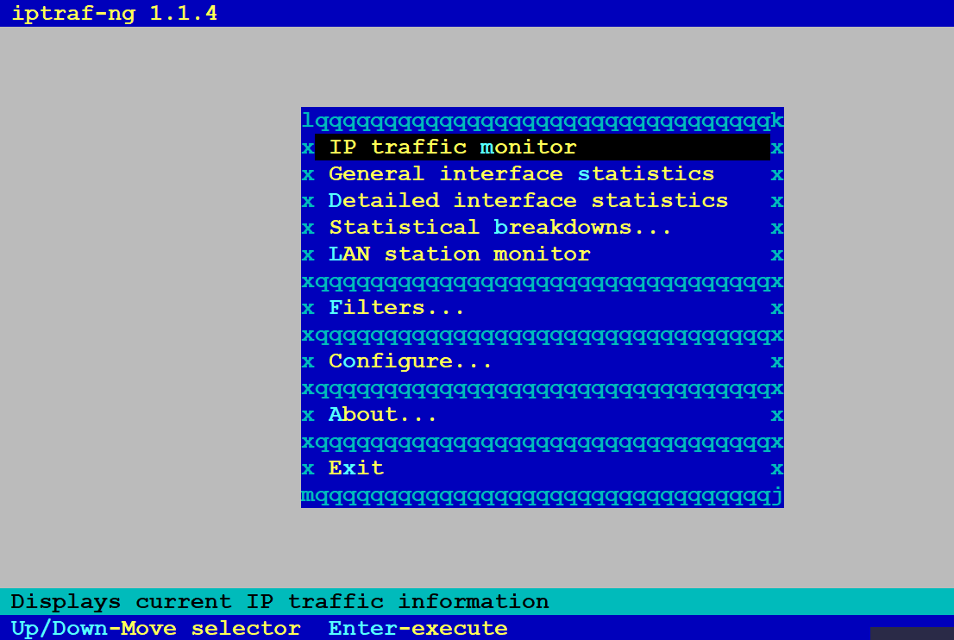

Slide 67
Troubleshooting Network Issues
Practice Lab Session
Scenario : I have a server which is having two network interface and second interface is not working properly and it should have the following IP Address
Ipv4 address = 192.168.43.59/24

Slide 68
Troubleshooting Network Issues
How to disable consistent network device naming in Red Hat Linux 7
With Red Hat Enterprise Linux 7 they have introduced a network device naming scheme wherein it provides methods for consistent and predictable network device naming for network interfaces. These features change the name of network interfaces on a system in order to make locating and differentiating the interfaces easier.
Although in many case we prefer to stick to the traditional naming scheme wherein the interface name would be eth[0123…]. By default on a RHEL 7 node the consistent network device naming would be enabled but if you wish to disable the same there are couple of method.

Slide 69
Troubleshooting Network Issues
How to disable consistent network device naming in Red Hat Linux 7
This naming scheme is enabled via deifferent set of rules using udev and/or biosdevname depending upon the kernel parameter which is enabled on your system. biosdevname is disabled by default on all hardware except DELL, if you wish to enable biosdevname then you have to explicitly ad biosdevname=1 in your kernel command line parameter.

Slide 70
Troubleshooting Network Issues
On-board network devices are assigned names similar to eno1. en is the Ethernet prefix, and o stands for on-board, followed by a device number. PCI Express hotplug slot devices have names similar to ens1; s stands for slot. Other network devices have names based on physical location of the hardware connector, enp2s0. Traditional, unpredictable naming, such as eth0, is used if previous methods did not work.
The /etc/udev/rules.d/80-net-name-slot.rules udev rules file implements the persistent naming. This file will be symbolically linked to /dev/null when traditional device naming is desired.
System administrators can also write their own udev device naming rules in /etc/udev/rules.d/70-persistent-net.rules. These rules will override the default network device naming performed by systemd.

Slide 71
Troubleshooting Network Issues
Create an override for the default rules policy
ln –s /dev/null /etc/dev/rules.d/80-net-name-slot.rules
System administrators can also write their own udev device naming rules in /etc/udev/rules.d/70-persistent-net.rules. These rules will override the default network device naming performed by systemd.
SUBSYSTEM=="net", ACTION=="add", DRIVERS=="?*", ATTR{address}=="7c:fr:80:cb:76:05", ATTR{dev_id}=="0x0", ATTR{type}=="1", KERNEL=="eth*", NAME="eth1"
SUBSYSTEM=="net", ACTION=="add", DRIVERS=="?*", ATTR{address}=="7c:fr:80:cb:76:07", ATTR{dev_id}=="0x0", ATTR{type}=="1", KERNEL=="eth*", NAME="eth2"

Slide 72
Last Lecture

