Slide 1
Internet Small Computer System Interface (iSCSI) is an TCP/IP-based standard for connecting storage devices. iSCSI uses IP networks to encapsulate SCSI commands, allowing data to be transferred over long distances.
iSCSI provides shared storage among a number of client systems. Storage devices are attached to servers (targets). Client systems (initiators) access the remote storage devices over IP networks.
To the client systems, the storage devices appear to be locally attached. iSCSI uses the existing IP infrastructure and does not require any additional cabling, as is the case with Fibre Channel (FC) storage area networks.
Shikhar Verma

Slide 2
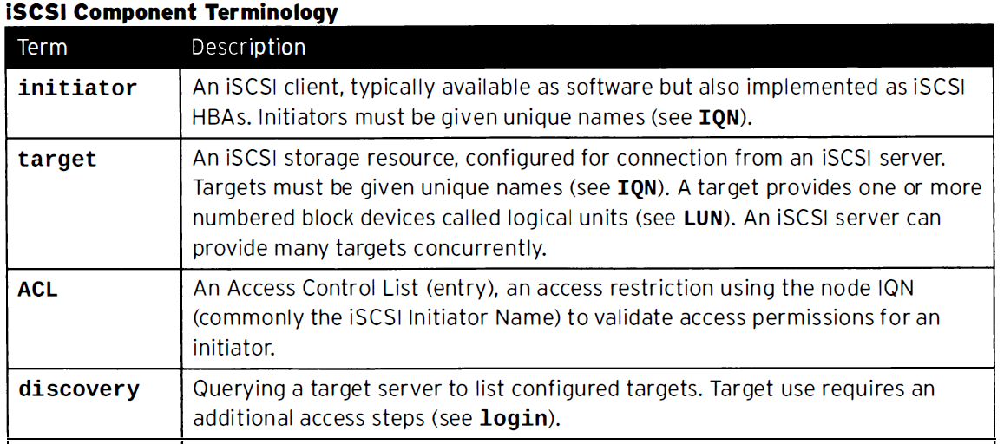
iSCSI fundamentals
Shikhar Verma

Slide 3
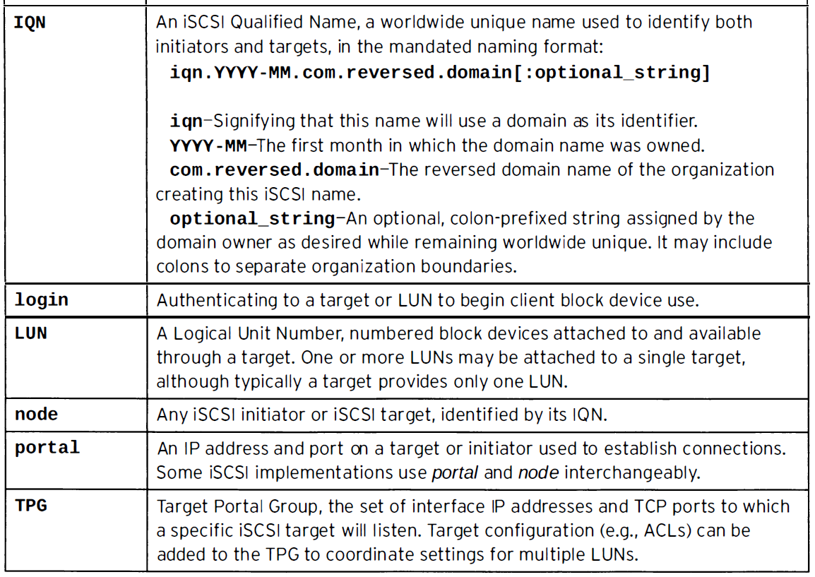
iSCSI fundamentals
Shikhar Verma

Slide 4
Configuring an iSCSI Server
RHEL/CentOS 7 uses the Linux-IO (LIO) kernel target subsystem for iSCSI. In addition to iSCSI, LIO supports a number of storage fabrics including Fibre Channel over Ethernet (FCoE).
In RHEL 7, all storage fabrics are managed with the targetcli utility.
To configure RHEL system as an iSCSI server, begin by installing the targetcli software package:
yum install targetcli
Installing the targetcli software package also installs the python-rtslib package, which provides the /usr/lib/systemd/system/target.service file.
Shikhar Verma

Slide 5
Configuring an iSCSI Server
Before using the targetcli utility to create, delete, and view storage targets, use the systemctl command to enable and start the target service on the iSCSI server.
systemctl start target
systemctl status target
systemctl enable target
Shikhar Verma

Slide 6
Configuring an iSCSI Server
targetcli Utility
The targetcli utility is the administration shell for creating, editing, and viewing the configuration of the kernel’s target subsystem. Run targetcli to enter the configuration shell.
targetcli
Warning: Could not load preferences file /root/.targetcli/prefs.bin.
targetcli shell version 2.2.fb56
Copyright 2011-2013 by Datera, Inc and others.
For help on commands, type 'help’.
/> help
Shikhar Verma

Slide 7
Configuring an iSCSI Server
Backstores
The first thing listed are the backstores. Backstores provide different ways of storing the data locally that will be exported to an external system. The available options are block, fileio, pscsi and ramdisk.
The mappings to local storage resources that each backstore creates are called storage objects. Use the targetcli ls command to list the different types of backstores.
Shikhar Verma

Slide 8
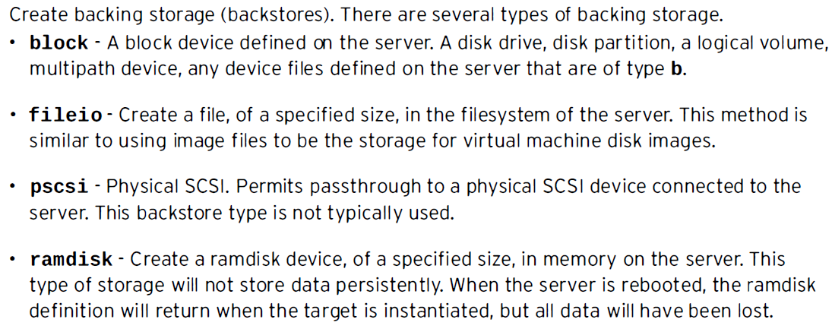
Configuring an iSCSI Server
Backstores
Shikhar Verma

Slide 9
Configuring an iSCSI Server
To create a block backstore from the targetcli shell:
/> cd /backstores/block
/backstores/block> create <name of shared lun> /dev/xxx
/backstores/block> create sharedlun0 /dev/sde
To create a fileio backstore from the targetcli shell:
/> cd /backstores/fileio
/backstores/fileio> create name=LUN_3 /root/disk1.img 5G
Shikhar Verma

Slide 10
Creating an iSCSI Target
To create an iSCSI target from the targetcli shell, use the cd command to change to the /iscsi directory.
/> cd /iscsi
/iscsi>
Shikhar Verma

Slide 11
Creating an iSCSI Target
Use the create command without any arguments to create an iSCSI target by using a default target name. By default, the target is identified by an “iqn” identifier. This is an iSCSI Qualified Name (IQN), which uniquely identifies a target. IQN format addresses are most commonly used to identify a target. This address consists of the following fields:
Literal iqn
Date (in yyyy-mm format) that the naming authority took ownership of the domain
Reversed domain name of the authority
Optional “:” that prefixes a storage target name specified by the naming authority
Shikhar Verma

Slide 12
Creating an iSCSI Target
/> cd /iscsi
/iscsi> create
Created target iqn.2007-02.org.linux-iscsi.user.x8664:sn.b0dd6e768beb.
Created TPG 1.
Global pref auto_add_default_portal=true
Created default portal listening on all IPs (0.0.0.0), port 3260.
/iscsi>
Shikhar Verma

Slide 13
To allow remote systems to access an iSCSI target on port 3260, either disable the firewalld service on the iSCSI server or configure firewalld to trust the 3260/tcp port. The following example uses firewall-cmd to open the 3260/tcp port for the firewalld service.
# firewall-cmd --permanent --add-port=3260/tcp
If you include the –permanent option when adding a port, use the firewall-cmd command to reload the configuration.
# firewall-cmd –reload
Shikhar Verma

Slide 14
Creating iSCSI LUNs
The kernel target exports SCSI Logical Units to remote systems. Use the targetcli shell to link previously defined storage objects with a target, and to specify which Logical Unit Number (LUN) the device uses.
/iscsi> cd /iscsi/iqn.2007-02.org.linux-iscsi.user.x8664:sn.b0dd6e768beb /
/iscsi/iqn.20....b0dd6e768beb> cd tpgl/luns
The following commands create a LUN from the previously defined block storage objects.
/iscsi/iqn.20....b0dd6e768beb> create /backstores/block/sharedlun0
Created LUN 1.
Shikhar Verma

Slide 15
Creating ACLs
Access Control Lists (ACLs) restrict access to LUNs from remote systems. You can create an ACL for each initiator to enforce authentication when the initiator connects to the target. This allows you to give a specific initiator exclusive access to a specific target. The following example uses the create command to create an ACL for an initiator. From the targetcli shell, begin by using the cd command to change to the acls directory within the [target/TGP] hierarchy.
/> cd /iscsi/iqn.2007-02.org.linux-iscsi.user.x8664:sn.b0dd6e768beb/tpg1/acls
/iscsi/iqn.20...beb/tpg1/acls> create iqn.2008-05.com.abcded:aabb51a64012 <= IQN of the client
Created Node ACL for iqn.2005-05.com.abcded:aabb51a64012
Created mapped LUN 1.
Shikhar Verma

Slide 16
Configuring an iSCSI Initiator
To configure a Linux system as an iSCSI initiator, install the iscsi-initiator-utils software package. This package is the Linux Open-iSCSI Initiator.
yum install iscsi-initiator-utils
The package installs several files including the following:
/etc/iscsi/iscsid.conf: The configuration file read by iscsid and iscsiadm. This file is heavily commented with descriptions for each configuration directive.
/sbin/iscsid: The Open-iSCSI daemon that implements the control path and management facilities
/sbin/iscsiadm: The Open-iSCSI administration utility used to discover and log in to iSCSI targets
Shikhar Verma

