Slide 1
Introduction to GPU programming
Lucas Gasparino

Slide 2
Objectives
Overview of GPU architecture
  What IS a GPU
  SM structure and execution model
  Memory layout
Accessing the hardware
  Developer’s POV: grids and threads
  Programming models
  Overview of CUDA
  OpenACC basics
Example 1: matrix multiplication
Example 2: FEM1D

Slide 3
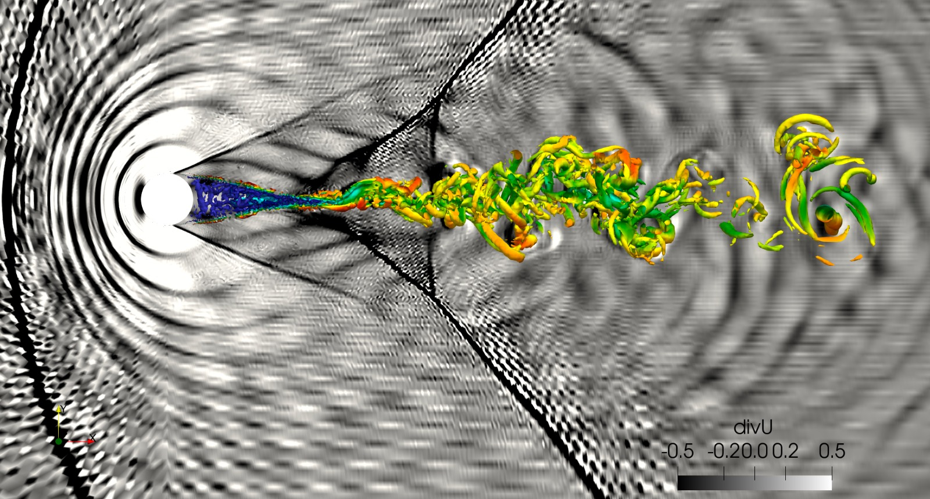
Motivating example

Slide 4
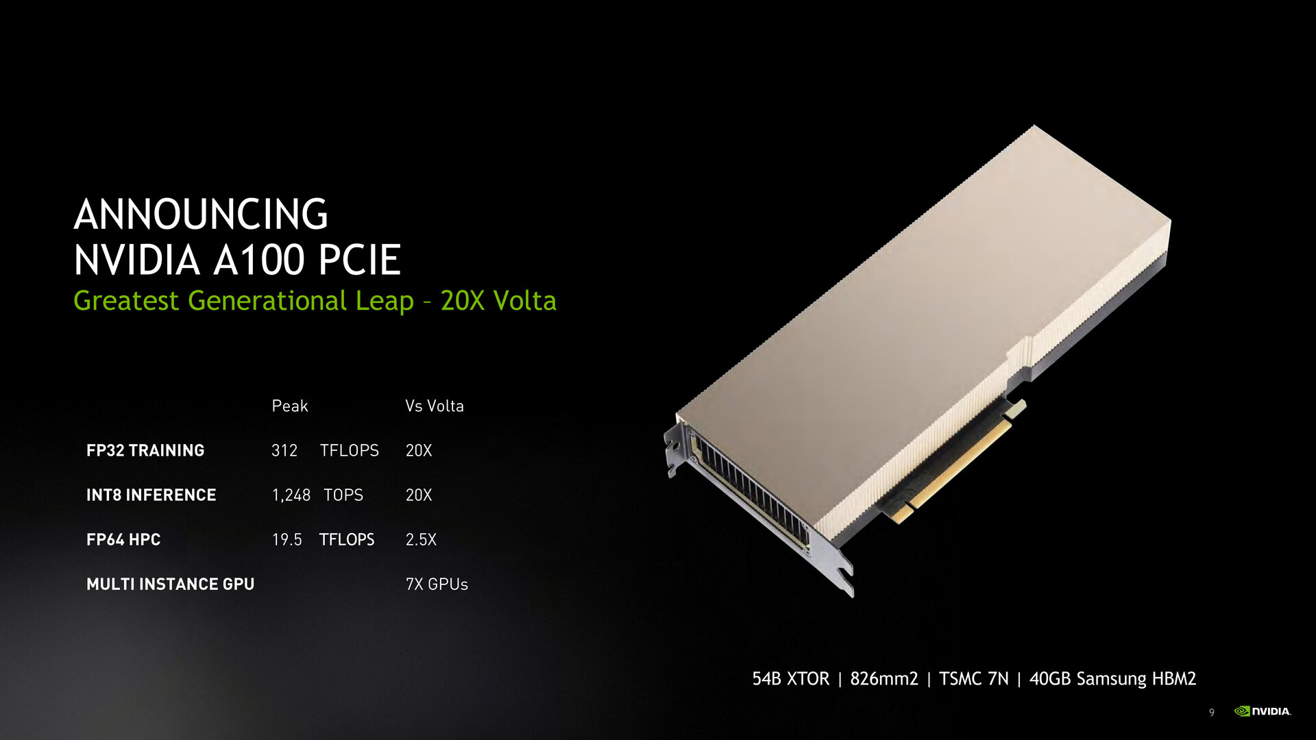

What IS a GPU
GPGPU: General Purpose Graphics Processing Unit;
Massively parallel hardware, created to handle millions of pixels simultaneously;
On HPC: expected to be more efficient than multicore CPU architectures for certain types of computations;

Slide 5
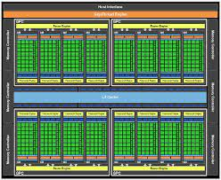
The computing guts: SMs
GPU “core” composed of many SMs (CUDA cores for NVIDIA);
Each SM contains a multitude of threads;
Instructions in each cycle are issued to “warps” containing 32 threads each, per SM;

Slide 6
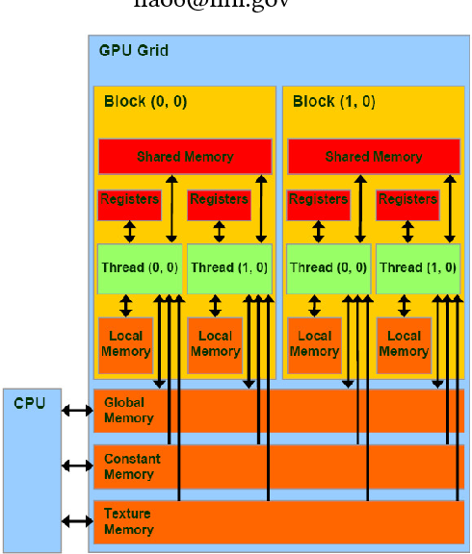
Memory layout
GPU memory is detached from system memory;
Multiple caches and registers that allow better data access rates;
Hierarchy:
  Global memory
    Shared memory
    L1 cache
    Constant memory
    Texture memory
      Thread register

Slide 7
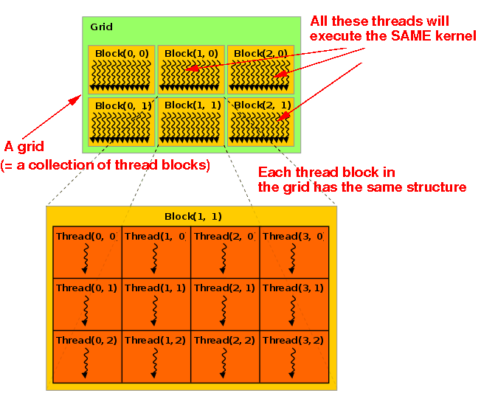
Developer’s POV: grids and threads
GPU kernel execution must happen in a grid, composed of thread blocks;
Thread blocks are groupings of threads that access the same region of data;
Developer’s task: ensure that the algorithm can be efficiently parallelized using this structure;

Slide 8






GPU programming models
Low level models:
  CUDA, OpenCL, NVPTX, SYCL
Pragma-based high level models:
  OpenACC, OpenMP
Graphics engines:
  Unreal, DirectX, Vulkan, OpenGL
Language standard parallelization:
  Stdpar for Fortran and C/C++
Library-based:
  PyTorch, Thrust

Slide 9
CUDA API
Excellent low-level control capabilities:
  Micromanaged usage of threads and thread blocks;
  Allow access to all memory caches in the GPU;
  Allows configuration of streams to asynchronously execute data movements and kernel executions;
  Offer peer-to-peer GPU communication tools;
Hard to learn, hard to master:
  Data transfer micromanagement can lead to issues;
  Using hierarchical memory is not simple;
  Data partition within the grid depends on developer skill;

Slide 10
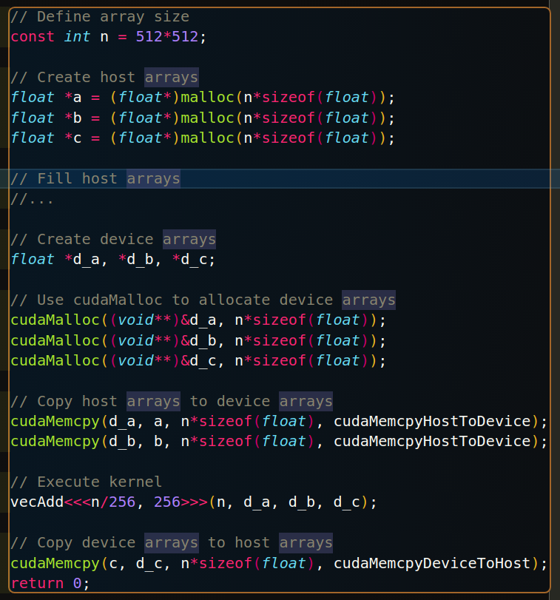
CUDA C: Host/Device memory ops
Basic device memory ops:
  cudaMalloc: allocates memory on global device memory pool;
  cudaMemcpy: copies a host or device array into it’s counterpart;

Slide 11
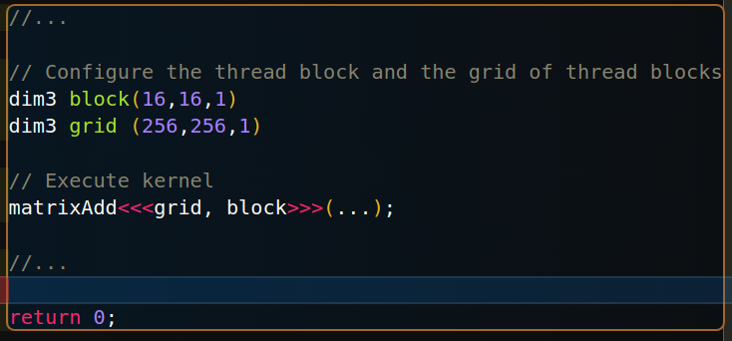
CUDA C: grid configuration
Kernels must be launched on a grid of “thread blocks”;
“dim3” type variables can be created to describe the configuration of the set of thread blocks, and the thread block sizes itself;
Both the grid and the thread blocks can be 3 dimensional. Hardware sets limits n max. sizes;

Slide 12
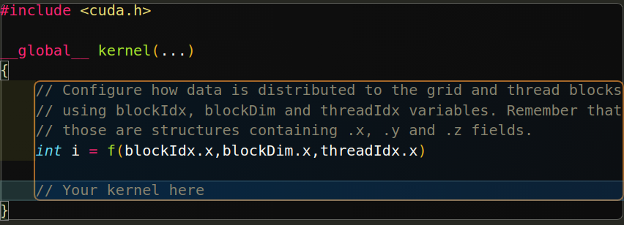
CUDA C: kernel structure
CUDA kernels must have an attribute descriptor. Basic ones are:
  Global: device code launched by host code;
  Device: device code launched from device code;
Indexes to access data structures are build using a combination of the following structs:
  blockDim: size of thread block;
  blockIdx: index of thread block on grid;
  threadIdx: index of thread within the block;
All these include x, y and z fields to account for their three-dimensionality;

Slide 13
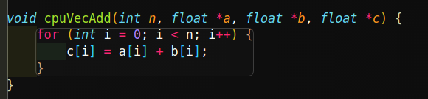
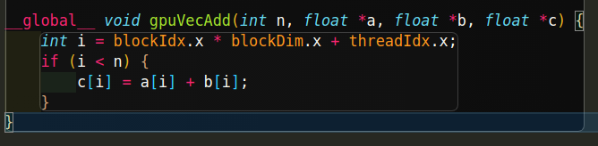
Example: Vector Addition
Host kernel
GPU kernel

Slide 14
OpenACC
High level alternative to CUDA;
Directive-based approach;
Provides both “automagic” and user-controlled options;
Good balance between efficiency and ease of use;
Usage: “#pragma acc [directive] [options]” over section of code to be parallelized. Fortran pragma is “!$”;

Slide 15
OpenACC: data movement
Structured data regions: data remains on device until the end of the scope. Allocates data if 1st time usage;
Unstructured data regions: one-time transfers between host and device. More flexibility on usage, data will persist on device until manually destroyed;

Slide 16
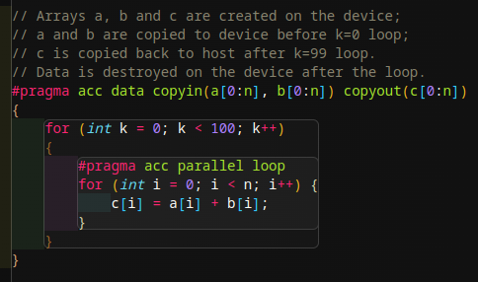
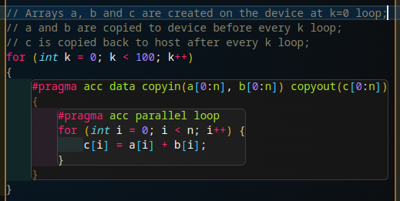
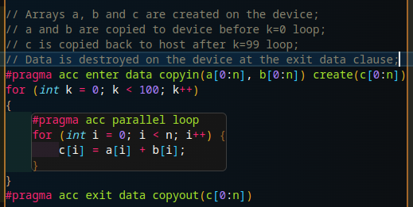
OpenACC: data movement snips

Slide 17
OpenACC: managed memory
When “-gpu=managed” is used to compile, the code can make use of Nvidia’s Unified Virtual Memory (UVM) space;
Now, compiler both generates automatic data transfers and tracks whether data is already present on the device (no need for manual transfer);
Completely safe for pointers and values, not usable with objects!

Slide 18
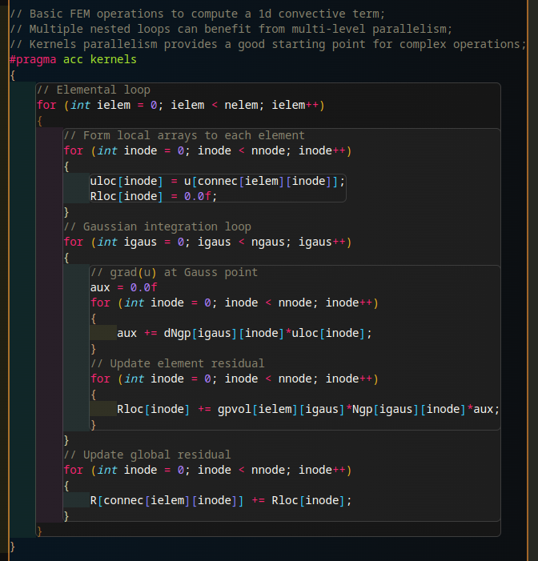
OpenACC: automagic
OpenACC provides the “kernels” directive for compute constructs;
Instructs the compiler to generate a gpu-capable, “thread-safe” code;
Good starting point, but rarely optimal;

Slide 19
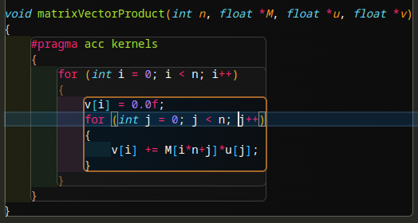
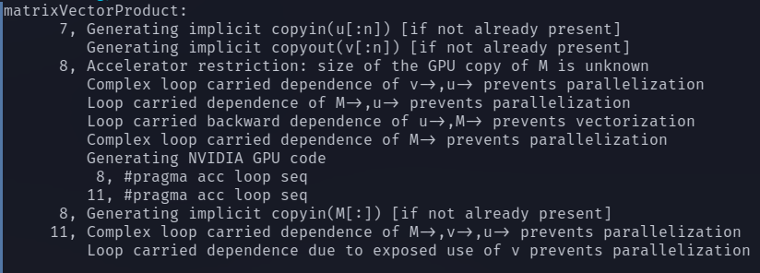
OpenACC: kernel example

Slide 20
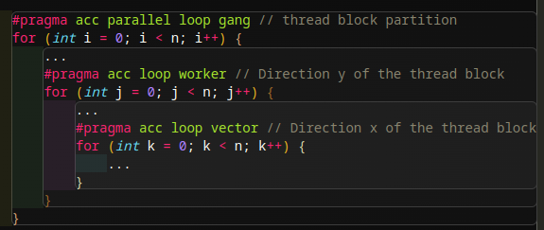
OpenACC: DIY
Kernels are easy, parallel constructs are faster*;
The “parallel” construct is the DIY of ACC usage, dev must ensure loops are indeed parallelizable;
Trade-off: usually requires that the kernel is refactored to make proper use of the construct (a.k.a., back to the drawing board);
Parallel allows usage of more advanced tools, such as shared memory caching;
3 levels of parallelism to exploit: gang, worker and vector => 1D grid of 2D thread blocks;

Slide 21
Practical example: matrix multiplication
Very time-consuming for dense matrices;
c_ij = a_ik * b_kj implies many simultaneous dot products;
Parallel version using MPI quite tricky, and still requires many resources;
Easy to write a naive GPU version, much harder to optimize;

Slide 22
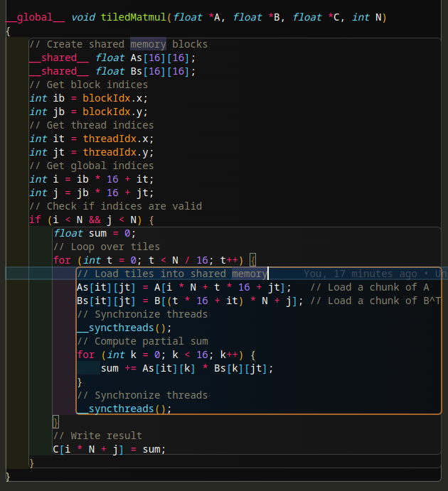
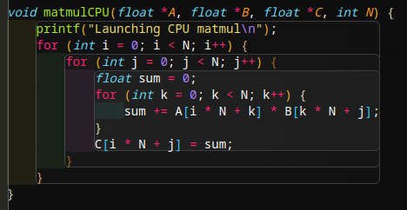
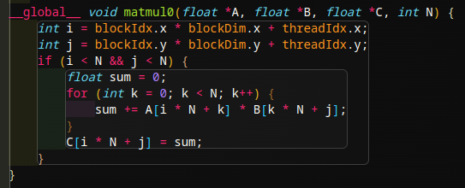
Matmul: CPU vs GPU vs GPU
CPU
Naive GPU
Tiled GPU

Slide 23
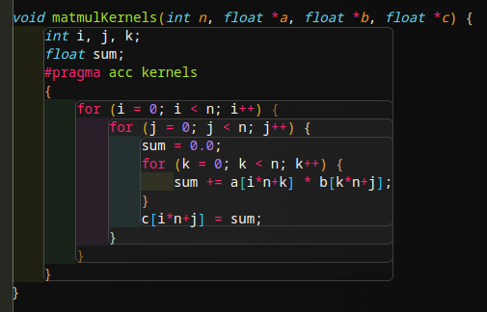
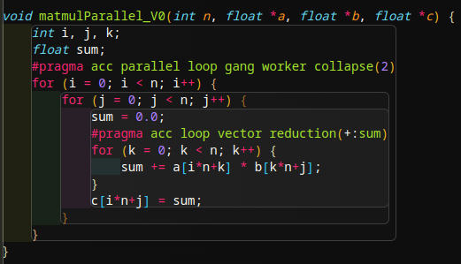
Matmul: OpenACC versions

Slide 24
Matmul: ACC vs CUDA timings
All test done using nrows=ncols=2000;
Hardware: 1x NVIDIA RTX 3080Ti;
  Acc-kernels: 8.7s
  Acc-parallel: 422.126ms
  CUDA-naive: 19.225ms
  CUDA-tiled: 11.873ms

Slide 25
Matmul: analysis
Naive version requires many global memory access requests, which is “slow”;
Shared memory version loads data into cache, making data access much faster;
In practice, performance gains only for very large datasets, and dependent on tiling size;
ACC kernels slowed down as compiler thinks there are data dependencies;
CUDA is faster as it can more easily exploit multi-level parallelism (2D grid of 2D blocks);

Slide 26
Example: FEM1D
FEM: backbone of BSC-CASE research;
Alya, SOD2D are FEM-based approaches;
Elemental operations are costly, and can benefit greatly from GPU usage;
Objective: introduce OpenACC into a 1D scalar convection kernel;

Slide 27
Conclusions
GPUs are not magic boxes: just because code is on the device, doesn’t mean it go brrrrr!
CUDA is not practical, OpenACC can deliver excellent performance without making you rage-quit;
However, CUDA CAN deliver fantastic performance if multidimensional grids can be used in the kernel;
ACC kernels is like James May driving. Parallel is like Hammond;
Micro-managing host/device data transfers is painful, and you’re probably doing it wrong; use managed memory to avoid performance and hair loss;

