Slide 1
Historical Women In Computing
A timeline of famous women
in computing

Slide 2
Warm-up
Think: Write down some influential women in history. Why are they influential? Pair: Make a circle with your “sticker team” and share your responses. Share: Share with the group one of the women your group discussed.

Slide 3
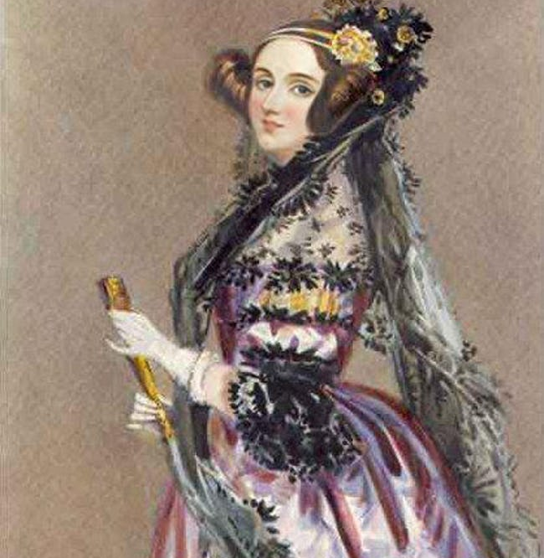
Ada Lovelace
English mathematician
Only child of poet Lord Byron
Considered 1st computer programmer
Programmed on Charles Babbage's Analytical Engine
First person to publish an algorithm
1815 - 1852
Photo: Metaweb (FB)/Public domain

Slide 4
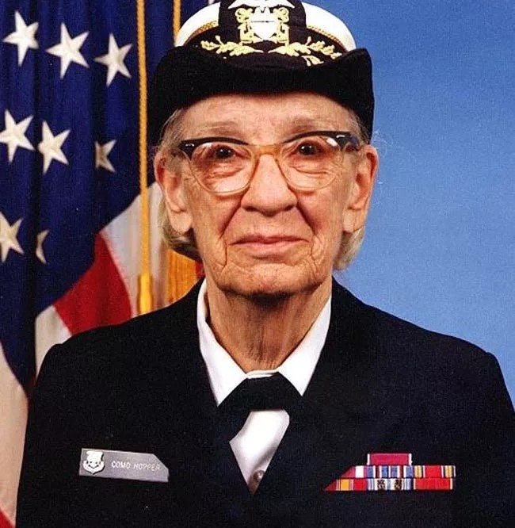
Grace Hopper
US Navy Rear Admiral
One of the 1st programmers of the Harvard Mark I in 1944
Invented first compiler
Helped develop COBOL programming language
Credited for the term "debugging"
1906 - 1992
Photo: Metaweb (FB)/Public domain

Slide 5
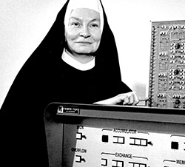
Mary Kenneth Keller
American Roman Catholic religious sister, educator and pioneer in computer science.
First woman to earn a Ph.D. in computer science in the United States.
Founded the computer science department at Clarke College (now Clarke University), a Catholic women's college in Dubuque, Iowa.
1913 - 1985
Notes:
She entered the Sisters of Charity of the Blessed Virgin Mary in 1932 and took her vows with that religious congregation in 1940.
She completed both her B.S. (Bachelor of Science) in Mathematics in 1943 and her M.S. (Master of Science) in Mathematics and Physics in 1953 from DePaul University in Chicago.
Keller earned her Ph.D. from the University of Wisconsin–Madison in 1965.
Keller believed in the potential for computers to increase access to information and promote education.

Slide 6
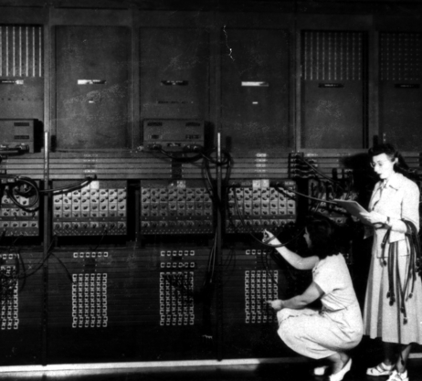
ENIAC Programmers
The programmers of the ENIAC computer in 1944 were six female mathematicians:
Marlyn Meltzer
Betty Holberton
Kathleen Antonelli
Ruth Teitelbaum
Jean Bartik
Frances Spence
They were known as the "ENIAC girls”
They learned how the ENIAC worked by repairing it, sometimes crawling through the computer, and by fixing "bugs" in the machinery.
1946 – The ENIAC Girls
By Unidentified U.S. Army photographer - ARL Technical Library, Public Domain, https://commons.wikimedia.org/w/index.php?curid=39349766
Notes:
Designing the hardware was "men's work" and programming the software was "women's work."
Even though the programmers were supposed to be doing the "soft" work of programming, in reality, they did that and fully understood and worked with the hardware of the ENIAC.
When the ENIAC was revealed in 1946, the women prepared the machine and the demonstration programs it ran for the public. None of their work in preparing the demonstrations was mentioned in the official accounts of the public events. After the demonstration, the university hosted an expensive celebratory dinner to which none of the ENIAC six were invited.

Slide 7
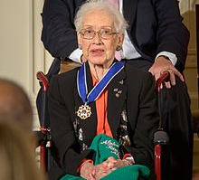
Katherine Johnson
Mathematician
35-year career at NASA and its predecessor, the National Advisory Committee for Aeronautics
Her work at NASA included calculating trajectories, launch windows and emergency return paths for Project Mercury spaceflights.
In 2015, President Barack Obama awarded Johnson the Presidential Medal of Freedom.
Taraji P. Henson portrayed her in the 2016 film Hidden Figures.
1918 -
Notes:
During her 35-year career at NASA and its predecessor, the National Advisory Committee for Aeronautics, she earned a reputation for mastering complex manual calculations and helped the space agency pioneer the use of computers to perform the tasks.
She help on calculations for spaceflights for astronauts Alan Shepard, the first American in space, and John Glenn, the first American in orbit, and rendezvous paths for the Apollo lunar lander and command module on flights to the Moon.
Her calculations were also essential to the beginning of the Space Shuttle program,^{[2]} and she worked on plans for a mission to Mars.

Slide 8
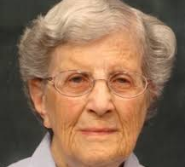
Jean Sammet
Developed the FORMAC programming language in 1962 and was influential in developing the COBOL programming language.
Worked for Sperry Gyroscope, Sylvania, and IBM.
Founded the ACM Special Interest Group on Programming Languages (SIGPLAN).
The first woman president of ACM (Association for Computing Machinery) - 1974 – 1976.
1928 - 2017

Slide 9
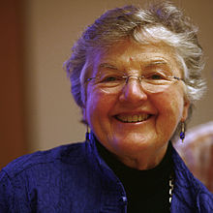
Frances E. Allen
American computer scientist and pioneer in the field of optimizing compilers.
The first female IBM Fellow
In 2006 she became the first woman to win the Turing Award (like the Nobel Prize for computing).
Her achievements include work in compilers, program optimization, and parallelization.
1932 -

Slide 10
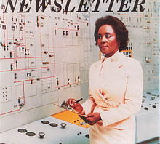
Annie Easley
Computer scientist, mathematician, and rocket scientist.
34-year career for Lewis Research Center (now Glenn Research Center) of NASA and its predecessor, the National Advisory Committee for Aeronautics (NACA).
Leading member of the team which developed software for the Centaur rocket stage
One of the first African-Americans to work as a computer scientist at NASA.
1933 - 2011

Slide 11
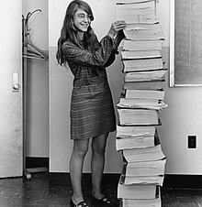
Margaret Hamilton
Director of Software Engineering Division of MIT Instrumentation Lab
Developed on-board flight software for Apollo space program
Published over 130 papers and reports
One of the people credited with coining the term "software engineering"
Awarded Presidential Medal of Freedom in 2016 by Barack Obama
1936 -

Slide 12
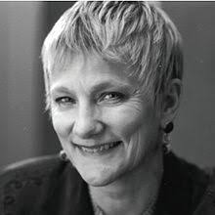
Anita Borg
American computer scientist
Founded the Institute for Women and Technology and the Grace Hopper Celebration of Women in Computing. Taught herself to program while working at a small insurance company. Awarded her PhD in Computer Science by New York University in 1981.
Borg passionately believed in working for greater representation of technical women.
Was one of two who founded the Grace Hopper Celebration of Women in Computing, a conference by and for women computer scientists
1949 - 2003

Slide 13
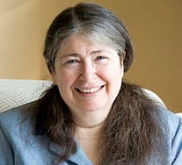
Radia Perlman
American computer programmer and network engineer
Most famous for her invention of the spanning-tree protocol (STP), which is fundamental to the operation of networks.
Has made large contributions to many other areas of network design and standardization of routing protocols.
She has worked for DEC (Digital Equipment Corporation) and now Dell EMC.
1951 -

Slide 14
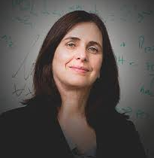
Shafi Goldwasser
American – Israeli computer scientist
Turing Award winner in 2012
Professor at MIT and Weizmann Institute of Science, Israel
Researches cryptography
Co-inventor of probabilistic encryption and zero-knowledge proofs
1958 -
Notes:
co-founder and chief scientist of Duality Technologies^{[5]} and the director of the Simons Institute for the Theory of Computing in Berkeley, CA
Probabilistic encryption which set up and achieved the gold standard for security for data encryption.
She is the co-inventor of zero-knowledge proofs, which probabilistically and interactively demonstrate the validity of an assertion without conveying any additional knowledge, and are a key tool in the design of cryptographic protocols.

Slide 15
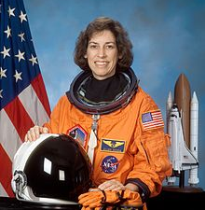
Ellen Ochoa
American engineer and computer scientist
First Hispanic woman in the world to go into space (1993)
Former Director of the Johnson Space Center
Four space flights and nearly 1000 hours in space
1958 -

Slide 16
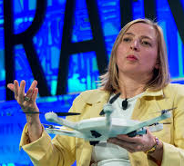
Helen Greiner
Co-founder of iRobot and helped to invent the Roomba.
Former CTO of CyPhyWorks, a start-up company specializing in small multi-rotor drones for the consumer, commercial and military markets.
Has worked at NASA's Jet Propulsion Laboratory and the MIT Artificial Intelligence Laboratory.
She currently works as an advisor to the United States Army.
1967 -

Slide 17
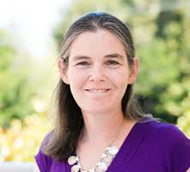
Daphne Koller
An Israeli-American Professor in the Department of Computer Science at Stanford University.
One of the founders of Coursera, an online education platform.
Her general research area is artificial intelligence and its applications in the biomedical sciences.
One of three woman who developed PhysiScore, which uses various data elements to predict whether premature babies are likely to have health issues.
1968 -
Notes:
Koller was featured in a 2004 article by MIT Technology Review titled "10 Emerging Technologies That Will Change Your World" concerning the topic of Bayesian machine learning.^{[10][11]}

Slide 18
Closing Reflection
Think: Which woman inspired you the most? Why?
Pair: Make a circle with your “sticker team” and share your responses. Share: Share with the group one of the women your group discussed.

Slide 19
Puzzle Time

