Slide 1
Current Status of IRIS Darks
Lucas Guliano
July 2022

Slide 2
Notes on reprocessing procedure
Parameter adjustments are made (via computational GUI) whenever misalignment is seen
Sometimes limited parameters are adjusted, other times best results come from adjusting most or all parameters
Data is reprocessed going back to point of misalignment
Data from before point of misalignment is not reprocessed even though model covering that time period may have been slightly modified as well

Slide 3
Summary of Current Model
(amp1*SIN(c*(dt0/p1+phi1)))+(amp2*SIN(c*(dt0/(p1/2)+phi2)))+(trend*(dtl))+(quad*(dtq**2.00))+(off)
amp1: The amplitude of the approximately 1 year sine function.
amp2: The amplitude of the approximately 1/2 year sine function.
p1: Period of approximately 1 year sine function (or ½ year in second term)
phi1: Phase of the approximately 1 year sine function in radians.
phi2: The phase of the approximately 1/2 year sine function in radians.
trend: The linear coefficient explaining the increase in the pedestal level.
quad : The quadratic coefficient explaining the increase in the pedestal level.
off: The intercept for the quadratic and linear function

Slide 4
Additional (Modifier) Terms
qscale: Adjustment of the linear and quadratic term after August 2017 (<1)
dtq[adj] = (dtq[adj])*(og_qscale)**.5
dtl[adj] = (dtl[adj])*(og_qscale)
bo_drop: The fractional drop in the offset (intercept term) due to the bake out on June 13-15, 2018
sc_amp: The amplication fraction in the in the sine function amplitudes due to the bake out on June 13-15, 2018.
trend[post_bo] = (trend+drop_trend_offset+incs_trend_amplit)[post_bo]
ns_incr: The fractional increase in the offset (intercept term) due to non-standard IRIS operations from October 27th to December 15th, 2018.
trend[post_ns] = (trend+incr_trend_offset)[post_ns]
**lower: Fractional decrease in offset after consistent overestimate seen starting June 2021 (**would be eliminated moving forward)
trend[low_21] = (trend-lower)[low_21]

Slide 5
The Issue
From 2014 to 2020, a significant increase was seen each year
This was handled by the trend and quad terms
Starting in summer of 2020, model reached a point of increased stability
Year to year variations significantly declined
The model now struggles with adjusting to new data due to an expectation of increase
Quad term reduced in 2017, but still exists in model
Linear term expects some year to year increase

Slide 6
Emergence of Misalignment
Model began to consistently overestimate starting summer of 2021
Overestimate seen across all 8 ports
With limited data at the time, an additional offset modification in line with previous adjustments was implemented (lower)
Term successfully increased alignment for several months of data
Eventually model continually rose to over-estimate data
From dark report 2021/10

Slide 7
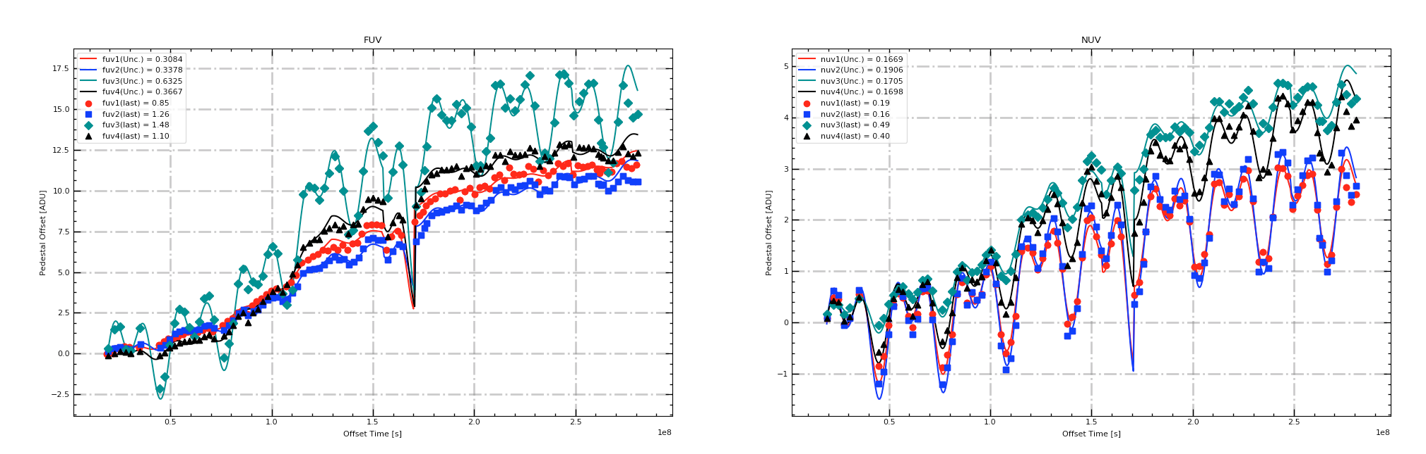
Plot of Current Model V28

Slide 8
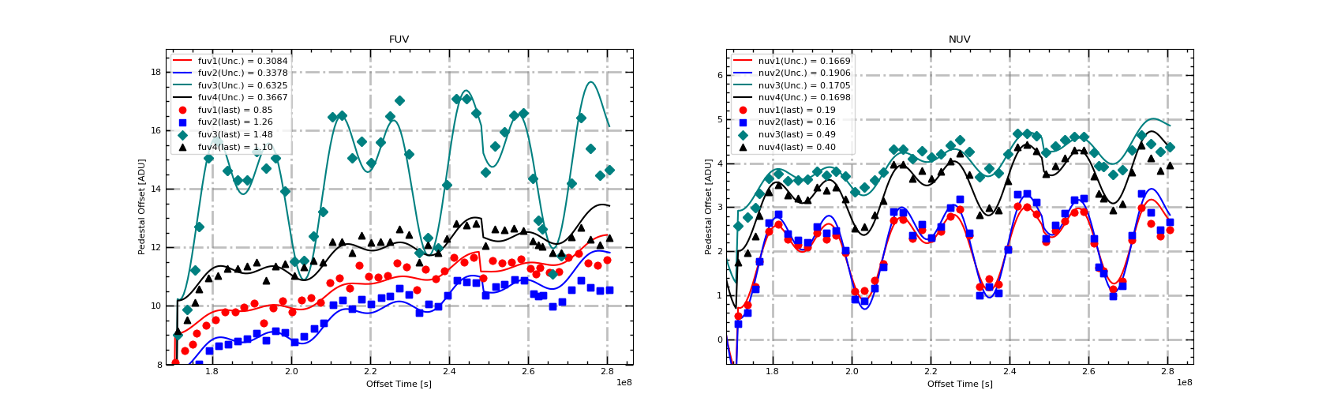
Plot of Current Model V28 (2019 to 2022)

Slide 9
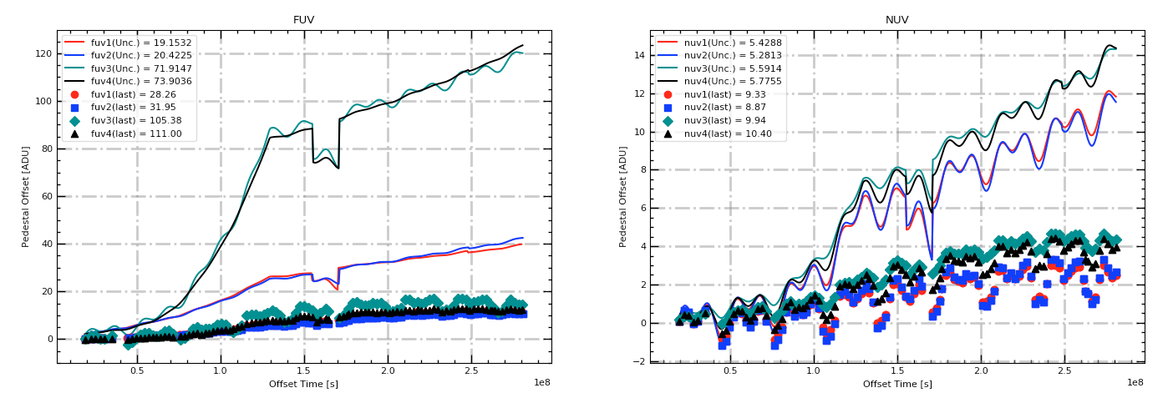
Exaggeration of Trend and Quad terms (x10)

Slide 10
Year | FUV2 |  |  |  | FUV3 |  |  |  | NUV1
 | Average | Min | Max | Delta | Average | Min | Max | Delta | Average | Min | Max | Delta
2014 | 0.34 | 0.14 | 0.58 | N/A | 0.48 | -2.14 | 1.66 | N/A | 0.11 | -0.85 | 0.55 | N/A
2015 | 1.43 | 0.90 | 1.76 | +1.09 | 1.92 | -0.24 | 3.55 | +1.44 | 0.19 | -0.87 | 0.62 | +0.08
2016 | 2.80 | 1.75 | 3.45 | +1.37 | 4.22 | 0.62 | 6.58 | +2.30 | 0.34 | -0.62 | 1.11 | +0.15
2017 | 5.24 | 3.71 | 5.91 | +2.44 | 9.13 | 3.91 | 12.08 | +4.91 | 0.94 | -0.38 | 1.79 | +0.60
2018 | 6.59 | 5.75 | 7.08 | +1.35 | 11.49 | 8.47 | 13.96 | +2.36 | 1.42 | 0.42 | 2.05 | +0.48
2019 | 8.59 | 7.28 | 9.14 | +2.00 | 13.56 | 9.88 | 15.63 | +2.07 | 1.9 | 0.78 | 2.61 | +0.48
2020 | 10.04 | 9.24 | 10.60 | +1.45 | 14.82 | 11.81 | 17.04 | +1.26 | 2.21 | 1.19 | 2.96 | +0.31
2021 | 10.54 | 9.98 | 10.91 | +0.5 | 14.79 | 11.10 | 17.10 | -0.03 | 2.28 | 1.14 | 3.02 | +0.07
2022* | 10.55* | 10.15* | 10.87* | +0.01* | 14.48* | 11.72* | 16.45* | -0.31* | 2.34* | 1.33* | 2.99* | +0.06*

Slide 12
FUV3
2019 |  | 2020 |  | 2021 |  | 2022
1/17/19 | 9.88 | 1/23/20 | 12.38 | 1/22/21 | 11.98 | 1/19/22 | 11.72
2/20/19 | 12.72 | 2/19/20 | 13.22 | 2/17/21 | 14.15 | 2/16/22 | 14.20
3/20/19 | 15.06 | 3/18/20 | 16.47 | 3/17/21 | 17.09 | 3/16/22 | 16.45
4/17/19 | 15.63 | 4/15/20 | 16.53 | 4/15/21 | 17.10 | 4/14/22 | 15.38
5/15/19 | 14.63 | 5/14/20 | 15.05 | 5/12/21 | 16.59 | 5/12/22 | 14.48
6/13/19 | 14.30 | 6/11/20 | 15.62 | 6/9/21 | 14.59 | 6/9/22 | 14.67
7/10/19 | 14.31 | 7/9/20 | 14.89 | 7/8/21 | 15.46 | Not yet available
8/7/19 | 15.27 | 8/6/20 | 15.61 | 8/5/21 | 15.96
9/4/19 | 14.71 | 9/2/20 | 16.49 | 9/2/21 | 16.52
10/3/19 | 15.06 | 9/30/20 | 17.04 | 9/30/21 | 16.59
10/30/19 | 13.93 | 10/28/20 | 15.19 | 10/28/21 | 14.36
11/27/19 | 11.52 | 11/27/20 | 11.81 | 11/25/21 | 12.64
12/25/19 | 11.54 | 12/24/20 | 12.33 | 12/23/21 | 11.10

Slide 14
NUV1
2019 |  | 2020 |  | 2021 |  | 2022
1/17/19 | 0.78 | 1/23/20 | 1.34 | 1/22/21 | 1.25 | 1/19/22 | 1.33
2/20/19 | 1.77 | 2/19/20 | 1.73 | 2/17/21 | 2.06 | 2/16/22 | 2.25
3/20/19 | 2.46 | 3/18/20 | 2.70 | 3/17/21 | 3.02 | 3/16/22 | 2.99
4/17/19 | 2.61 | 4/15/20 | 2.73 | 4/15/21 | 3.01 | 4/14/22 | 2.64
5/15/19 | 2.27 | 5/14/20 | 2.29 | 5/12/21 | 2.85 | 5/12/22 | 2.35
6/13/19 | 2.16 | 6/11/20 | 2.50 | 6/9/21 | 2.22 | 6/9/22 | 2.50
7/10/19 | 2.09 | 7/9/20 | 2.29 | 7/8/21 | 2.47 | Not yet available
8/7/19 | 2.42 | 8/6/20 | 2.45 | 8/5/21 | 2.68
9/4/19 | 2.28 | 9/2/20 | 2.80 | 9/2/21 | 2.88
10/3/19 | 2.37 | 9/30/20 | 2.96 | 9/30/21 | 2.90
10/30/19 | 1.96 | 10/28/20 | 2.36 | 10/28/21 | 2.19
11/27/19 | 1.09 | 11/27/20 | 1.19 | 11/25/21 | 1.56
12/25/19 | 1.10 | 12/24/20 | 1.38 | 12/23/21 | 1.14

Slide 15
Potential Solutions
Additional Parameters
Introduce additional modifier parameters similar to what has been done with previous versions
Maintains singular model consistent with previous adjustments
Continues to increase complexity of the model
Functionally creates piecewise model
Early mission model parameters would continue to change
Discontinuity at point of implementation
Model Separation (“Frozen” Model)
Lock in parameter terms before a given data and move forward with simplified model form (drop modifier variables)
Breaks singular model into multiple distinct models (not done before)
Reduces complexity of model moving forward (easier future adjustments and readability)
Ensures early mission model would never change and forever remain consistent
Allows for optimization of model 2014-2020 without dependency on post 2020 data
Discontinuity at point of implementation

Slide 16
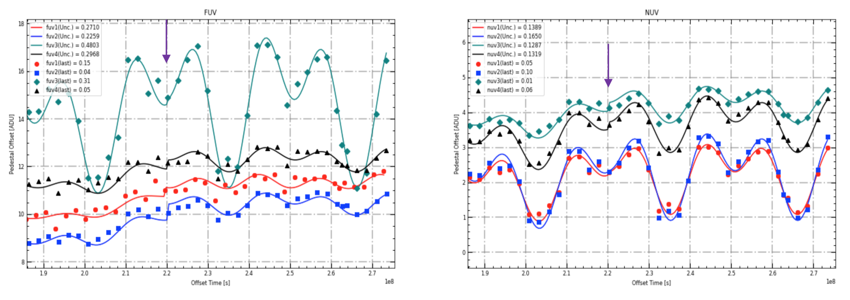
Determination of Lock-in Date
Full analysis was performed in March 2022 report
4 potential implementation times were chosen
Only times at the beginning or direct middle of a given cycle were chosen
Best result came from summer of 2020 (July 9th, 2020)
Emergence of stability at this point
Model adjusted well
Produced best results
Results would be retested
Pending general agreement

Slide 17
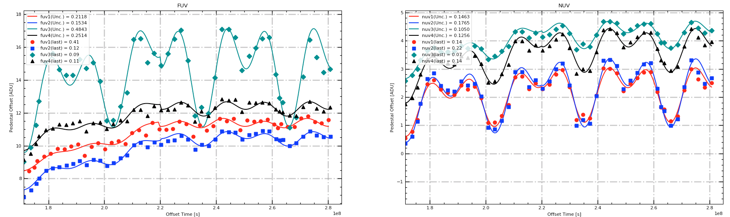
Frozen Model
Model frozen middle of 2020 cycle (07/09/2020). Point where increase is seen to level out and was determined from testing to be most effective time

Slide 18
Additional Considerations
Darks from 07/06 should be first set to use new model solution
Data going back to lock in date will need to be reprocessed
Interesting result from previous 3 dark runs
Will be addressed once larger issue solution is determined and more data is gathered
Is it worthwhile to re-process all data from start of mission to July 2020?
Would ensure that a consistent dark model is used across that dataset and never modified in the future
Would be significant processing work for what is ultimately very minor changes
Changes to how we handle reprocessing?

