Slide 1

Development of a toy CBIR
Recognition of paddy plant diseases based on histogram oriented gradient features
Lucas García de Viedma & Lucía catalán

Slide 2
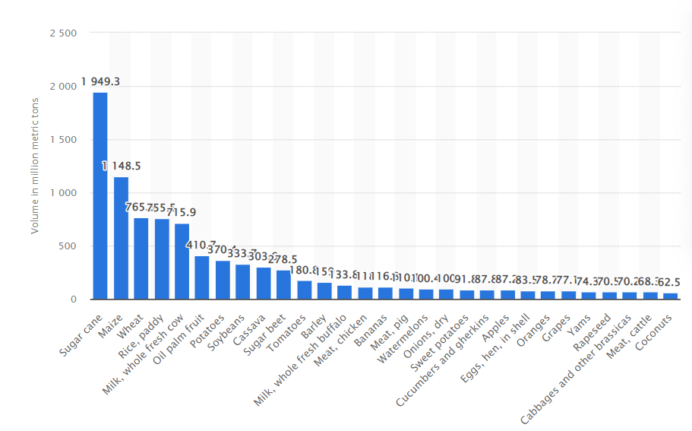
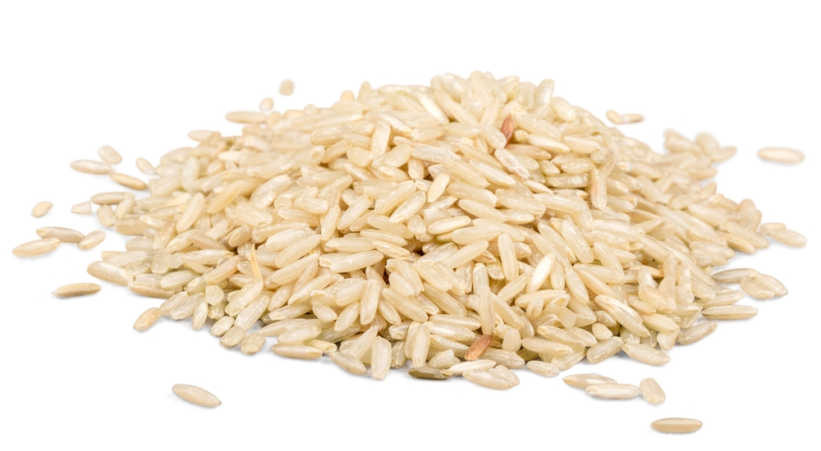
Problem: Loss of rice harvests due to pests and diseases
Top 4 most produced and consumed food source.

Slide 3
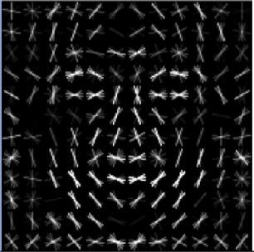
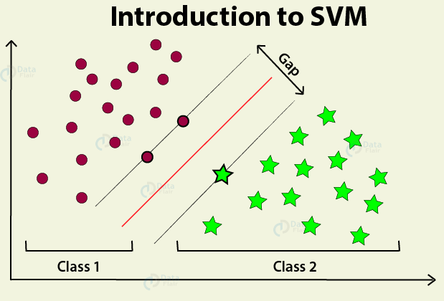
Solution: Recognition of paddy plant diseases based on histogram oriented gradient features
Histogram of gradients (HOG)
Algorithm (SVM)
+
=
Classification

Slide 4
Building the CBIR according to the methods described in the article
Initial Flow of the CBIR
Preparing an alternative dataset
Selected Image
Dataset
Original Images
Background filling (with black)
HOG
HOGs
Dataset 2
Chi.Sqr Dist
Top 5 ranked images

Slide 5
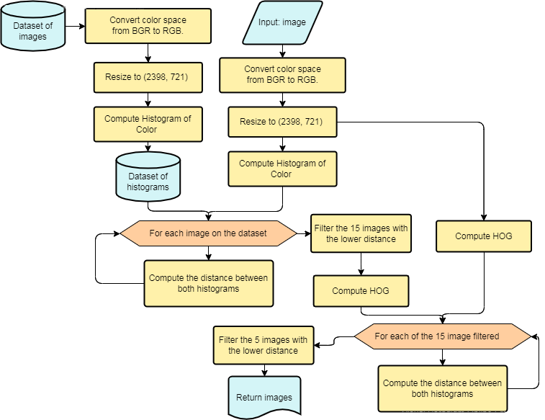
Further actions
taken
Chosen aditional method for image comparison: Histograms of Color
Chosen aditional distances for image comparison: Euclidean & Bhattacharyya
Tested models:
Only HOG
Only HCL (histogram of color)
Ranking with HOG and then with HCL
Ranking with HCL and then with HOG

Slide 6
Toy CBIR accuracy results (for each tested aproach)
Accuracy
Used dataset | Used histograms | Result euclid.* | Result ChiSqr.* | Result Bhatta.*
Original | HOG | 0.66 | 0.48 | 0.67
Original | Histogram of Color | 0.67 | 0.73 | 0.79
Original | Histogram of Color + HOG | 0.68 | 0.71 | 0.75
Fixed background | HOG | 0.62 | 0.46 | 0.60
Fixed background | Histogram of Color | 0.77 | 0.81 | 0.82
Fixed background | Histogram of Color + HOG | 0.74 | 0.70 | 0.81
* The values in these columns refer to the average percentage of plants that have the same disease as the one used as input among the best 5 ranked by the system. The average has been obtained with the percentage obtained for every single image of the dataset.

Slide 7
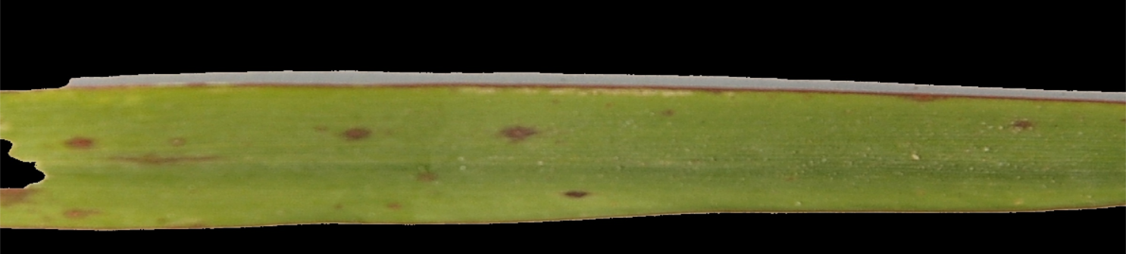
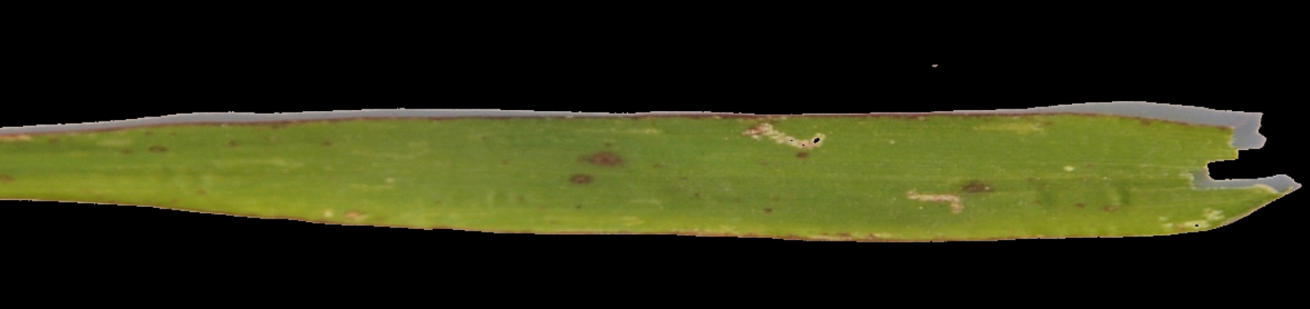
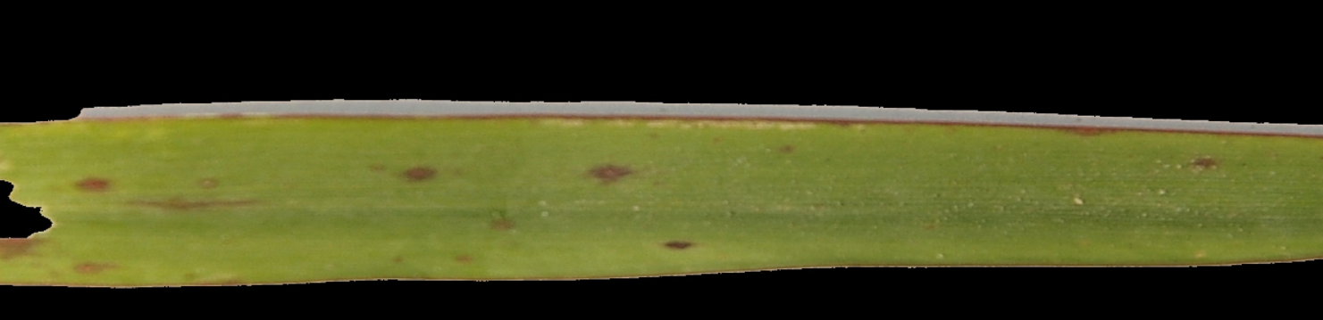
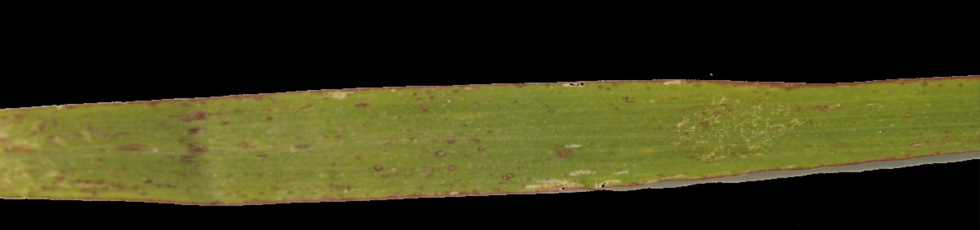
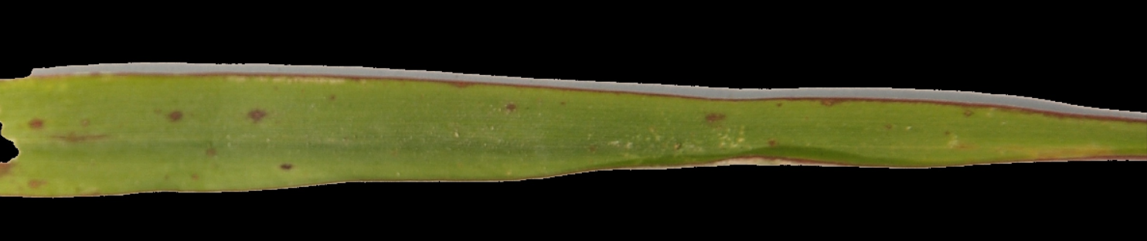
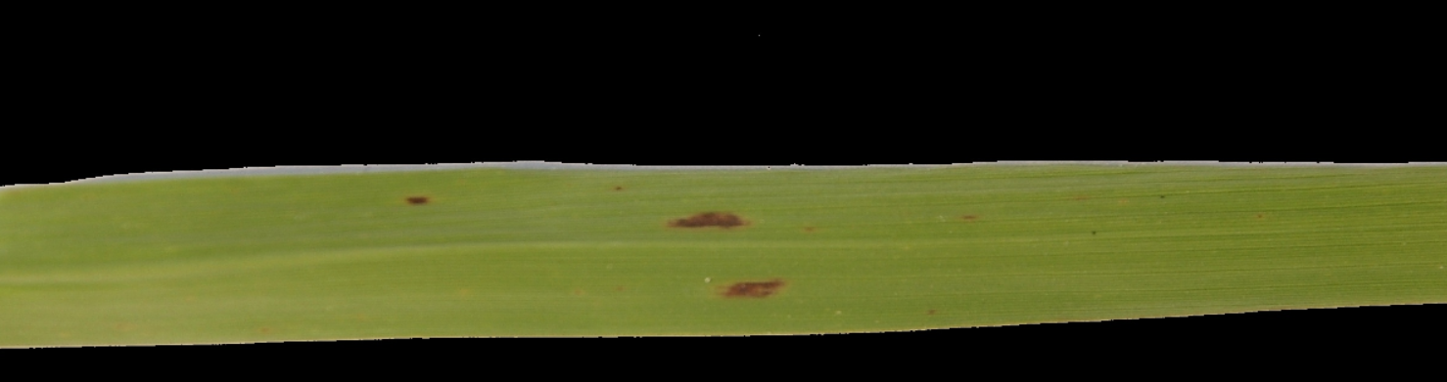
Toy CBIR test results (HCL + Bhatta example)
INPUT:
leaf_smut_8.jpg
Rank 3:
leaf_smut_0.jpg
Rank 1:
leaf_smut_8.jpg
Rank 4:
leaf_smut_14.jpg
Rank 5:
brown_spot_35.jpg
Rank 2:
leaf_smut_9.jpg

Slide 8
References
Main article
https://arxiv.org/ftp/arxiv/papers/2106/2106.10698.pdf
Other articles and information:
https://www.statista.com/statistics/1003455/most-produced-crops-and-livestock-products-worldwide/
https://www.mdpi.com/2309-608X/7/12/1095
https://www.pnas.org/doi/10.1073/pnas.2022239118#:~:text=Change%20History-,Abstract,poverty%20and%20improve%20health%20outcomes.
https://www.pnas.org/doi/10.1073/pnas.2022239118
https://arxiv.org/ftp/arxiv/papers/2106/2106.10698.pdf
https://www.ijarcce.com/upload/2016/march-16/IJARCCE%20257.pdf

