Slide 1
SFML
BY
Lucas Hasting, Mel Hart, Josh Jordan, Raiden Greene, Brandon Smith

Slide 2
WHAT DOES SFML STAND FOR
SIMPLE
AND FAST
MULTIMEDIA
LIBRARY

Slide 3
WHAT IS (SFML) ?
Simple and Fast Multimedia Library (SFML) is a cross-platform software development library. SFML is supposed to be to provide a simple (API) for developers to use to crate games.
SFML provides a simple interface to the various components of your PC, to ease the development of games and multimedia applications. It is composed of five modules: system, window, graphics, audio and network.
We used version 3.0.0

Slide 4
SFML consists of various modules:
System – provides building blocks used buy other modules that include 2D/3D vector classes, Unicode string handling, Cross-platform support for
Window –Manages application windows and user input. Handles: Opening, closing, and controlling windows. Windows also controls the mouse and keyboard
Graphics –Handles 2D /3D drawing with hardware acceleration . Drawing sprites, shapes and text.
Audio – Spatialized audio playback and recording
Network –supports networks communication using TCP

Slide 5
Modern C++ Background
A pointer is a variable that contains a memory address which contains a specific data type
Pointers are commonly used when allocating a variable onto the heap (dynamic allocation)
They must be deallocated (deleted) manually to avoid memory related bugs
Modern C++ makes use of smart pointers
Smart pointers have a destructor that allows the pointer to deallocate themselves

Slide 6
Modern C++ Background
Smart pointers are generic to the type
We specifically use a shared smart pointer which allows multiple variables to contain the same address
Initialization: std::shared_ptr<T> var = std::make_shared<T>();
Accessing the data in a pointer: *var
* is referred to as the dereference operator
var->attr is an operator with the following operation (*var).attr

Slide 7
Vectors and namespaces
std::vector<T> is a generic class in the C++ standard template library that works as a dynamic array
Namespace: a region of code (scope) with a given name
Example: vector<T> belongs to the std scope
using namespace <name space> allows the use of defined variables from that namespace implicitly
We implicitly use the sf namespace in all code and explicitly use the std namespace
The sf namespace is used for all SFML objects.

Slide 8
Compiling when using a module
g++ <program files> -lsfml-<module>
Tells the linker which module to include with the programs

Slide 9
Project Overview
https://github.com/LucasHasting/Fish

Slide 10
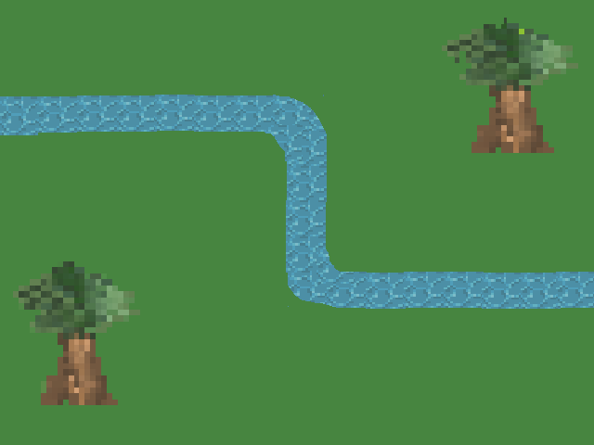
PROJECT DEMONSTRATION

Slide 11
Fish
We used SFML to program a game that we called Fish.
In this game you spend points to place cats by the river to catch fish.
The fish follow the river path as the cat sits by the river.

Slide 12
Components of the game
We included a main menu screen and two levels one can play.
The first level is field with trees and a river, the second level is in a volcano with a river of lava.
We made fish of various color and three different cats you can choose from

Slide 13


Slide 14
Modules

Slide 15
The System Module
The System module is broke up into three section
Handling angles and vector operations,
handling time,
User data streams.
We specifically use the Vector2 Object (really the child class Vector2f)
https://github.com/LucasHasting/Fish/blob/main/src/paths/Stage1.txt
https://github.com/LucasHasting/Fish/blob/main/src/rounds/Stage1/round1.txt

Slide 16
The Audio Module
Allows for 3D audio
Simple audio controls
Similar functions to normal files.

Slide 17
Making the Audio
Menu Music Stage 1 Stage 2
2 piano samples timbales timpani
River sample violins
Kalimba cello

Slide 18
How We Used It
Used the Music class in the audio module.
Opened music file with openFromFile.
Played the file with the play function.
Looped the music with the setlooping function.

Slide 19
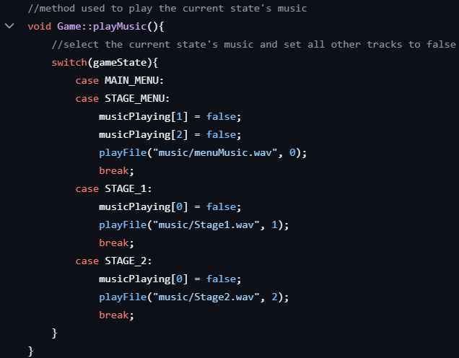
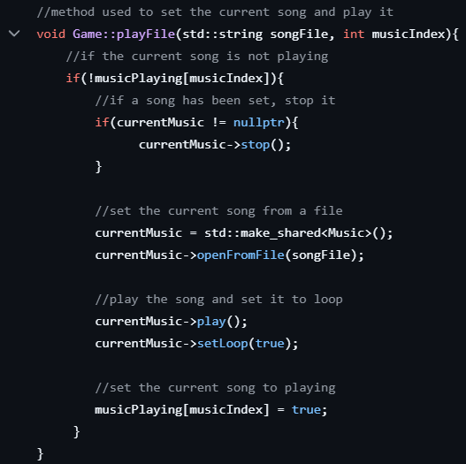
playMusic method
playFile method

Slide 20
Graphics Module
The graphics module deals with visuals and - you guessed it - graphics.
While SFML can create its own shapes, we created our own art
SFML allows you to insert your own images using sprite and textures.
Textures are basically the images you insert
Sprites are basically textured rectangles that encapsulate your image.
We put textures and sprites together in order to create the images

Slide 21
Graphics cont.
In the game we used a file named NewSprite to create a new Sprite.
This method automatically loads new sprites into a texture, without it SFML would deallocate the texture and we would lose the sprite.
Sprites can have three specifications
Position
Orientation
Scale

Slide 22
Graphics cont.
For the art we used a free website called Pixelart.com
This website allowed us to create pngs and backgrounds with specific dimensions.
32x32 for the pngs
640x480 for the backgrounds

Slide 23


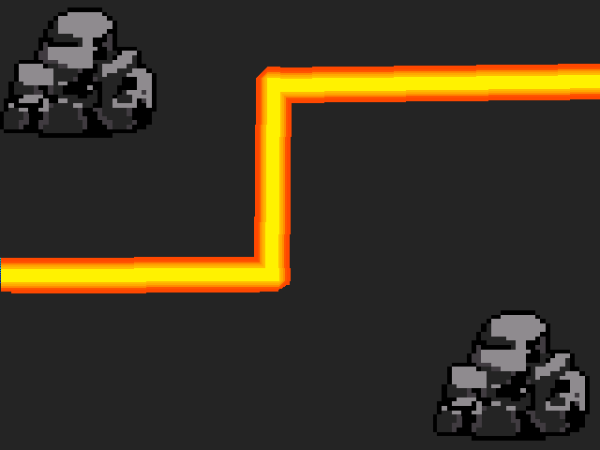
Art examples

Slide 24
Window Module
Provides OpenGL-based windows, and abstractions for events and input handling.
This includes interaction with external devices such as they keyboard and mouse
We specifically used the Mouse class to get the position of the mouse to see if it is within the boundary of a sprite (this results in a way to determine if a sprite was clicked).

Slide 25
Network Module
We did not make use of this module
Can easily create an HTTP and FTP client
Can be used to build packets and establish sockets
Supports both UDP and TCP and has a class to encapsulate an IPv4 address
Does not support IPv6

Slide 26
Wrapping Up

Slide 27
Pros
Easier than OpenGL
C++ Users will find it easy
It has wrappers for other languages

Slide 28
Cons
Downloading and getting it to work with both mac, windows, and vm debian was complicated
Is harder if you aren’t well versed in C++
SFML documentation can be incorrect or misleading

Slide 29
Games that have used SFML
SFML is primarily used for small indie games
Atom Zombie Smasher
Zloxx
Ovid the Owl
The Shooting of Isaac

Slide 30
WHO USES SFML?
SFML is primarily used by hobbyist game developers, small independent video game developers, and startup companies consisting of several developers at most.

Slide 31
Any Questions?

Slide 32
Sources
https://www.sfml-dev.org/documentation/2.5.1/modules.php (can be used to get to 3.0.0 modules)
https://www.sfml-dev.org/documentation/3.0.0/annotated.html
https://en.cppreference.com/w/cpp/memory/shared_ptr
https://cplusplus.com/reference/stl/
https://learn.microsoft.com/en-us/cpp/cpp/namespaces-cpp?view=msvc-170#:~:text=A%20namespace%20is%20a%20declarative,code%20base%20includes%20multiple%20libraries.
https://stackoverflow.com/questions/34129141/what-does-using-namespace-do-exactly
https://www.indiedb.com/engines/sfml/games

