Slide 1


Door Lucas Hilgevoord & Troy Toendang
GD2A

Slide 2





Het Concept
100

Slide 3
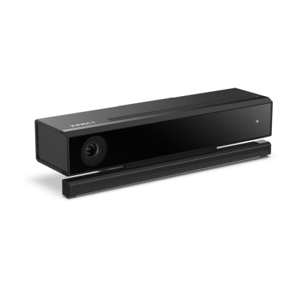
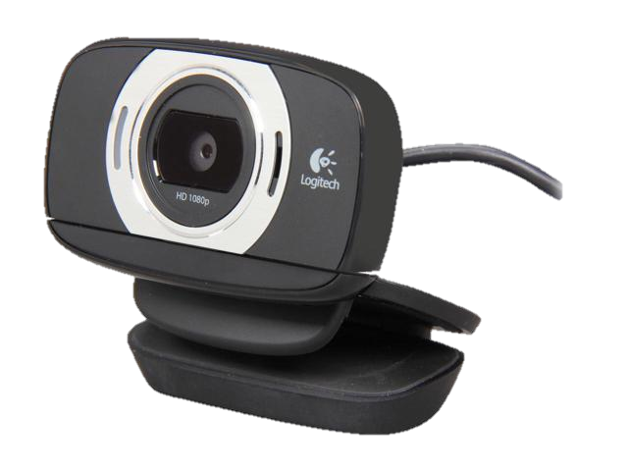
Technologieën
-=Engines=-
Prosessing (Javascript
Unity (C#
Unreal (C++
-=Overige software=-
Microsoft Kinect SDK
Github
-=Hardware=-
Xbox 360 Kinect
Kinect adapter
PC
Camera/Webcam
Tv Screen

Slide 4

De game

Slide 5
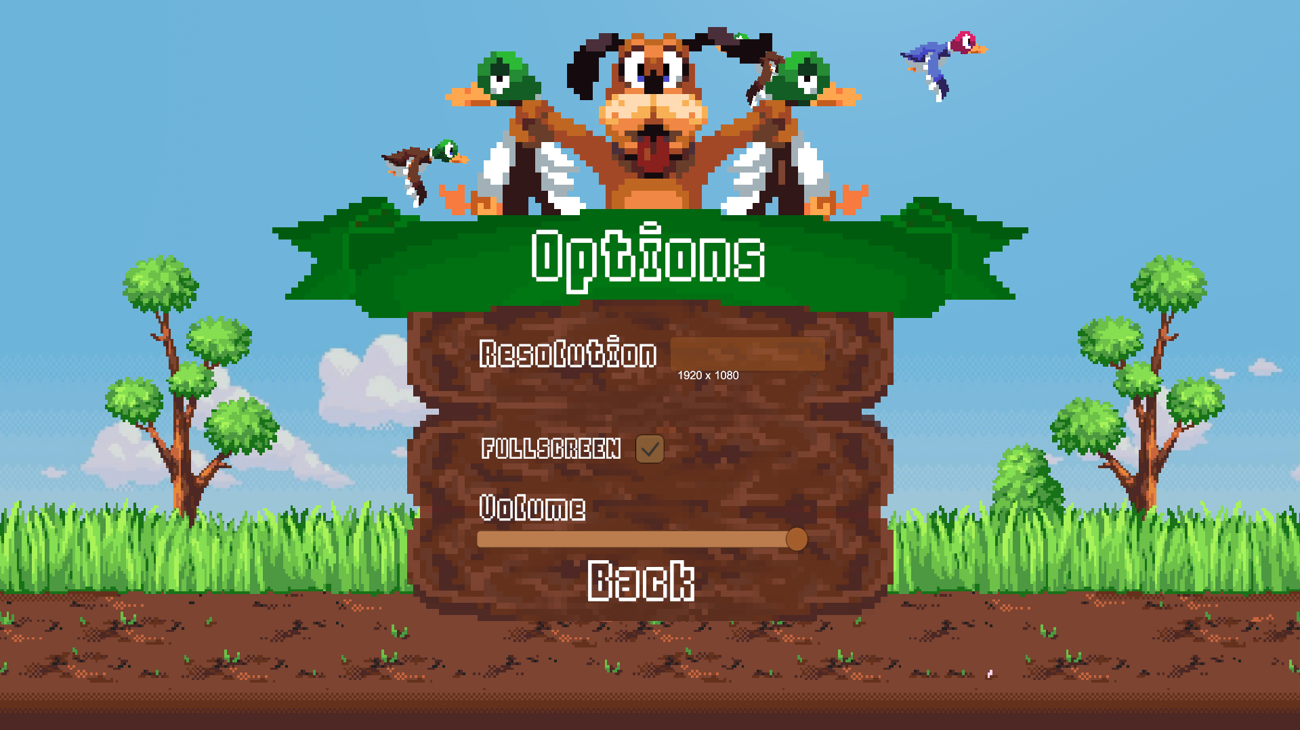
Main menu

Slide 6
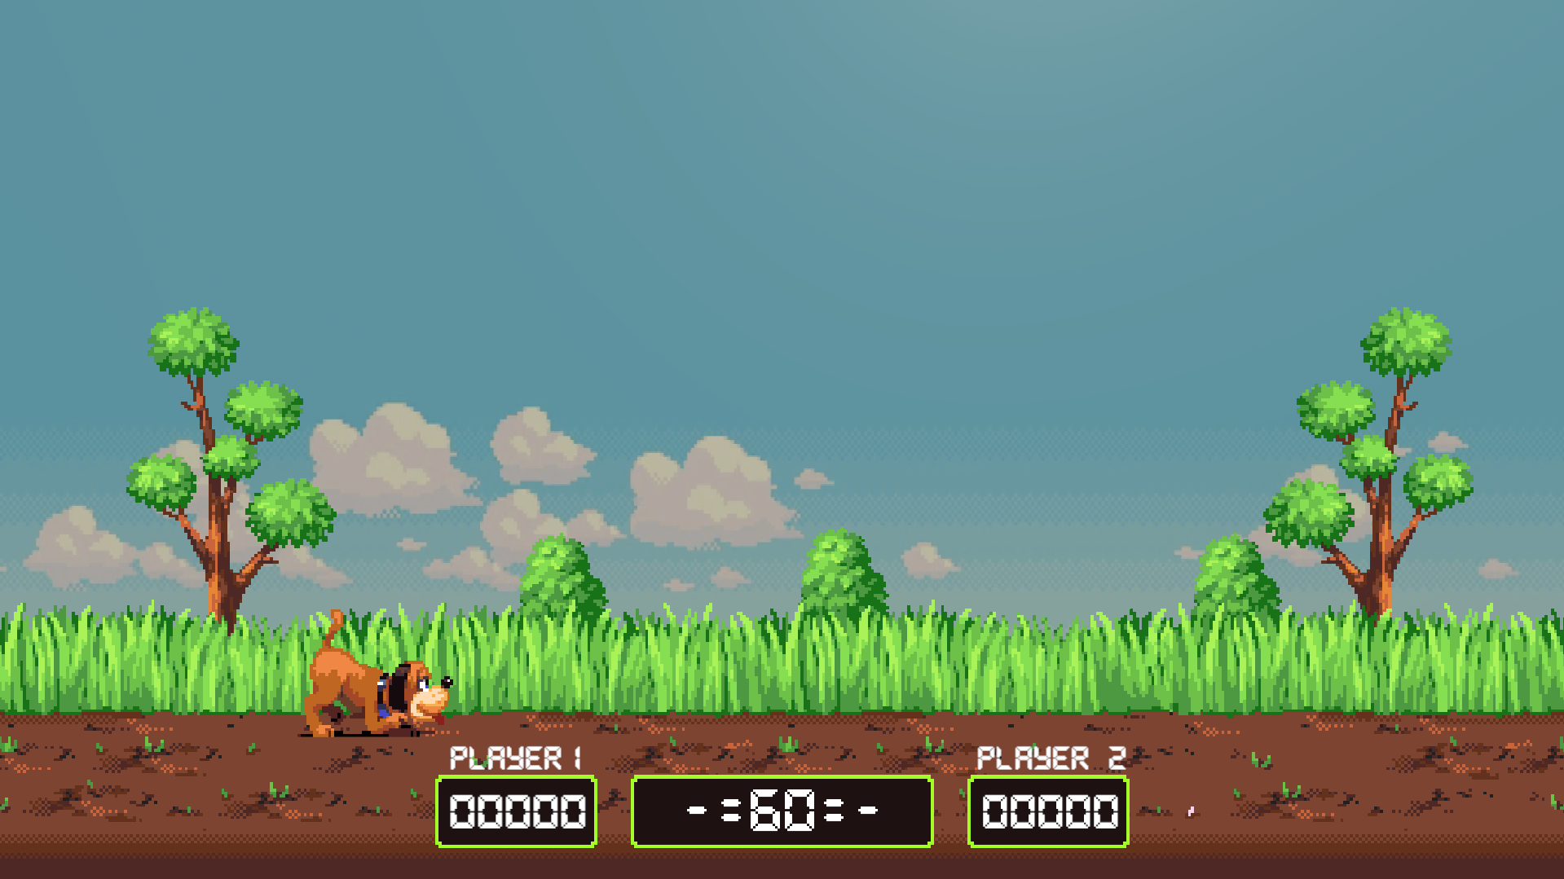
Begin game

Slide 7
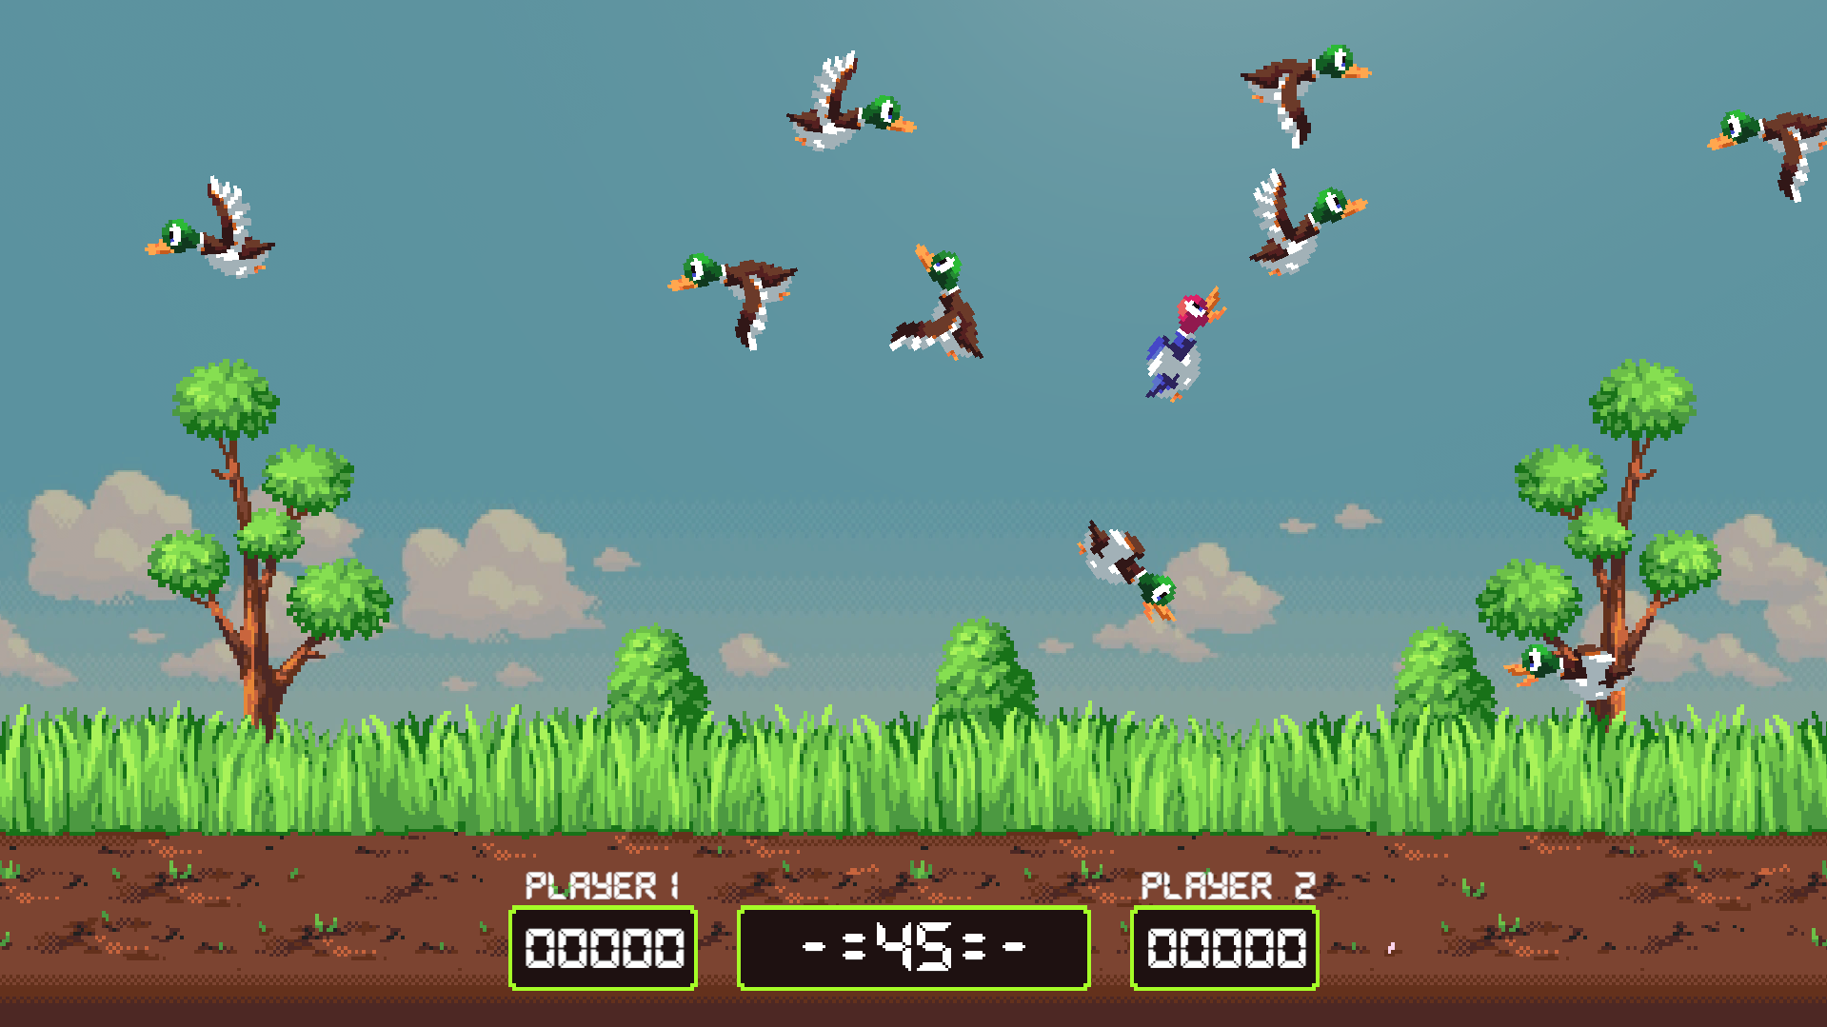
Mid game

Slide 8

End Game

Slide 9
Einde

