Slide 1

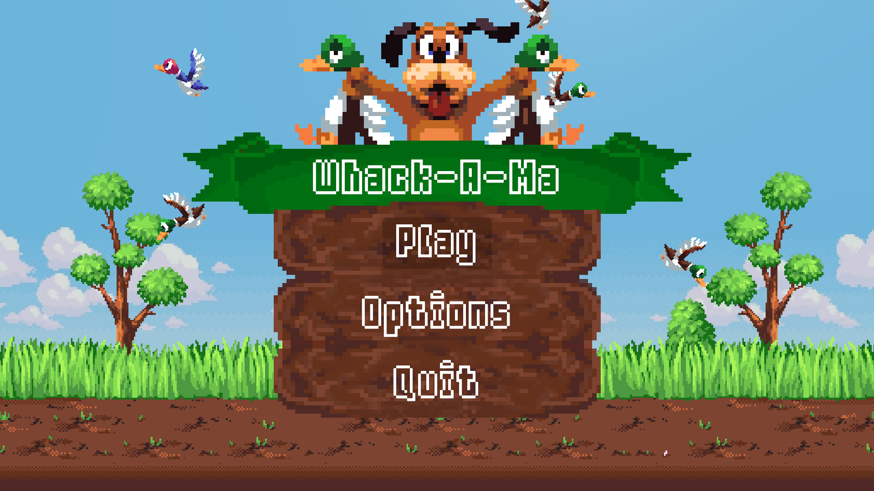
Door Lucas Hilgevoord & Troy Toendang
GD2A

Slide 2
Scrum
-=Google Drive=-
https://goo.gl/crfH1W
-=Trello=-
https://trello.com/b/vVQ1XhPd/whack-a-ma
-=Github=-
https://github.com/Troy2000/ProjectGamelab

Slide 3





Het Concept
100

Slide 4


Technologieën
-=Engines=-
Prosessing (Javascript
Unity (C#
Unreal (C++
-=Overige software=-
Microsoft Kinect SDK
Github
-=Hardware=-
Xbox 360 Kinect
Kinect adapter
PC
Camera/Webcam
Tv Screen

Slide 5

De game

Slide 6
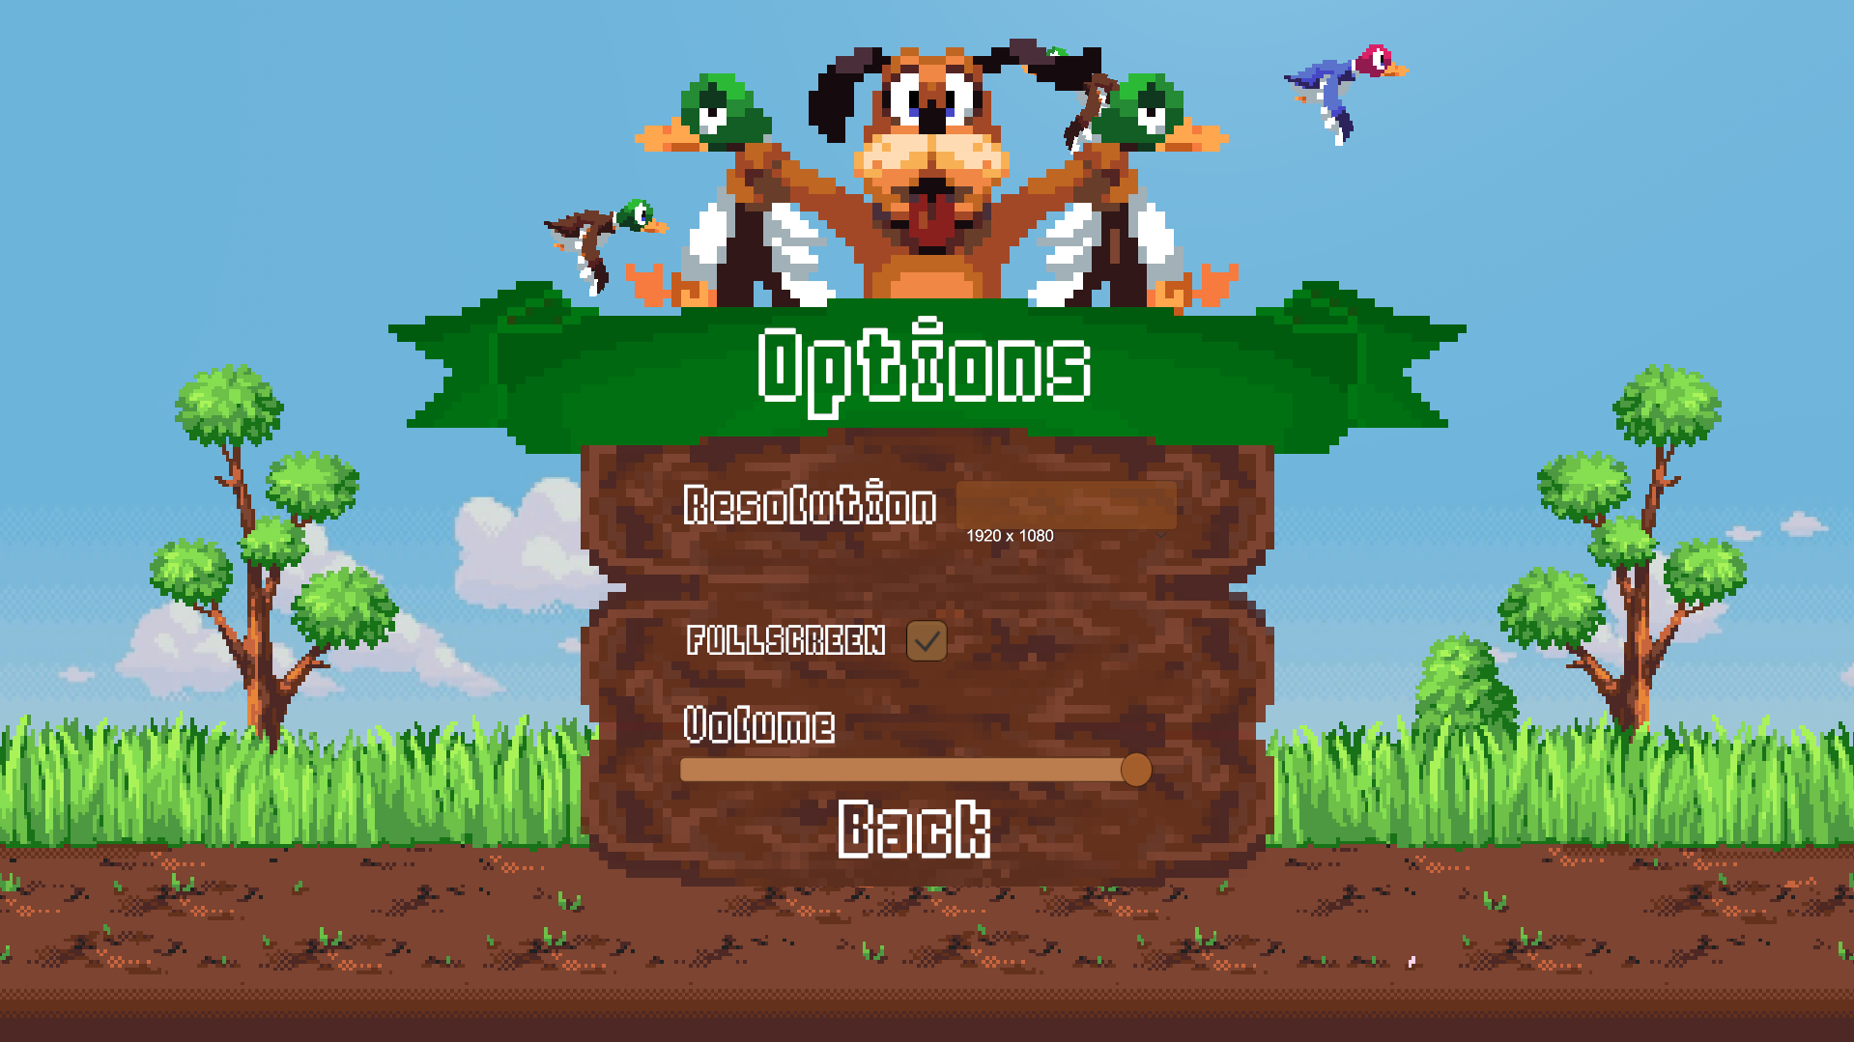
Main menu

Slide 7
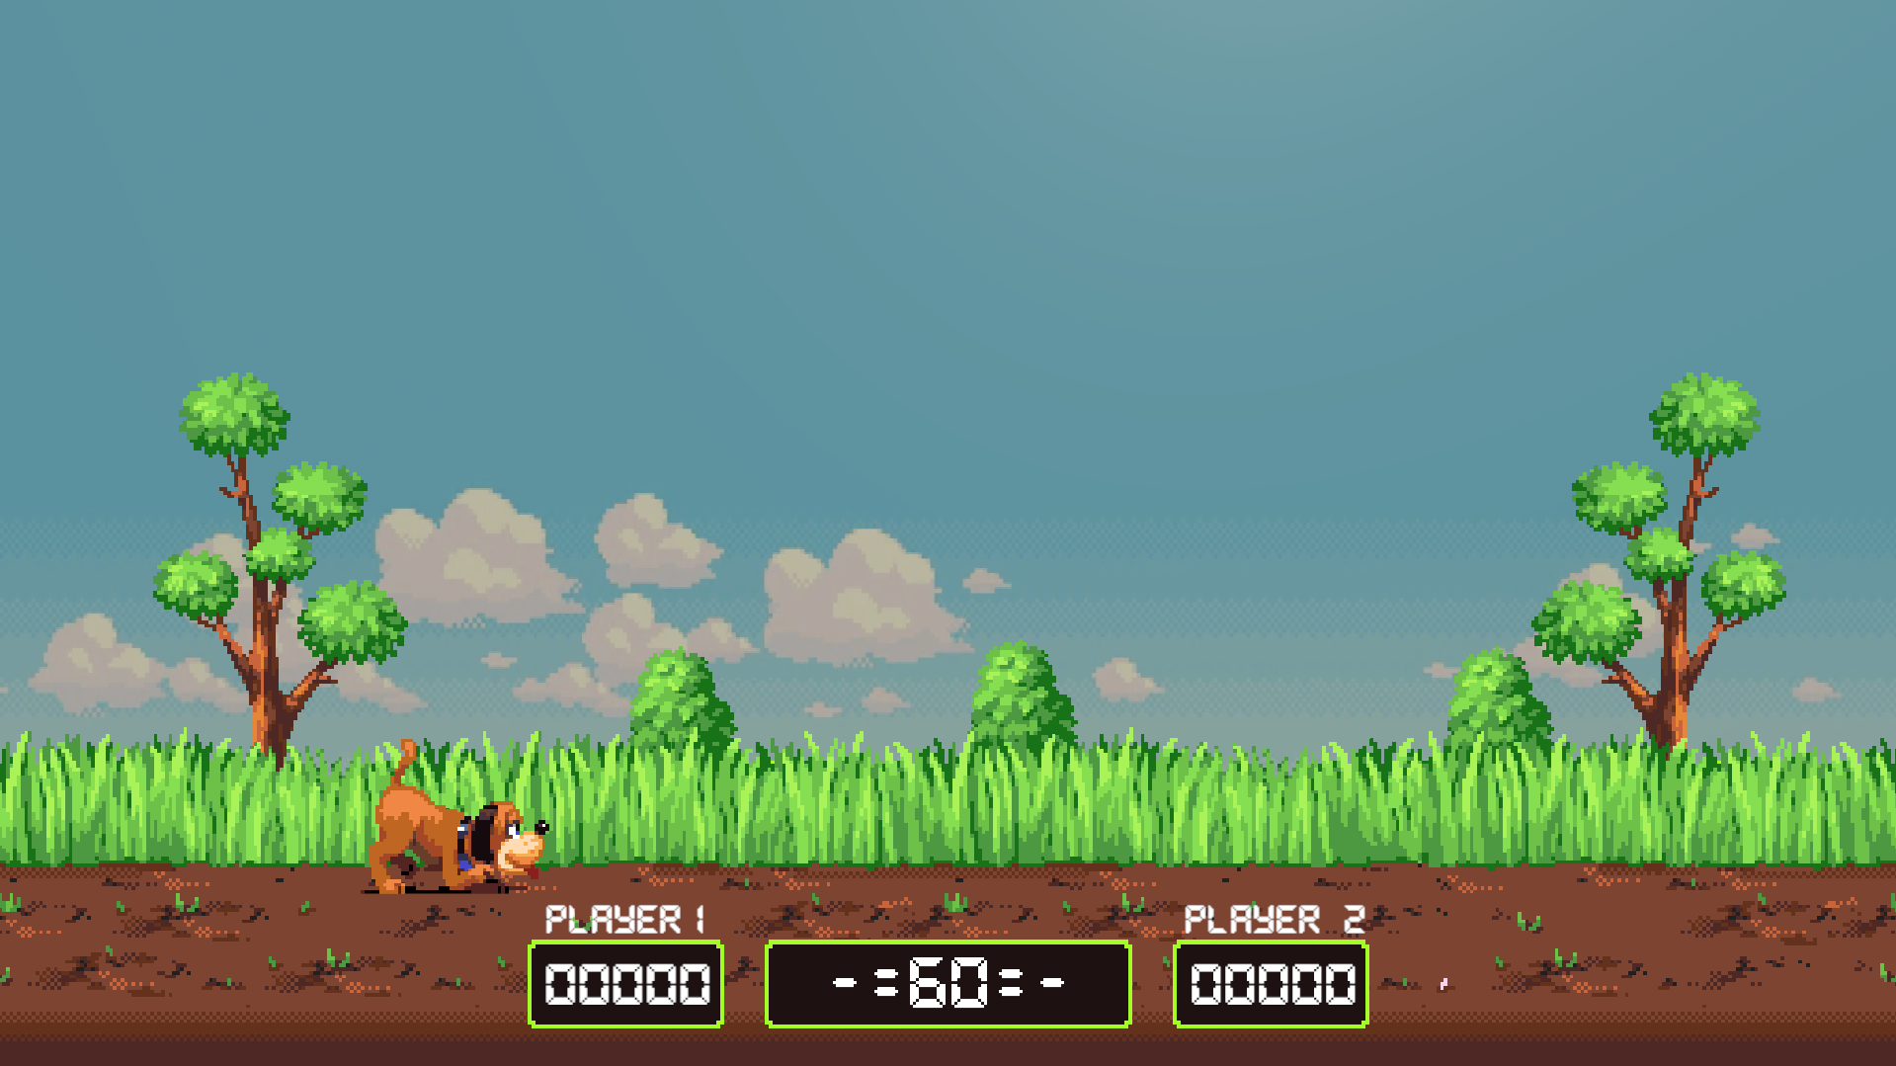
Begin game

Slide 8

Mid game

Slide 9

End Game

Slide 10
Einde

