Slide 1



Which Markets to Play In?
A tool for Entrepreneurs and Innovators
Assignment 3: Design your Agile Focus Strategy
Instructions:
Enter the title of
your project / start-up
and your name here
My Project/ start-up
My Name

Slide 2
Assignment 3: Design your Agile Focus Strategy
Background: Market Opportunity Set and Attractiveness Map
Instructions:
As a background, give a short overview of your project/ venture, and
describe briefly the opportunities in your set and their location on the Attractiveness Map
Present here shortly your project and your set of market opportunities

Slide 3
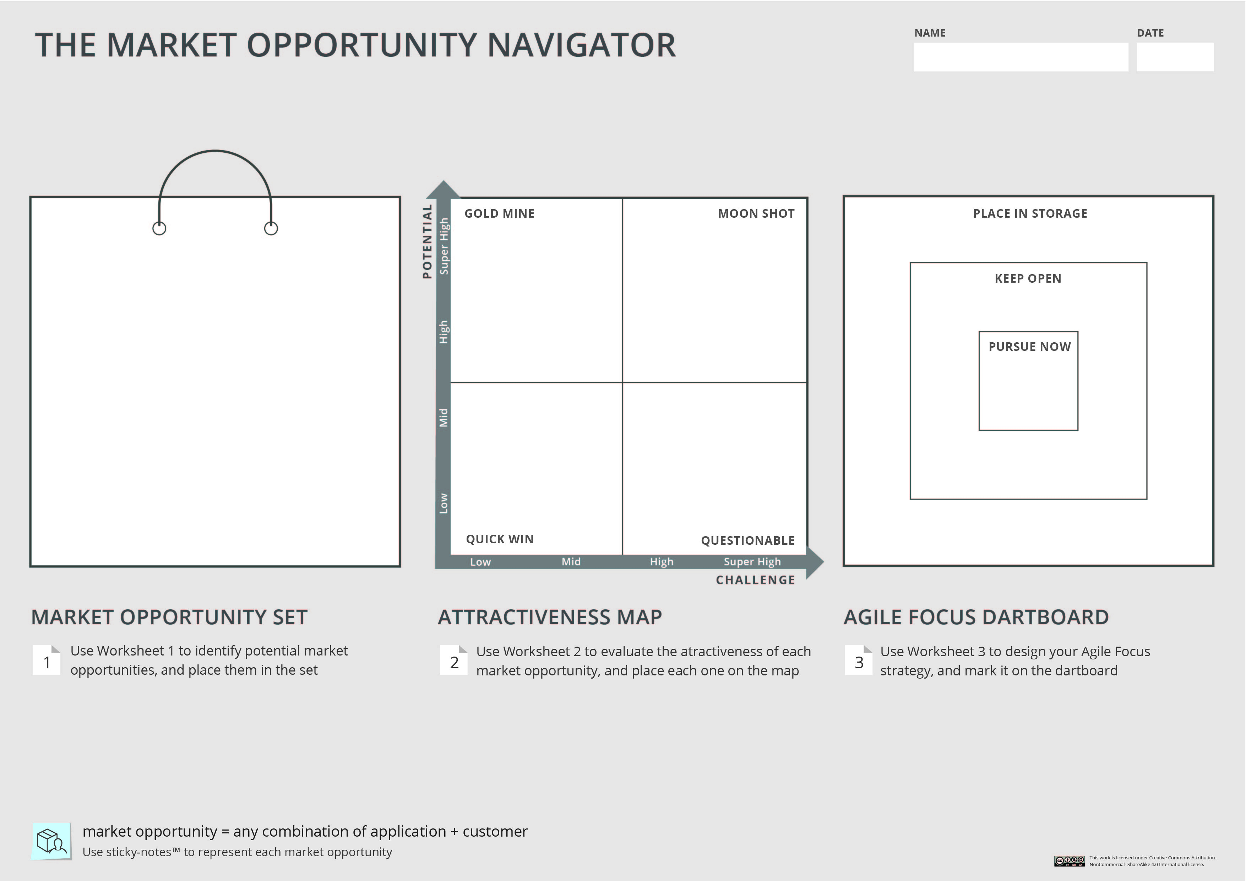
Instructions:
As a background , depict your Market Opportunity Set and your Attractiveness Map on the Navigator. You can copy the relevant slide from Assignment 2.
Your project/ startup

Slide 4
Assignment 3: Design your Agile Focus Strategy
Choosing your Primary Market Opportunity
Describe here shortly how you chose your Primary Market Opportunity
Instructions:
Begin with choosing your Primary Market Opportunity.
Explain which option will be your main focus and why you chose it.

Slide 5
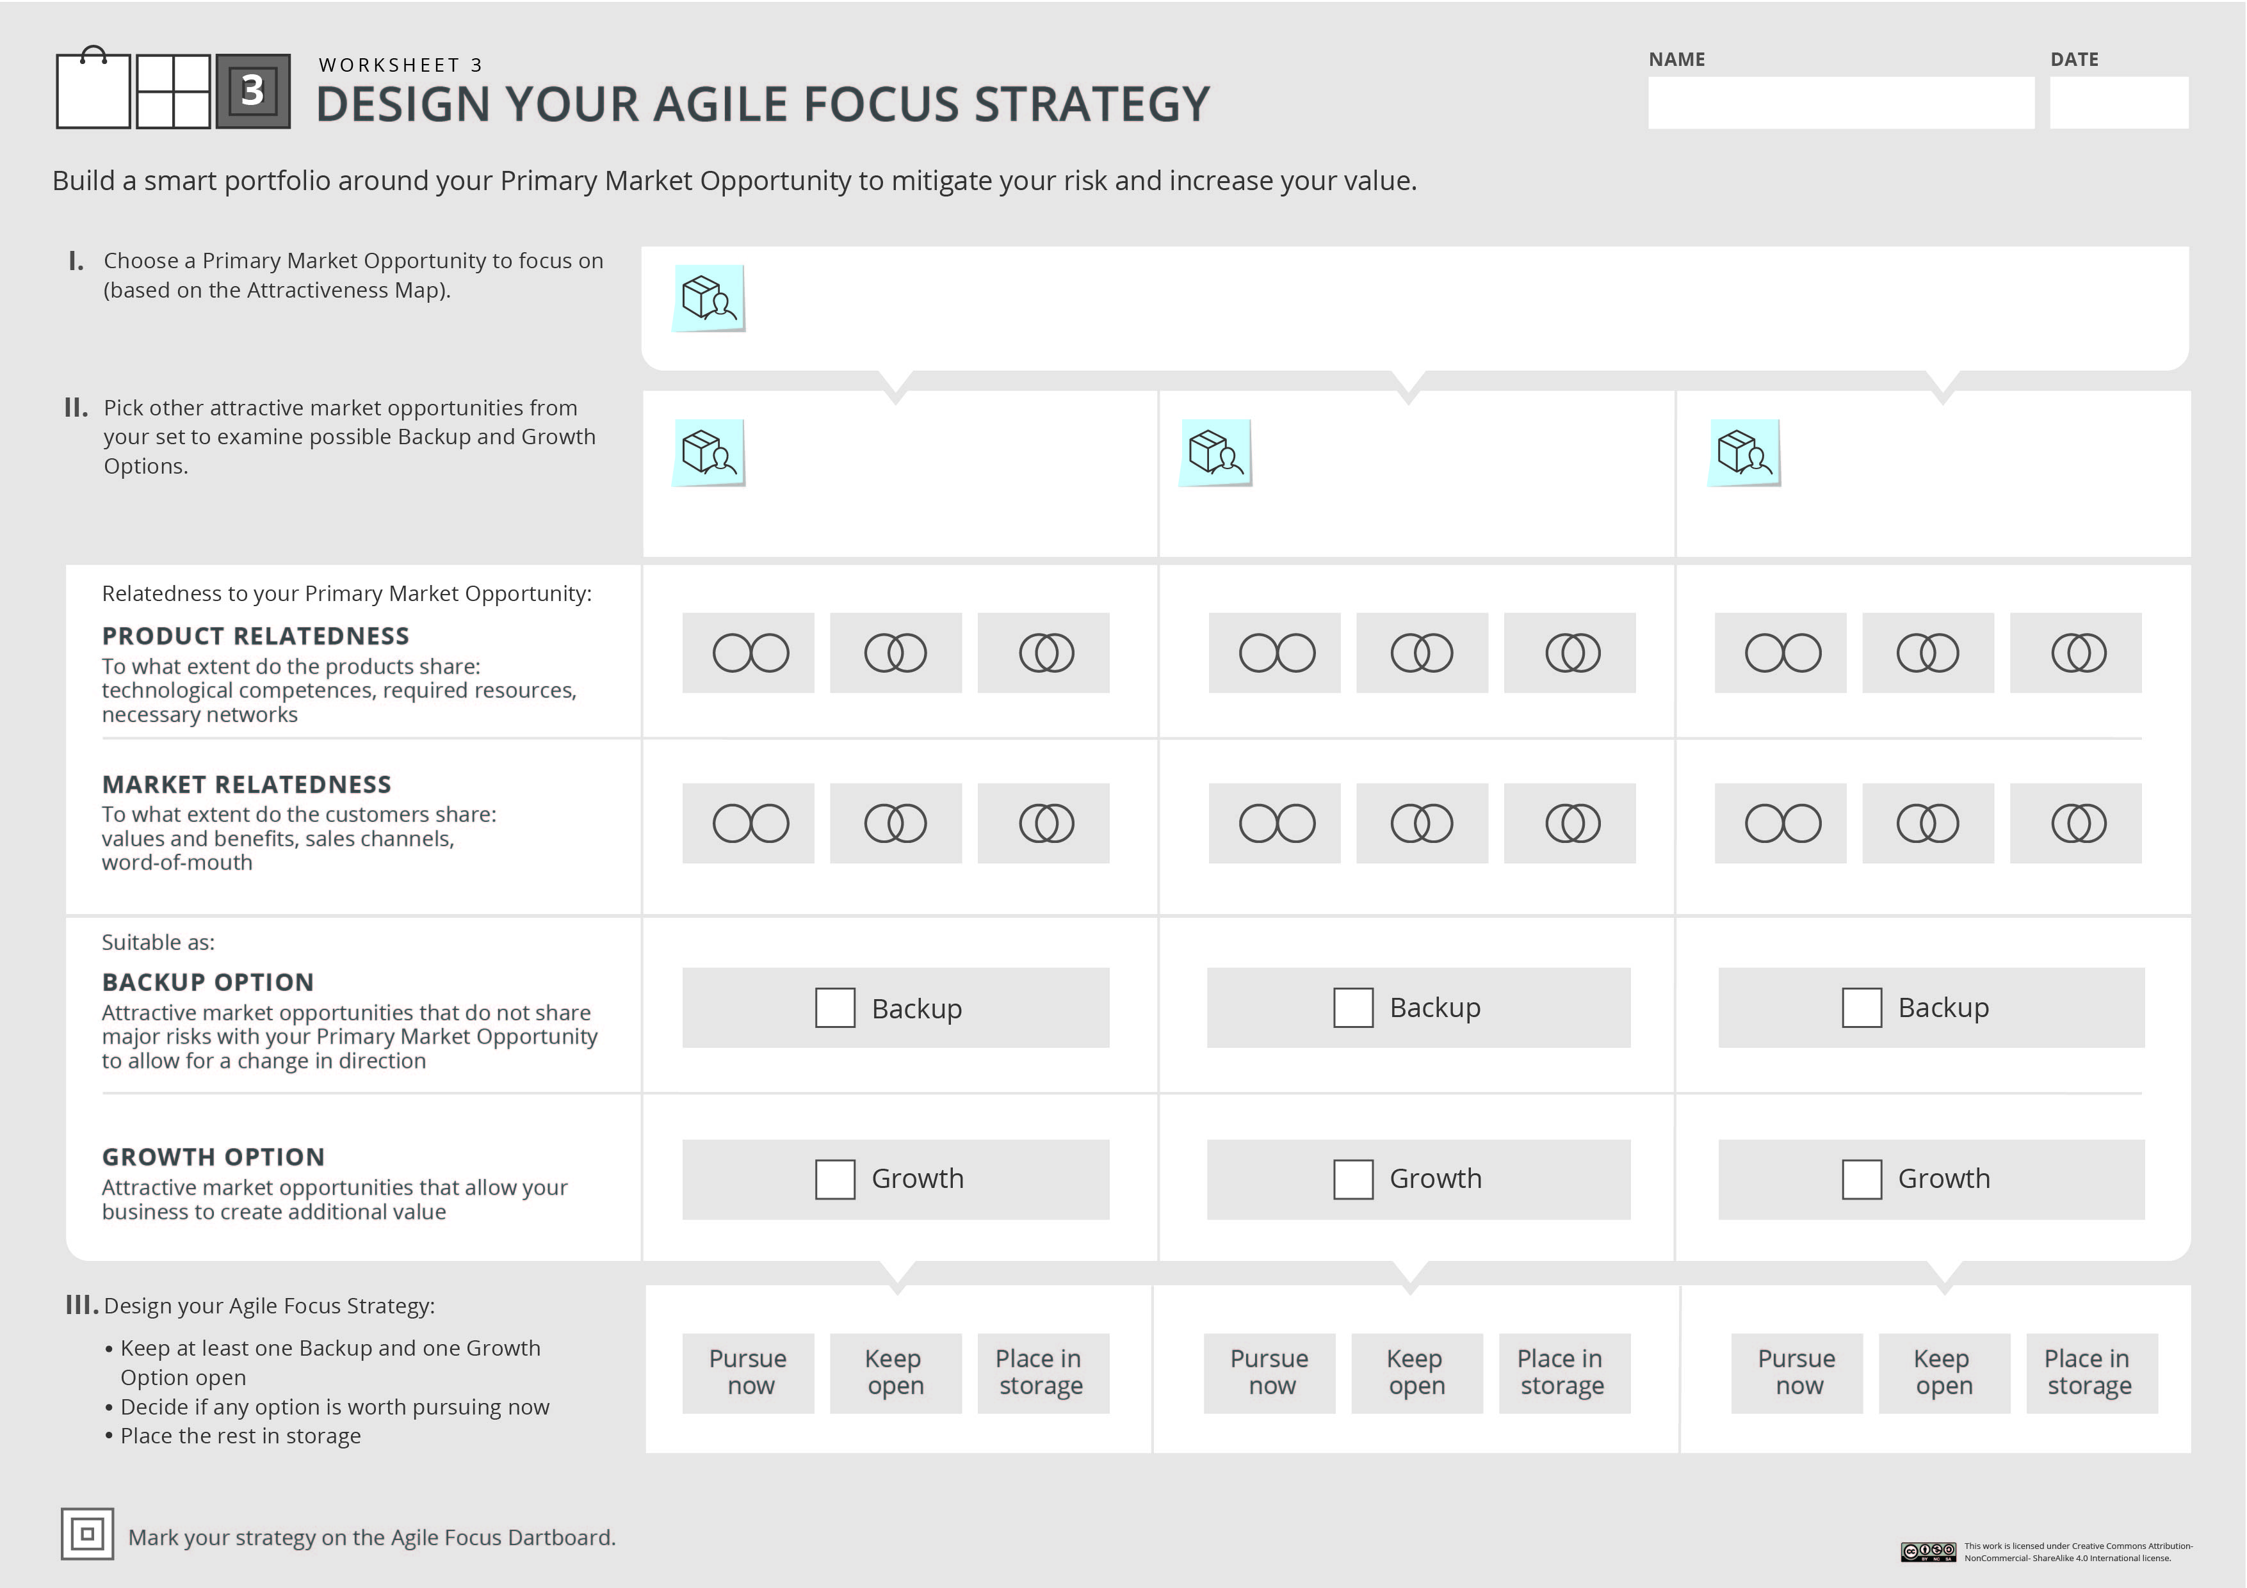


Your project/ startup
Instructions:
Fill in Worksheet 3: list your primary opportunity, and examine possible candidates for backup and growth. Make sure to keep at least on backup and one growth option open.
If you wish to consider more than 3 options, use an additional worksheet.
You can use the circles and V signs below to mark your analysis.

Slide 6
Assignment 3: Design your Agile Focus Strategy
Building a smart portfolio
Describe here shortly your backup and growth options
Instructions:
Describe shortly which opportunities you chose as backup and growth options, and explain why.

Slide 7
Instructions:
Fill out the last step of the Navigator- depict your Agile Focus Strategy on the Agile Focus Dartboard.
You can use the sticky notes below.
Your project/ startup
Congrats! you now have the full Navigator at your disposal. If you are working on a real project, date and save this Navigator for future tracking and updating.

Slide 8
Assignment 3: Design your Agile Focus Strategy
The Agile Focus Strategy
Instructions:
To summarize, explain your Agile Focus Strategy and how do you plan to apply it in your venture.
Summarize here shortly your Agile Focus Strategy
Once you are done, please save your work in a PDF format, and upload it under Assignment 3

