Slide 1



Which Markets to Play In?
A tool for Entrepreneurs and Innovators
Assignment 2: Creating your Attractiveness Map
Instructions:
Enter the title of
your project / start-up
and your name here
My Project/ start-up
My Name

Slide 2
Assignment 2: Creating your Market Opportunity Set
Background: Market Opportunity Set
Instructions:
As a background, give a short overview of your project/ venture, and
describe briefly the 3-5 options in your Market Opportunity Set
Present your project and your Market Opportunity Set shortly here
When describing each market opportunity, explain what is the application and who are the customers

Slide 3
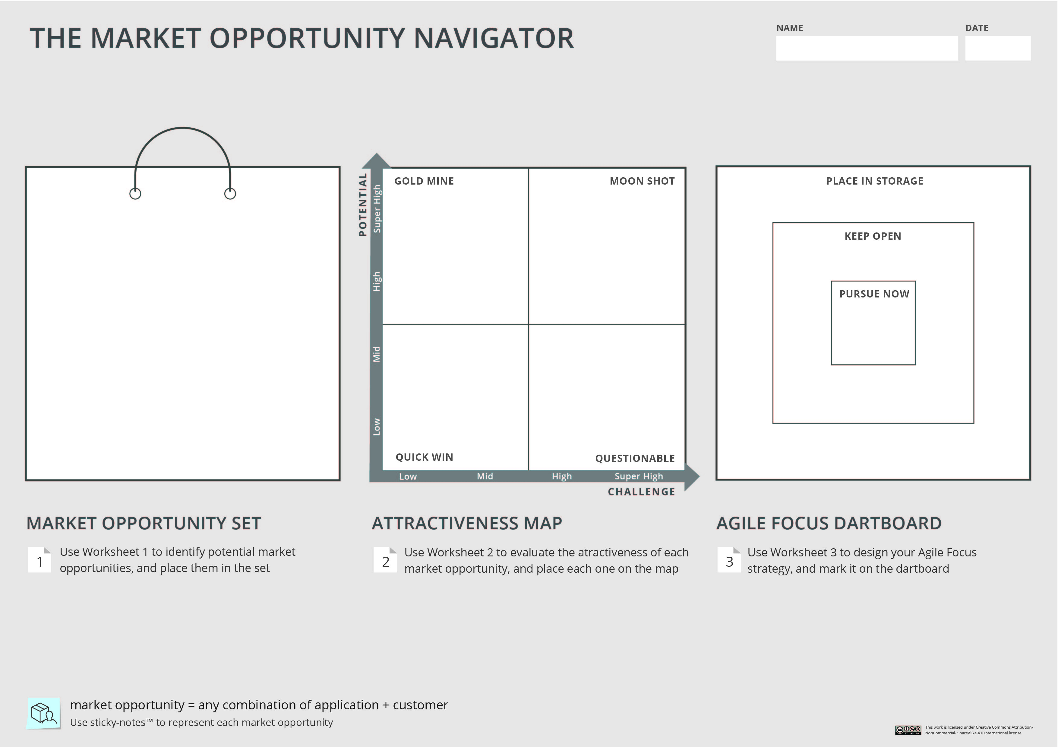
Instructions:
Depict your Market Opportunity Set on the Navigator.
You can copy the relevant slide form Assignment 1
Your project/ startup

Slide 4
Assignment 2: Creating your Market Opportunity Set
Evaluating Market Opportunity #1
Enter here the name of this market opportunity
Instructions:
Summarize here shortly what are your key considerations in evaluating the potential of this opportunity, and what is the overall potential score
Potential- key considerations and overall score:
Instructions:
Summarize here shortly what are your key considerations in evaluating the challenge of this opportunity, and what is the overall challenge score
Challenge- key considerations and overall score:

Slide 5
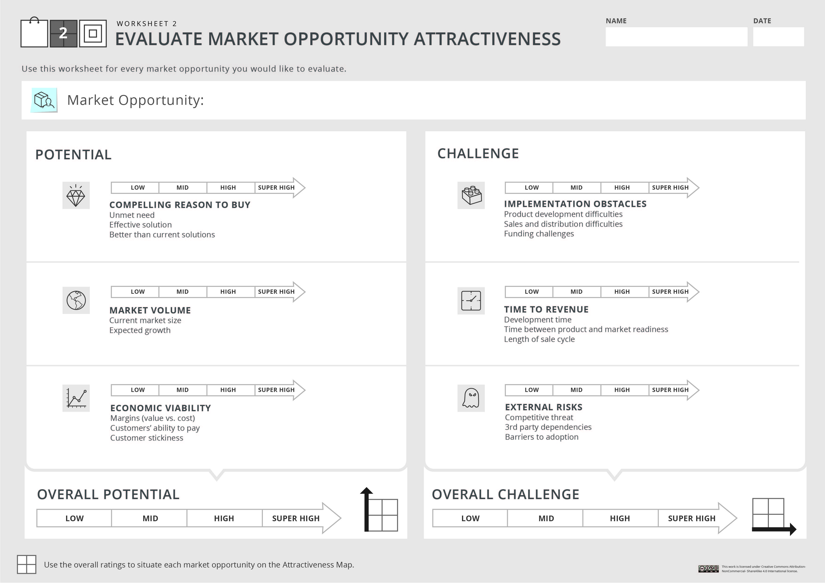

Your project/ startup
Instructions:
Fill in Worksheet 2 -
Evaluate carefully each of these factors, and score your opportunity accordingly. You can use the X signs below to mark your scores.
Market opportunity #1
After you feel comfortable with scoring the overall potential and the overall challenge, you can place this market opportunity on the Attractiveness Map

Slide 6
Assignment 2: Creating your Market Opportunity Set
Evaluating Market Opportunity #2
Instructions:
Follow the same process for market opportunity #2.
Enter here the name of this market opportunity
Potential- key considerations and overall score:
Challenge- key considerations and overall score:

Slide 7
Your project/ startup
Instructions:
Fill in Worksheet 2 for market opportunity #2
Market opportunity #2

Slide 8
Assignment 2: Creating your Market Opportunity Set
Evaluating Market Opportunity #3
Instructions:
Follow the same process for market opportunity #3.
Enter here the name of this market opportunity
Potential- key considerations and overall score:
Challenge- key considerations and overall score:

Slide 9
Your project/ startup
Instructions:
Fill in Worksheet 2 for market opportunity #3
Market opportunity #3

Slide 10
Assignment 2: Creating your Market Opportunity Set
Evaluating Market Opportunity #4
Instructions:
If you have more than 3 market opportunities in your set, follow the same process for market opportunity #4.
If not- delete slides 10-13
Enter here the name of this market opportunity
Potential- key considerations and overall score:
Challenge- key considerations and overall score:

Slide 11
Your project/ startup
Instructions:
If applicable,
fill in Worksheet 2 for market opportunity #4
Market opportunity #4

Slide 12
Assignment 2: Creating your Market Opportunity Set
Evaluating Market Opportunity #5
Instructions:
If you have more than 4 market opportunities in your set, follow the same process for market opportunity #5.
If not- delete slides 12-13
Enter here the name of this market opportunity
Potential- key considerations and overall score:
Challenge- key considerations and overall score:

Slide 13
Your project/ startup
Instructions:
If applicable,
fill in Worksheet 2 for market opportunity #5
Market opportunity #5

Slide 14
Instructions:
Depict your market opportunities on the Attractiveness Map, based on their overall potential and challenge. You can use the sticky notes below.
Your project/ startup

Slide 15
Assignment 2: Creating your Market Opportunity Set
Analyzing the Attractiveness Map
Instructions:
Examine your Attractiveness Map carefully and shortly describe what can you learn from it: how are your options spread? is there a superior opportunity? Etc.
Explain here shortly what can you learn from your Attractiveness Map
Once you are done, please save your work in a PDF format, and upload it under Assignment 2

