Slide 1



Which Markets to Play In?
A tool for Entrepreneurs and Innovators
Assignment 1: Generating your Market Opportunity Set
Instructions:
Enter the title of
your project / start-up
and your name here
My Project/ start-up
My Name

Slide 2
Assignment 1: Generating your Market Opportunity Set
De-linking my unique abilities/ core technologies
Instructions:
Give a short overview of your project/ venture.
Describe shortly and in simple words what type of unique abilities or core technologies do you possess.
Explain your abilities shortly here
Based on this description, you will then fill the
upper part of
Worksheet 1.

Slide 3
Assignment 1: Generating your Market Opportunity Set
Re-linking my unique abilities/ core technologies
Instructions:
Describe here shortly and in simple words what type of applications can be created with your abilities, and who are the different customers that may need it.
Explain your applications and possible customers here
Based on this description, you will then fill the bottom part of
Worksheet 1.

Slide 4
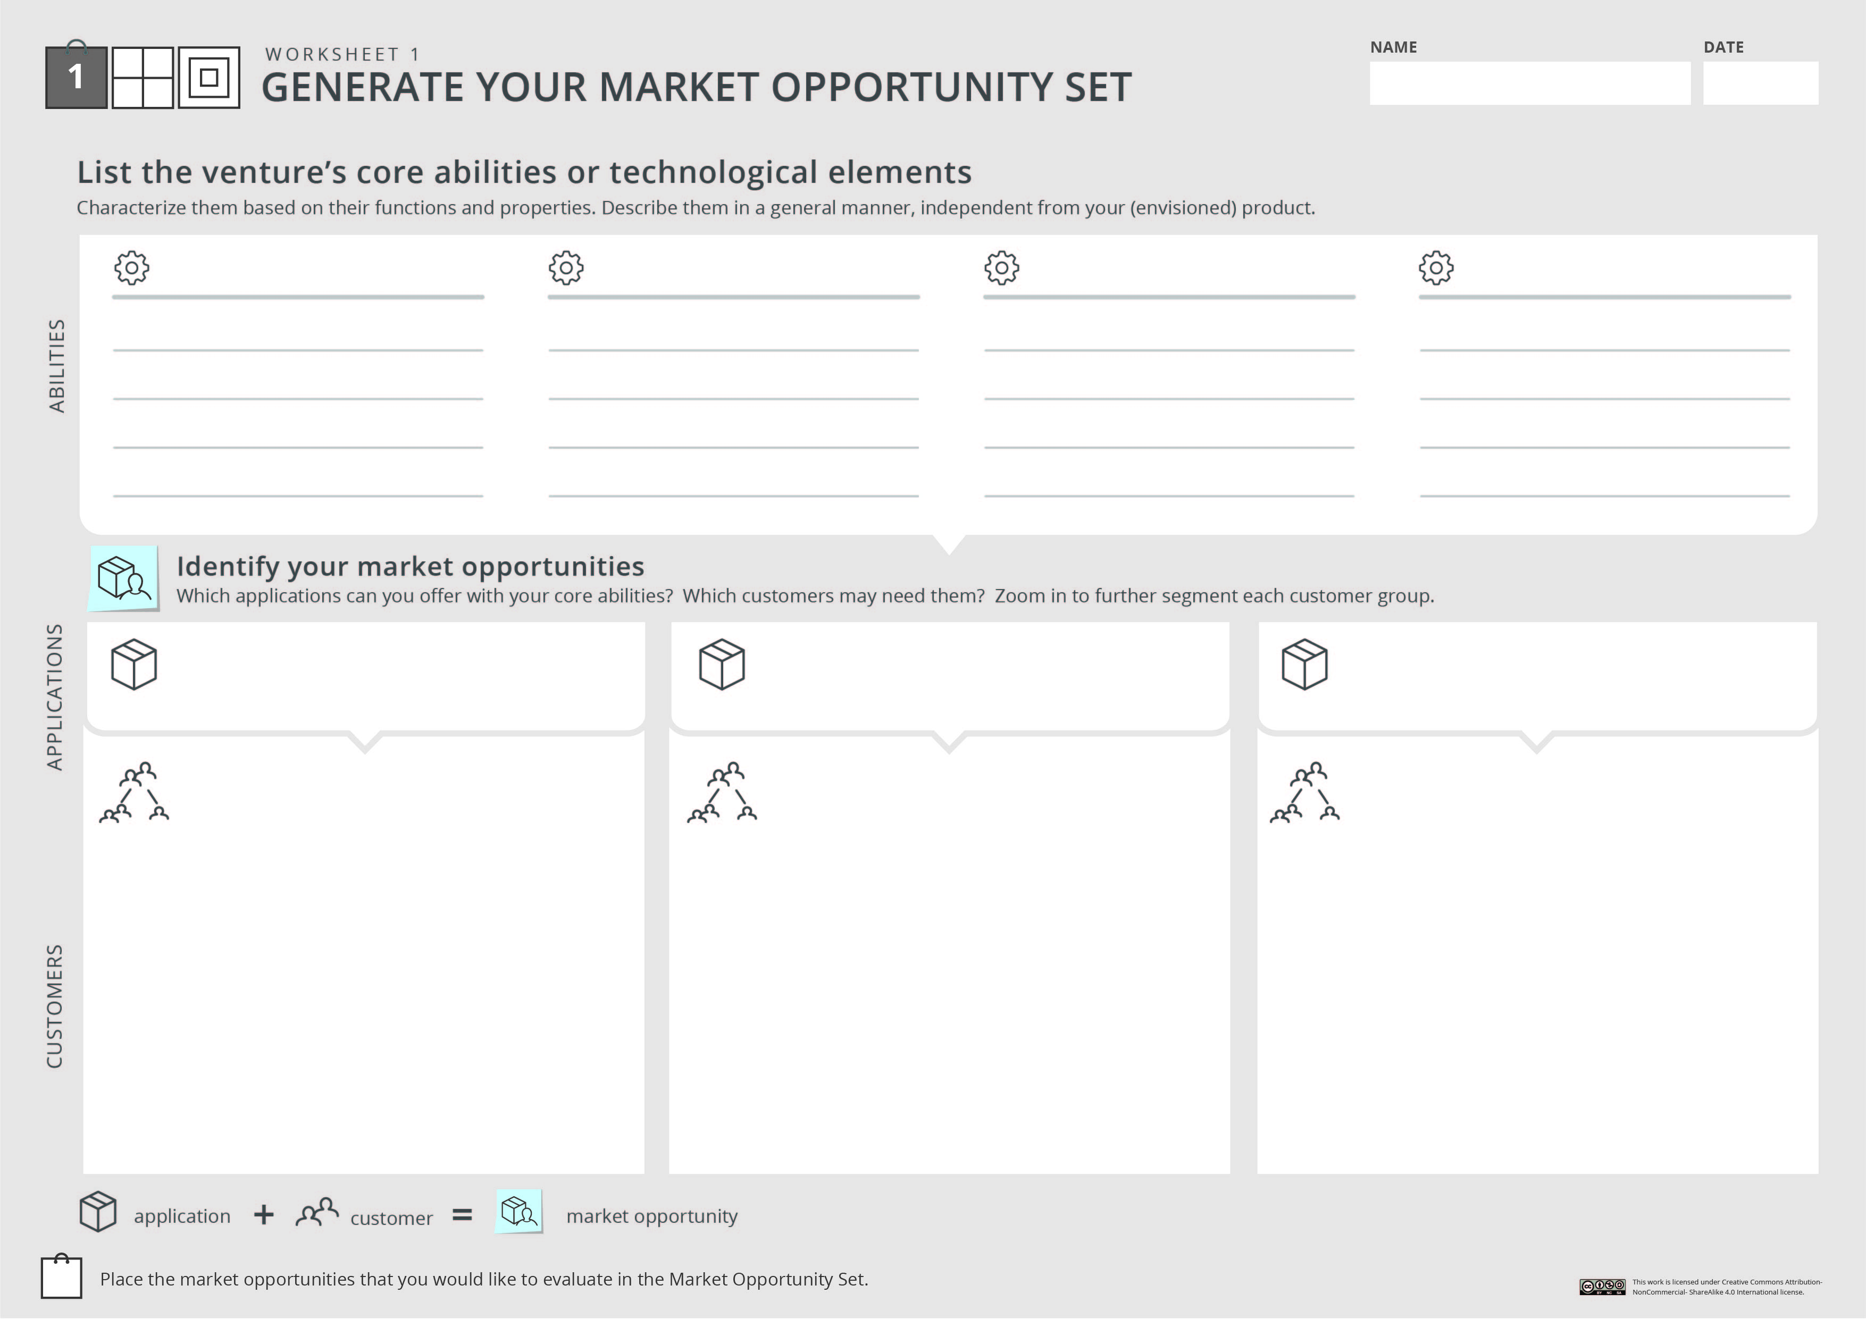

Your project/ startup
Instructions:
Fill in Worksheet 1 : list your unique abilities, the applications that can be created with them, and the different customers who may need these applications. Be creative and unconstrained!
Unique ability #1
Unique ability #2
Unique ability #3
Unique ability #4
Functions and properties
Functions and properties
Functions and properties
Functions and properties
You don’t need to use all the designated text boxes. We created them to help you fill this worksheet.
On the other hand- if you need more space- feel free to use an additional worksheet.
Application #1
Application #2
Application #3
After applying initial screening questions, you can use the circles below to mark the opportunities that are worth considering. They will create your Market Opportunity Set
Customer segment
Customer segment
Customer segment
Sub segment
Sub segment
….
Sub segment
Sub segment
Sub segment
Sub segment
Customer segment
Sub segment
Sub segment

Slide 5
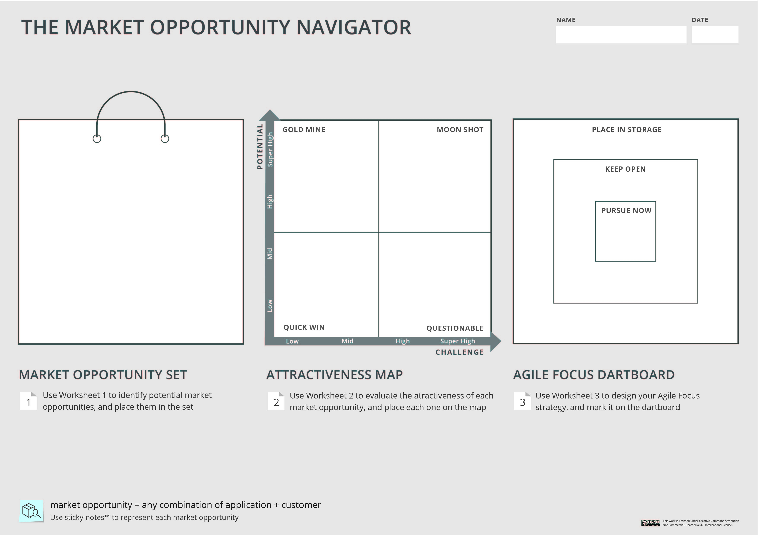
Instructions:
Choose 3-5 market opportunity that you want to further consider and depict them in your Market Opportunity Set. You can use the sticky notes below
Your project/ startup
When you label your options, remember that a market opportunity
is a combination of application & customers

Slide 6
Assignment 1: Generating your Market Opportunity Set
Generating your Market Opportunity Set
Instructions:
Apply the initial screening questions to shortly explain how you chose the 3-5 opportunities that create your Market Opportunity Set
Explain here why you chose the 3-5 market opportunities in your set
Once you are done, please save your work in a PDF format, and upload it under Assignment 1

