Slide 1
Gene State Table
Aim: Classify each gene in one of 5 categories
Active
  Active (no-variant genes)
  Variant Active
  Variant Semiactive (vairant genes with an intermediate state)
Inactive
  Inactive (no-variant genes)
  Variant Repressed
Not-Settable

Slide 2
Data
Microarray Data
  Red Signal: Average between the two highest -> Percentiles
  Area FC: Time interval (left,mid,right,sides) with max. Difference.
RNA-Seq Data
  4 Datasets (Otto et.al., Hoeijmakers et.al., Toenhake et.al., Bartfai et.al.)
  Uniquely mapped (scaled) reads.
  First column with max val among timepoints → Percentiles
  Average Percentile

Slide 3
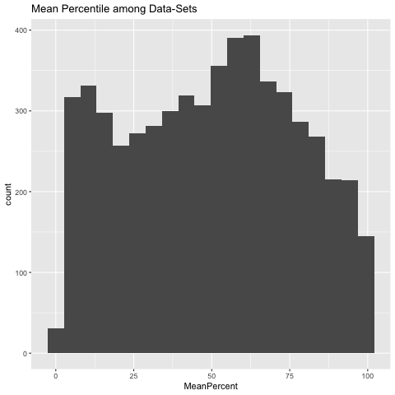
RNA-Seq: Averaged Percentile distribution

Slide 4
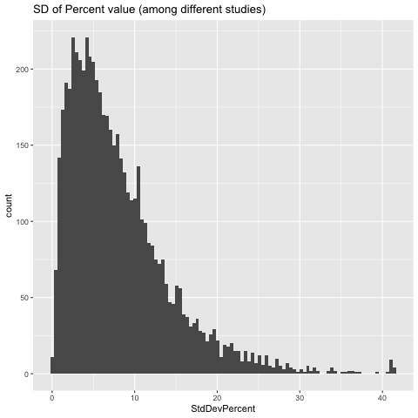
RNA-Seq: Averaged Percentile SD

Slide 5
Relative Expression
Min Area Val
Max Area Val
1/3
1/3
Min | Mid | Max
Gene (min)

Slide 6
Classification
RNA-Seq
  RNA-Seq mean percentile: 25%
Red Signal
  Red Signal Mean Percentile : 25%
  Red Signal Percentile for "rescuing": 40%
  Red Signal Percentile for "downgrading": 15%
Fold Change
  Area log2 Fold-Change: 1
  Red Signal Percentile Difference: 30%

Slide 7
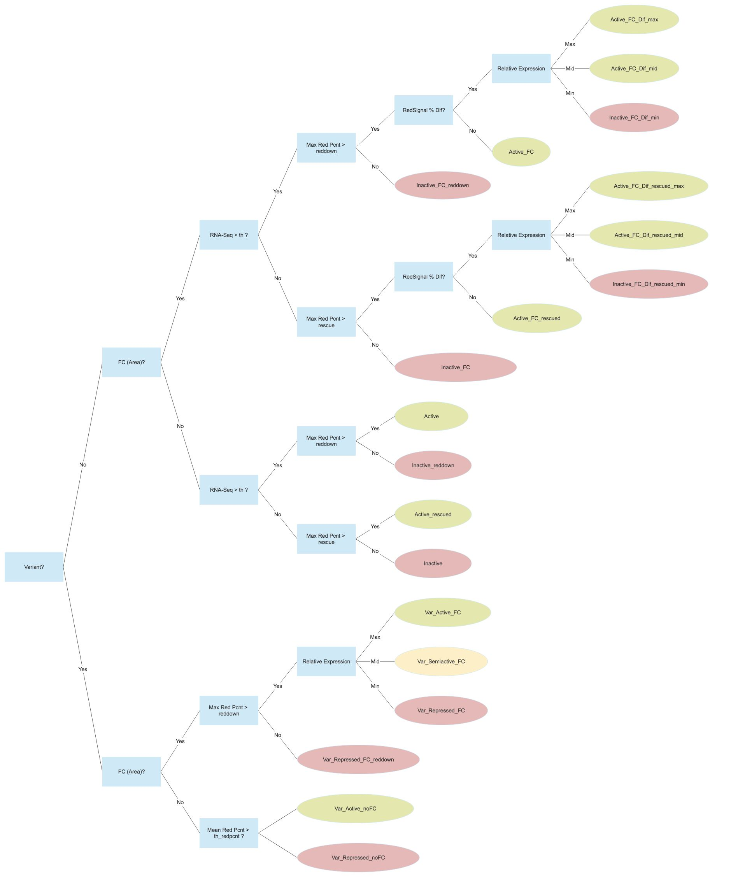
Classification Tree

Slide 8
Non-Variant
with FC

Slide 9
Non-Variant
no FC

Slide 10
Variant

Slide 11
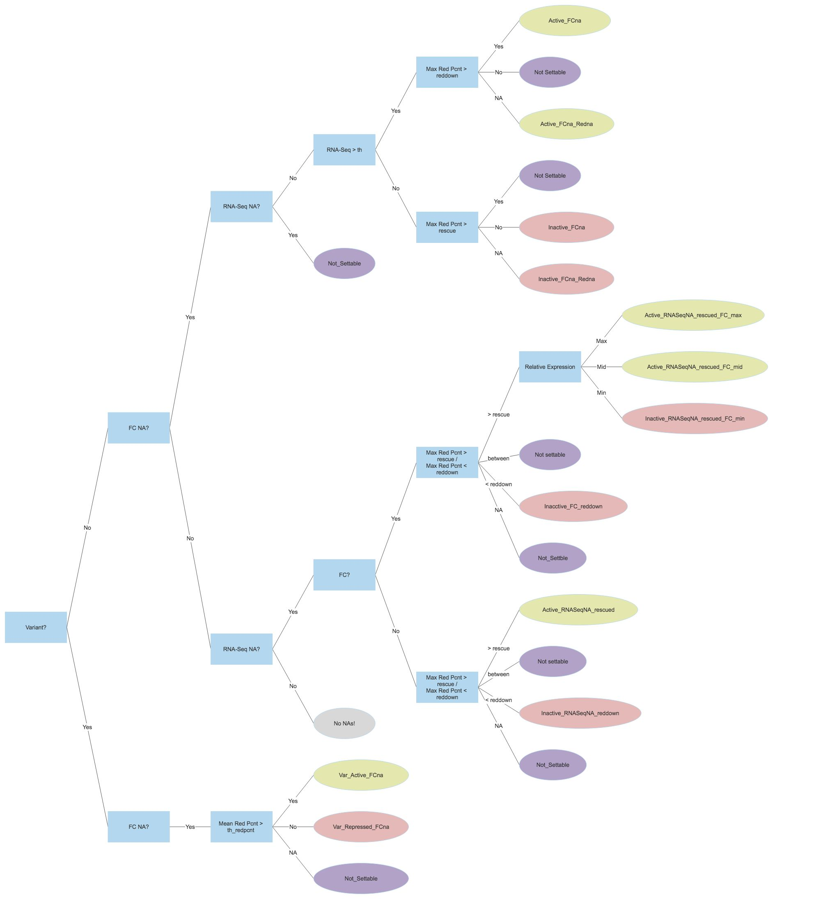
Handling
Missing Data

Slide 12
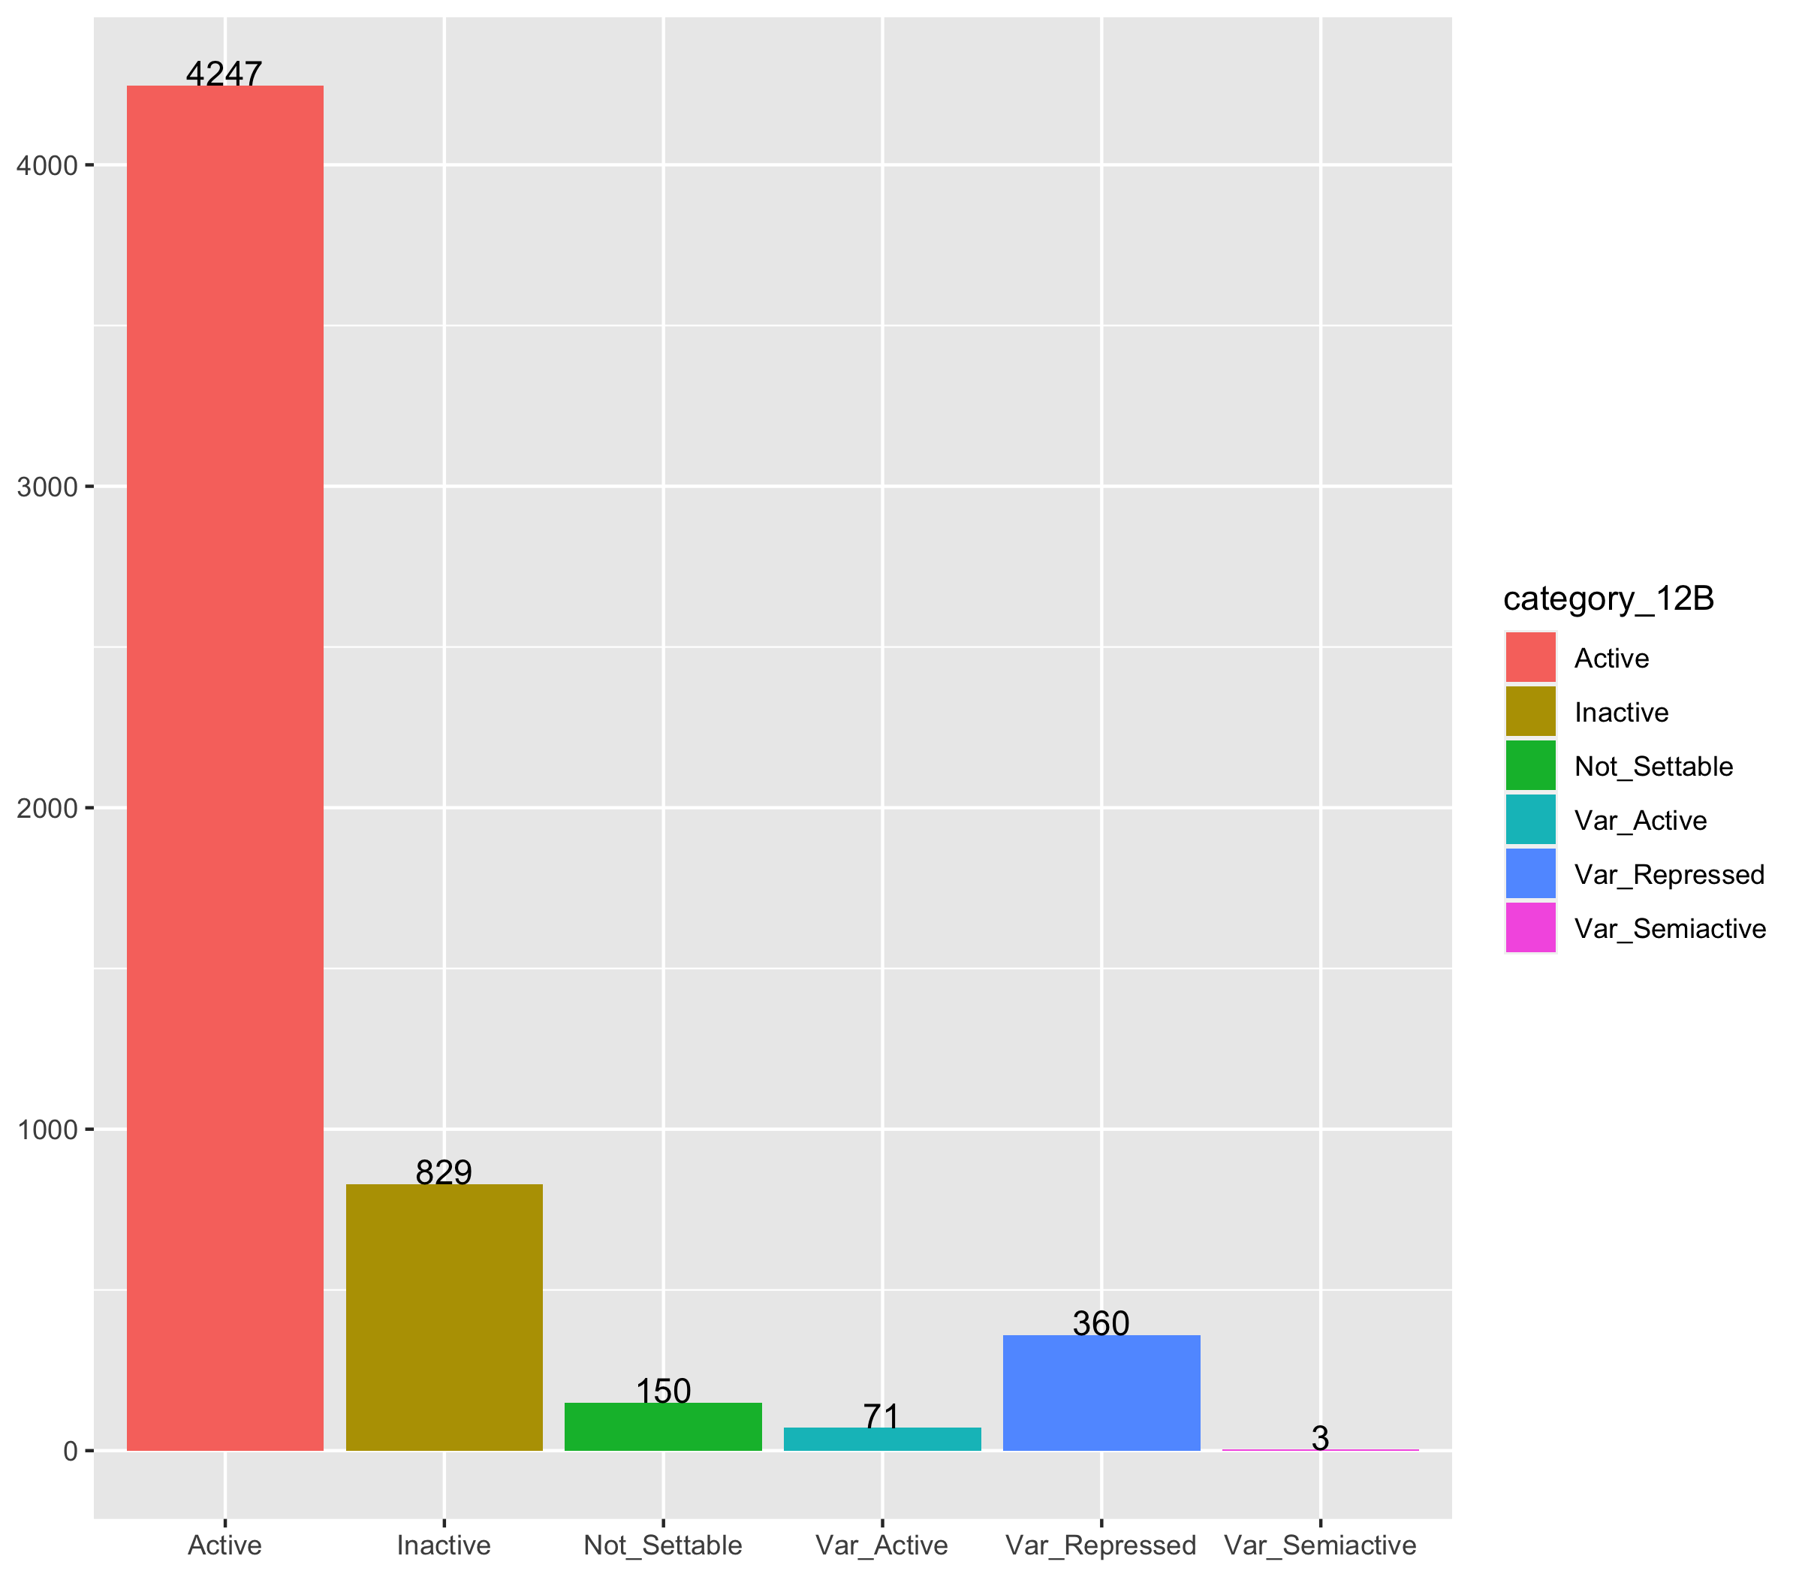


Results

Slide 13
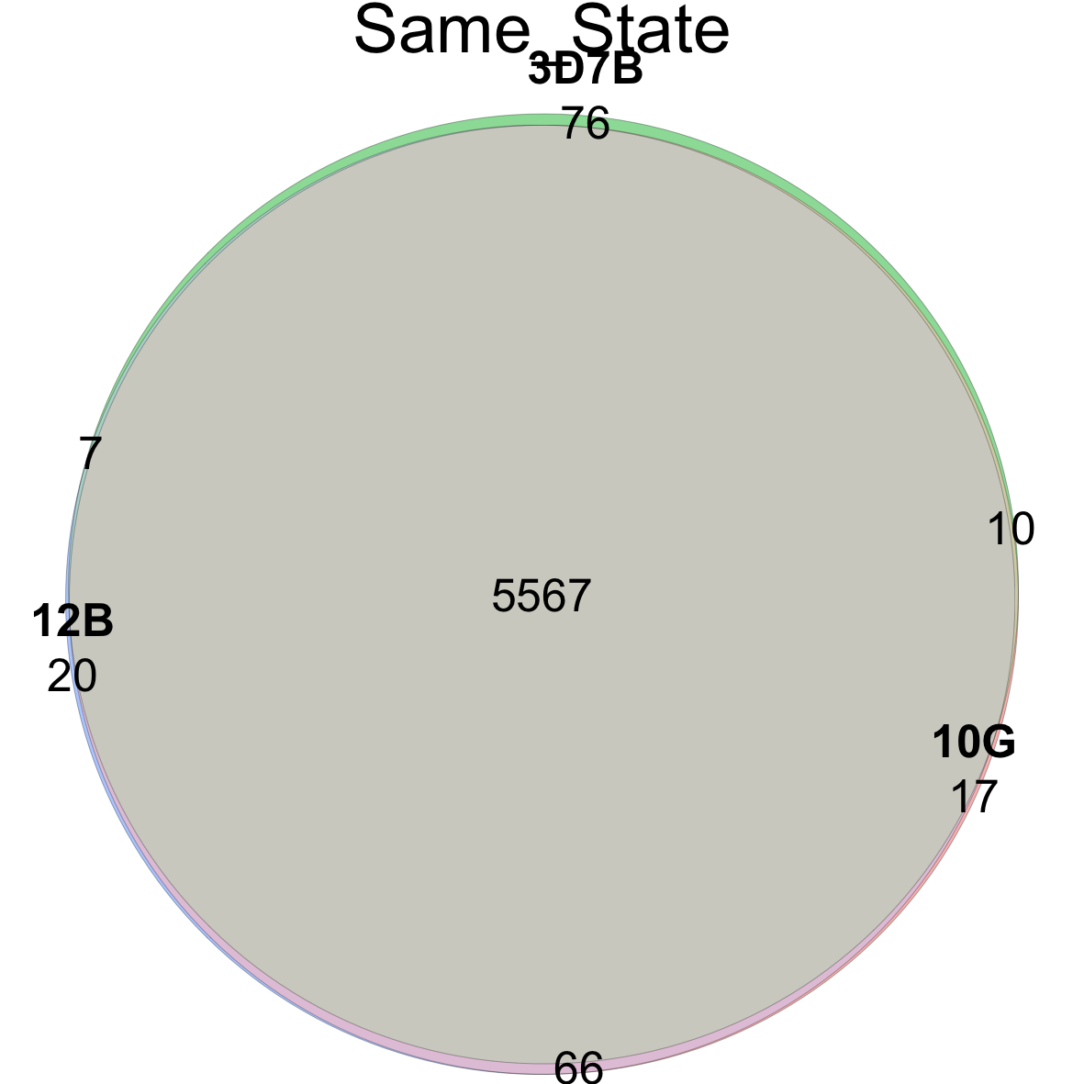
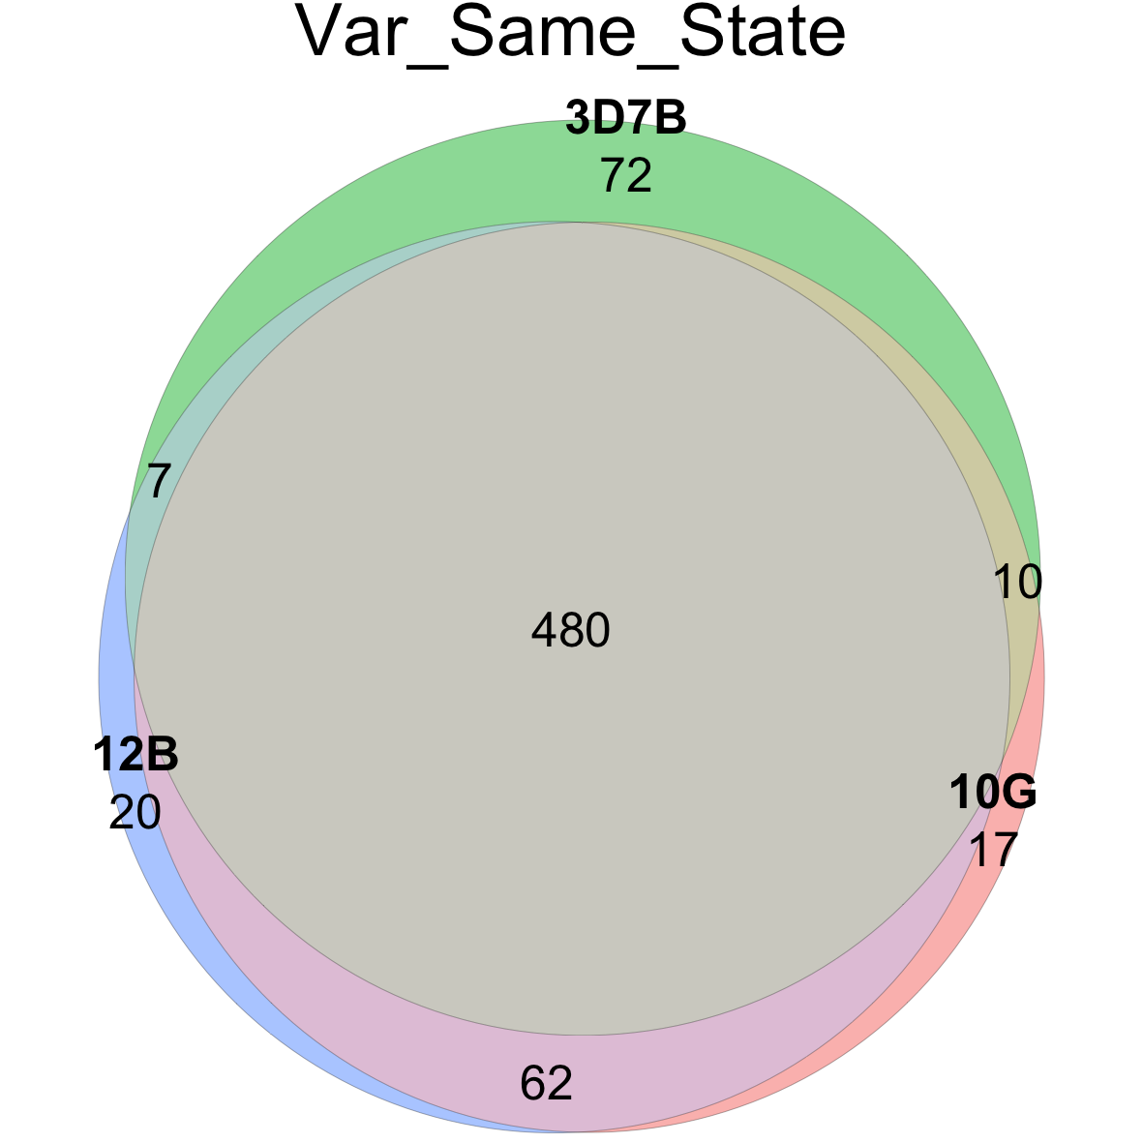
Venn: Same category

Slide 14
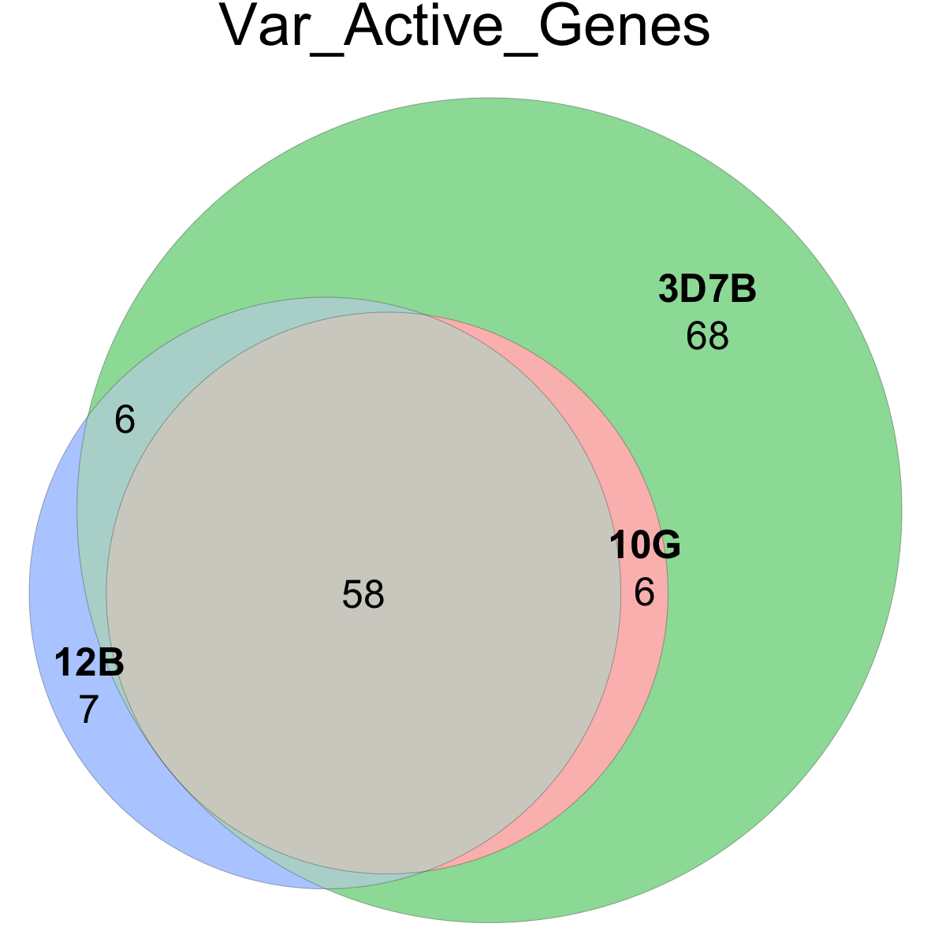
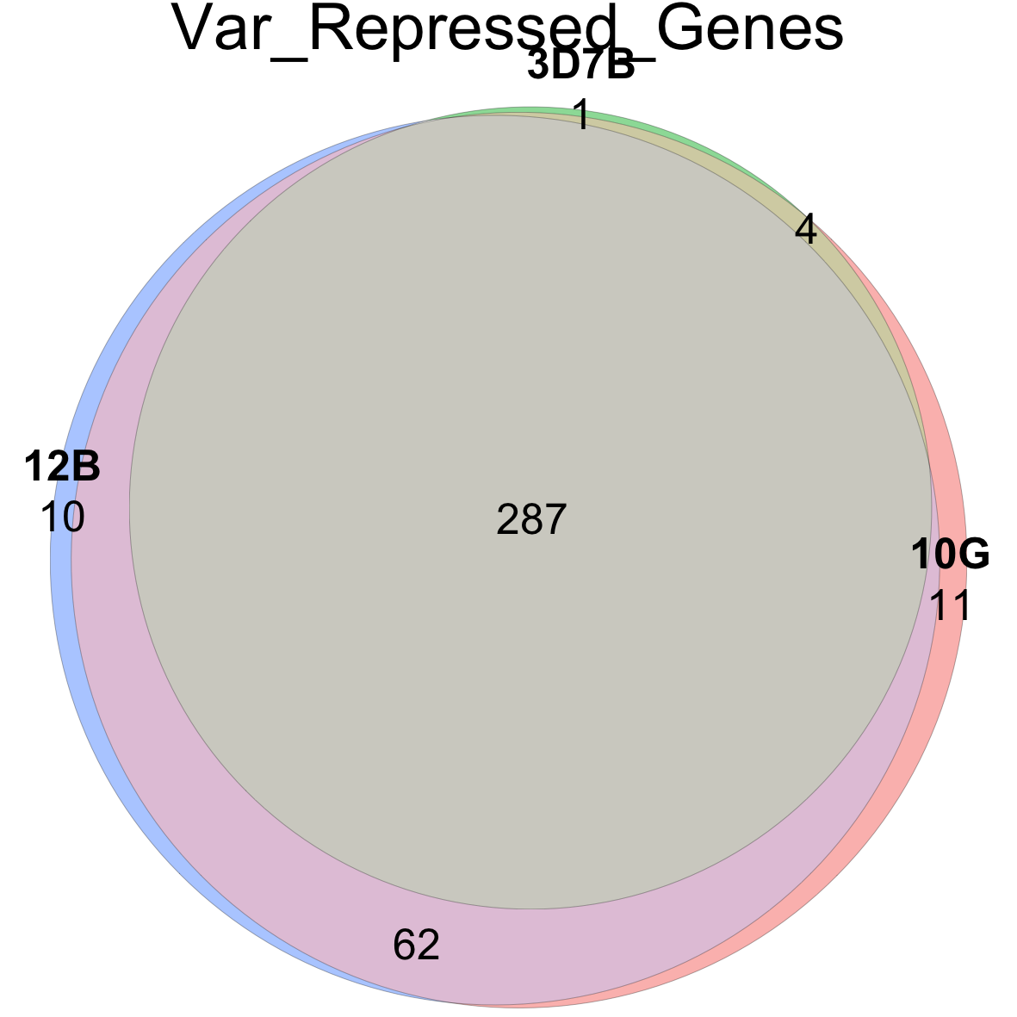
Venn Var Genes

