Slide 1
CUDA Programming
Lucas Molander

Slide 2
Goal
Learn more about CUDA programming and massive parallelism

Slide 3

Matrix Multiplication
$O(n^{3})$ → decrease $n^{3}$ coefficient as much as possible
Source matrices aren’t mutated Each product element depends on 1 unique dot product → lends nicely to parallelism

Slide 4
GitHub
https://github.com/LucasMolander/CUDA-fun

Slide 5
Hardware
AWS
Tesla K80 (2x Kepler GK210) ~ $4,000
Intel Xeon E5-2686 v4 @ 2.30GHz ~ few thousand dollars (v3 benchmarked around $2,000 CPUs)

Slide 6
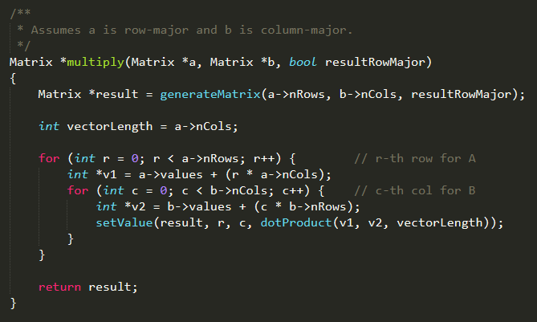
Matrix Multiplication – Single-threaded

Slide 7
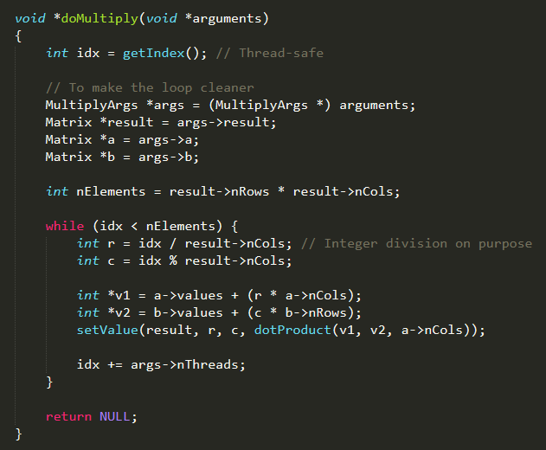
CPU-threaded

Slide 8
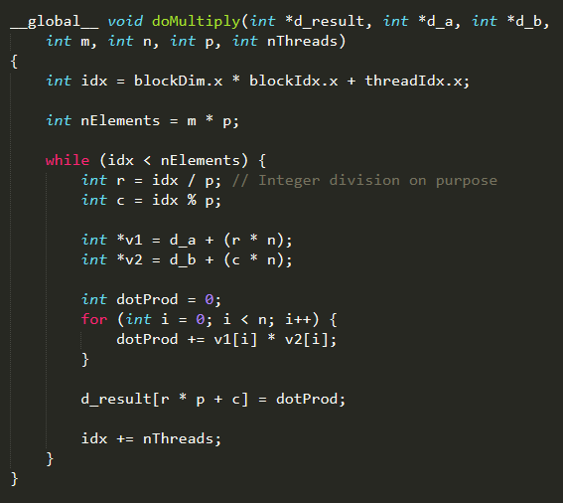
GPU

Slide 9
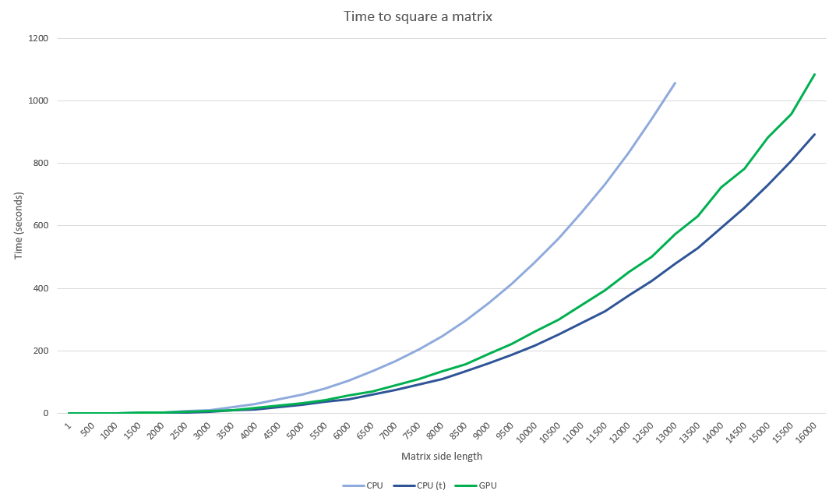

Slide 10
Why is the $4,000 GPU not doing so well?
Maybe it’s low occupancy?
Downloaded CUDA Occupancy Calculator
Kernel: Used 21 registers, 76 bytes cmem[0]
Changed threads / block to 128
Helped about 5%
Must be something wrong with the kernel…

Slide 11
Change the Kernel
Calculate all offsets beforehand (give CPU some easy overhead)
Then GPU does math and stores in memory

Slide 12
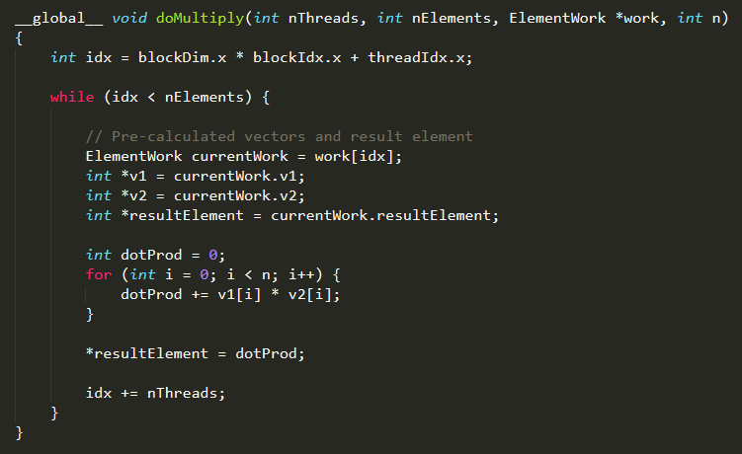
Modified Kernel

Slide 13
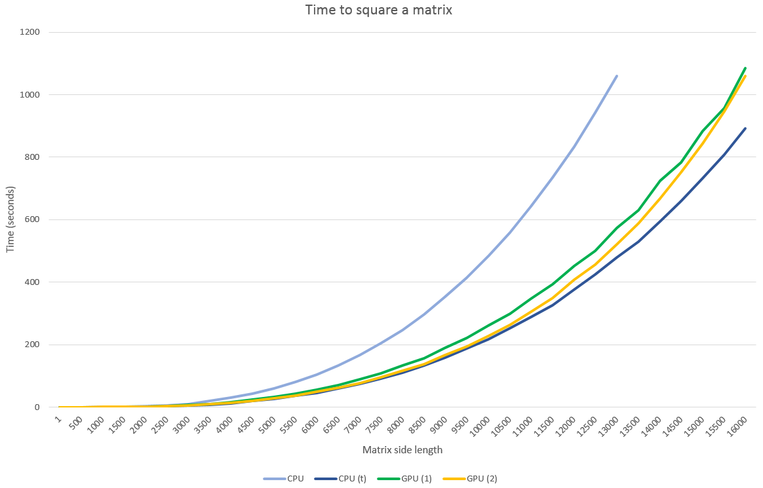

Slide 14
Need to find out what’s going wrong
Profiler!
→ Use nvprof then import to Nvidia Visual Profiler

Slide 15
Profiler information
Global load efficiency: 12.5%
→ Do some memory benchmarking

Slide 16
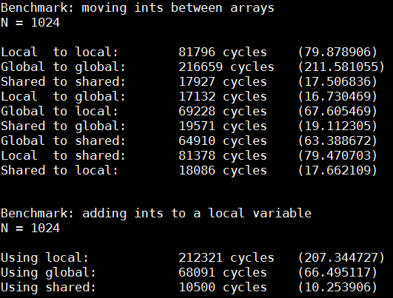
Benchmark results <<<1, 1>>>

Slide 17
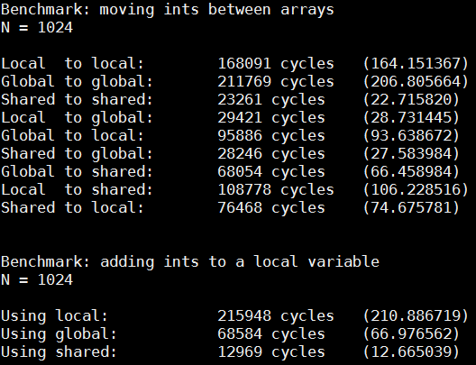
Benchmark results <<<32, 128>>>

Slide 18
Use shared memory!
1st approach didn’t really work (branching, extra math)
Other approach worked (no branching, low math)

Slide 19
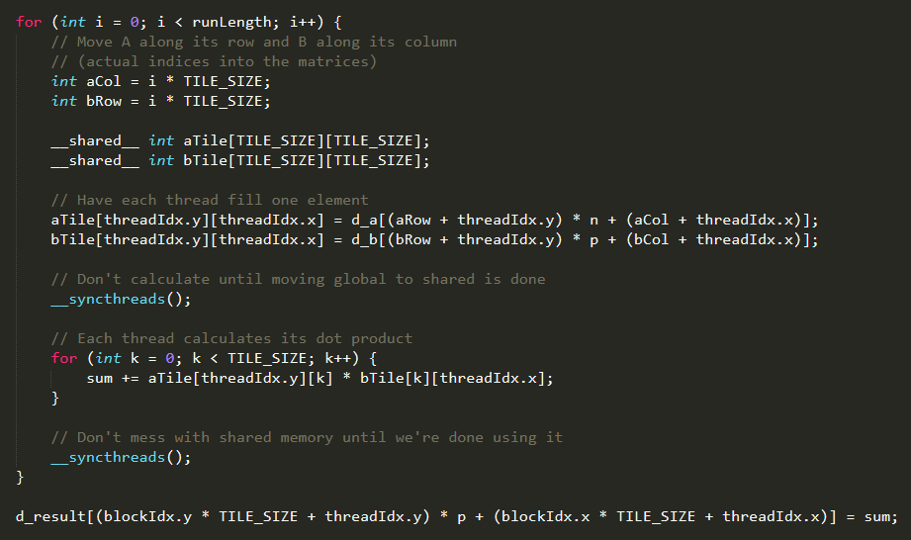

Slide 20
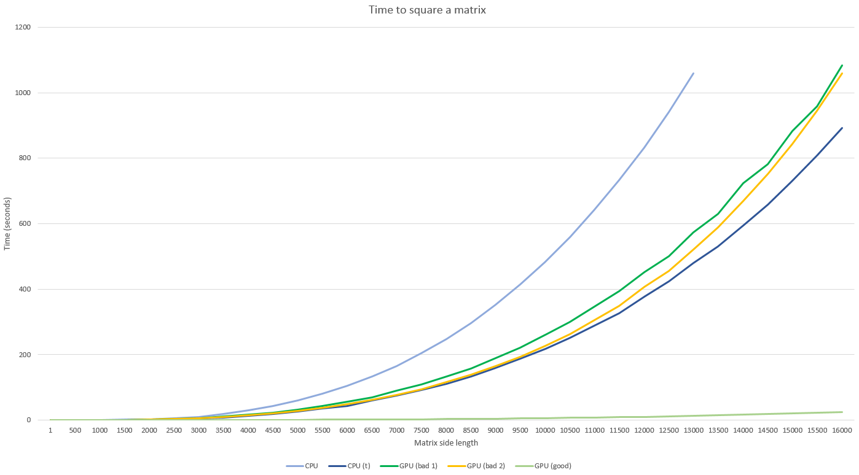

Slide 21

Regression $x^{3}$ coefficients
CPU: 4.6982928e-10
CPU (threaded): 2.1788559e-10
GPU (bad): 3.6553611e-10
GPU (good): 5.6258415e-12
GPU tends toward being 38.73 times faster than CPU (threaded)
(In practice, about 35x)

Slide 22
Can we get better?
Profiler says so: 65.9% shared memory efficiency

Slide 23
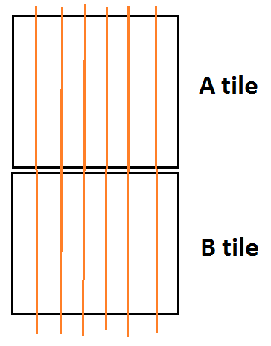
Shared memory

Slide 24
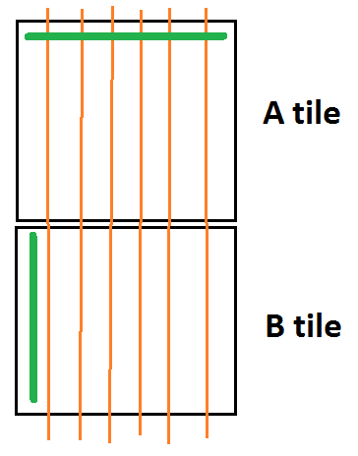
Shared memory
B row-major: good Minimal, consistent conflicts

Slide 25
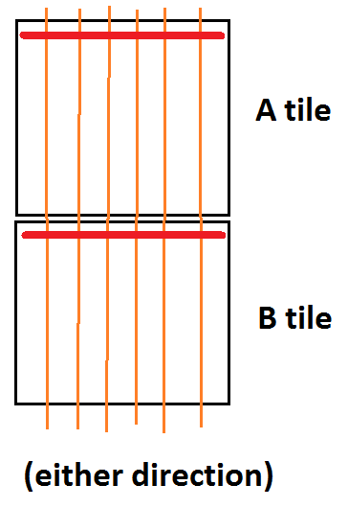
Shared memory
B column-major: bad (tested: 2.6x worse)

Slide 26
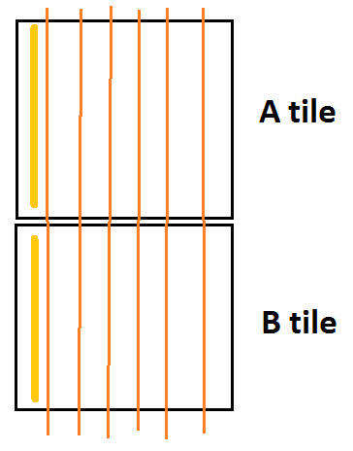
Shared memory
A column-major: Still bad 1.5x worse

Slide 27
Shared memory
Conclusion: Leave it how it was

