Slide 1
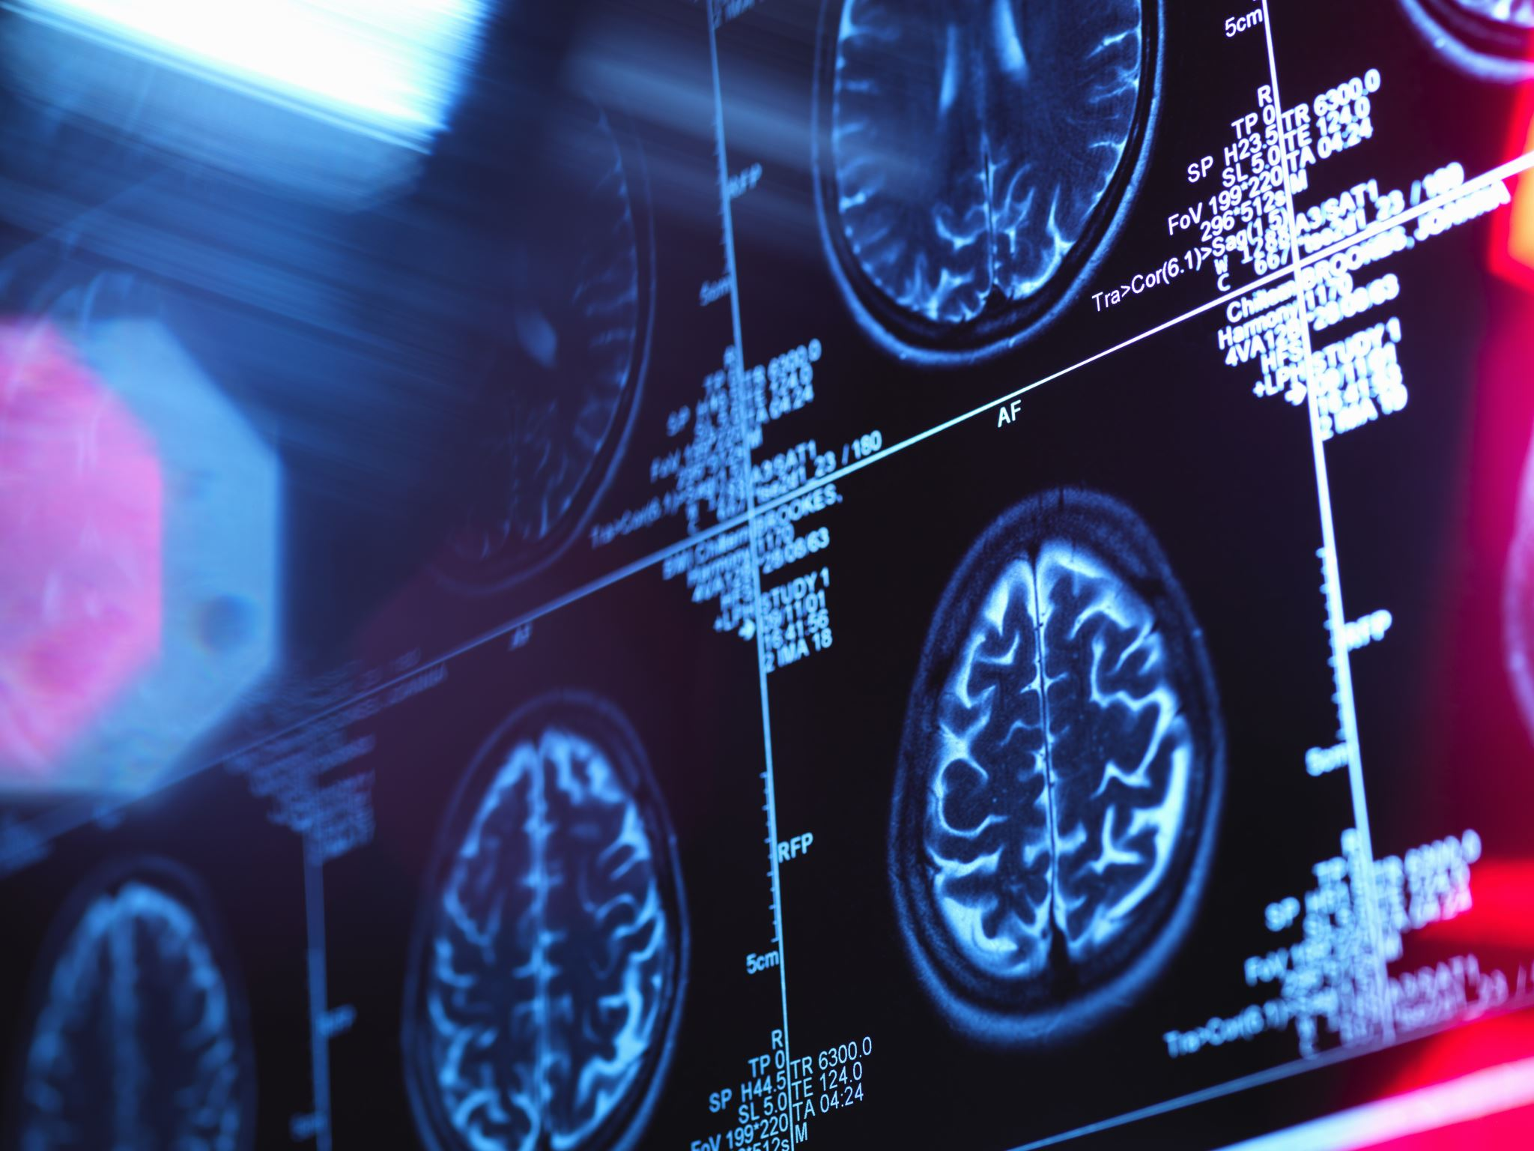
KNOWING THE DATASET
General dataset information:
- STUDENTS X GENDER
- STUDENTS X MOBILE OPERATING SYSTEM
- GENDER X MOBILE OPERATING SYSTEM
- HEALTH RATING X DAILY USAGES
- PERFORMANCE IMPACT X DAILY USAGES
- SYMPTOMS x FREQUENCY:
- FREQUENCY X HEADACHE
- FREQUENCY X SLEEP DISTURBANCE
- FREQUENCY X ANXIETY/STRESS

Slide 2
EXPLORATORY DATA ANALYSIS (EDA)
- SYMPTOMS x DAILY USAGES:
- HEADACHE X DAILY USAGES
- SLEEP DISTURBANCE X DAILY USAGES
- ANXIETY/STRESS X DAILY USAGES
- STUDENTS X HEALTH RISKS
- AGE X DAILY USAGES
- AGE X ATTENTION SPAN
- AGE X HEALTH PRECAUTIONS
- ATTENTION SPAN x HEALTH PRECAUTIONS
- EDUCATIONAL APPS x DAILY USAGES
- EDUCATIONAL APPS x USAGE DISTRACTION
- MOBILE PHONE ACTIVITIES X SYMPTOM FREQUENCY
- DAILY USAGES X HEALTH PRECAUTION
- USEFUL FEATURES x ATTENTION SPAN

Slide 9
People who use the smartphone for 2 hours or less don't have a headache?
https://www.ncbi.nlm.nih.gov/pmc/articles/PMC8015465/
https://edition.cnn.com/2020/03/04/health/smartphone-headache-wellness/index.html
https://www.sciencedirect.com/science/article/pii/S0013935124001944
Through these studies, excessive cell phone use increases the duration and frequency of headaches. The famous "text neck" also seems to have some relationship, considering that it causes tension in the spine. This excessive use in patients suffering from migraines is linked to nighttime drowsiness (which is also included in the data) and poor sleep quality. Therefore, it makes sense that people who use it for less than 2 hours do not have this problem.

Slide 10
Possible solutions:
Try to use your cell phone at the same height as your neck, making sure you look down as much as possible.
Adjust Smartphone Settings: Activate blue light filter or night mode to reduce exposure to blue light, especially at night;
Increase font size to make reading easier and reduce eye fatigue;
Reduce motion effects on the screen to avoid dizziness or motion sensitivity;
Choosing Wallpaper: Choose wallpapers with less vibrant colors and preferably static to reduce visual stress;
Brightness Control: Adjust the screen brightness according to the ambient brightness;
Consider using glasses with a blue light filter to protect your eyes;
Set time limits for smartphone use, especially before bed;
Notifications disabled during rest periods.

Slide 12
SLEEP DISTURBANCE X DAILY USAGES
https://hbr.org/2015/08/research-shows-how-anxiety-and-technology-are-affecting-our-sleep
Blue wavelength light from LED-based devices (phones, tablets, computers) increases the release of cortisol in the brain, which makes us more alert and inhibits the production of melatonin, which is necessary for falling asleep. Anxious people already have a higher amount of cortisol, which makes the situation worse. Not to mention the immediate need we have to look at our cell phones as soon as we receive a notification, which hinders our ability to concentrate and make decisions, in addition to causing unnecessary anxiety in our brain.

Slide 13
Possible Solutions:
Total darkness: Turning off all the lights in the room – including the lights on all the appliances in the room – is essential for a peaceful sleep;
Breathing exercises: inhale through your nose and exhale through your mouth three times in a row;
Stay away from electronic devices: Using electronic devices makes the mind work, instead of preparing to rest. Avoid using them at least 60 minutes before going to bed.
An hour before bed, start slowly dimming the lights in your bedroom to release melatonin.Store all devices in another room instead of in your bedroom to discourage you from checking them during the night. (If you need to keep a phone nearby in case of emergency, set it to ring only when certain people call, but still place it on the other side of the room and away from your bedside table.)
During the last hour before bed, choose an activity that your brain finds predictable and therefore not anxiety-provoking.

Slide 15

ANXIETY/STRESS X DAILY USAGES
Of the symptoms, anxiety does not seem to have a pattern, this is because it is the result of other problems, and the cell phone would be just one element that influences.
Of the symptoms above, anxiety seems to have no pattern, this is because anxiety is a symptom of a set of problems and the cell phone would just be another element. In these cases, another type of help is needed to understand the root of the problem and thus resolve it. A possible solution would be a partnership/agreement with therapists and psychologists.

Slide 19
SLEEP DISTURBANCE
Of all the symptoms and their frequency, almost all the values ​​are balanced, between yes and no. However, when we talk about students who sometimes suffer from sleep disturbance, this difference becomes very large, showing that this is indeed affecting many students. However, this can sometimes be specific situations, such as a test the next day, some personal problem, at the same time, these students may be the ones who, in weeks or even months, will enter the statistics of students who suffer from this frequently. Emphasizing the importance of replicating the information that helps them focus during their studies, day to day, and to encourage healthier habits.

Slide 21

STUDENTS X HEALTH RISKS
Only 58.2% of students are fully aware of the risks, 21.4% partially know and 20.4% do not know.
Therefore, awareness is necessary so that all students are aware of the risks and, therefore, how to avoid or reduce damage.

Slide 25
AGE x ATTENTION SPAN/HEALTH
Interestingly, the age group that presents a large discrepancy between students who suffer or not with the ability to concentrate is between 21-25. The logic would be that the youngest or the oldest should show this difference, but that's not what happens.
This leads us to the question: why people between 21 and 25?
  Could it be because 71 of the 99 (approximately 72%) students this age
  - Because this age group has a higher average use
Still on this topic, students between 21 and 25 years old are those who take the most precautionary measures.
- Can this be explained by the fact that they are the ones who use it most and, therefore, suffer damage most frequently?
  - Or even because it represents almost 3/4 of the students, thus causing a distortion in the data.

Slide 29
EDUCATIONAL APP X DISTRACTION/DAILY USAGES
Students who study via video tend to study longer. However, it is the students who are most distracted (whether during lectures, exams or during studies).
Students who use productivity tools have a 0% distraction rate during exams.

Slide 31
ACTIVITIES X FREQUENCY SYMPTOM
Students who use social networks feel some type of symptom more frequently.

Slide 33
DAILY USAGES X HEALTH PRECAUTION
As the time of use increases, it tends to create a balance in the percentage of precautions taken, thus reducing the differences between them.
This may indicate that people who don't spend as much time, or who think they don't spend as much time using their smartphone, don't feel the need for these measures.

Slide 35
USEFUL FEATURE X ATTENTION
Of the students who study using the "internet access" feature, 3 out of 4 report feeling an impact on their ability to concentrate, and this is easy to understand. On the same website where the material is, there may be advertisements, news, and other topics that distract or even make the student study later. Or even while loading a website or file, those few seconds may be enough for students who have the habit of checking their cell phones all the time to check it and pause their study to answer a question, research something, etc.

Slide 36
Possible Solutions:
Identify whether the distraction is actually coming from your cell phone or from your surroundings.
If possible, set times to study.
Avoid unplanned interruptions.
If possible, put your cell phone on "do not disturb" mode, thus avoiding frequent notifications.

Slide 39

Students up to 25 years old prefer to study using videos, regardless of the subject. This is understandable and is already expected if we consider the new generation, however, it raises a red flag, considering that students who study using videos:
  1 - study more
  2 - get more distracted
  3 - tend to experience more symptoms.
It is true that they are also the ones who take the most care of themselves, and this is very important, but is this preventive care or harm reduction?

Slide 40
Solutions?
The need to raise awareness of the risks, given the high percentage of students who are not fully aware of them.
Students who are aware of the risks and who take some precautions were shown that a little more is needed, as despite the precautions, there is still some data that turns on the warning light. Therefore, this awareness may have some effect among this group.
If it is within the institution's reach, a partnership/agreement with psychologists and the like is extremely important, because although cell phones have some advantages, in many cases they are just an extension of some problem related to mental health.
In the future, a new search should be carried out, preferably with more fields, such as: "Most used app", "Self-evaluation of nutrition (from 0-10)", "do you practice sports", "do you have any hobbies?", "in If so, which one?, because although many data are conclusive, many also seem to be a pattern, but due to the lack of specific data or even because a group in some category is the vast majority, it can distort the analysis and direct the amount of doubts , therefore, also mastering the solutions. Also reinforce, if possible, that the student answers an answer like this, as in some moments, the same student answered "excellent, good, fair", realizing that there is a big gap between excellent and fair.

Slide 41
Solutions
Create initiatives related to sport/leisure that encourage activities that have a positive effect on health, whether physical or mental. This can come from partnerships, be it a discount coupon at gyms, organizing an annual race, creating international competitions that encourage them to distract their minds more, reinforcing friendship and inclusive bonds, pushing time on the cell phone with things that are not so important and that may cause some type of discomfort. It is worth highlighting that as a student, discomfort is normal, often tiring and stressful during exam/assignment periods. Therefore, any initiative that takes you out of this stressful routine, and inserts you into a new environment, associated with fun and positive things, helps to make everyday life easier and, as proven in studies, improves performance in studies.

