Slide 1
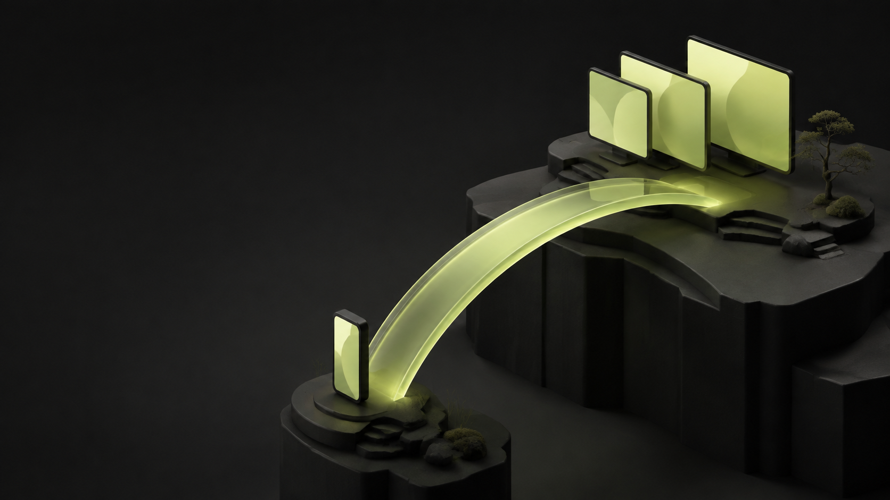
ponte.
Your Omarchy desktop,
within reach.
Android remote control
and live monitor views
over Tailscale
Open source alpha · September 2026
Notes:
Independent project by LucasOl1337. Cover is AI-generated concept art, not a product screenshot. Full prompt and credits: docs/assets.md. Project source: https://github.com/LucasOl1337/ponte

Slide 2
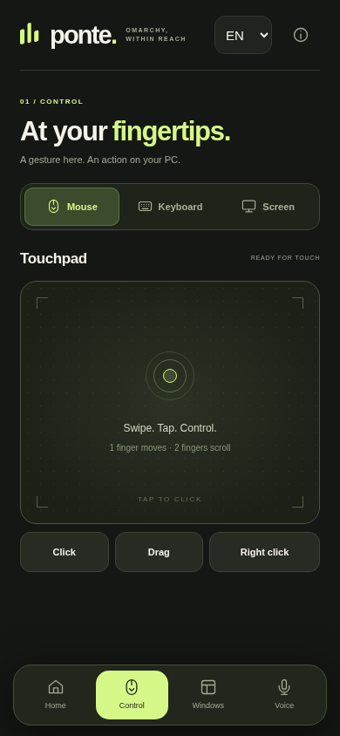
Desktop controls that fit a phone
Use the touchpad. Send text.
Choose the window you need.
Pairing stays saved between launches.
English is the default. Portuguese is one tap
away, with your preference saved.
English browser preview. Device evidence is in the repository.
Notes:
Screenshot is an original 390px browser capture of the running English app connected to a read-only local review instance. Separate physical Redmi evidence, including persistent login, is documented in docs/evidence.md. The browser language test verified English default on a Portuguese browser, Portuguese retained after reload and preservation of unsent input.

Slide 3
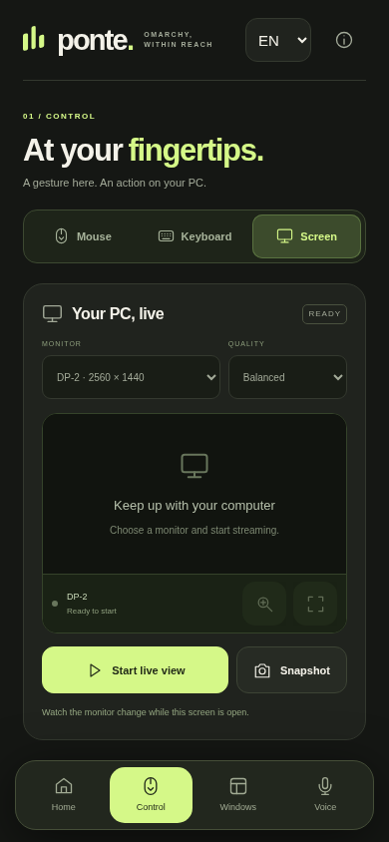
Live views of your monitors
Select a monitor, then zoom
or open it in fullscreen.
Authenticated MJPEG, with profiles up to 10 fps.
Video stops when you leave the live view.
System audio is not streamed.
English browser preview. Device evidence is in the repository.
Notes:
Screenshot is an original English browser preview of the monitor controls before streaming. Changing frames from DP-2 were verified in this browser instance. Separate original Redmi captures document TLS over Tailscale without ADB reverse. See docs/evidence.md for physical-device evidence, source credits and limits.

Slide 4
Measured on a real Omarchy PC
7.1–7.3
3 simultaneous monitors
4.54-second sample
10 fps requested at half scale
frames per second per stream
78–177 ms to the first frame in the local sample.
PC-side capture measurement. Phone frame rate, battery use and remote cellular performance remain unmeasured.
Notes:
Source: docs/evidence.md, PC benchmark from September 5, 2026. HDMI-A-1 7.33fps / 78ms / 2.76Mbit/s; DP-1 7.33fps /120ms /3.35Mbit/s; DP-2 7.11fps /177ms /6.84Mbit/s. 8.51 CPU seconds over 4.54 wall seconds. This is not a WAN latency claim.

Slide 5
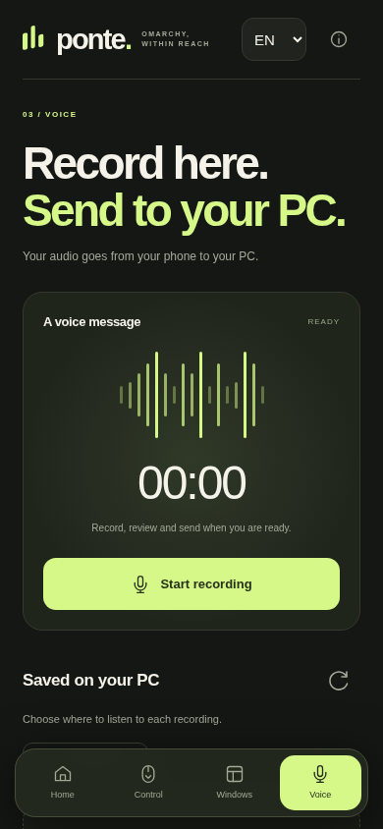
Voice messages
Record on the phone.
Review before sending to the PC.
Files stay on the PC.
No AI transcription service is involved.
Android recording remains under verification.
English browser preview. Recorder idle.
Notes:
The physical device test found a missing MODIFY_AUDIO_SETTINGS permission. The fixed manifest passed packaging checks. A physical-device recording retest remains pending. This slide does not claim a successful recording. See docs/evidence.md and android/README.md.

Slide 6
Your PC hosts the connection
Android
Omarchy
Private loopback proxy
Saved pairing token
Exact server certificate pin
Node.js service on the PC
Hyprland desktop controls
Local recordings and captures
The app connects to the PC over Tailscale and TLS.
Notes:
Design source: server.mjs, backend/, android/src/app/ponte/omarchy/LoopbackProxy.java and SECURITY.md. A paired phone controls the live user session. Tailscale ACLs and trusted peers are prerequisites, not managed by Ponte. Certificate renewal requires a rebuilt APK. No independent security audit.

Slide 7
A small, inspectable first release
MIT licensed
No production npm dependencies.
Local setup and a personal Android build.
Next: simpler first pairing, Android recording verification,
and measurements beyond the home network.
Notes:
Source: package.json, LICENSE, README.md, docs/evidence.md. Scope is experimental alpha. Android build downloads pinned third-party tools that retain their own licenses. No implication of official Omarchy acceptance.

Slide 8
Built for Omarchy users
ponte.
github.com/LucasOl1337/ponte
Source, setup, original screenshots and measured evidence.
Feedback on the first-run experience is especially welcome.
Notes:
Independent project, not endorsed by or bundled with Omarchy. Official Omarchy: https://github.com/omacom/omarchy. Creator: https://dhh.dk/. Full factual record: docs/evidence.md.

