Slide 1


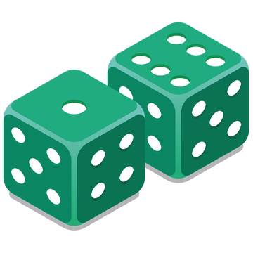
OUR YAHTZEE GAME
-a java project-
Lucas PECH – Arthur RAPP – Lucas CHAMPSAUR

Slide 2
INDEX
What did we learn from this project ?
Our game design
What can we improve ?
Our yahtzee in figures

Slide 3
I. What did we learn ?
Testing
Java
Yahtzee rules
DrJava
Code optimization
Intell IJ Idea
GUI
Teamwork
GitKraken

Slide 4
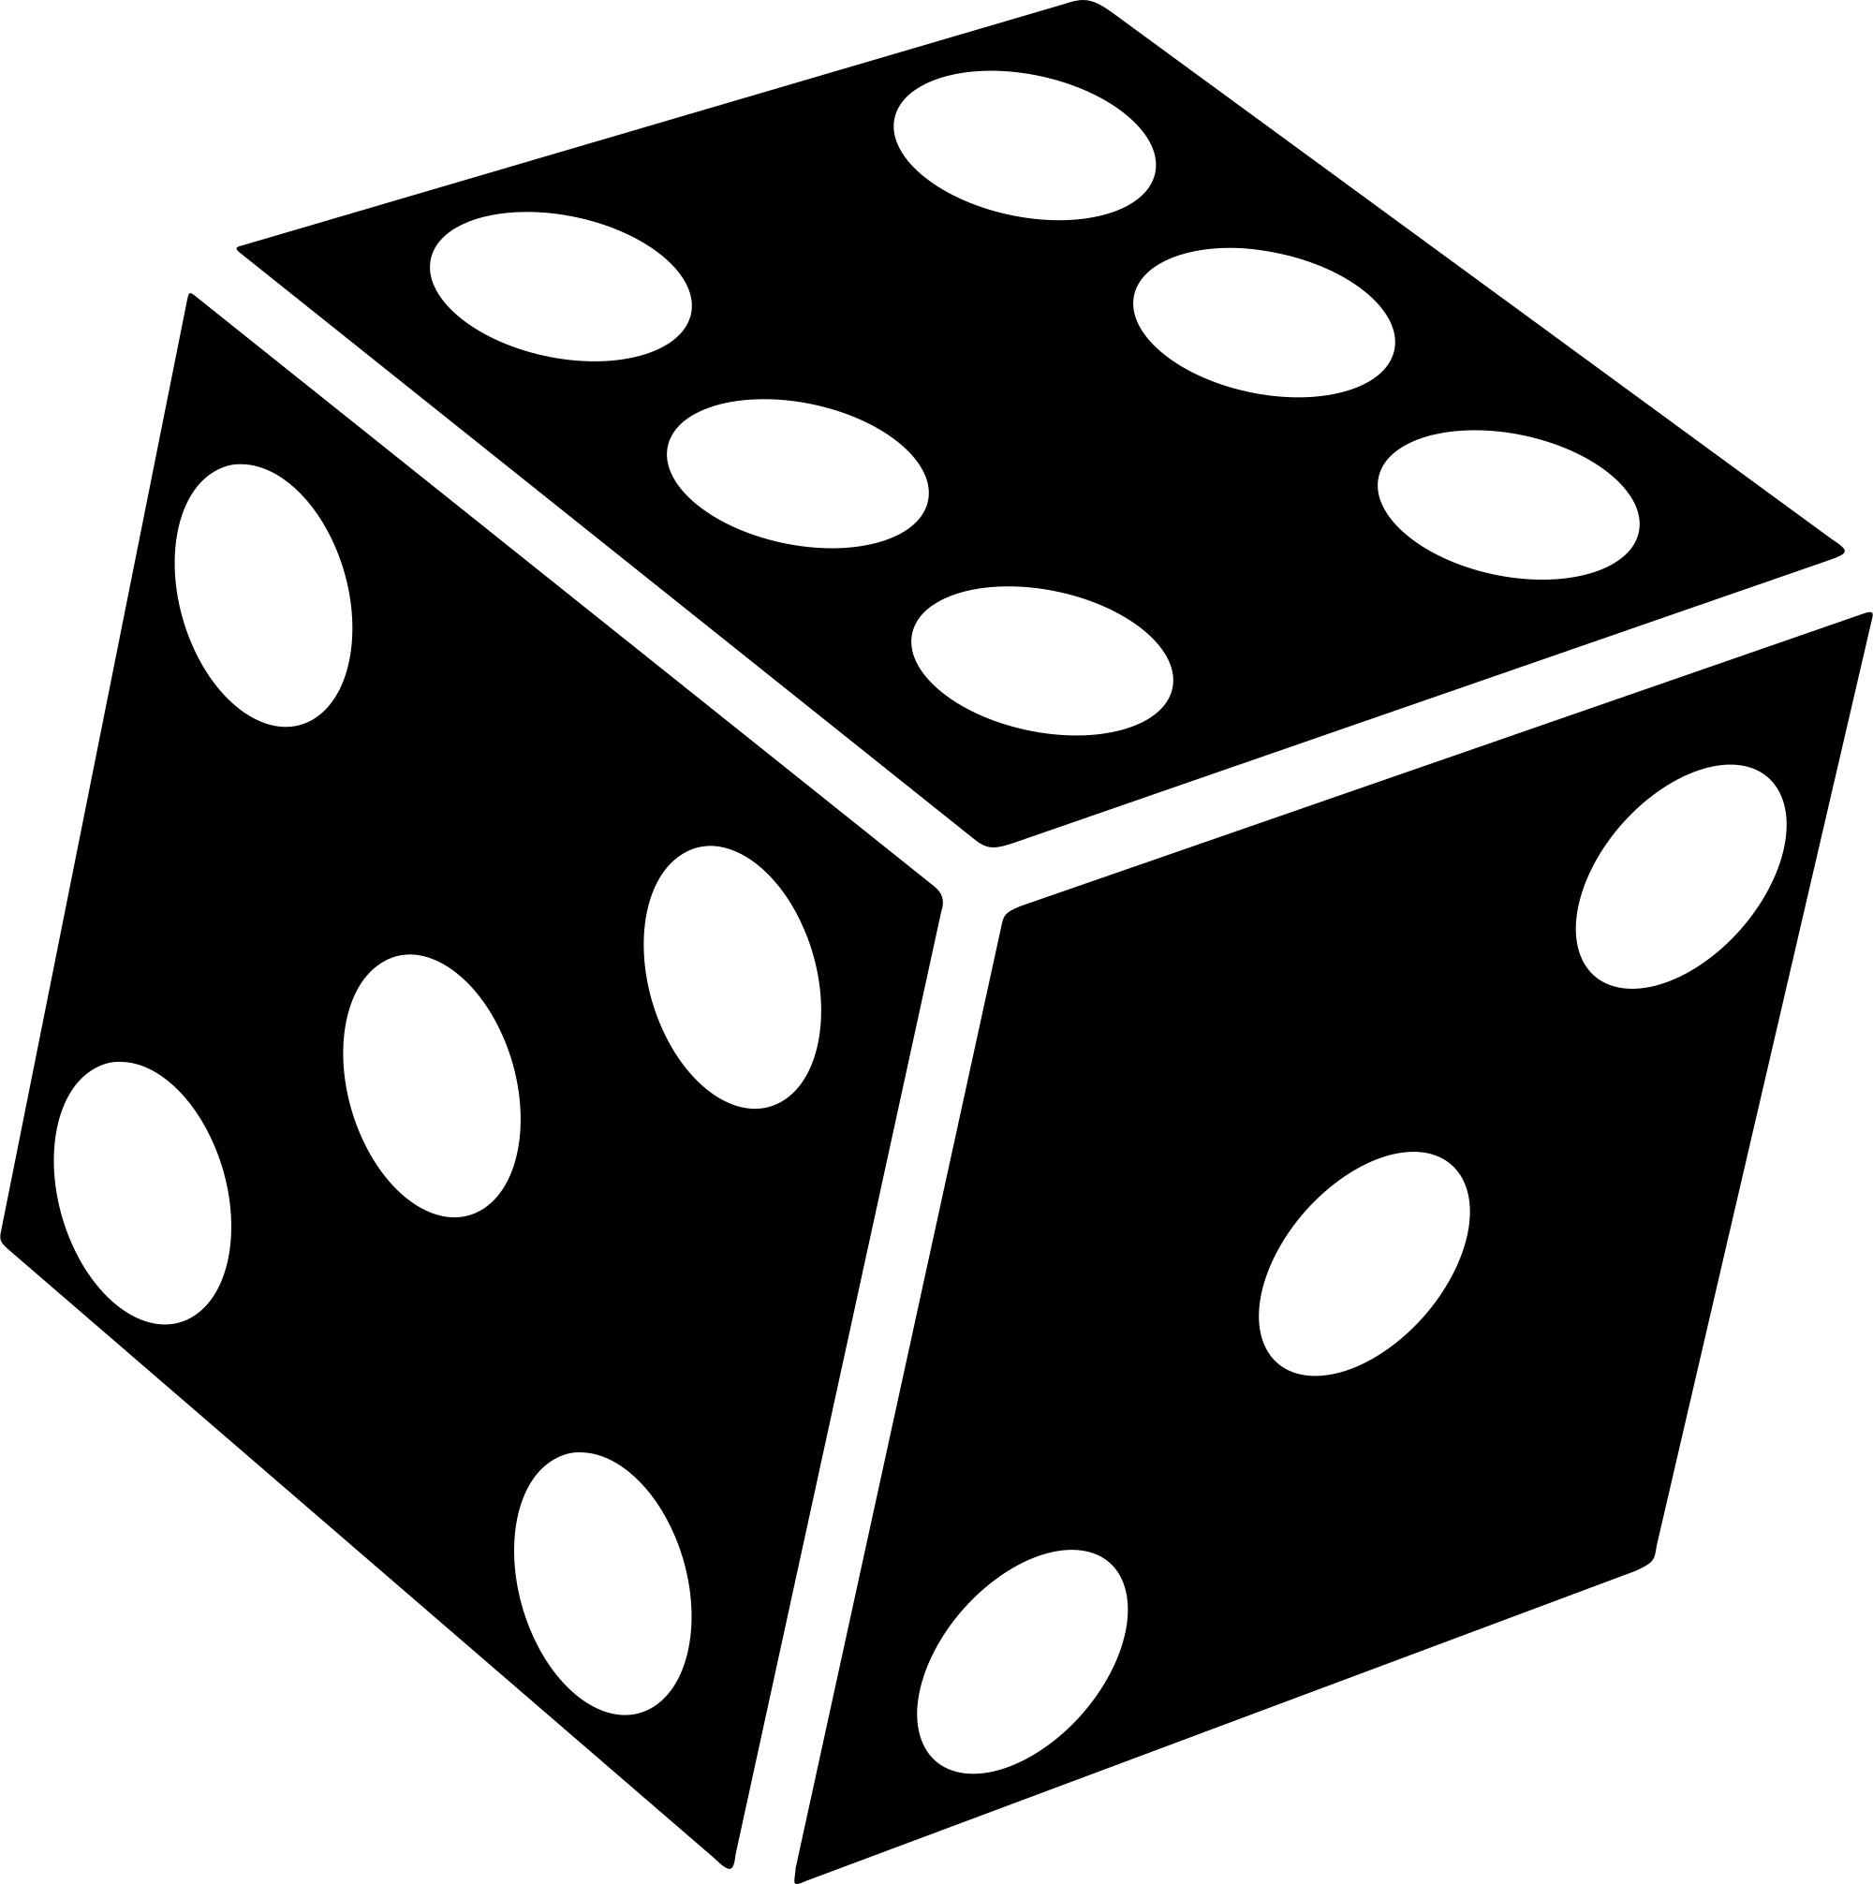
4 classes:
-Dices
-Rolls
-Scoreboard
-UserInterface
handles the random
sampling
II. Our game design

Slide 5

store and check the
dice rolls
4 classes:
-Dices
-Rolls
-Scoreboard
-UserInterface
handles the random
sampling
II. Our game design

Slide 6
store and check the
dice rolls
4 classes:
-Dices
-Rolls
-Scoreboard
-UserInterface
private int value
public Dice()
II. Our game design

Slide 7

display the scoreboard,
save the game…
4 classes:
-Dices
-Rolls
-Scoreboard
-UserInterface
store and check the
dice rolls
handles the random
sampling
II. Our game design

Slide 8
display the scoreboard,
save the game…
4 classes:
-Dices
-Rolls
-Scoreboard
-UserInterface
private Dice [] roll
handles the random
sampling
II. Our game design

Slide 9
display the scoreboard,
save the game…
public void InitalRoll()
public boolean IsThere_n_SameDice(int n)
public boolean SmallStraight()
public int min()
- public int RollSum()
4 classes:
-Dices
-Rolls
-Scoreboard
-UserInterface
handles the random
sampling
II. Our game design

Slide 10

creates the game frame,
launches the functions
4 classes:
-Dices
-Rolls
-Scoreboard
-UserInterface
display the scoreboard,
save the game…
store and check the
dice rolls
II. Our game design

Slide 11
creates the game frame,
launches the functions
4 classes:
-Dices
-Rolls
-Scoreboard
-UserInterface
private int highscore
private int int_nbPlayer
private int [][] scoresheet
private boolean [][] alreadyFill
store and check the
dice rolls
II. Our game design

Slide 12
creates the game frame,
launches the functions
4 classes:
-Dices
-Rolls
-Scoreboard
-UserInterface
public Scoreboard()
public void Score(Rolls roll, int playerNb)
public void ReinitializeScoreSheet()
public boolean End()
public int TotalGame(int playerNb)
public void findWinner(int int_nbPlayer)
public void saveGame(int playerTurn, int nbReroll, int[] myRoll)
store and check the
dice rolls
II. Our game design

Slide 13
4 classes:
-Dices
-Rolls
-Scoreboard
-UserInterface
creates the game frame,
launches the functions
display the scoreboard,
save the game…
II. Our game design

Slide 14

III. What can we improve ?
Code organization
Visuals
New Features

Slide 15
IV. Our game in figures
40 hours of work
~100 games played
+1500 lines of code
+300 errors & warnings
3 members

Slide 16
THANK YOU
« One who doesn’t throw the dice
can never expect to score a six. »
-Navjot Sing Sidhu

