Slide 1
Tech Arena Challenge
Team - 7

Slide 2


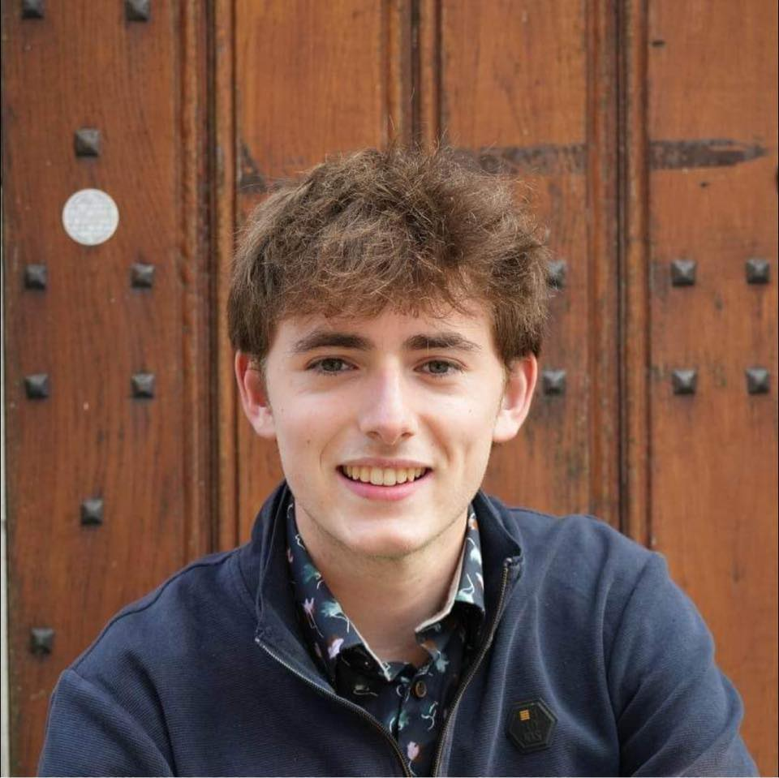
The team
Lucas
Chloé
Numa
Third year of bachelor
Electronical engeneering
Third year of bachelor
Chemical engeneeing
Second year of Master
Civil engeneering
Student at Ecole polytechique de Bruxelles

Slide 3
Our approach
Understand the problem
Begin with a simple algorithm
Upgrading it step by step

Slide 4
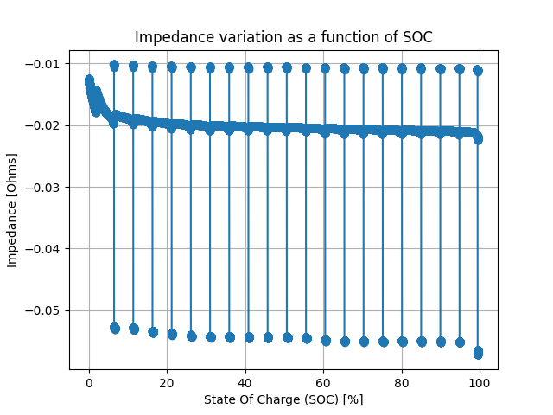
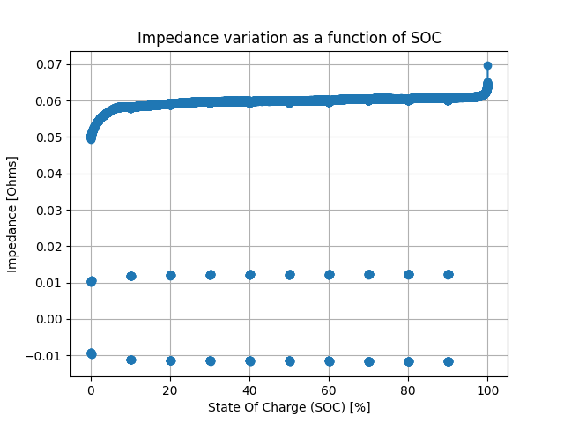
Compute the discharge & discharge impedance
Assumption : constant relationship between SoC and impedance
Discharge
Charge

Slide 5
Algorithm
We decided, after quite some research, to use an Extended Kalman Filter algorithm to estimate the SoC by linearizing the non-linear state and measurement equations around the current estimate. This method involves computing Jacobians for both the state transition and the measurement model.

Slide 6
Advantages
EKF can easily be optimized for greater computation speed and efficiency such as incorporating it as an FPGA or even an ASIC.
Much more efficient than a neural network

Slide 7
