Slide 1

45-MINUTE INSTRUCTOR-LED TRAINING
Beyond the Robot
Selling industrial automation as a business outcome
Original course concept informed by Challenger and solution-selling principles
Notes:
Facilitator opening: Set the expectation that this is not a product-training session. It is a sales judgment session built around a realistic automation opportunity.

Slide 2
Session outcomes
Keep this opening brief. The real value comes from applying the model to one realistic automation sales scenario.
Mindset
Method
Application
Move from a robot request to the business problem underneath it.
Use the Insight-to-Impact model to reframe, diagnose, quantify, tailor, and advance.
Practice every concept against the same fictional account: Northstar Components.
Design intent
Facilitation pattern
The course uses a single fictional account so each concept is applied immediately instead of staying theoretical.
Teach briefly, then ask learners to make a sales judgment before revealing the recommended path.
Beyond the Robot
02
Notes:
Timing: 3 minutes. Keep this brief. The main course value is in the scenario and decision points, not a long objective slide. The outcome row is a static agenda, not an interactive control.

Slide 3
Opening challenge: “Quote us a cobot”
Northstar Components sends the request below. Three competitors already sent budgetary pricing.
From: Manufacturing Engineer, Northstar Components
Subject: Cobot for CNC tending
Learner decision
Send pricing now
“We are looking for a cobot to load and unload three CNC machines. Please send us a budgetary quote.”
Ask for robot specifications
Request brief discovery first
Known facts: two shifts • six part variants • rising overtime • limited floor space • payback target below 24 months
Facilitator prompt: What does each choice cause the buyer to compare?
Opening challenge
03
Notes:
Timing: 4 minutes. Let learners vote. Do not reveal the best answer immediately. Ask: If we quote immediately, what have we made ourselves comparable on?

Slide 4
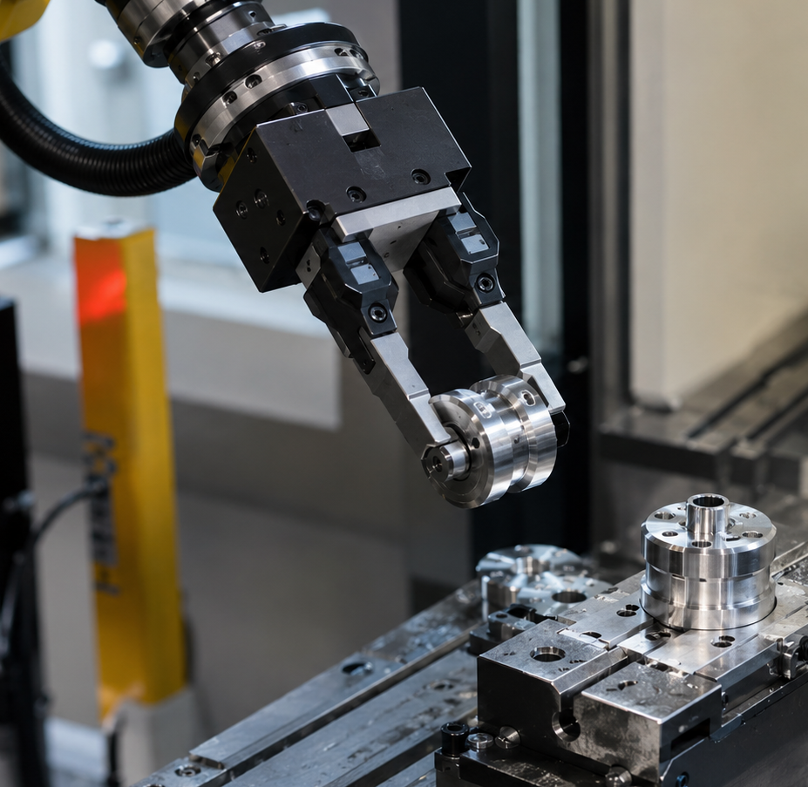
What are we really selling?
A robot arm is only one visible part of the business outcome.
Integration
Tooling
Controls
Robot arm
Safety
Training
Price comparison starts with the arm.
Value comparison starts with the system.
Maintenance
Beyond the Robot
04
Notes:
Timing: 4 minutes. Ask learners which overlooked component creates the most project risk in their experience. Emphasize total automation scope, not just robot specs.

Slide 5
Feature selling vs. outcome selling
Both are useful. The sequence determines whether the buyer compares specs or business impact.
Product-first opening
Outcome-led opening
“Our cobot has strong payload, easy programming, and fast deployment.”
“Before selecting the arm, let’s find where capacity is actually being lost.”
Buyer compares:
Buyer compares:
Price
Specs
Brand
Lead time
Capacity
Risk
Payback
Confidence
Beyond the Robot
05
Notes:
Timing: 4 minutes. The point is not “never discuss features.” It is “earn the right to discuss features after the business problem is clear.”

Slide 6
The Insight-to-Impact model
A practical sequence for automation sales conversations.
1
2
3
4
5
Reframe
Diagnose
Quantify
Tailor
Advance
Challenge the product-first assumption
Find causes, constraints, and decision criteria
Connect evidence to business impact
Align message to stakeholder priorities
Secure the right validation step
Core behavior: enter with a credible hypothesis, then test it through discovery.
Insight-to-Impact
06
Notes:
Timing: 2 minutes. Introduce this as the static structure for the rest of the session. Do not present the stage markers as buttons or progress states.

Slide 7
Stage 1: Reframe
Teach the customer something useful before you ask them to choose equipment.
1
2
3
4
5
Reframe
Diagnose
Quantify
Tailor
Advance
teach a better decision frame
discover causes and constraints
connect evidence to impact
align to stakeholders
secure the next step
Customers only know what they know.
Total cell economics
Robot arm
price
tooling • safety • changeover • support • uptime
The seller’s job is to help them see the full automation decision — not just compare robot prices.
Magnet gripper
Finger gripper
fast handling, less accurate grip
precise gripping – addition cycle time
Right lesson
tool choice can change downstream cost
Reframe = teach a decision risk, then invite discovery.
Beyond the Robot
07
Notes:
Timing: 5 minutes. Frame Challenger-style teaching as helping the customer see hidden decision risks. In this scenario, teach that robot price is only one part of total cell economics, and that tooling choices such as magnet versus finger grippers can change changeover time, supportability, and downstream cost.

Slide 8
Practice: turn a feature into an insight
Learners rewrite product language into a customer-centered commercial insight.
Starting statement
Better insight
“Ease of programming matters, but the bigger question is whether the cell can change over fast enough without specialist support.”
“Our cobot is easy to program.”
Discussion prompt
What buyer assumption does your rewritten statement challenge?
Activity
08
Notes:
Timing: 5 minutes. Give individuals 60 seconds to rewrite. Pair-share for 90 seconds. Debrief two examples.

Slide 9
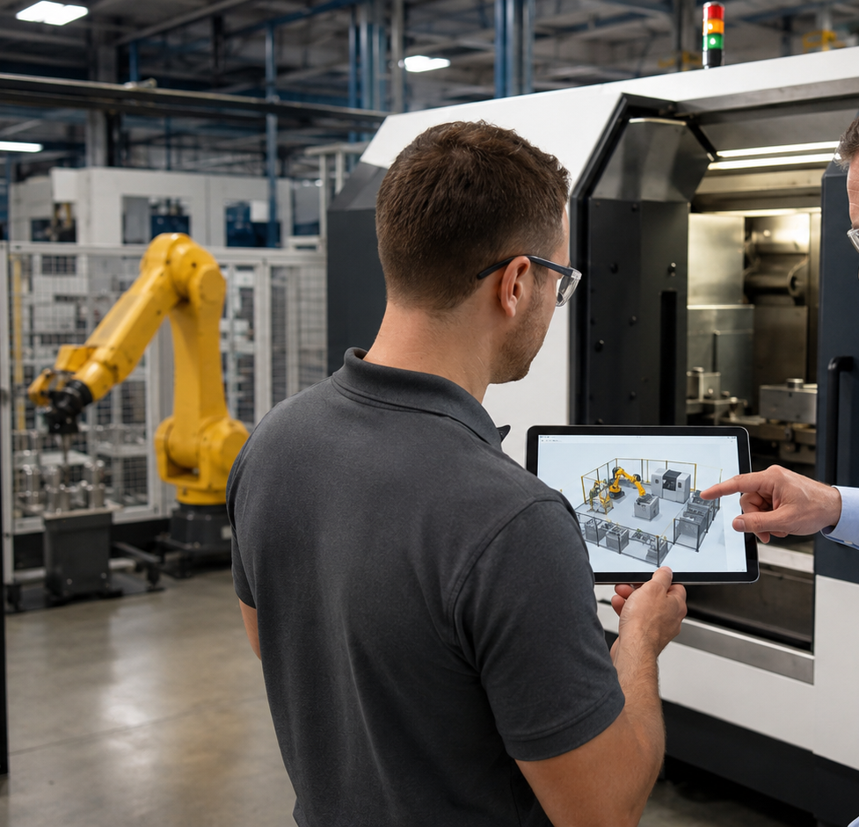
Stage 2: Diagnose
Discovery should move from symptoms to root causes, impact, stakeholders, and criteria.
1
Current process
How the application actually runs today
2
Constraint
What prevents target performance
3
Causes
Why the constraint exists
4
Consequences
Who or what is affected
5
Criteria
What must be true to proceed
Good diagnosis is not a checklist. It is a narrowing investigation.
Beyond the Robot
09
Notes:
Timing: 4 minutes. Draw the distinction between “what payload do you need?” and “what production target are you missing, and when does the process fall behind?”

Slide 10
Discovery question map
Organize questions across the full automation decision — not only the robot specification.
Operational
Technical
Where does the process miss target?
What part variability exists?
When do machines wait?
What total cell cycle time is required?
How often does part mix change?
What equipment must communicate?
Business
Organizational / Risk
What payback period is required?
Who operates and maintains it?
What costs are created by delay?
What internal automation skill exists?
Is the goal capacity, safety, or labor?
How will safety be validated?
Beyond the Robot
10
Notes:
Timing: 4 minutes. Ask learners which category sales teams tend to over-index on and which gets missed.

Slide 11
Practice: sequence the discovery
Arrange questions so the conversation moves from broad business issue to specific validation need.
What prevents the area from hitting target output?
Recommended logic
1
Start with constraint
When do the machines wait for operators?
2
Find timing and causes
How often do part families change?
3
Test variability
What payback period will finance require?
4
Surface decision economics
5
Expose adoption risk
Who will support the system after launch?
Activity
11
Notes:
Timing: 5 minutes. Have tables rank the five questions. Debrief: discovery is not only question quality, it is question order.

Slide 12
Stage 3: Quantify
Translate operational evidence into a defensible value case.
Northstar evidence uncovered
recoverable
capacity
reduced
losses
Potential value
+
21.5s
18s
12h
24mo
actual cycle time
target cycle time
weekly overtime
payback threshold
total implementation cost
Value is not “labor saved.” It is the sum of recoverable capacity, reduced operating losses, and risk reduction — minus total implementation cost.
Use ranges and validated assumptions — not invented precision.
Beyond the Robot
12
Notes:
Timing: 5 minutes. Ask learners which metric they would validate first. Discuss why cycle time alone may not capture shift-change waiting, downtime, quality, or support risk.

Slide 13
Stage 4: Tailor
The same automation cell needs a different value story for each stakeholder.
One automation solution — five different buyer concerns
Plant manager
Manufacturing engineer
Maintenance
Safety
Finance
Output, delivery, investment risk
Feasibility, cycle time, part handling
Reliability and troubleshooting
Hazards and validation
Payback and uncertainty
Message: recoverable capacity + confidence
Message: testing + simulation + application fit
Message: diagnostics + training + standard parts
Message: risk assessment + operating modes
Message: ranges + assumptions + milestones
Facilitator cue: ask which stakeholder would object first if the seller only talks about robot price and payload.
Beyond the Robot
13
Notes:
Timing: 4 minutes. This layout uses equal-width cards so the stakeholder categories align visually. Tailoring changes the message, not the underlying facts.

Slide 14
Stage 5: Advance
Taking control means guiding the customer toward the next useful decision.
1
2
3
4
5
Discovery call
Application review
Part testing
Risk assessment
Proposal
align on problem
validate process data
prove handling feasibility
define safety concept
scope the business case
Weak close
Strong advance
“Should I send a proposal?”
“Let’s validate cycle time, part handling, changeover, and safety before selecting equipment.”
Advance the decision
14
Notes:
Timing: 4 minutes. The five numbers are aligned to equal columns and are not interactive. Stress that a proposal before validation often creates scope churn, discount pressure, and stalled opportunities.

Slide 15
Final application: respond to Northstar
Learners build a spoken or written response, then compare it to a model answer.
Learner task
Facilitator listens for
1
Reframe
What assumption will you challenge?
✓
Starts with a useful decision risk, not a feature claim
2
Ask
Which two questions matter first?
✓
Prioritizes missing evidence over broad questioning
3
Quantify
Which impact must be validated?
✓
Connects impact to capacity, quality, labor, or risk
✓
Guides the buyer to validation rather than a premature quote
4
Advance
What step should happen before proposal?
Response pattern: credible hypothesis → prioritized discovery → validated value driver → specific technical validation step
Application
15
Notes:
Timing: 5 minutes. This is not a workbook slide. Ask learners to draft or speak their response, then compare against the model answer on the next slide.

Slide 16
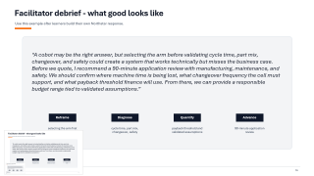
Facilitator debrief - what good looks like
Use this example after learners build their own Northstar response.
“A cobot may be the right answer, but selecting the arm before validating cycle time, part mix, changeover, and safety could create a system that works technically but misses the business case. Before we quote, I recommend a 90-minute application review with manufacturing, maintenance, and safety. We should confirm where machine time is being lost, what changeover frequency the cell must support, and what payback threshold finance will use. From there, we can provide a responsible budget range tied to validated assumptions.”
Reframe
Diagnose
Quantify
Advance
selecting the arm first may create risk
cycle time, part mix, changeover, safety
payback threshold and validated assumptions
90-minute application review
Beyond the Robot
16
Notes:
Timing: 3 minutes. Reveal this after learners share. Use it as a model, not a script they must memorize.

Slide 17
Takeaways
The best automation seller protects the customer from premature product selection.
1
Start with insight
Teach the customer something useful about the decision they are about to make.
2
Earn the specs
Use discovery to prove which specifications matter and why.
3
Quantify responsibly
Tie the business case to validated assumptions and ranges.
4
Guide the next step
Move the opportunity toward technical validation, not just a quote.
Automation Advisor = insight + diagnosis + value + momentum
Close
17
Notes:
Timing: 2 minutes. Close by tying the training back to customer trust and differentiated selling.

Slide 18
Appendix: 45-minute timing plan
Use as a facilitator reference slide or remove before presenting.
0–3
Opening challenge
3–7
What are we really selling?
7–12
Feature vs. outcome selling
12–18
Reframe + activity
18–26
Diagnose + question sequencing
26–32
Quantify value
32–37
Tailor to stakeholders
37–42
Advance the opportunity
42–45
Final response + close
Note: This deck includes speaker notes for facilitation cues.
Appendix
18
Notes:
This slide can remain as a facilitator appendix or be removed when exporting a learner-facing version.

