Slide 1
Conversion Rate Stuff
(that we should be aware of)
All charts are regarding ecommerce and come from the source below. All data has been aggregated from a number of recent studies.
https://www.growcode.com/blog/ecommerce-conversion-rate/

Slide 2
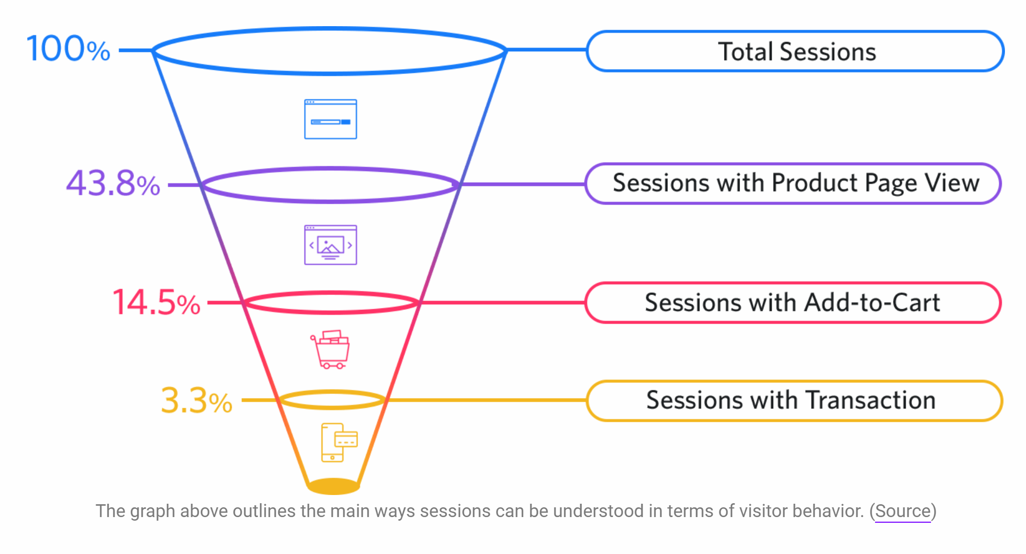
A cool conversion funnel

Slide 3
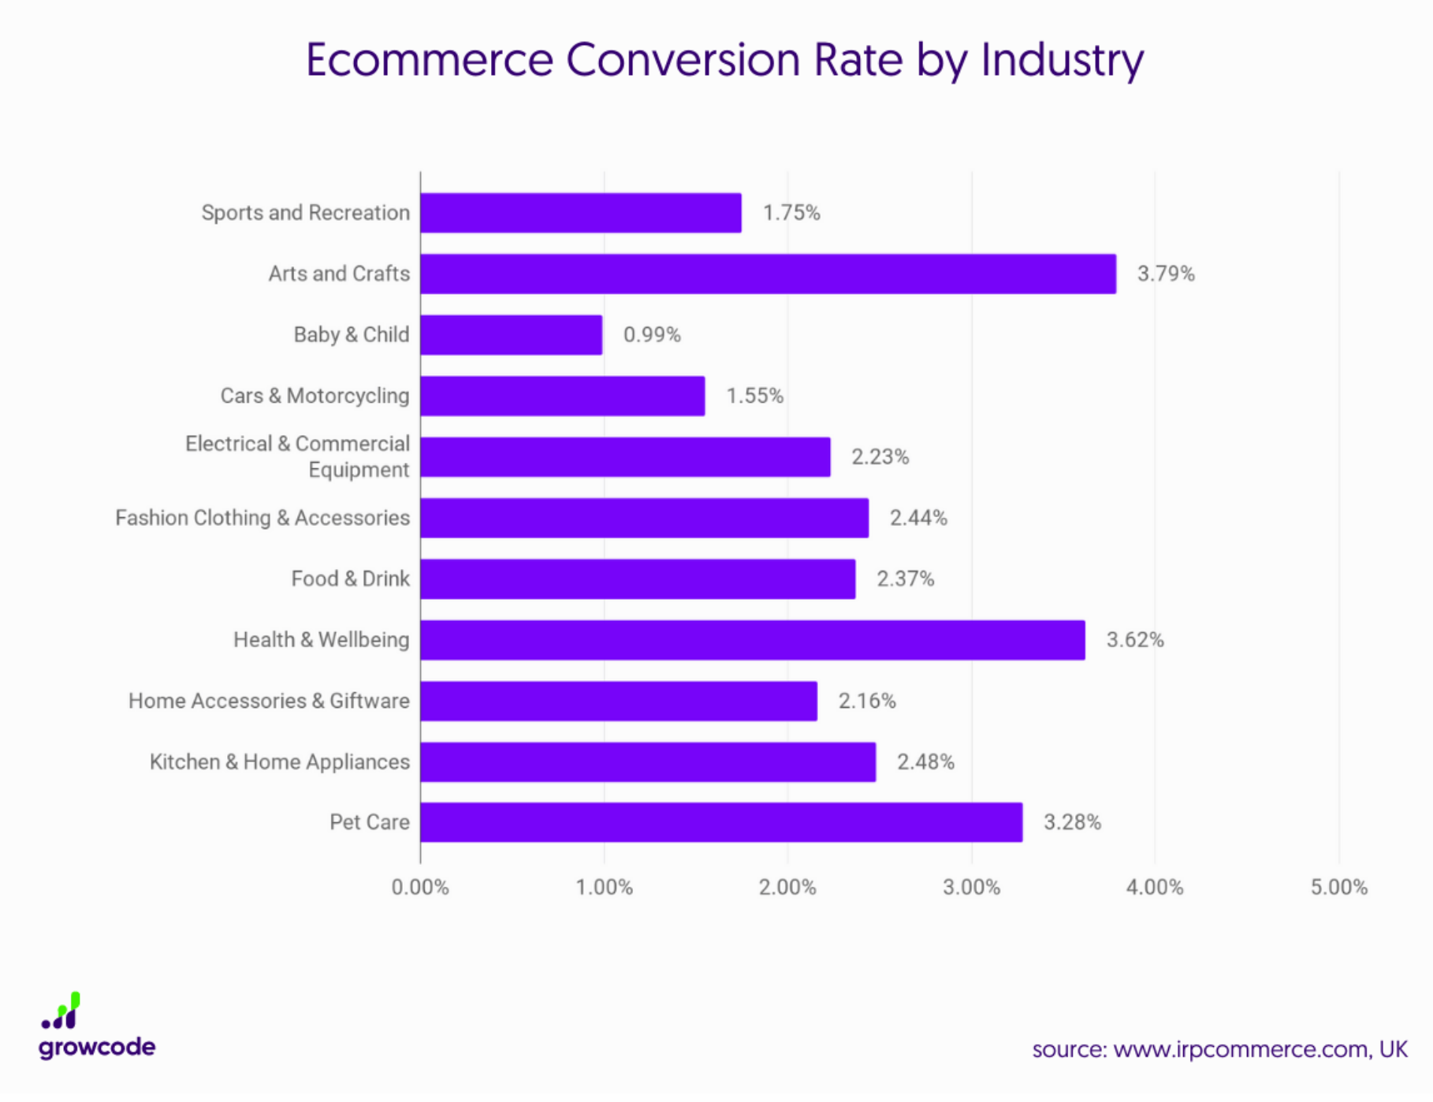

Slide 4
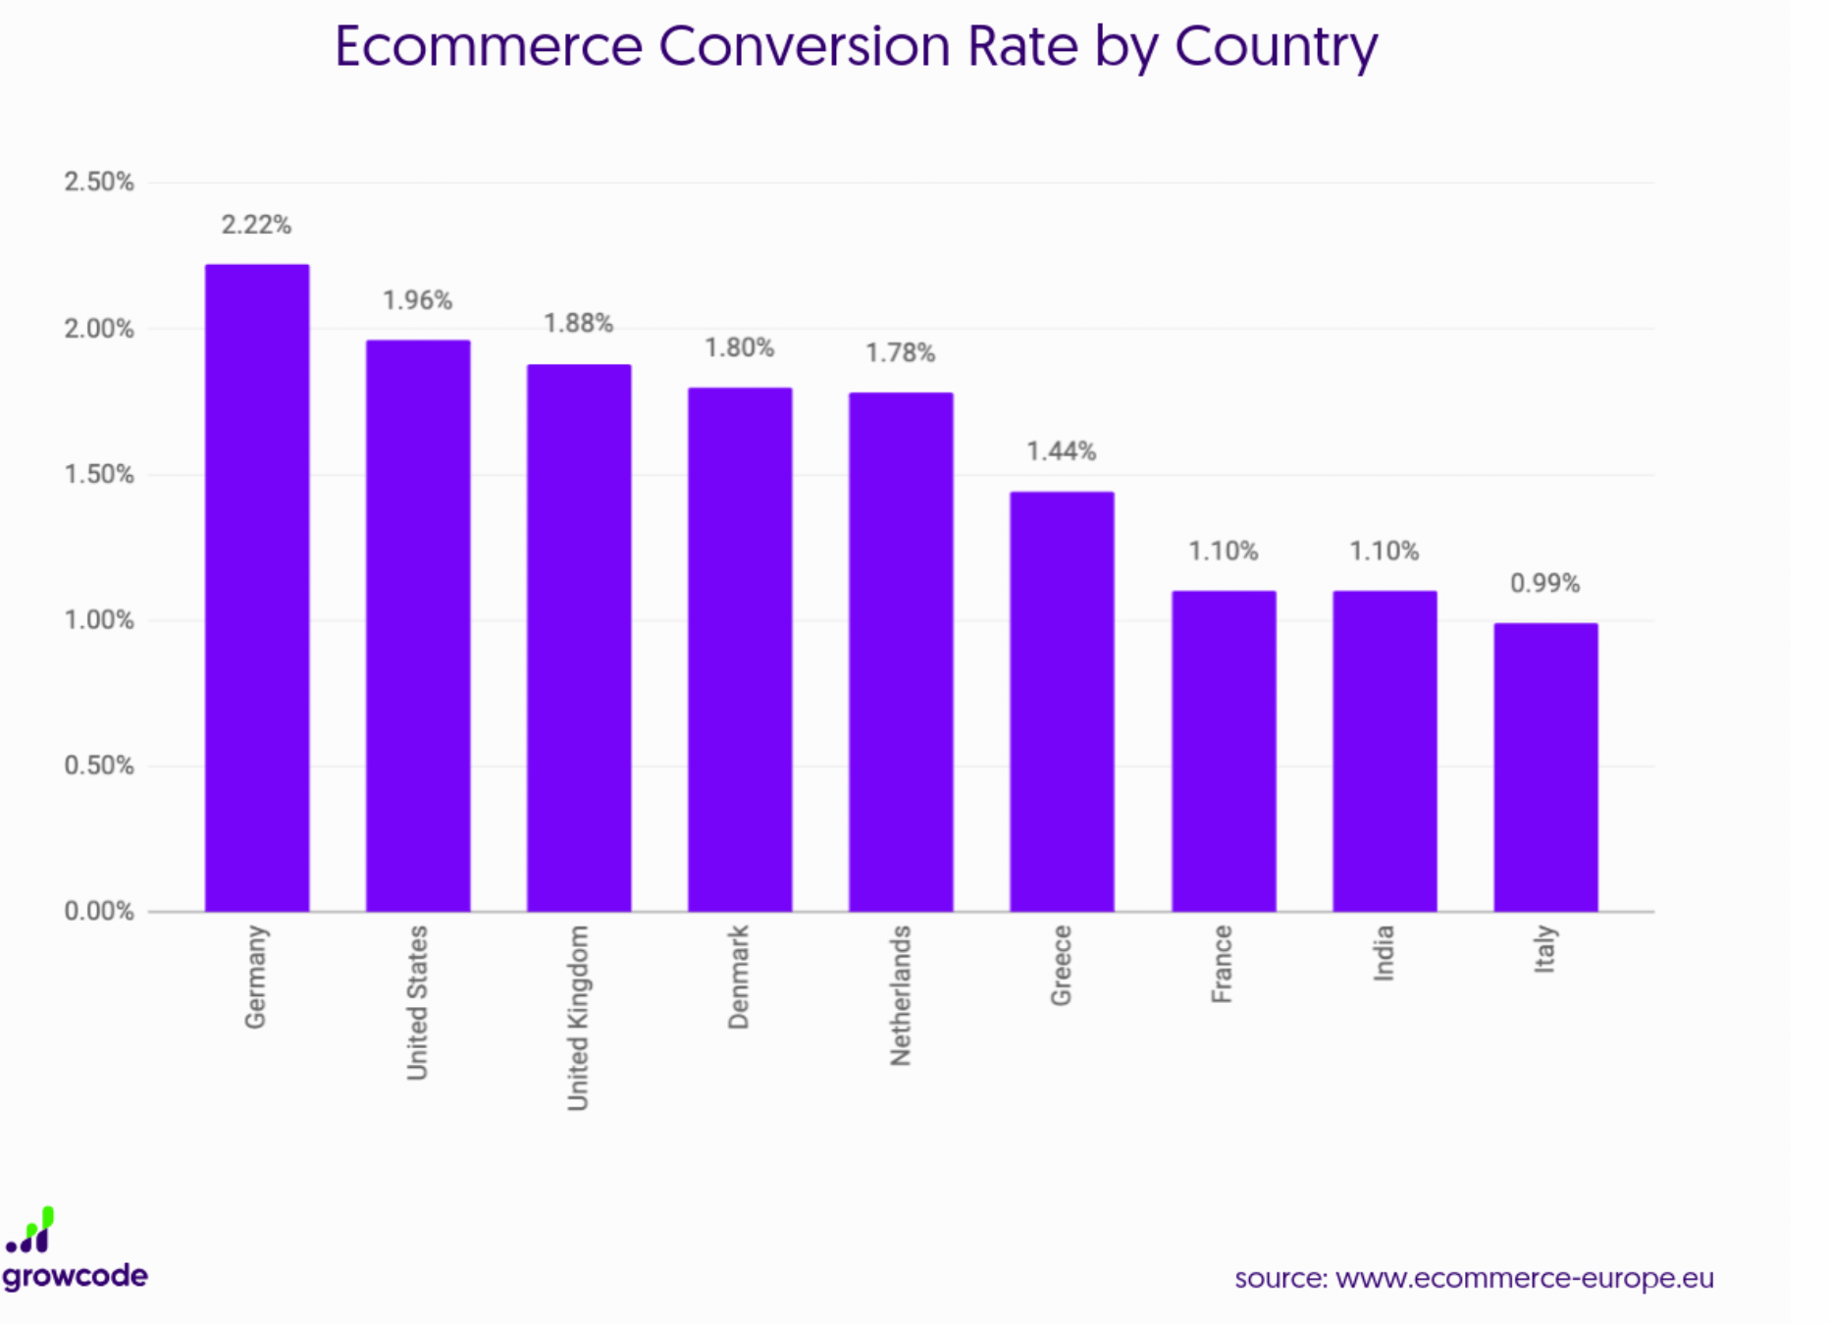

Slide 5
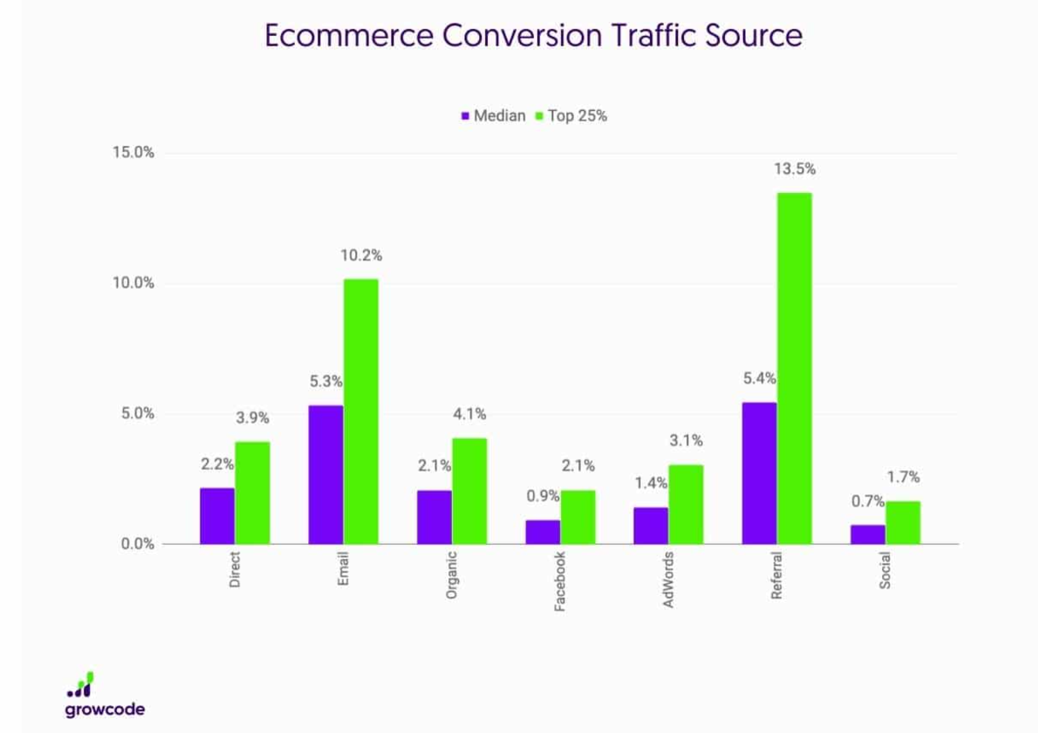
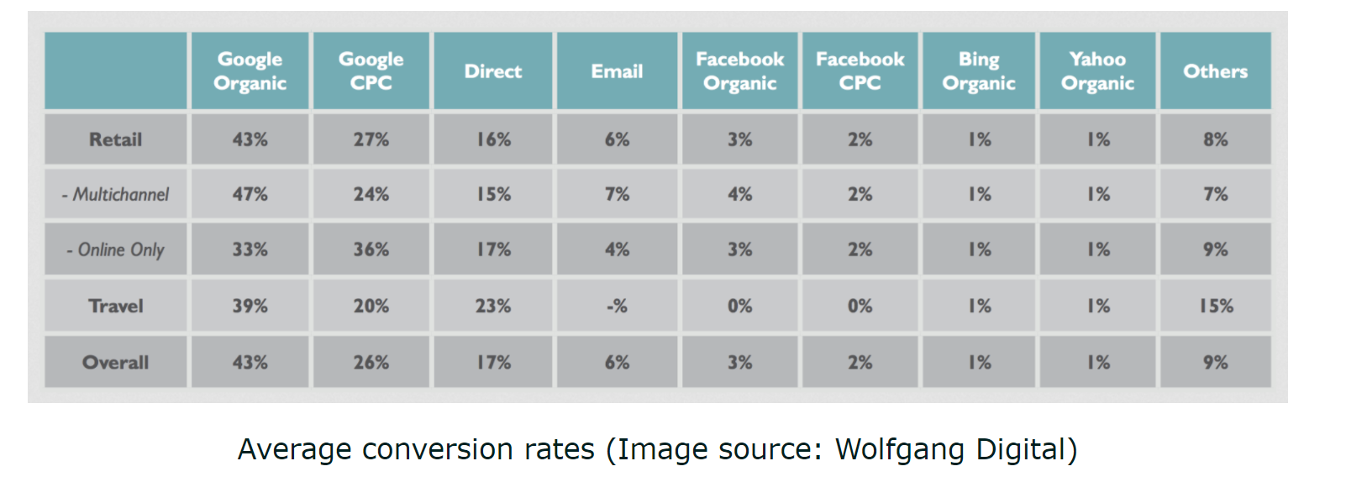
Social media conversion rates are among the lowest. E-mail is significantly better.

Slide 6
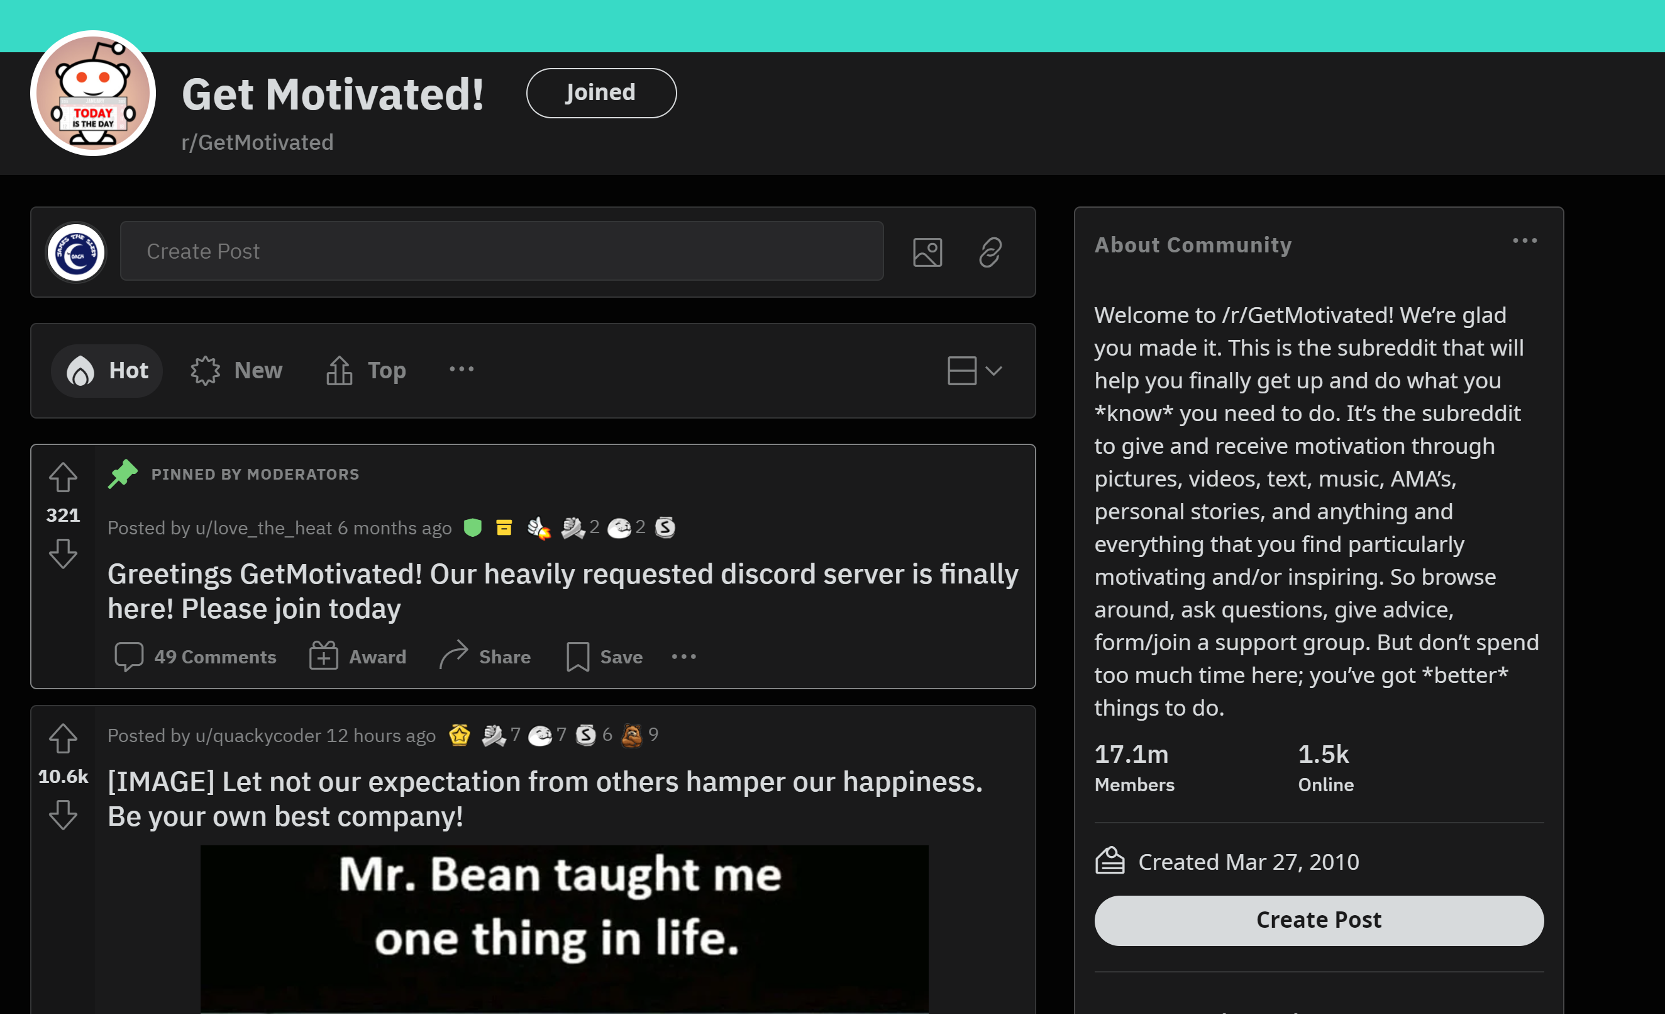
I still think we should put a greater emphasis on Reddit for our social media. I think the Sleep Coach content would fit this motivational group.
1500 people on this
Subreddit RIGHT NOW!
Look at the total number of members.

Slide 7
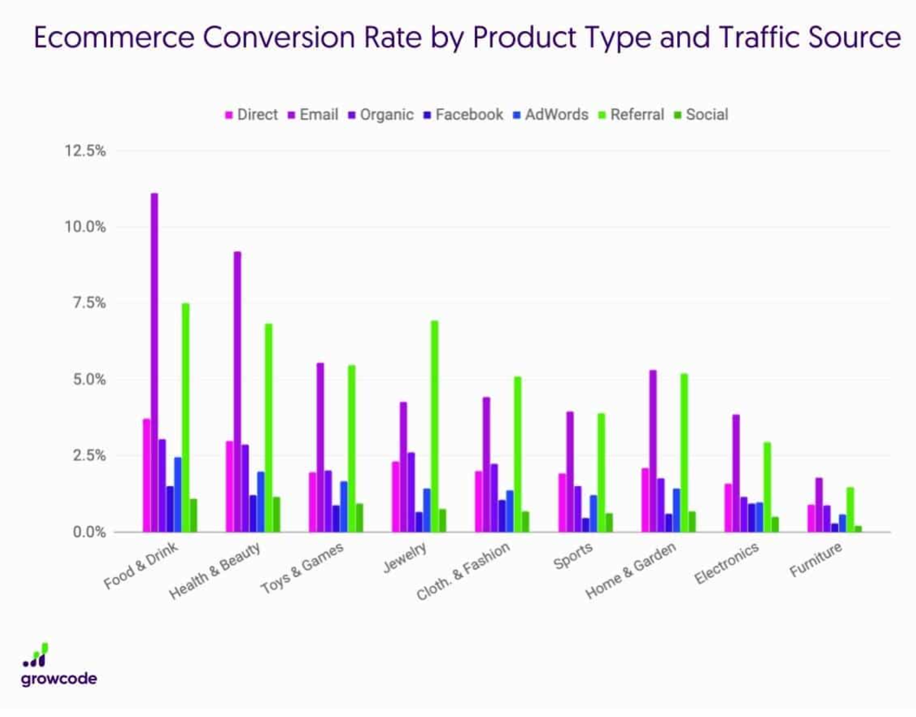
Social media very low for Health & Beauty. Email leads the way.

Slide 8
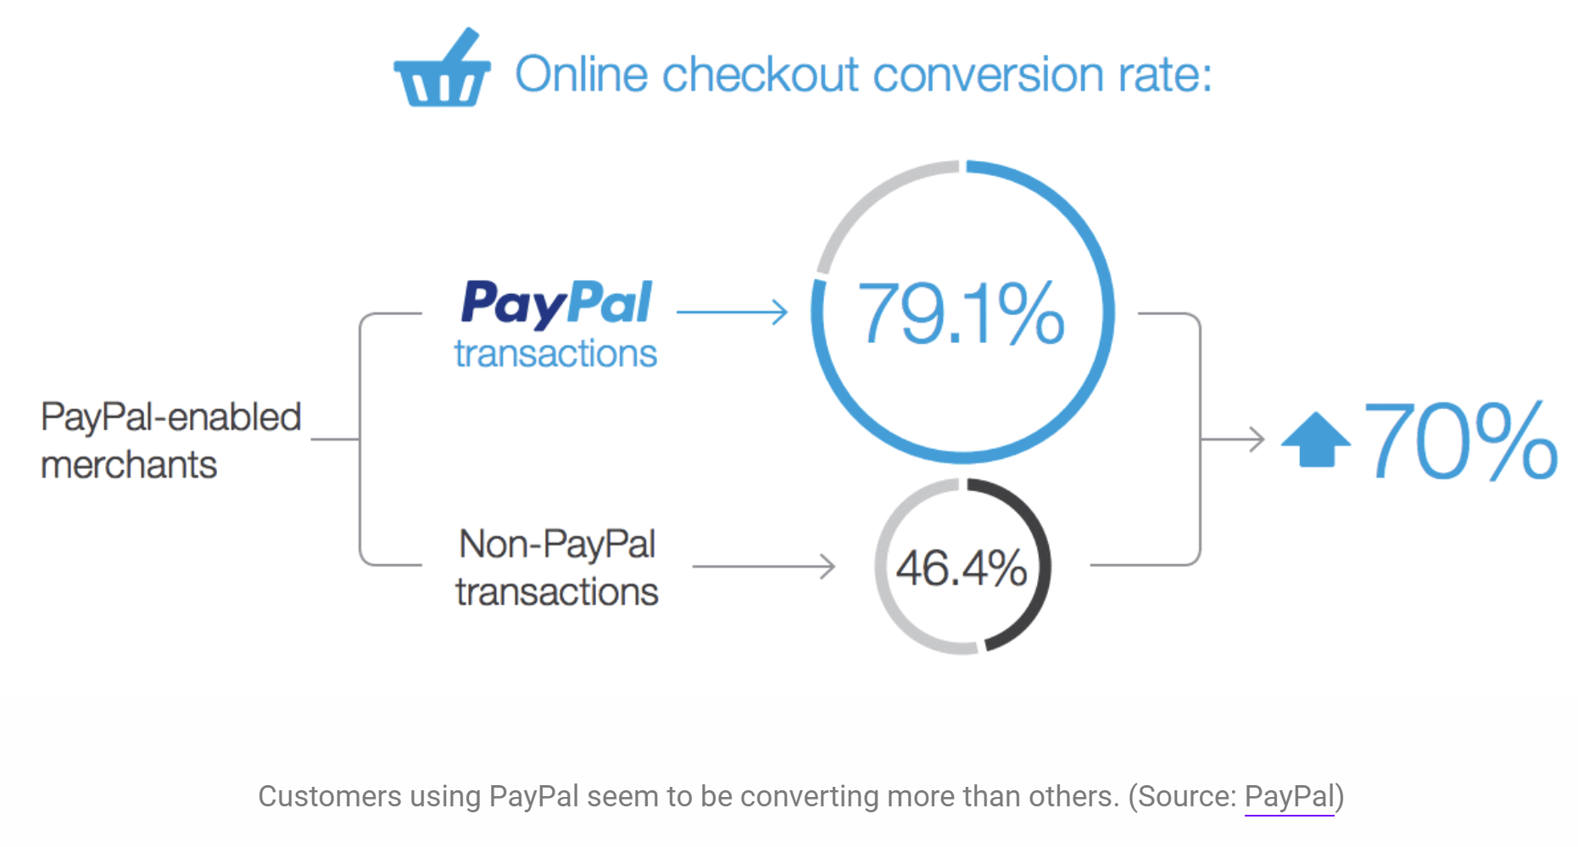
Paypal is definitely worth paying slightly higher fees for.
This is from Paypal themselves, but there are plenty of other sources saying similar. However, it does vary significanty by country.

