Slide 1
BackboneJS
Lucas Guillermo Solares Figueroa - 2018336
Jonathan Alexander Lima Ruiz - 2018485

Slide 2


Slide 3

PIONERO
CÓDIGO ESPAGUETI

Slide 4
MVC?

Slide 5


Slide 6

MV*
V
R
M
C

Slide 7
DEPENDENCIAS?

Slide 8





Slide 9
Model
Collections
Backbone.model.extends({})
Backbone.collection.extends({})
View
Routes
Backbone.view.extends({})
Backbone.route.extends({})

Slide 10
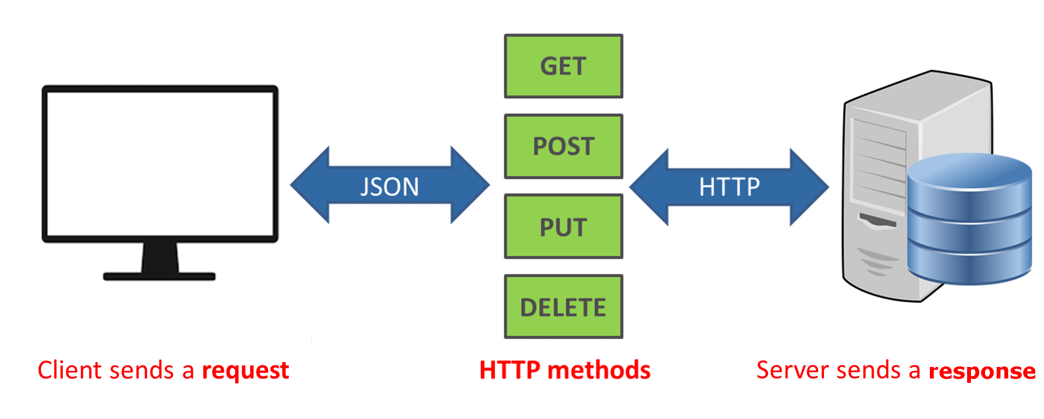

Slide 11
App’s que utilizan Backbone

Slide 12
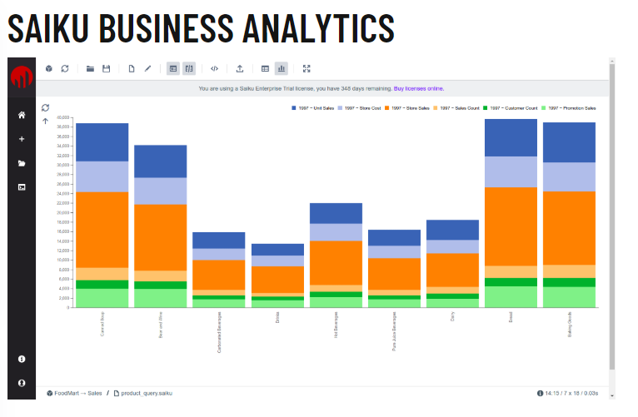

Slide 13


Slide 14
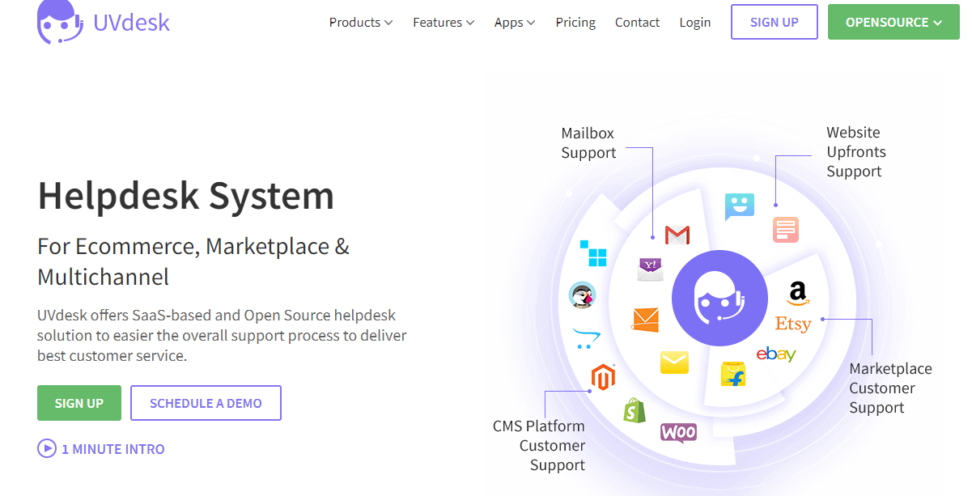

Slide 15





