Slide 1
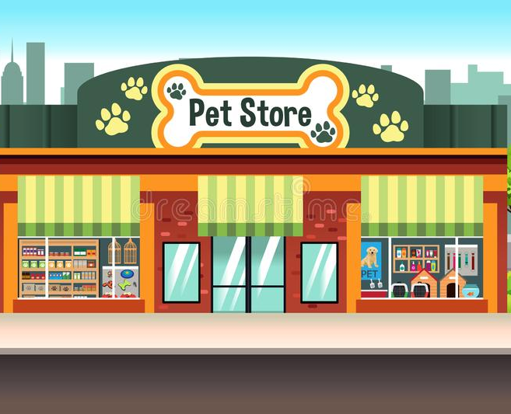
IBM Coursera Capstone
Starting a new business with Data Science

Slide 2
Where to start a new business?
Location is decisive for success
Similar neighborhoods and clients should produce similar results
Higher population density means more potential customers
Successful businesses shows the interest of a region
Given a Pet Store in Buritis, Belo Horizonte, where should a new store be opened?

Slide 3
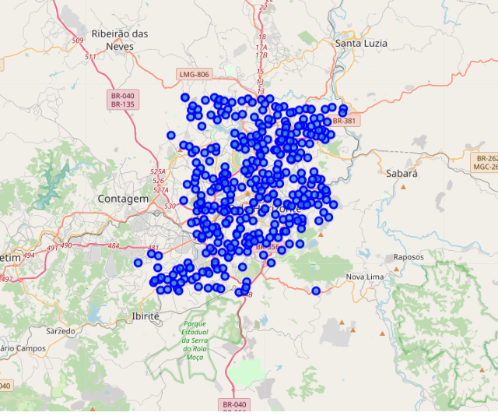
Can Data Science help?
Belo Horizonte has over 300 neighborhoods
More than 7864 venues on Foursquare
Only 98 Pet Stores

Slide 4
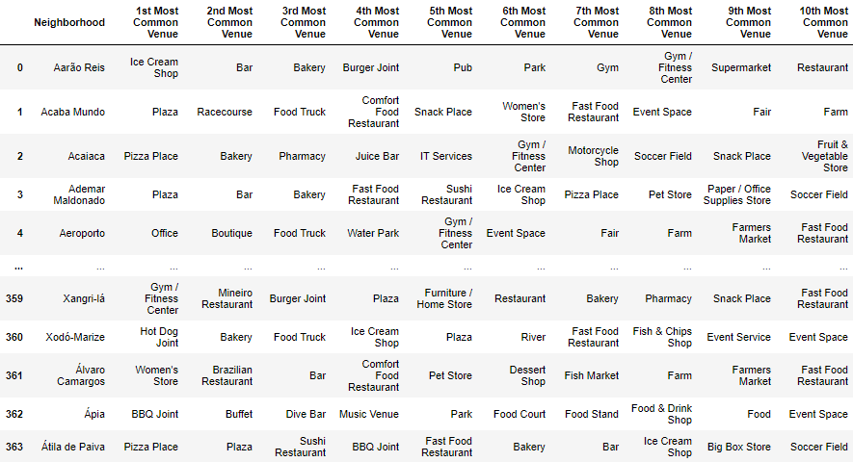
Finding similar neighborhoods
K-means clustering can be used to group neighborhoods with similar venue types

Slide 5
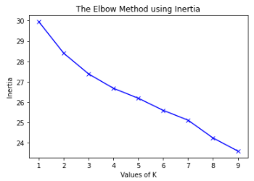
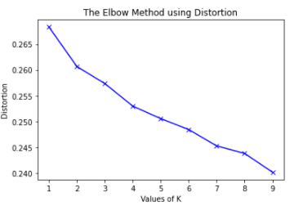
Choosing k with the Elbow Method

Slide 6
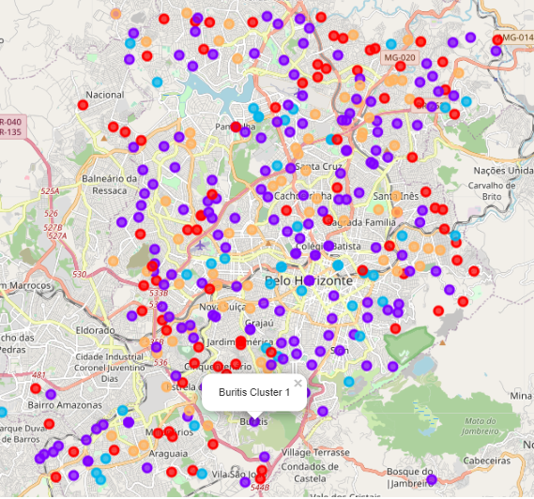
Clusters results

Slide 7
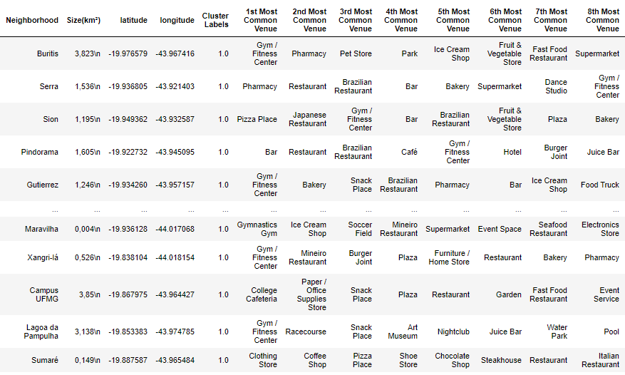
Cluster results
With a k=5 Buritis was placed in cluster 1, with a total 166 neighborhoods

Slide 8
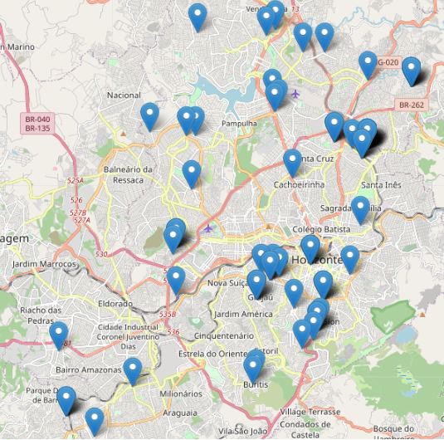
Pet Stores

Slide 9
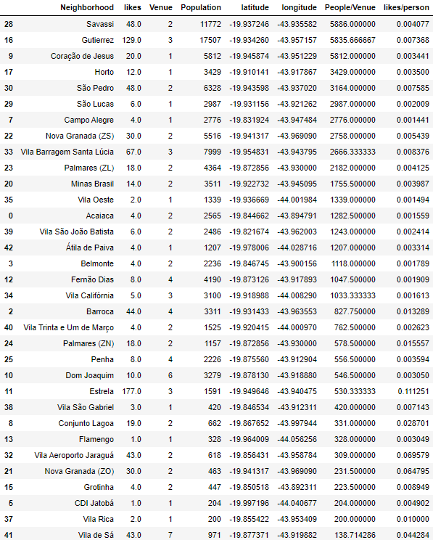
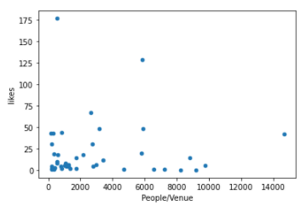
Likes/person and People/Venue
Both those indicators must be maximized

Slide 10
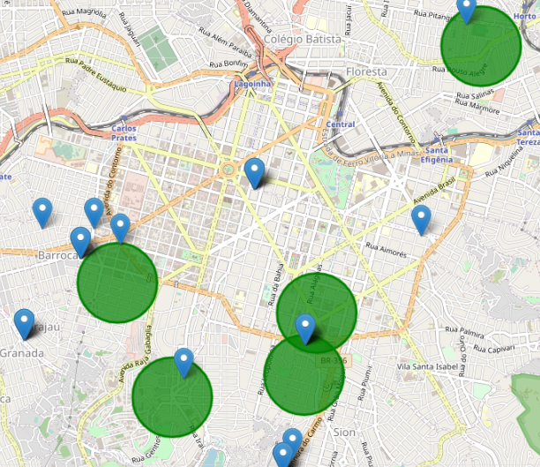
Top 5 neighborhoods

Slide 11
Conclusion
The number of “likes”, albeit sufficient for a basic analysis, is not a good measure of popularity.
Using machine learning to find the best area to open a new store should be possible if more data about the pet stores are gathered
Given prior knowledge about the city and some of its neighborhoods, the results observed in this work are realistic and would not surprise a resident of the city.
The basis of the work could be used to develop an algorithm to find the best place to open a franchise, given a list of other places where success was found.

