Slide 1
TheAgency,
Expand efficiently with Data
by Lucas Trost

Slide 2
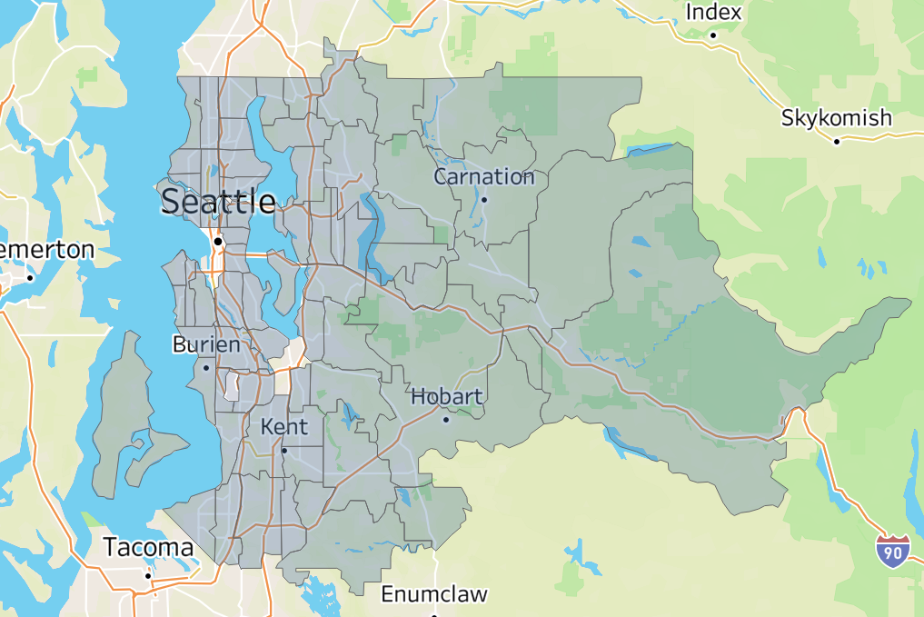
Expansion Target: Seattle
Key Focus
Gain market share in Seattle and surrounding
Secondary Focus
Expand portfolio to the east and south-east
Further steps
Enter markets of Tacoma and Bremerton

Slide 3
Strategy: Expanding with data
Study market
01
02
Create market model
Search for data
Play with, understand data
Trial & Error process
Choose basic model, advance, repeat
Gain insights
03
04
Market entry
Create competitive advantages
Vámonos!

Slide 4
Step 02: Market model (KN-Neighbours)
Model accuracy (k= 7): 72.25% -> On average the model is off by 195k
01
02
03
Map
Introduce & Measure
Neighbour
Plot our data-points on a “map”
Introduce new data & measure “distance” to existing
Calculate value based on neighbour

Slide 5
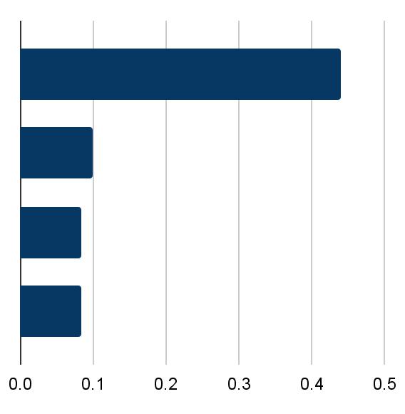
Step 03: Gain Specific Insights
Feature Importance for houses valued higher or equal to 650k $
Living Area
0.4
0.44
How big is the house?
Zip Code
0.099
0.1
Where is it located?
0.083
Year Built
0.08
When was it built?
0.083
Waterfront
0.08
Is it at the waterfront?

Slide 6
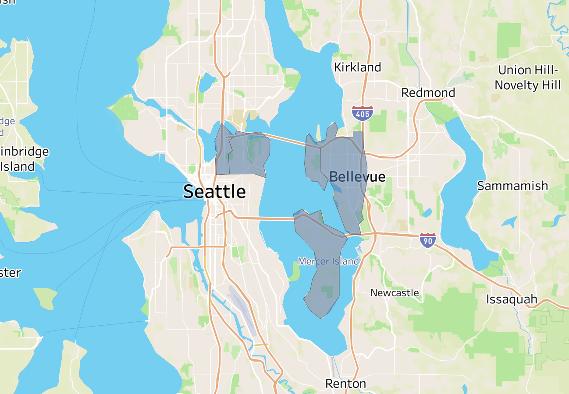
Potential Target: Luxury Properties
Large houses
In depicted zip codes
At the waterfront

Slide 7



Step 04: Market entry
Your move!
Step 4
Market entry
Step 3
Gain advantageous insights
Which features determine price
Step 2
Create market model
Rough estimate on price
Step 1
Study market

Slide 8
Thank you all for your attention!
To a successful expansion!
TheAgency
Interested in specific graphs, explanations or insights, shoot me an email at: lucas.trost@TheAgency.com

