Slide 1
Gesture Recognition Based on CNN
Runlin Hou
Sifan Yuan
Yuxiang Song
Haocong Wang

Slide 2
Introduction
Gesture recognition is a very important way which compared to primitive text user interfaces and traditional GUI.
It is widely used in daily life and applications, such as virtual reality and sign language.
Main technology:
LeNet: One of the oldest CNNs;
ResNet: Solved the degradation problem of deep neural networks using residual learning.

Slide 3
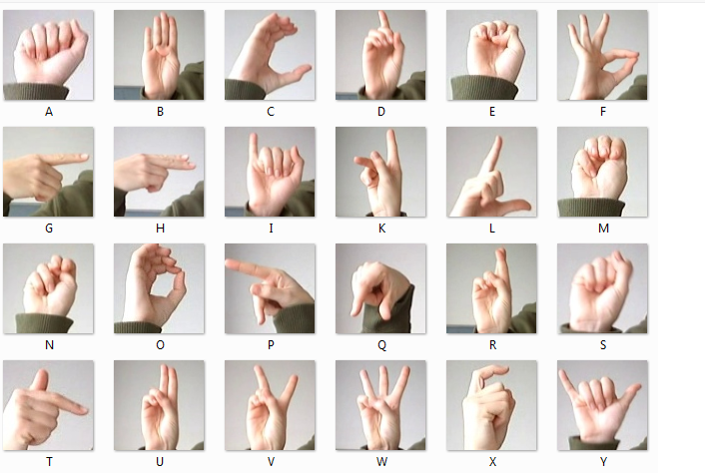
Datasets
Sign Language MNIST
One to one map for each letter with gesture;
27455 training cases and 7172 test cases;
Each case is a single 28*28 pixel image with
grayscale values between 0-255.
Microsoft Kinect and Leap motion
Contains 10 different gestures preformed by 14 people;
Include 10 gestures which represent 1-10;
Each sample's data acquired together color images.

Slide 4
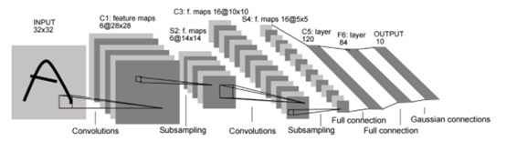
Model 1: LeNet5
Only 7 layers
Structure: input layer → convolutional layer → pooling layer → activation function → convolutional layer → pooling layer →activation function → convolutional layer → fully connect layer → fully connect layer → output layer
Original LeNet can only deal with gray scale images
Ours: both RGB and grey scale

Slide 5
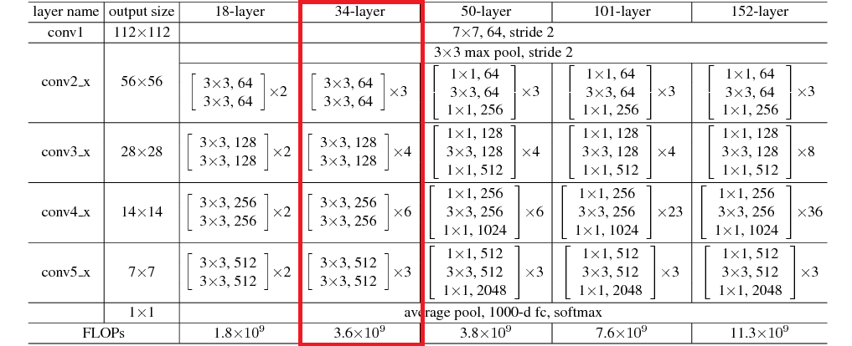
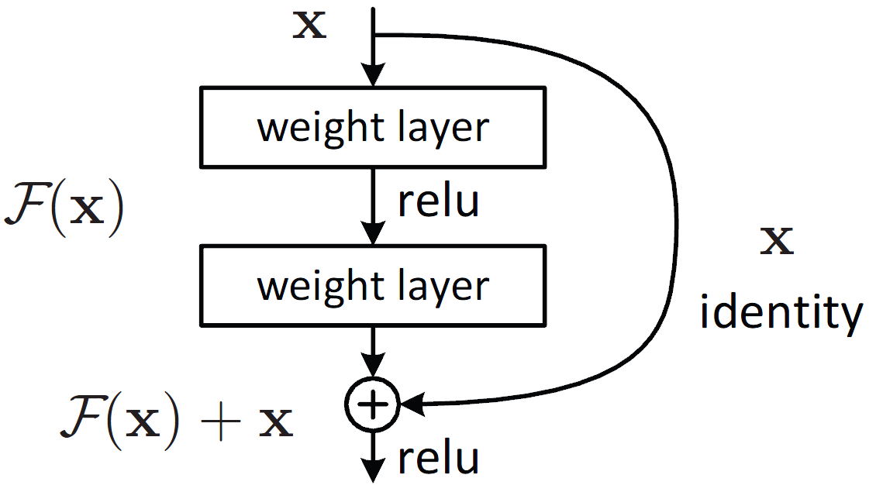
Model 2: ResNet34
Solve the problem of information loss
Use a shortcut to connect the layers
Include a repetitive structure called residual block

Slide 6
Experiments
Three sets of comparative tests:
How different models work on same dataset
How the gray scale of the image influence the result
How the size of training data influence the result

Slide 7
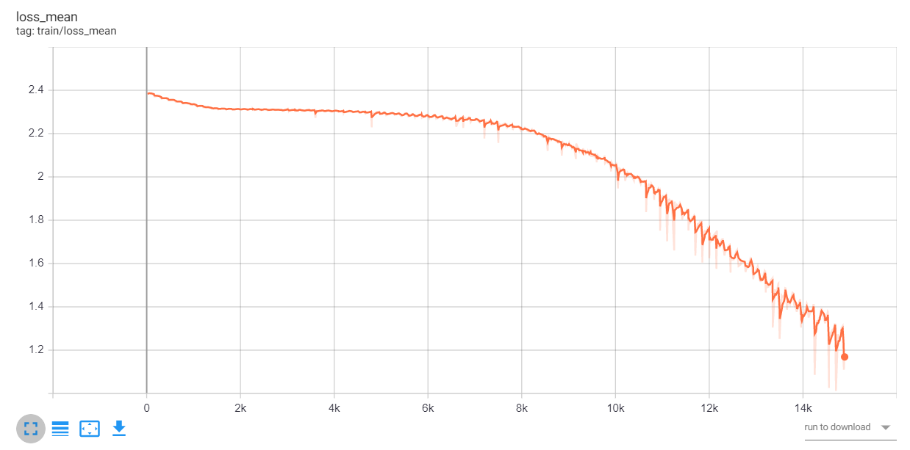
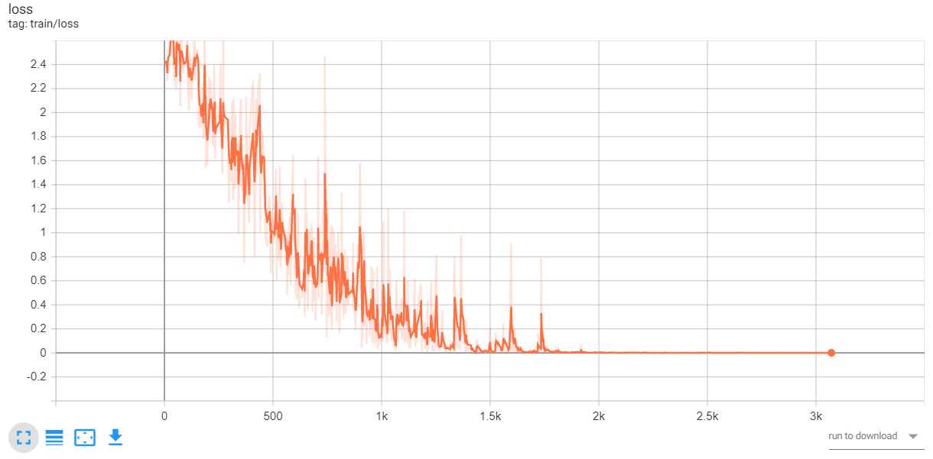
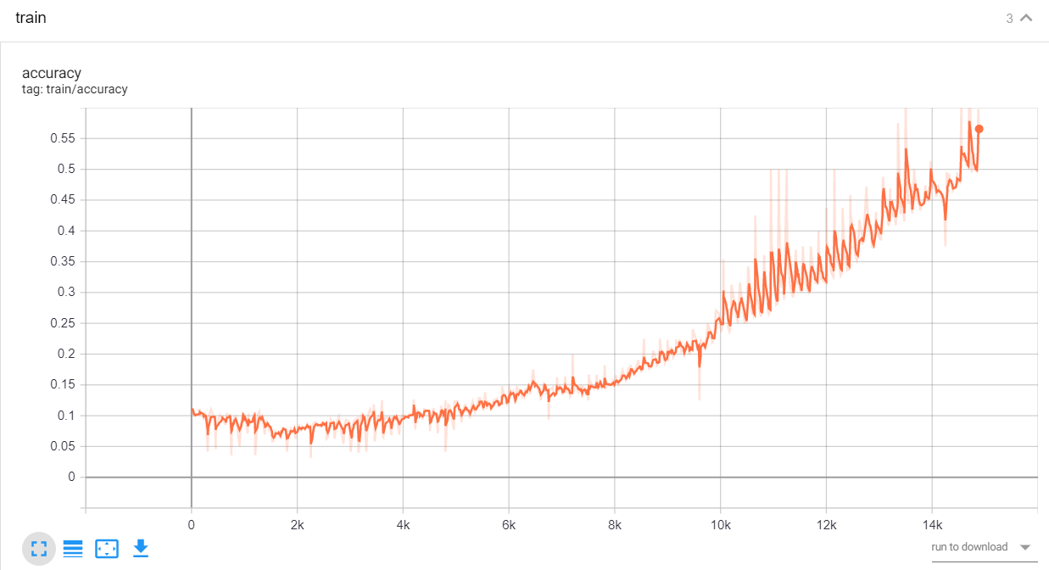
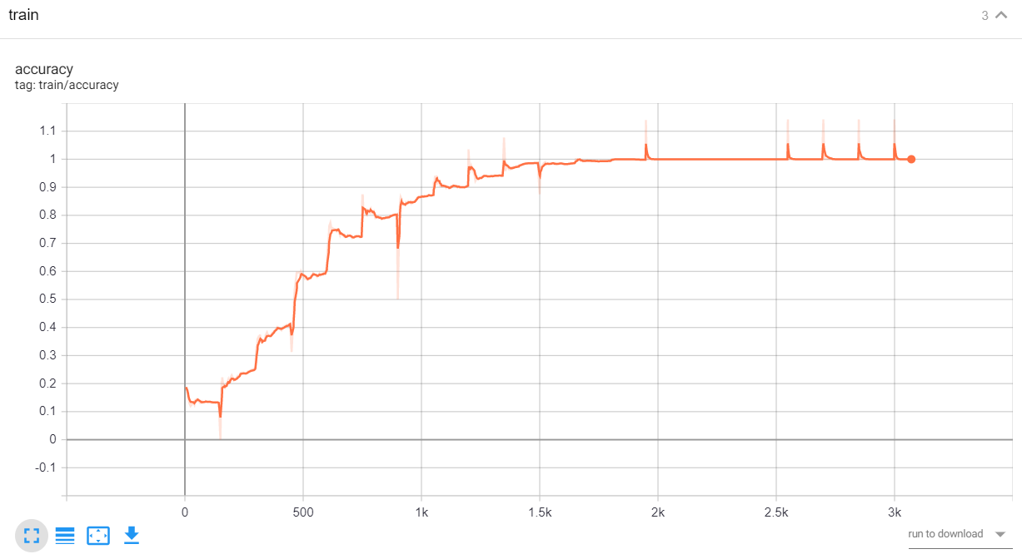
LeNet5 and ResNet34 work on Kinect Leap Dataset
Loss
Acc
LeNet5
ResNet34
Notes:
topleft-LeNet,loss,kleap topright-ReNet,loss,kleap
Botleft-LeNet,train,kleap Botright-ReNet,trian,kleap

Slide 8
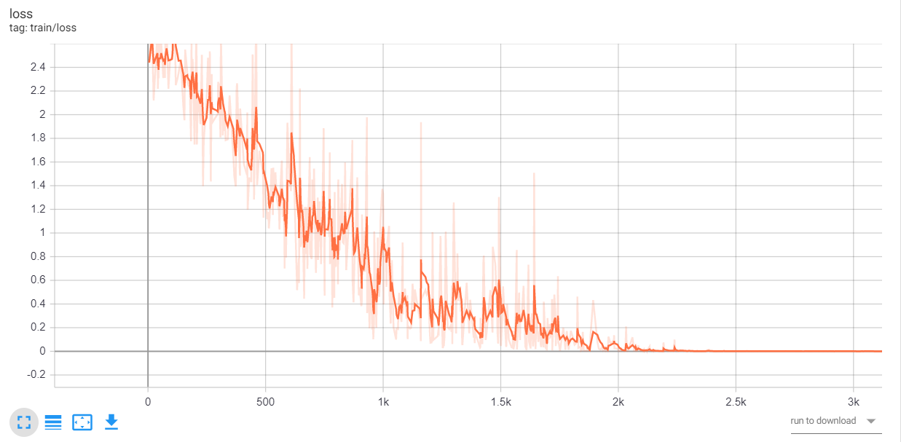
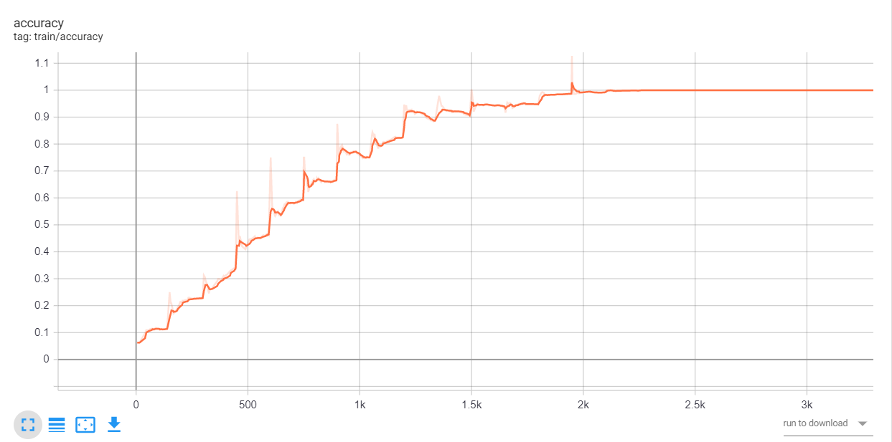
ResNet34 works on Kinect Leap with Gray Scale and RGB
Loss
Acc
Gray Scale
RGB
Notes:
topleft-Re,gray topright-Re,rgb
botleft-Le,gray botright-Le,rgb

Slide 9
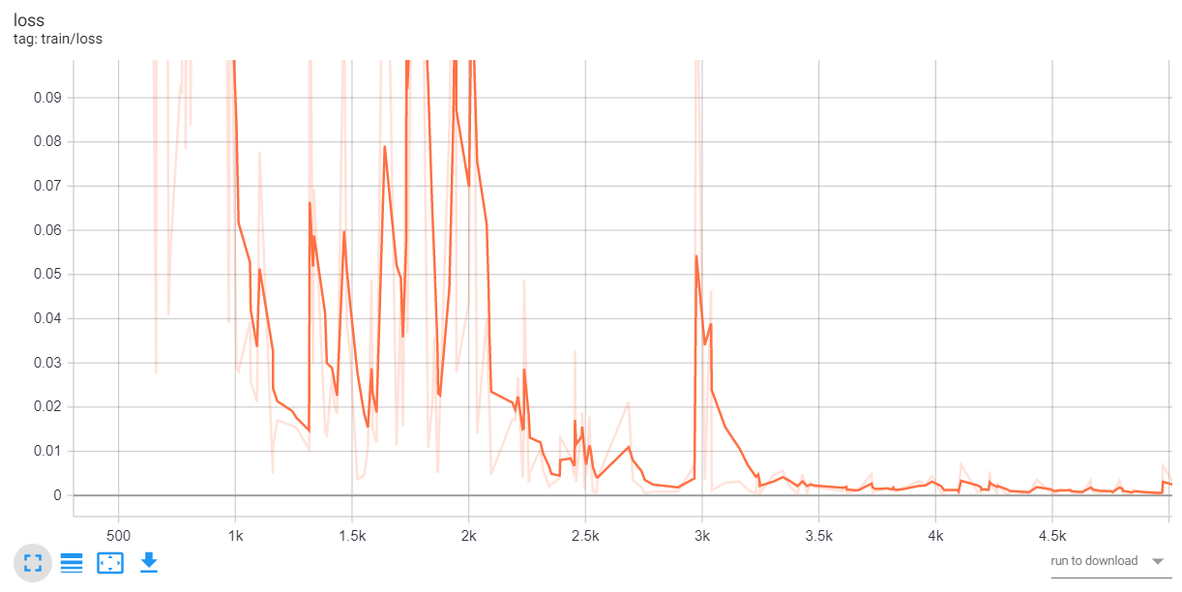
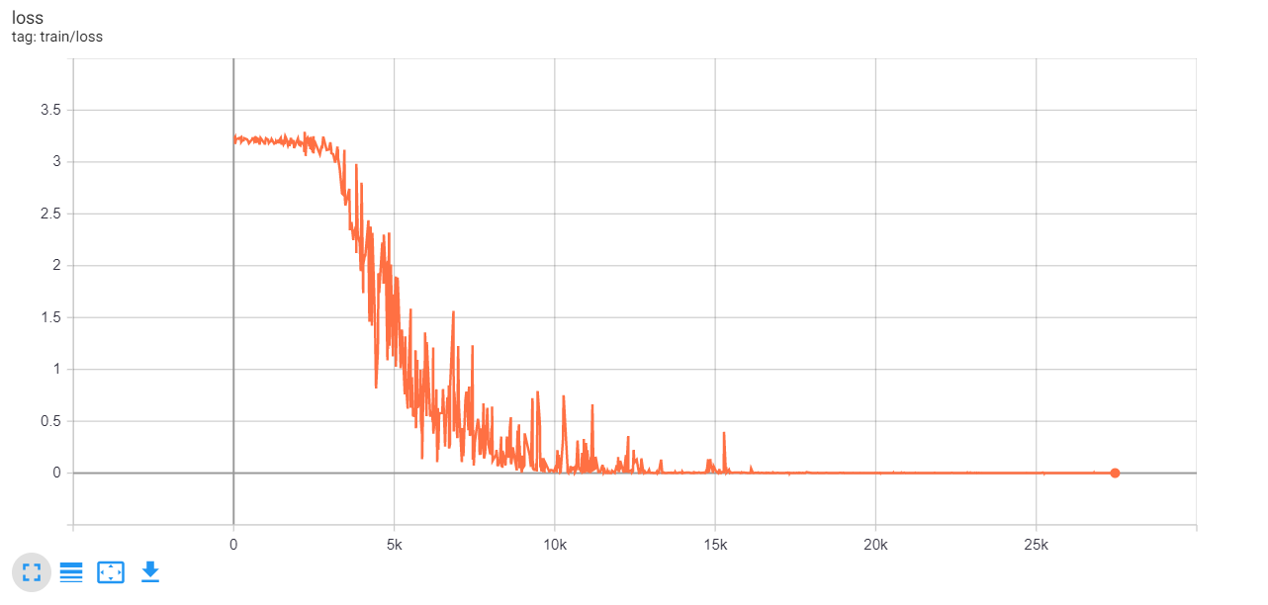
LeNet5 and ResNet34 work on MNIST and Kinect Leap set
ResNet34
LeNet5
Kinect Leap
MNIST
Notes:
Res leap Res mnist
Le leap Le mnist

Slide 10
Demonstration
More convenient to get the gesture recognition result.
Collect the experiment results and analyse the performance of different model
Choose the best model
Preprocess the image and finally do prediction
Demo

Slide 11
Future Work
Develop large-scale networks with deeper model and higher training speed
Dynamic gesture recognition

Slide 12
The End

