Slide 1

VIDEO ONLINE EXAMINATION INVIGILATION GUIDELINES (Open/Close BOOK)
2021/09
31 DECEMBER 2021

Slide 2
Introduction
Fairness and feasibility in the operation of the online examination are crucial to eliminating the chances of cheating.
Online final exams will be conducted through Microsoft Teams, and the students must have a smartphone and a computer connected with high-speed internet to attend the University’s online examination.

Slide 3
During Exam
The lecturers or invigilators enter the Teams invigilation 40 minutes before the examination to check attendance (students are required to show their faces and IDs) and check the students’ surroundings (no virtual background is allowed).
Students must join the MS Teams 30 minutes before the examination.
The invigilator must record the entire exam session in MS Teams so that the authority can review the recorded session if needed.

Slide 4
During Exam
The invigilator will "pin" the student for a closer view and, if necessary, may ask them to show their surroundings again if they are suspected of violating the exam rules.
Any violations of camera rules and requirements (including the malfunctioning camera, poor internet connections and others), the students might subject to retake the final exam.
Students must ensure that the camera screen is set to ON mode during the WHOLE exam session with NO Virtual/blurred background and the battery is sufficient.

Slide 5
During Exam
Students cannot leave the seat unless get the permission from invigilators.
Compulsory hand written exam (hand-written answers/solutions on digital device is not permitted).
All questions must be asked via Teams chat provided for the exam. Do not message the lecturer privately.

Slide 6
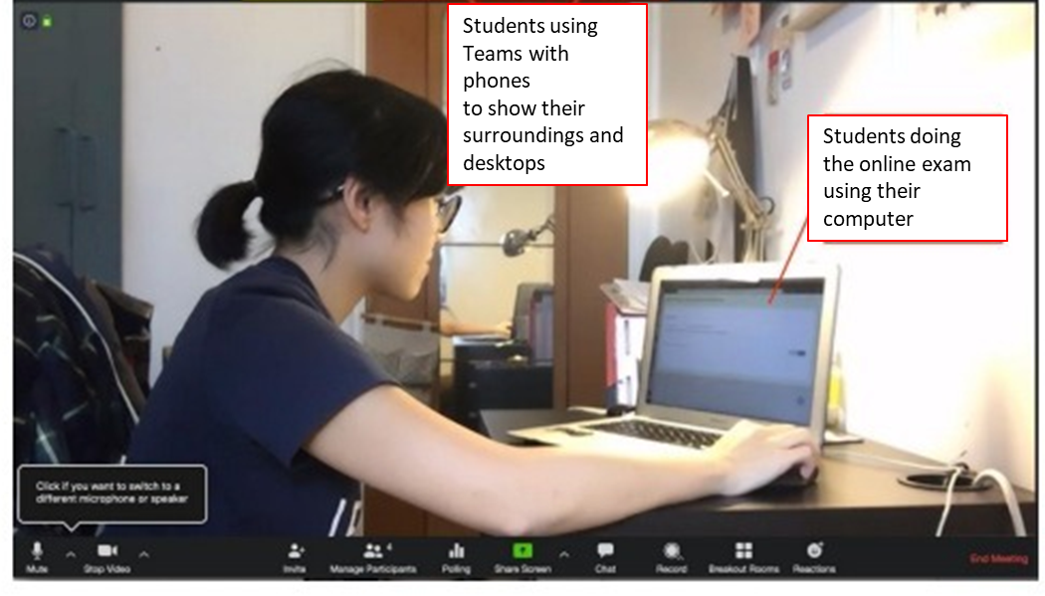
During Exam-Important
When everyone has done registering for their attendance, the invigilator will allow students to adjust their phone camera so that their desks, hands and themselves are captured clearly (Figure 1).
Figure 1. Camera Positioning

Slide 7
Answer Script Submissions
When time is up, students are given Extra Minutes to take a clear photo or scan what they have written, convert the photos into one PDF file, and submit it onto Moodle.
Before scanning by phone, you must switch to computer camera.
Students must double-check the converted PDF file to ensure that no page is missing and everything is legible.
Students must check that the submission in Moodle is complete, the correct file was selected and submitted. Late submission will be not accepted.

