Slide 1
COM207– Digital Electronics
Arrangements for the FINAL EXAM

Slide 2
SCOPE OF THE EXAM
Questions will be from all the chapters including tutorials.
Mostly logic solution type questions
There will be some short answer type questions as well
You can check Quizes for an idea

Slide 3
EXAM FORMAT
Written EXAM
  Three questions (30+40+30=100 marks)
  Each question has inter-related sub questions
    3 to 4 sub questions
  All together 9-10 questions each approximately 10 marks.
  No need to use any software for the exam

Slide 4

EXAMINATION
Tentative Plan
  Announcements, completion of cover page of answer book and check question paper cover page
  Total exam time: 2 hours

Slide 5
BE AWARE OF ACADEMIC MISCONDUCT
Answers copied from Internet or any other student will receive zero mark
Suspected academic misconduct cases (if any) will be reported to the exam unit for further investigations

Slide 6
QUERIES DURING THE EXAM
If you have any questions/queries during the exam regarding questions, you are not allowed to ask (Except if you find out that there are some data or values missing in the question).
Understanding question and identify appropriate answer is considered part of your exam.
During the exam time do not use any platform/means to communicate with any other students.

Slide 7
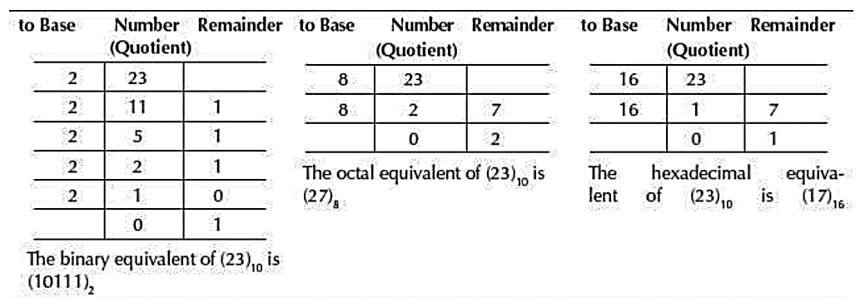
How to ANSWER?
Write your answers and you need to show all the steps to get the result. Only answer will be marked partially. For example:
Convert 23 from Base 10 to Base 2
Correct way to answer to get full marks:
Answer will be partially marked if you write:

Slide 8
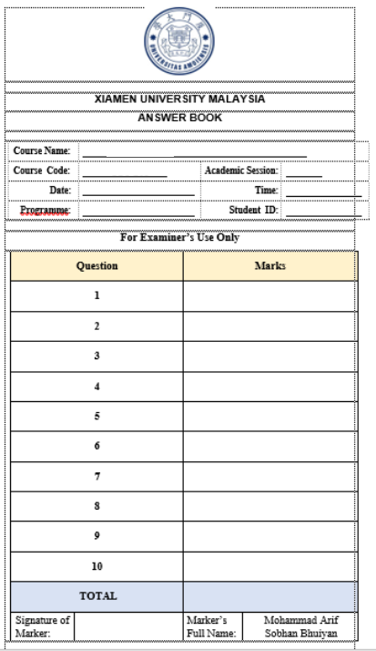

Slide 9
THANK YOU!
GOOD LUCK FOR THE FINAL EXAM! ☺

