Slide 1

202209 EEE203 instrumentation
Wang Yiju
Atifa Faaidha Binti Munauwer

Slide 2

Wang Yiju
Associate Professor
School of Aerospace and Engineering, Xiamen University
CST and EEE, Xiamen University Malaysia
wangyiju@xmu.edu.my
Office: A1-425

Slide 3
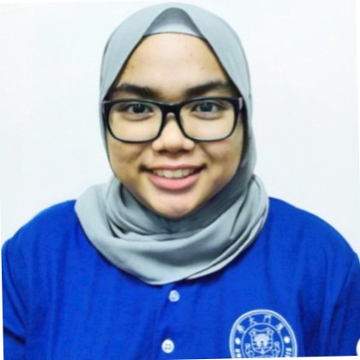
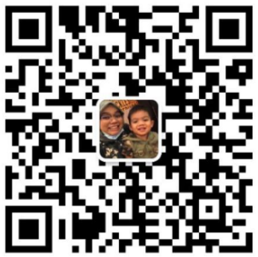


Atifa Faaidha Munauwer
EEE Laboratory Officer
Electrical & Electronics Engineering Department
atifa.munauwer@xmu.edu.my
Office: A1-208
[已打码 / redacted]

Slide 4
What is this class about?
This course prepares students for working with various types of electrical instruments.
Students will learn the basic workings of each instrument and understand their measurement accuracy, precision and errors.
Notes:
Open your mobile and see how many applications you have.
Each application takes a group of people a couple of months or years to develop.
They give us a lot of flexibility and convenience.

Slide 5
Credit Value
3

Slide 6
Programme Educational Objectives (PEOs)
PEO1 | Professionalism-Graduates will establish themselves as practicing professionals in the field of Electrical and Electronics Engineering or related fields.
PEO2 | Problem analysis and Development of Solutions-Identify, formulate, conduct research literature and analyse complex engineering problems and design solutions that meet specified needs with appropriate consideration for public health and safety, cultural, societal, and environmental considerations.
PEO3 | Continuous Personal Development-Graduates will engage in lifelong pursuit of knowledge and interdisciplinary learning appropriate for industrial and academic careers.

Slide 7
Programme Learning Outcomes (PLOs)
PLO2 | Problem Analysis - Identify, formulate, research literature and analyze complex engineering problems reaching substantiated conclusions using first principles of mathematics, natural sciences and engineering sciences.
PLO3 | Design/Development of Solutions - Design solutions for complex engineering problems and systems, components or processes that meet specified needs with appropriate consideration for public health and safety, cultural, societal, and environmental considerations.
PLO5 | Modern Tool Usage - Create, select and apply appropriate techniques, resources, and modern engineering and IT tools, including prediction and modelling, to complex

Slide 8
Learning Outcomes
Analyze electrical measuring instruments via error theory.
Design simple apparatus that improves measurement precision and accuracy.
Demonstrate electrical measuring instruments through experiments.
Notes:
After this course, I expect you so know how to program, solve a simple problem.

Slide 9
Course Outline
1. Introduction to Measurement Systems
2. Analog Instruments
3. DC and AC Measurements
4. Waveform Generation and Measurements
Notes:
15 weeks

Slide 10
Course Information
Moodle System
  http://l.xmu.edu.my/
  Course Short Name: 202209 EEE203 Instrumentation
  Enrolment key: [已打码 / redacted]
Notes:
Could someone show me you know how to use Moodle

Slide 11
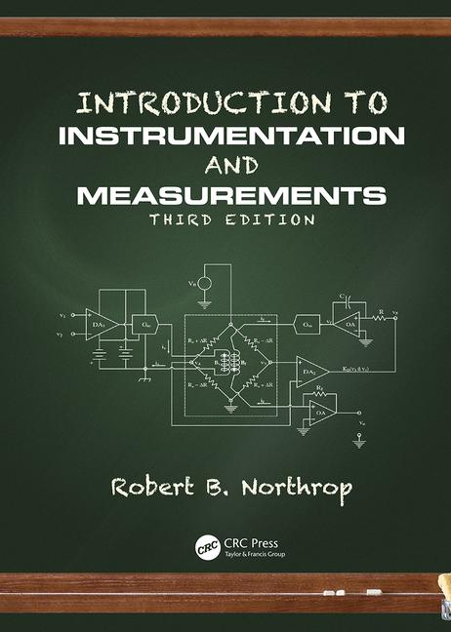
Textbook
Robert B. Northrop, Introduction to Instrumentation and Measurements, 3rd Edition, CRC Press, 2017

Slide 12
References
A. K. Sawhney, A Course in Electrical and Electronic Measurement and Instrumentation, 19th Edition, Dhanpat Rai & Sons, New Delhi, 2014
David Bell, Electronic Instruments and Measurements, Prentice Hall 2003

Slide 13
Course Information
Assessment Methods and Types:
Continuous Assessment | 50%
Assignment | 20%
Laboratory Report | 20%
Quiz | 10%
Final Examination | 50%
Total | 100%

Slide 14
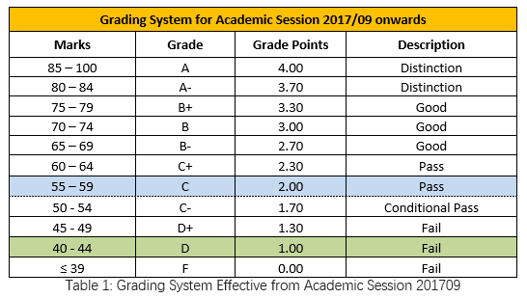
Grading System
Grading Scales and grades applicable to ALL intakes effective from Academic Session 2017/09:

Slide 15
Attendance
Attendance is required by Ministry of Higher Education Malaysia
Sick leave and other types leaves should go through standard procedures
Students will be barred from sitting final exam if their attendance rate is <80% of each course

Slide 16
Consultation Time
4-hour per week
  Tuesday, 11am-1pm
  Wednesday, 2pm-4pm

