Slide 1

Control System
Wang Yiju
Atifa Faaidha Binti Munauwer

Slide 2
Wang Yiju
Associate Professor
School of Aerospace and Engineering, Xiamen University
CST, Xiamen University Malaysia
wangyiju@xmu.edu.my

Slide 3
Atifa Faaidha Munauwer
EEE Laboratory Officer
Electrical & Electronics Engineering Department
atifa.munauwer@xmu.edu.my
Office: A1-208

Slide 4
What is this class about?
This course introduces the concepts of control system, Laplace Transform Solution, Formulation and Dynamic Behavior of Electrical Control Systems, Fundamentals of Control Systems, Time Response Analysis of Control Systems, Frequency Response Analysis of Control Systems, Stability Analysis of Control Systems, Error Analyzing and Calculating of the Control Systems.
Students will learn to use these concepts to design and analyze efficient control systems.
Notes:
Open your mobile and see how many applications you have.
Each application takes a group of people a couple of months or years to develop.
They give us a lot of flexibility and convenience.

Slide 5
Semester and Year Offered
04 semester or 09 semester
Y3

Slide 6
Credit Value
3

Slide 7
Programme Educational Objectives (PEOs)
PEO1 | Professionalism-Graduates will establish themselves as practicing professionals in the field of Electrical and Electronics Engineering or related fields.
PEO2 | Problem analysis and Development of Solutions-Identify, formulate, conduct research literature and analyse complex engineering problems and design solutions that meet specified needs with appropriate consideration for public health and safety, cultural, societal, and environmental considerations.
PEO3 | Continuous Personal Development-Graduates will engage in lifelong pursuit of knowledge and interdisciplinary learning appropriate for industrial and academic careers.

Slide 8
Programme Learning Outcomes (PLOs)
PLO2 | Problem Analysis - Identify, formulate, research literature and analyze complex engineering problems reaching substantiated conclusions using first principles of mathematics, natural sciences and engineering sciences.
PLO3 | Design/Development of Solutions - Design solutions for complex engineering problems and systems, components or processes that meet specified needs with appropriate consideration for public health and safety, cultural, societal, and environmental considerations.
PLO4 | Investigation - Conduct investigation into complex problems using research based knowledge and research methods including design of experiments, analysis and interpretation of data, and synthesis of information to provide valid conclusions.

Slide 9
Learning Outcomes
Analyze the stability, accuracy, and response speed of control systems manually.
Design an efficient control system with consideration of stability, accuracy, and response speed.
Evaluate the performance of control systems.
Notes:
After this course, I expect you so know how to program, solve a simple problem.

Slide 10
Course Outline
1 Introduction
2 Laplace Transform Solution
3 Formulation and Dynamic Behavior of Translational Mechanical Systems
4 Formulation and Dynamic Behavior of Electrical Systems
5 Fundamentals of Control Systems
6 Time Response Analysis of Control Systems
7 Frequency Response Analysis of Control Systems
8 Stability Analysis of Control Systems
9 Error Analyzing and Calculating of the Control Systems
Notes:
15 weeks

Slide 11
Course Information
Moodle System
  http://l.xmu.edu.my/
  Course Short Name: EEE319 Control System 2023/09
  Enrolment key: [已打码 / redacted]
Notes:
Could someone show me you know how to use Moodle

Slide 12
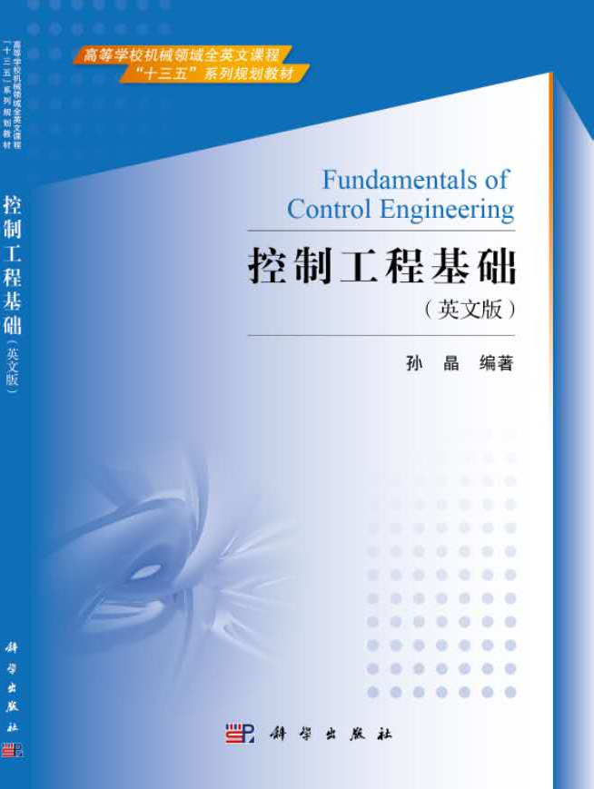
Textbook
Sun Jing, Fundamentals of Control Engineering, 1st Edition, Science Publication, 2017

Slide 13
References
Richard C. Dorf, Robert H. Bishop. Modern Control Systems. 13th Edition, Prentice Hall, 2016
Norman Nise. Control Systems Engineering, 7th Edition Wiley 2015
Katsuhiko Ogata. Modern Control Engineering. 5th Edition Pearson India 2015

Slide 14
Course Information
Assessment Methods and Types:
Assignments | 30%
Lab | 20%
Final Examination | 50%

Slide 15
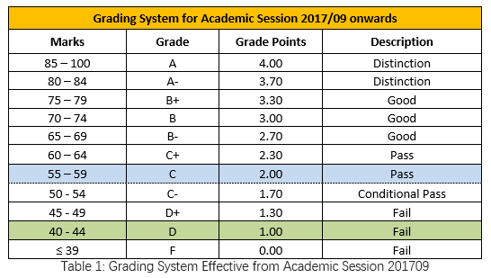
Grading System
Grading Scales and grades applicable to ALL intakes effective from Academic Session 2017/09:

Slide 16
Attendance
Attendance is required by Ministry of Higher Education Malaysia
Attendance sheet should be signed on each class, including lab sessions
Sick leave and other types leaves should go through standard procedures
Students will be barred from sitting final exam if their attendance rate is <80% of each course).

Slide 17
Consultation Time
4-hour per week
  Monday, 1pm-3pm
  Wednesday, 11am-1pm

Slide 18

Contact
wangyiju@xmu.edu.my
Teams
Wechat

