Slide 1
Tutorial 2

Slide 2
Question 1: Add the binary numbers.
(a) 11.111 and 11
(b) 11010111 and 01010001
Question 2: Subtract the binary numbers
(a) 11010 – 10111
(b) 10110010 – 111101
Question 3: Multiply the binary numbers (a) 10111 × 110010
(b) 11001 × 1011011
Change to decimal to confirm the answers.
Question 4: Perform the binary division
(a) 100111010 ÷ 1101
(b) 111010011 ÷ 11011
Change to decimal to confirm the answers.
Question 5: Convert the following numbers to BCD:
(a) 42
(b) 872.8
Question 6: Convert the following numbers to their BCD equivalents.
(a) 10101102
(b) 1100100.112
Question 7: Add the following BCD numbers.
(a) 01100100 + 00110011
(b) 100101111000 + 100101010001
Question 8: Convert the binary to Gray code.
(a) 10110
(b) 11000110
Question 9:

Slide 3
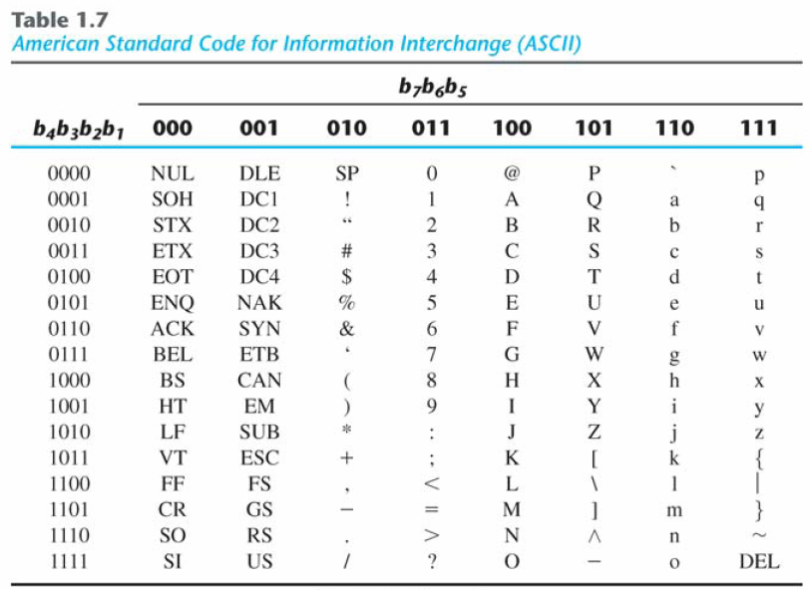
ASCII Code
*Get More information on:
ASCII code
EBCDIC code and
Unicode

