Slide 1
Tutorial 1

Slide 2
Question 1: Convert 23 from Base 10 to Base 2, 8, 16.
Question 2: Convert 147 from Base 10 to Base 2, 8 and 16.
Question 3: Convert 0.865 from Base 10 to Base 2,8 and 16.
Question 4: Convert 34.4674 from Base 10 to Base 2
Question 5: Convert 34.4674 from Base 10 to Base 8.
Question 6: Convert 34.4674 from Base 10 to Base 16.
Question 7: Convert 1011 from Base 2 to Base 10.
Convert 62 from Base 8 to Base 10.
Convert C15 from Base 16 to Base 10.
Question 8: Convert 0.1101 from Base 2 to Base 10.
Convert 0.345 from Base 8 to Base 10.
Convert 0.15 from Base 16 to Base 10.
Question 9: Convert 1011.1001 from Base 2 to Base 10.
Convert 24.36 from Base 8 to Base 10.
Convert 4D.21 from Base 16 to Base 10.
Question 10: Convert the binary number 1110101100110 to octal.
Question 11: Convert the binary number 1110101100110 to hexadecimal.
Question 12: Convert the hexadecimal number 2BA3 to binary.
Question 13: Convert the octal number 473 to binary.

Slide 3
Octal to Binary Conversion
Because each octal digit can be represented by a 3-bit binary number, it is very easy to convert from octal to binary.
Each octal digit is represented by 3 bits as shown in table below.
Octal Digit | 0 | 1 | 2 | 3 | 4 | 5 | 6 | 7
Binary | 000 | 001 | 010 | 011 | 100 | 101 | 110 | 111

Slide 4
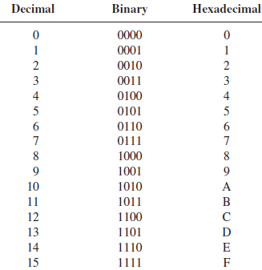
Hexadecimal system
The hexadecimal number system has a base 16. It is composed of 16 numeric (0-9) and alphabetic characters (A-F).

Slide 5

Binary Weights
The weight structure of binary number is
Positive Powers of 2 (Whole numbers) |  |  |  |  |  |  |  |  | Negative Powers of 2 (Fractional Number)
2⁸ | 2⁷ | 2⁶ | 2⁵ | 2⁴ | 2³ | 2² | 2¹ | 2⁰ | 2⁻¹ | 2⁻² | 2⁻³ | 2⁻⁴ | 2⁻⁵ | 2⁻⁶
256 | 128 | 64 | 32 | 16 | 8 | 4 | 2 | 1 | 1 2 | 1 4 | 1 8 | 1 16 | 1 32 | 1 64

Slide 6


