Slide 1
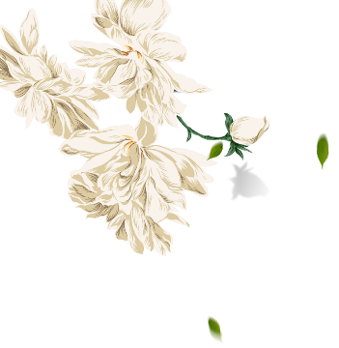
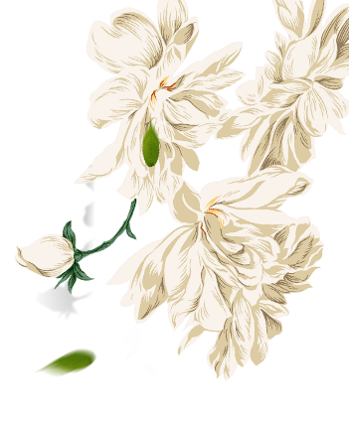
The Symbol of Marriage in Antient China
—Yue Lao
赵之航

Slide 2
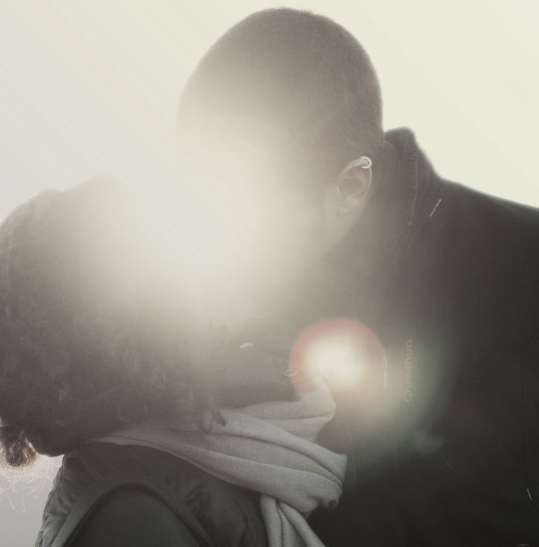
WE ARE 18
2019
Relationship
What is it?
one thing that we are all long to have and now we are no longer afraid to talk about it

Slide 3
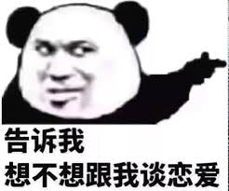
I cannot
stand lonely
There is a person, waiting for you in the depths of time. Chase your dreams became my goal, a grizzled troubadour captive of sorrow and tears

Slide 4
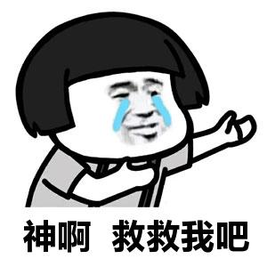
Ancient Chinese
share the same thought
There is a person, waiting for you in the depths of time. Chase your dreams became my goal, a grizzled troubadour captive of sorrow and tears

Slide 5
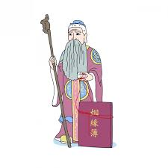

Red Thread
Stick
Marriage Book
the old lunar matchmaker god
Yue Lao

Slide 6
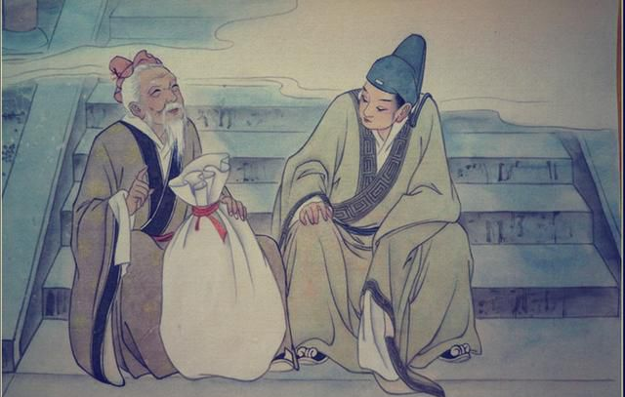
A story about Yue Lao

Slide 7
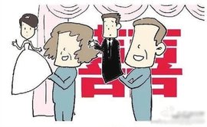
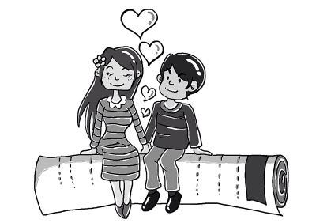
This is a god who…
Created to
resemble arranged marriage…
But eventually evolved into a symbol of free love.

Slide 8
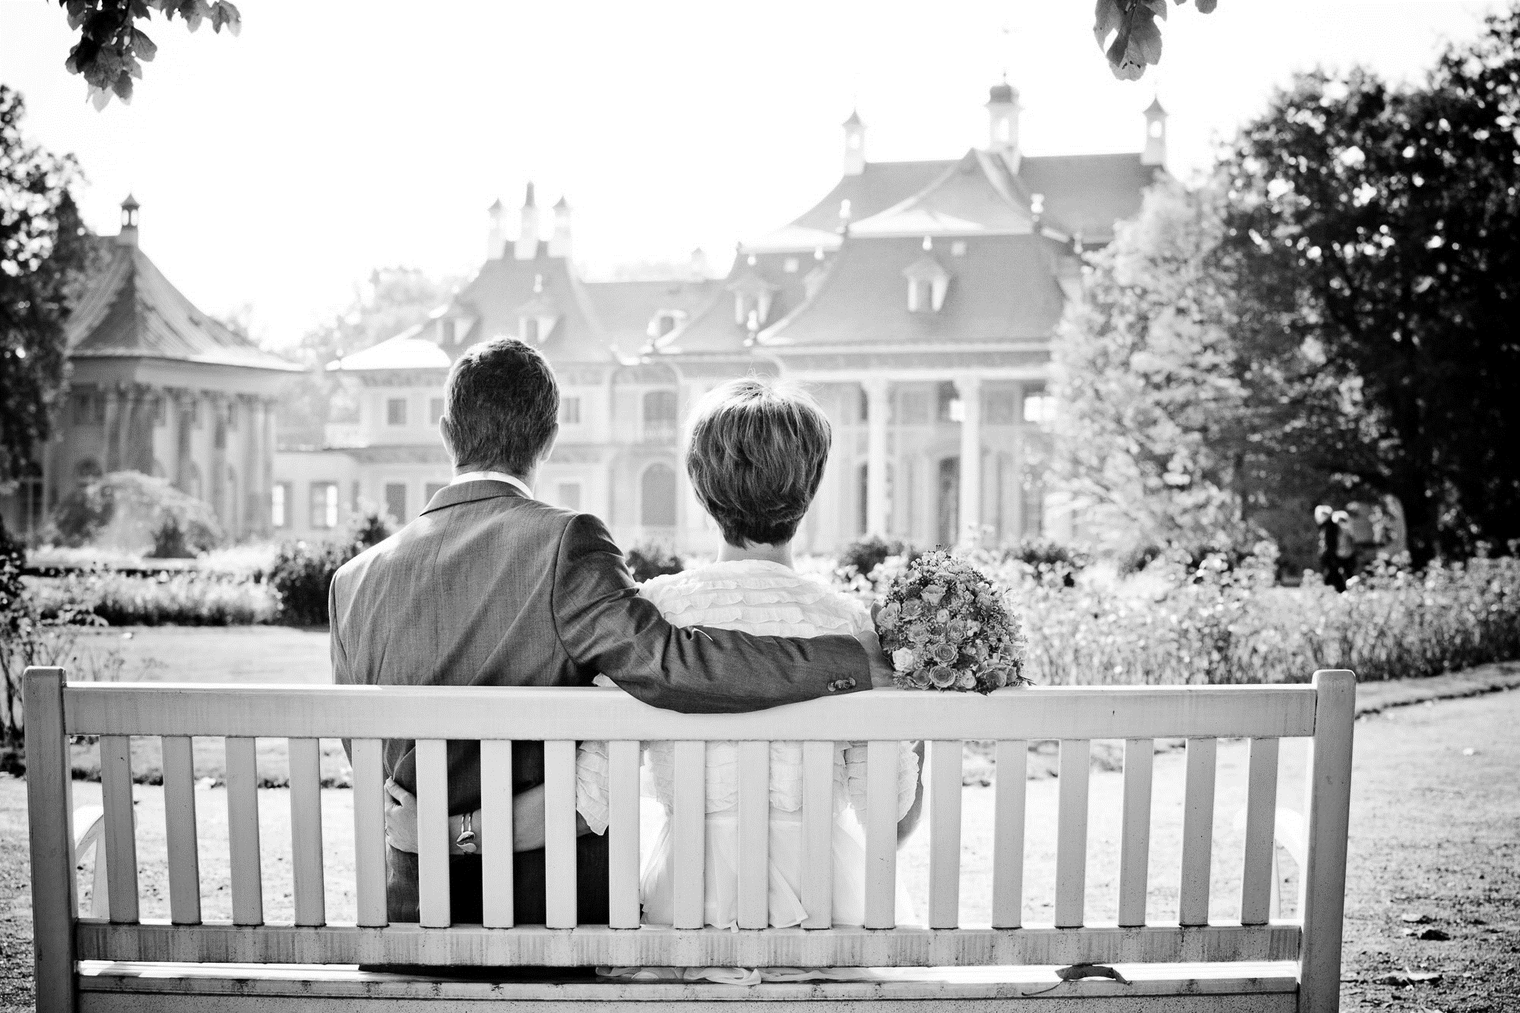
Hello, my love.
KEEPING THE FAITH
There is a person, waiting for you in the depths of time. Chase your dreams became my goal, a grizzled troubadour captive of sorrow and tears

Slide 9
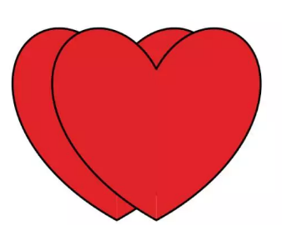
THANK YOU FOR
LISTENING

