Slide 1

Course Project
Implicit Normalizing Flows
ICLR 2021
前沿交叉学科研究院 王秋皓 龚祝萍

Slide 2






Normalizing Flows: Recap
Normalizing Flows: efficient sampling and density evaluation.
X：data
Z：random variable with a known and tractable probability density （e.g. Gaussian)
Change of variables
To enhance the expressive ability

Slide 3
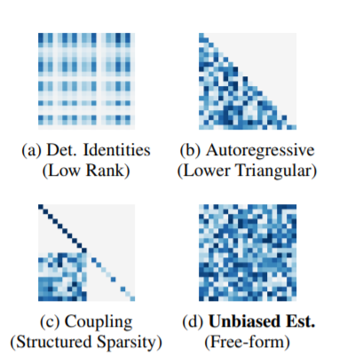
Normalizing Flows: Recap
Normalizing flows should be:
Invertible
for sampling
2. Easy to compute
for density estimation
RealNVP
MAF
3. strong expressive ability
IAF
Glow
…
4. tractable determinant of the Jacobian.
(block) triangular Jacobian matrix

Slide 4



ResFlow
Ricky TQ Chen (2019 NIPS)
Resflow
A free-form Jacobian approaches
Lemma: Resflow is invertible iff the Lipschitz constant of the residual block is Lip(F) < 1.
(Skilling-Hutchinson trace estimator)

Slide 5
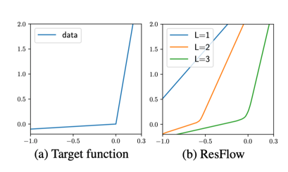
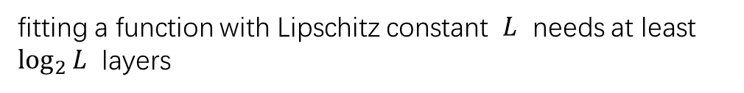
ResFlow
Invertible √
Tractable Jacobian √
What’s the limitation of ResFlow？
Lemma: Resflow is invertible iff the Lipschitz constant of the residual block is Lip(F) < 1.
The Lipschitz coefficient of ResFlow is upper bounded by 2！
Poor expressive ability！
fitting a function with Lipschitz constant $L$ needs at least $\log_{2}{L}$ layers

Slide 6


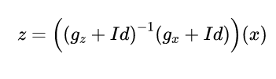
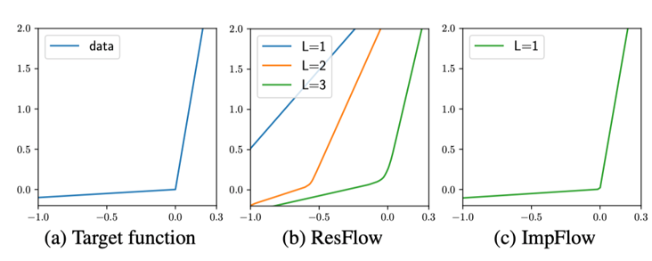
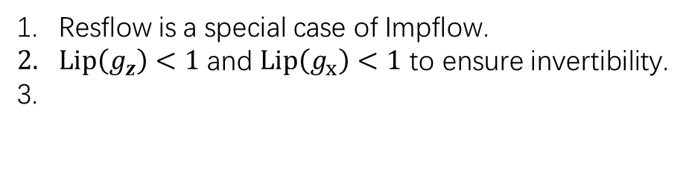
ImpFlow
Resflow
Impflow
Explicit defined
Implicit defined
Resflow is a special case of Impflow.
$Lip\left(g_{z}\right)<1$ and $Lip\left(g_{x}\right)<1$ to ensure invertibility.
eliminate Lipschitz restriction

Slide 7

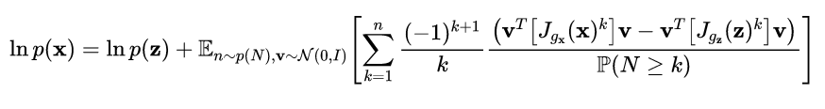
ImpFlow
The logdet term in MLE
Resflow
Impflow

Slide 8



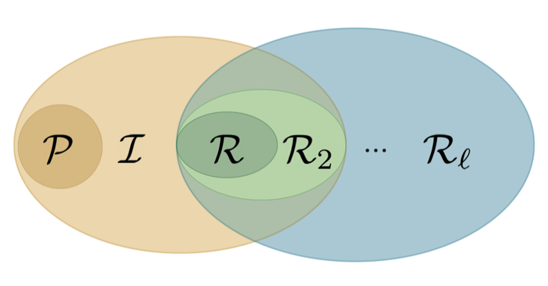
Expressive ability: From the
perspective of function space
Function space of Resflow
Composition function space of Resflow, with Lip<2^n
Function space of Impflow
Id in R, therefore R in I
Question: R_n in I ?

Slide 9
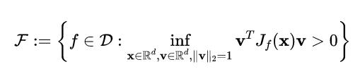




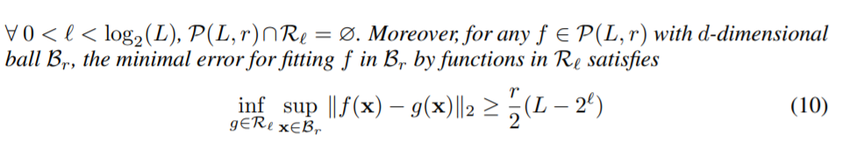
Expressive ability
Differentiable monotone function
Unfortunately， , but there is still a big gap between and ：

Slide 10









Some issues in training
: parameters in NNs
Using MLE:
How to solve
any root-find algorithm to solve：
Broyden’s quasi-Newton
Fixed point iteration
（IFT）
How to compute gradient
Another fixed point equation（linear）

Slide 11


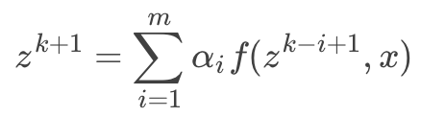

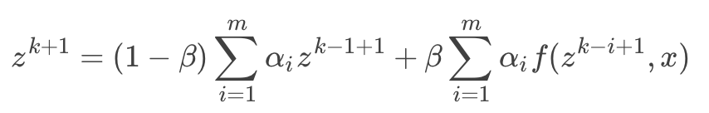
Limitations
Limitations：隐式模型，
前向和后向都要解不动点(前向是非线性，后向是线性不动点方程）
Solutions: Anderson 加速不动点迭代算法
Anderson 加速算法：
使用过去的信息：
如何确定权重？ Minimize error:
generalized udpate
Notes:
这是最主要的缺点。
论文中用的是Broyden’s quasi-Newton，但是因为很高维，所以可能不是很快。

Slide 12
Anderson
在pytorch 中并行实现, 使用 torch.solve 求解权重
实验结果：
计算开销上(比较相对时间)
toy 环境： 维数为2 broyden: 1.4563s Anderson:2.0948s ：
Power 环境： 维数为6 broyden: 5.894 s Anderson: 16.137 s 显著较慢
维度较低时 求解 Anderson的系数的开销占比高，且solve 常遇到 Singular matrix
CIFAR-10 3×32×32 broyden:4.637, Anderson: 2.537 训练有所加速

Slide 13
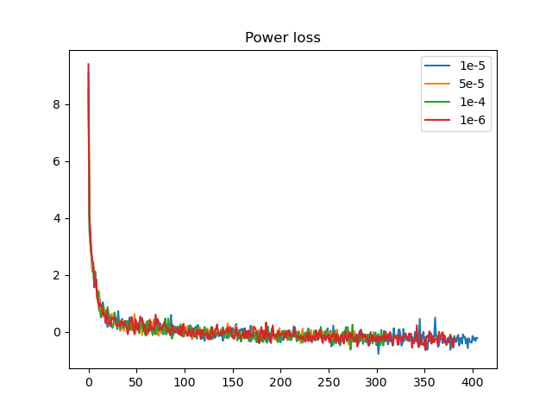
Threshold
不动点迭代精度 对 训练速度的影响：
Power：
Threshold epsilon | Train time / epoch
1E-04 | 3.62785
5E-05 | 7.736
1E-05 | 4.74179
1E-06 | 6.07048
Notes:
求解时间会随着threshold εf（见下图） 的减少而增大（终止准则变得严格了，所以要迭代更久），但是论文里没报时间，看看能不能把训练时间关于threshold 的敏感性报一下，然后说这个对训练总时间很关键。

Slide 14
Summary
A new type of normalizing flows with free-form Jacobian
- No Lipschitz restriction，strong expressive ability
- Back propagation by implicit differential theorem（IFT）
Next Step
- Faster fixed point solver？
- Stabilize IFT computation
Notes:
第一个就是说有没有更快的不动点求解算法，我们已经用了一个稍微快一点的加速算法，希望能有更快的。如果想要有更快的就要去结合函数的形式，网络的结构去探索出来一些更快的方法
第二个就是探索一下阈值对于这个计算的影响，我们不是实验稍微看了一下，当阈值比较小的时候，他就会算的很慢嘛，然后阈值大也可能会有一些数值不稳定的情况。这是用隐式微分要面临的 ，所以希望有些方法能稳定隐式微分的计算

Slide 15
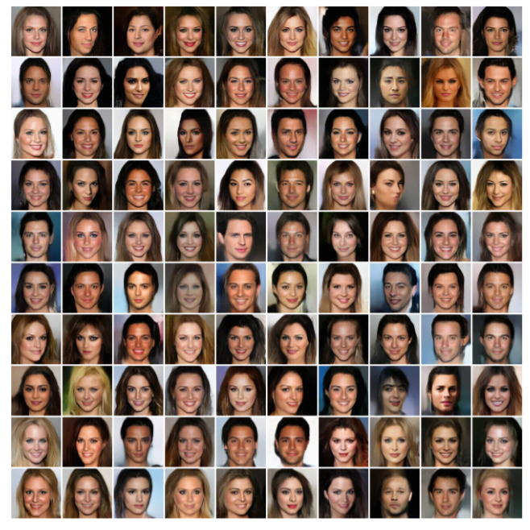
Task
最后我们展示一下ImpFlow 的生成效果

Slide 16
Task
[1] Lu C, Chen J, Li C, et al. Implicit Normalizing Flows[J]. arXiv preprint arXiv:2103.09527, 2021.
[2] Kobyzev I, Prince S, Brubaker M. Normalizing flows: An introduction and review of current methods[J]. IEEE Transactions on Pattern Analysis and Machine Intelligence, 2020.
[3] Ricky TQ Chen, Jens Behrmann, David K Duvenaud, and Jorn-Henrik Jacobsen. Residual flows ¨ for invertible generative modeling. In Advances in Neural Information Processing Systems, pp. 9916–9926, 2019.
[4] Walker, Homer F., and Peng Ni. “Anderson Acceleration for Fixed-Point Iterations.” SIAM Journal on Numerical Analysis 49, no. 4 (January 1, 2011): 1715–35. https://doi.org/10.1137/10078356X.

