Slide 1
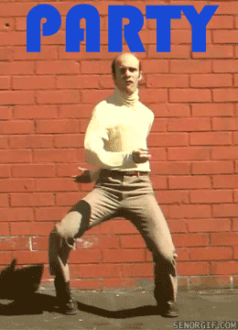
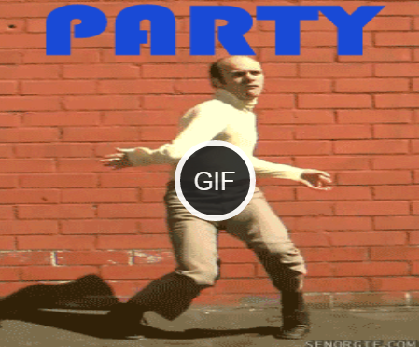
Gif Player plugin
Did you realize that, when you implement a gif on one of your web projects, said gif does not pause when you click on it, unlike facebook or 9gag? (example below)

Slide 2
Parameters
Most of the parameters are shared with the video element parameters. As such, we will name the ones relevant to this presentation:
Width and height: you can alter the gif's dimensions.

Slide 3
Parameters(2)
Source(s): using “src” attribute, you set the initial image, and with “data-gif” attribute, you can set the gif. By default, gif player plugin will auto select the gif if both the img and gif have the same name.

Slide 4
Parameters(3)
onClick: allows the gif to be only played when the user clicks on it (this is the default option of the plugin).
data-wait: Waits until the animated gif/video is fully loaded.

Slide 5
Parameters(4)
video mode: When pausing the gif, it will pause the animation as a video and continue where it was when you reclick it.

Slide 6
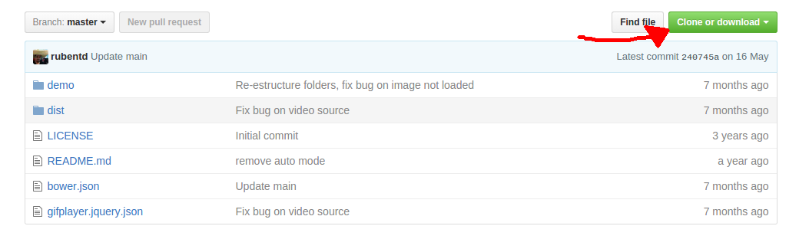
How to use (step by step)
1 - Find and download a gif from the internet.
2 - Head over this link http://rubentd.com/gifplayer/ or just find “jquery gif player” on google, and download it from the github link.

Slide 7
How to use (step by step- 2)
3 - Implementing the plugin into our code is quite simple, we just have to include the css and the javascript references to our code that can be found at the end of their webpage.
4 – Create an img element with class “gifplayer" (as an example), containing the src of the image of your gif*, and add any additional parameters if you want to.
*Look at our demo for further explanation and explore all the cool posibilities!

Slide 8
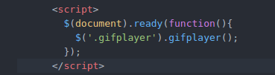
How to use (step by step- 3)
5 - Lastly, implement this script into your code.
.gifplayer function will basically alter the img element src from a png/jpg file to a gif file.

Slide 9
DEMO!
We will now do a simple exercise showing the options we mentioned a while ago.

Slide 10
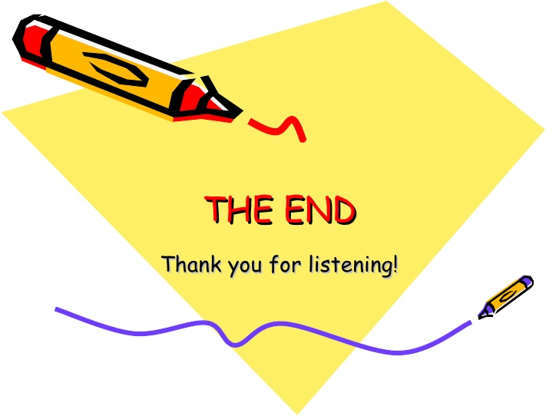
Presentation made by: Carlos Queralt Peiró, Jose García Murcia and Alberto Barbera Campos.

