Slide 1







Capstone Project
Lucas Vilas Boas de Lima
18th of August, 2022

Slide 2




OUTLINE
Executive Summary
Introduction
Methodology
Results
Visualization – Charts
Dashboard
Discussion
Findings & Implications
Conclusion
Appendix

Slide 3

EXECUTIVE SUMMARY
The Internet and the Interconnectivity of our World are at their highest points of importance. With that comes the necessity of people capable of manipulating web pages, databases, software and, often, with interconnected programming Languages.
But the question is, what Languages and Databases are dominating the current Market? How are todays Data manipulators and Code writers preparing themselves for the future?

Slide 4

INTRODUCTION
Through a very ample study involving Professionals in the Programming world we will try to find out:
What Languages they currently use
What Languages the plan to learn in the future
What Database they make use of
Which Databases they are preparing themselves for

Slide 5

METHODOLOGY
The data presented has been collected from Kaggle and IBM database with following methods applied:
Scraping from websites
API and direct connect retrievals
Cleaned and Sorted (outliers removed, sorted for better understanding etc.)
Clustered and Graphed out to enhance the visibility of main factors related to presentation of the Data

Slide 6
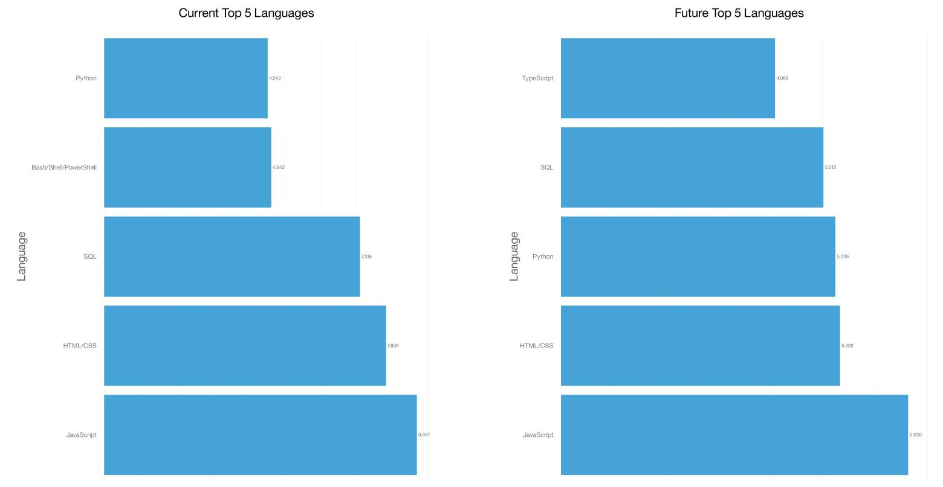
PROGRAMMING LANGUAGE TRENDS

Slide 7
PROGRAMMING LANGUAGE TRENDS - FINDINGS & IMPLICATIONS
From these graphs we can retrieve that:
JavaScript holds the top position for Current and Future Programming Languages
Html following right behind JavaScript
Python gaining space from 5th to 3rd
We see a strong JavaScript and HTML dominance when it comes to Programming Languages, but with Python gaining space and SQL coding is in top 4. That comes to show the magnitude of necessity of all the tools within Python and SQL to make use of the information created in HTML and JavaScript.

Slide 8
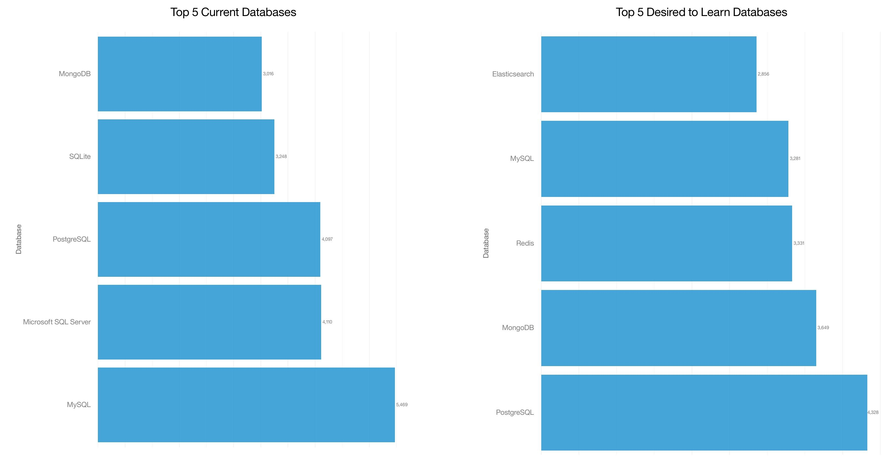
DATABASE TRENDS

Slide 9
DATABASE TRENDS - FINDINGS & IMPLICATIONS
The Database Trends Graphs allow us to analyze:
Clear SQL dominance in the current Database sector
More diverse Databases desired to learn
Considering these observations, we can easily identify the importance of SQL database knowledge currently. Also valid to note that the trend is to incorporate other Database formats and Languages in the near future!

Slide 10

DASHBOARD
Dashboard created to better visualize and understand the current and future Language and Database needs, along with more vital information:
https://dataplatform.cloud.ibm.com/dashboards/f6354f91-ea69-4ecc-8ac6-c0623743ab0e/view/7f09e02c2ee31de24cb2dce407cf2d527f37210ee7bb870082827b495c697197f0681499c828485dda195363a7ee10599a

Slide 11
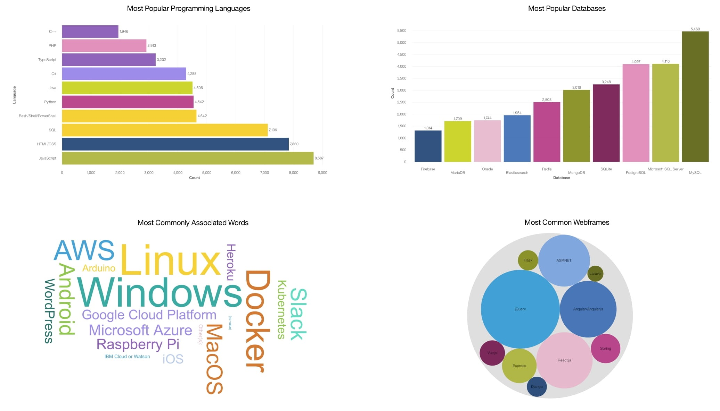
Current Popular Languages and Databases Leaded by JavaScript and MySQL, respectively

Slide 12
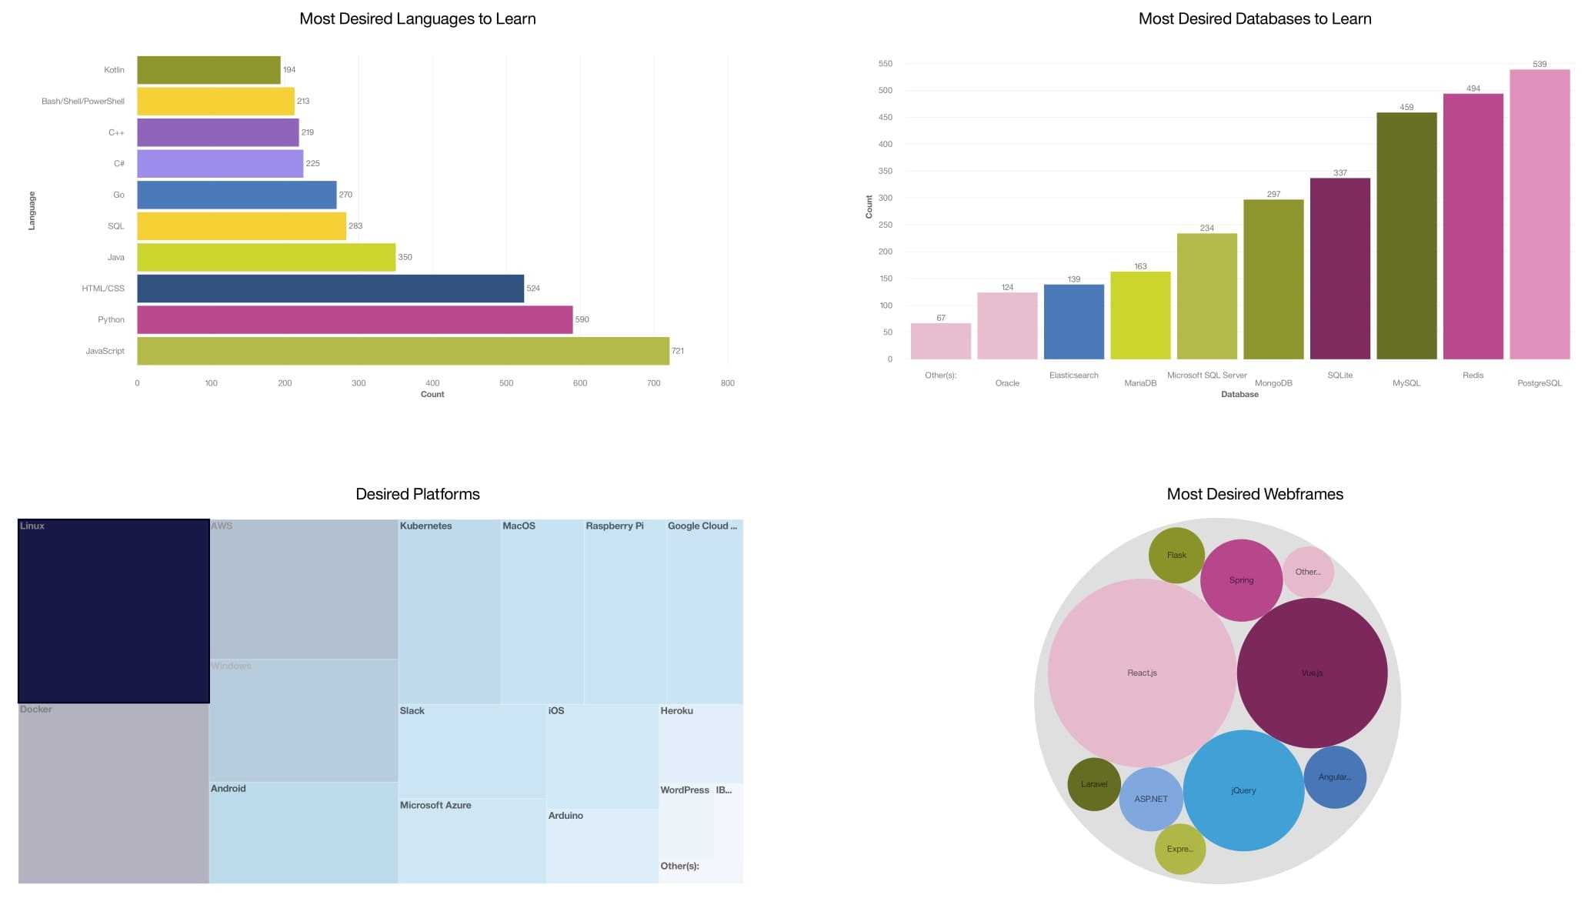
Popular Languages and Databases to Learn in near Future Leaded by JavaScript and PostgreSQL, respectively

Slide 13
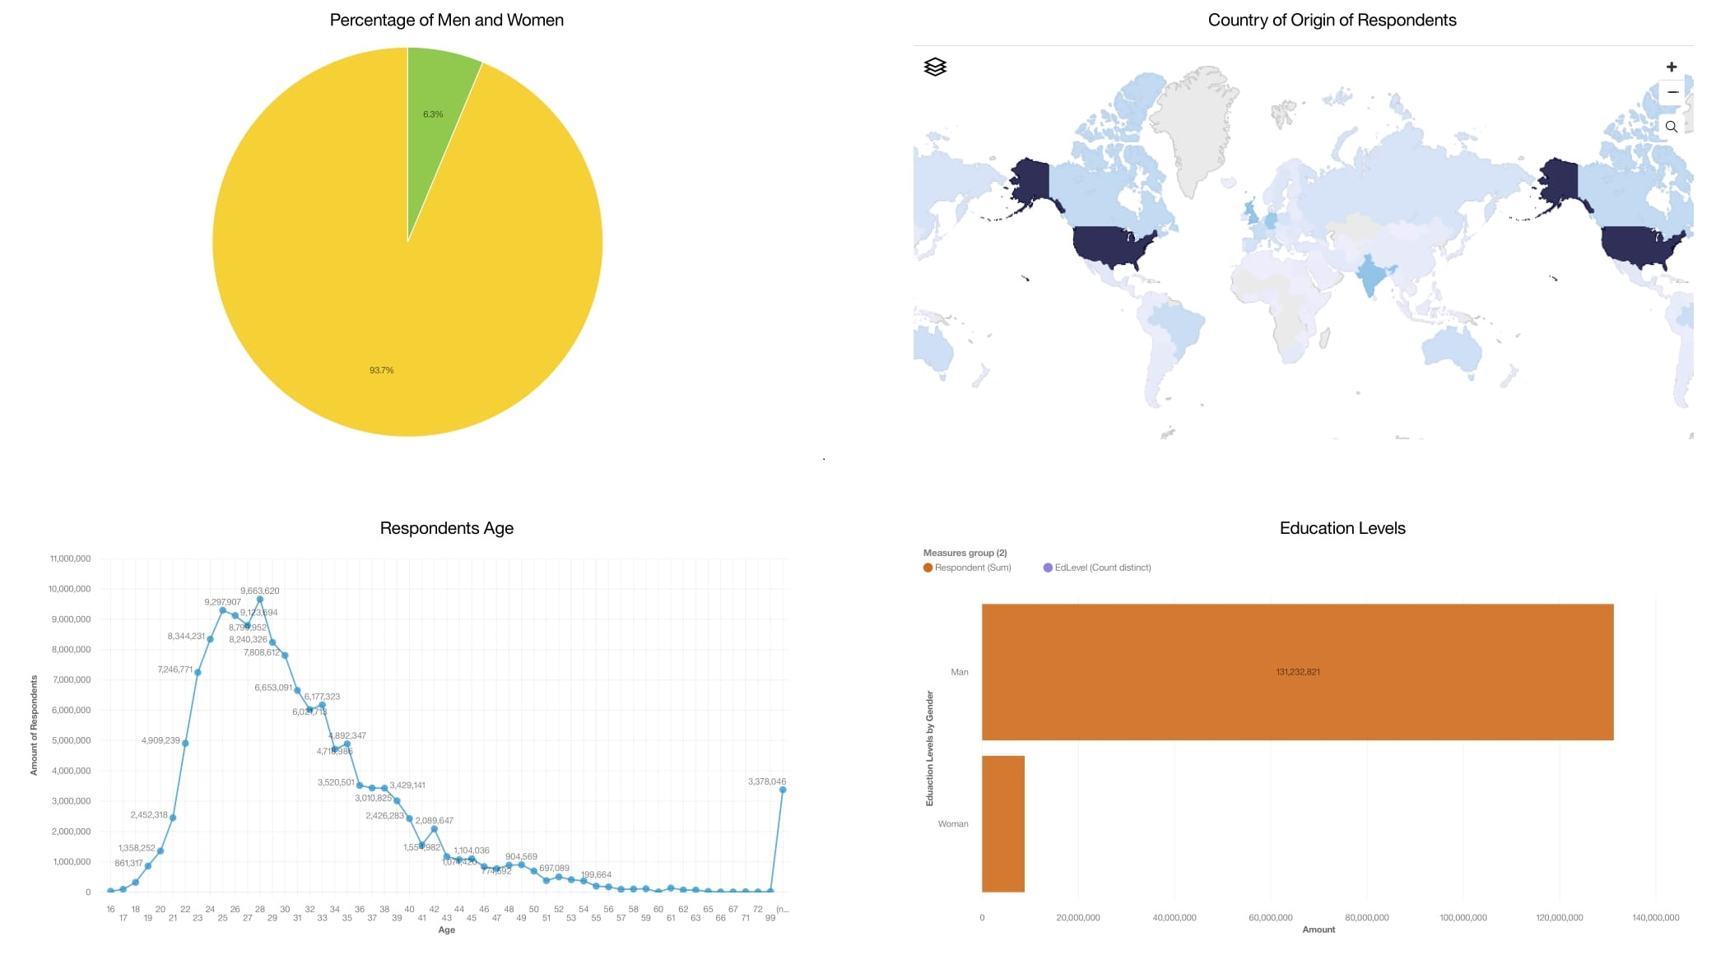
Overview of Respondents pictured by Gender, Geographical location, Age and Education Level

Slide 14
DISCUSSION
Although the data was extracted from a very ample source, it represents a very Northern American Male dominated opinion. Would be interesting to compare with results from other countries, preferably with a more diverse Sample of Respondents.

Slide 15
OVERALL FINDINGS & IMPLICATIONS
Current Language and Database Trend around JavaScript, HTML and MySQL
Future Language and Database currently tend to stay close to JavaScript and PostgreSQL
Python in strong tendence to be learned
Important eye-catching Keywords: Linux, Android, Windows, Docker
It is clear the importance of JavaScript and HTML in todays interconnected world. And consequentially, because of that interconnectivity, the high demand for Python programming with SQL based Databases.

Slide 16

CONCLUSION
Dominance of JavaScript and HTML programming
SQL based Databases are super popular
Python and SQL learning should be beneficial for the near future for virtually every Economical sector

Slide 17

APPENDIX
Additionally, despite the aforementioned dominance in todays Language knowledge being around JavaScript, HTML and Python/SQL, we can observe a very high demand in C based programming after scraping online for job postings.
Overall, Pay grade seems to not differ much between programming Language.

Slide 18
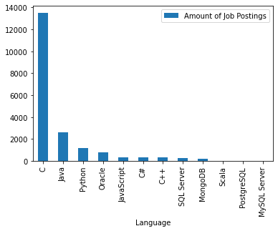
JOB POSTINGS and the related Programming Language

Slide 19
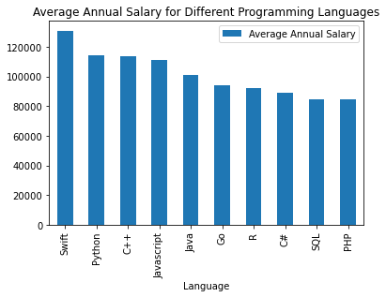
POPULAR LANGUAGES and their associated Average Salaries

