Slide 1




Development of a Simplified Prototype for Wave Generation Using Arduino
XXXVIII CILAMCE
Ibero-Latin American Congress on Computational Methods in Engineering
Lucas Gouveia Omena Lopes, Adriano da Silva Rocha, Heleno Pontes Bezerra Neto, Romildo dos Santos Escarpini Filho. Universidade Federal de Alagoas (UFAL), Laboratório de Computação Científica e Visualização (LCCV)
Lucas Gouveia Omena Lopes (lucasomena9@gmail.com)
Adriano da Silva Rocha (adrianosrocha1@gmail.com)
Heleno Pontes Bezerra Neto (helenopontes@lccv.ufal.br)
Romildo dos Santos Escarpini Filho (romildo@lccv.ufal.br)
Universidade Federal de Alagoas (UFAL)
Laboratório de Computação Científica e Visualização (LCCV)
Av. Lourival Melo Mota, S/N - Tabuleiro do Martins, 57072-900, Maceió - AL, Brasil

Slide 2
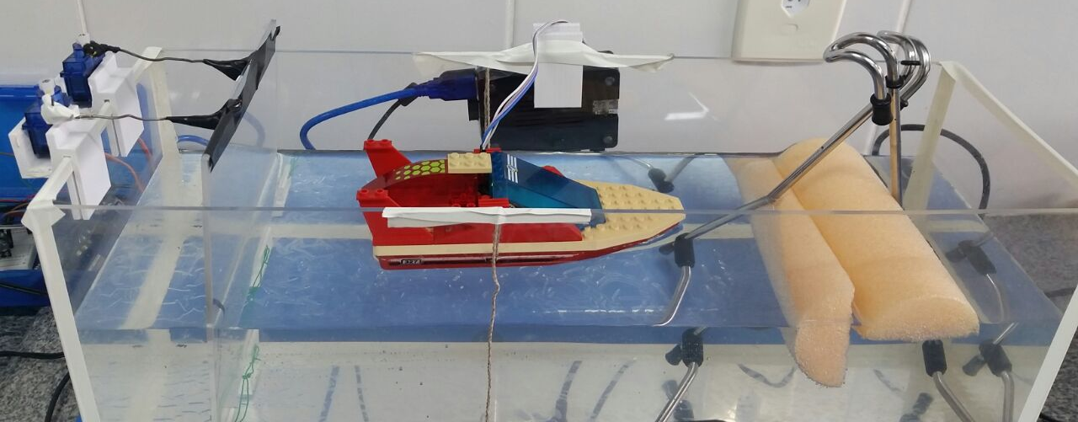
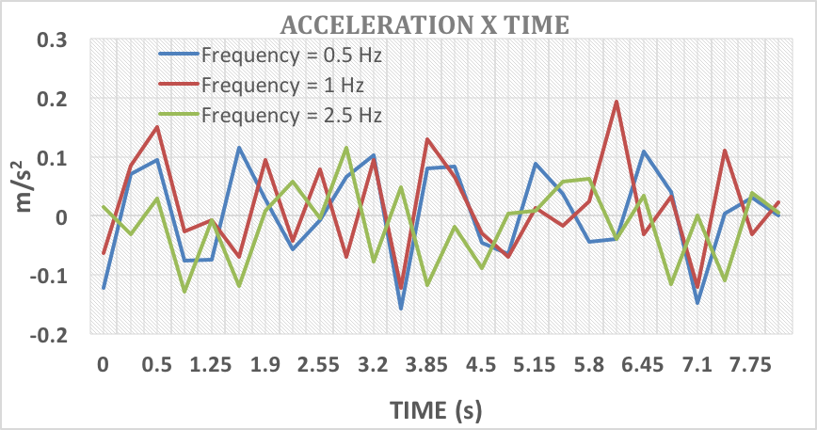
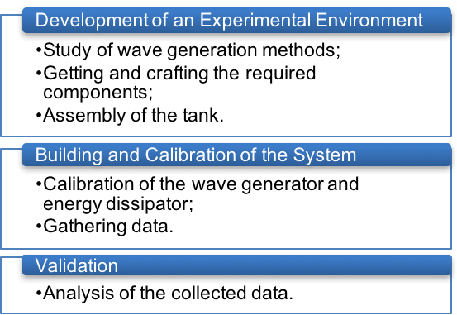
Development of a Simplified Prototype for Wave Generation Using Arduino
XXXVIII CILAMCE
Ibero-Latin American Congress on Computational Methods in Engineering
Lucas Gouveia Omena Lopes, Adriano da Silva Rocha, Heleno Pontes Bezerra Neto, Romildo dos Santos Escarpini Filho. Universidade Federal de Alagoas (UFAL), Laboratório de Computação Científica e Visualização (LCCV)
1 - INTRODUCTION
4 - RESULTS
This paper focus in the development of a simplified prototype for wave generation using Arduino. The main objective of the project is the development of a simplified model of an experimental environment composed of a wave generator, an accelerometer and an energy dissipation mechanism, using the Arduino electronic prototyping platform. The final result of the project is a simplified model able to reproduce behaviors of offshore environments for didactic purposes. The system will be used in the Laboratory of Platforms and Automation of the Federal University of Alagoas, being able to constantly evolve and open doors for new projects.
The results are described in the following Figures and Table:
Figure 2 – Test tank during operation
Table 1– Gathered data
2 - OBJECTIVES
Input Frequency | Measured Frequency | Average Acceleration (m/s²)
0,5 Hz | 1,3 Hz | 0,066
0,7 Hz | 1,45 Hz | 0,077
1 Hz | 1,5 Hz | 0,069
1,5 Hz | 1,6 Hz | 0,102
2,5 Hz | 2 Hz | 0,126
Develop an experimental environment for wave generation;
Build and calibrate the system, collecting data;
Validate the system through analysis of the data collected.
3 - METHODOLOGY
The development of the test environment was divided into three macro steps, as described in Figure 1:
Figure 3 – Acceleration x Time
5 - CONCLUSION
The objectives proposed in this paper were achieved by developing a test tank capable of generating waves and enabling the acquisition of data. Due to the academic nature of the project, It will be improved from the data and results obtained in the work, being able to constantly evolve and be used for the most diverse educational purposes.
Figure 1 – Macro steps of the project

Slide 3
Development of a Simplified Prototype for Wave Generation Using Arduino
XXXVIII CILAMCE
Ibero-Latin American Congress on Computational Methods in Engineering
Lucas Gouveia Omena Lopes, Adriano da Silva Rocha, Heleno Pontes Bezerra Neto, Romildo dos Santos Escarpini Filho. Universidade Federal de Alagoas (UFAL), Laboratório de Computação Científica e Visualização (LCCV)
REFERENCes
Carneiro, M. L., 2012. Desenvolvimento de Sistema de Controle para Geração e Absorção Ativa de Ondas em Tanques de Ensaios de Estruturas Oceânicas. Tese de doutorado, Universidade de São Paulo.
Chakrabarti, S. K., 1994. Offshore Structure Modelling. Singapore: World Scientific.
Dean, R. G., Dalrymple, R. A., 1984. Water Wave Mechanics for Engineers and Scientists. New Jersey : Prentice-Hall, Inc.
Miller, V. Arduino Wave Generator Tank. Disponível em: < https://hackaday.io/project/9104-arduino-wave-generator-tank>. Acesso em: 12/11/2016

