Slide 1

Final Project
Analysis for Data Science
Aaron Bracho | Andres Lopez | Melissa Osorio | Lucas Nishimoto

Slide 2
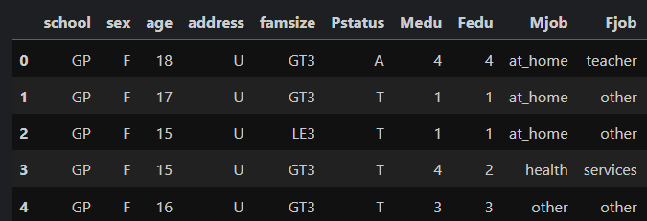
Introduction to Dataset
The Mathematics dataset contains 395 rows × 33 columns, including demographic, social, and academic variables.
Numeric variables: age, study time, number of past failures, absences, grades (G1, G2, G3), and various scales.
Categorical variables: gender, school, address type (urban/rural), family size, parents’ education and occupation, support programs, extracurricular activities, internet access, and relationship status.

Slide 3
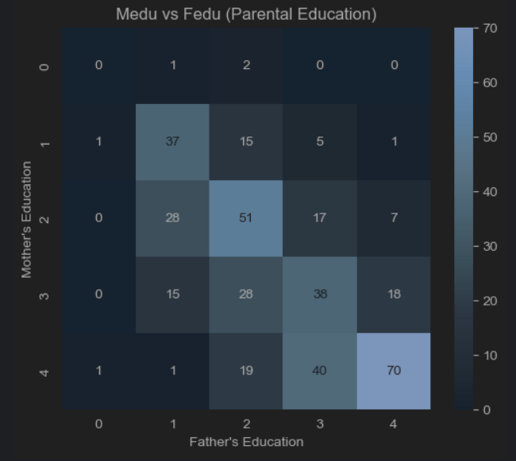
Association 1 Mother’s Education (Medu) and Father’s Education (Fedu)
Correlation: Pearson ≈ 0.62 (high), Spearman ≈ 0.63, Kendall ≈ 0.55.
Interpretation: Parents with higher education levels tend to partner with someone with a similar education level.
Why it makes sense: Educational attainment is often linked between spouses due to socioeconomic status, environment, or shared values.
Data quality check: No strong missing data here, but both are ordinal, so Spearman/Kendall are also appropriate.

Slide 4
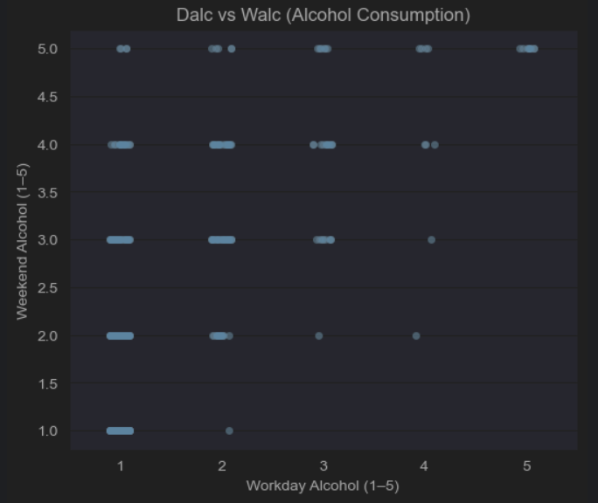
Association 2 Workday alcohol consumption (Dalc) ↔ Weekend alcohol consumption (Walc)
Correlation: Pearson ≈ 0.65, Spearman ≈ 0.64, Kendall ≈ 0.58.
Interpretation: Students who drink more on weekdays are also likely to drink more on weekends.
Why it makes sense: This reflects consistent drinking behavior — those who drink often don’t limit it only to one part of the week.
Data quality check: Both are ordinal (1–5 scale). Pearson still works but Spearman/Kendall give a better picture since the relationship is monotonic, not necessarily linear.

Slide 5
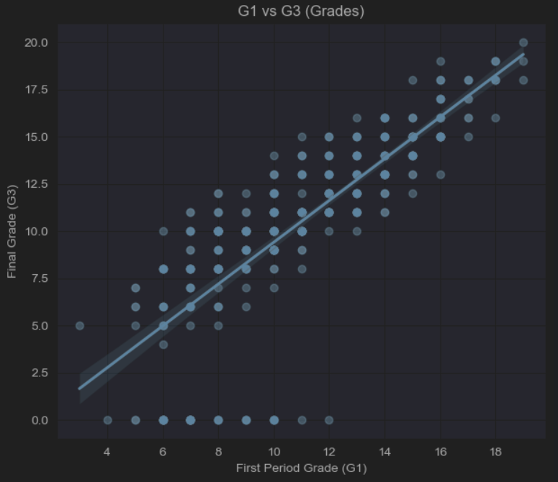
Association 3 First period grade (G1) ↔ Final grade (G3)
Correlation: Pearson ≈ 0.80, Spearman ≈ 0.88, Kendall ≈ 0.75.
Interpretation: Students who perform well in the first evaluation also tend to perform well in the final exam.
Why it makes sense: Academic performance across terms is strongly linked to prior preparation, habits, and consistency.
Data quality check: Grades are numeric and linear, so Pearson is perfectly valid here.

Slide 6
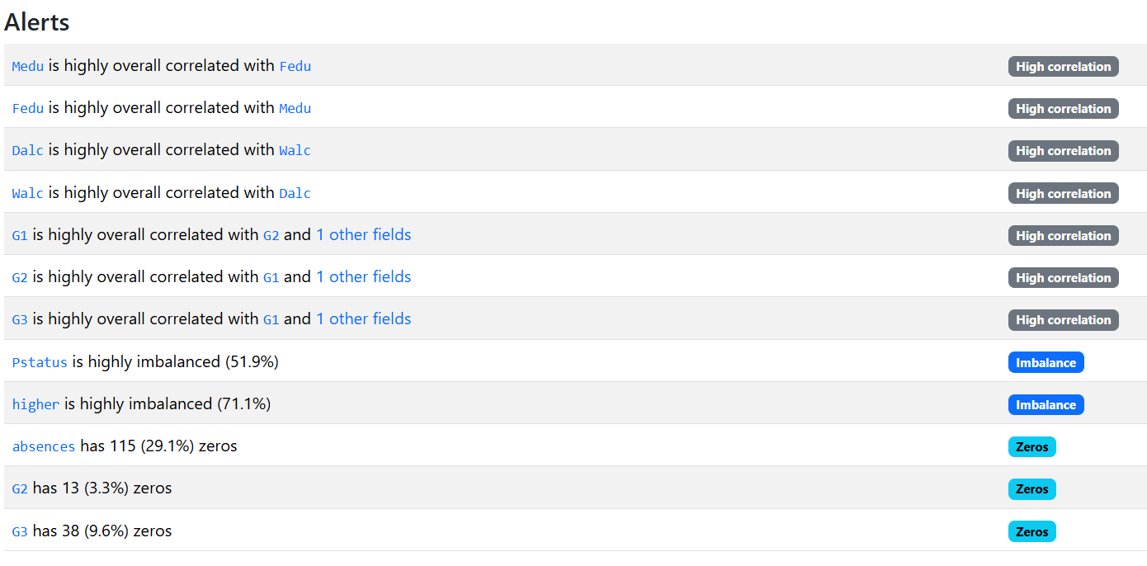
Data Quality Issues

Slide 7
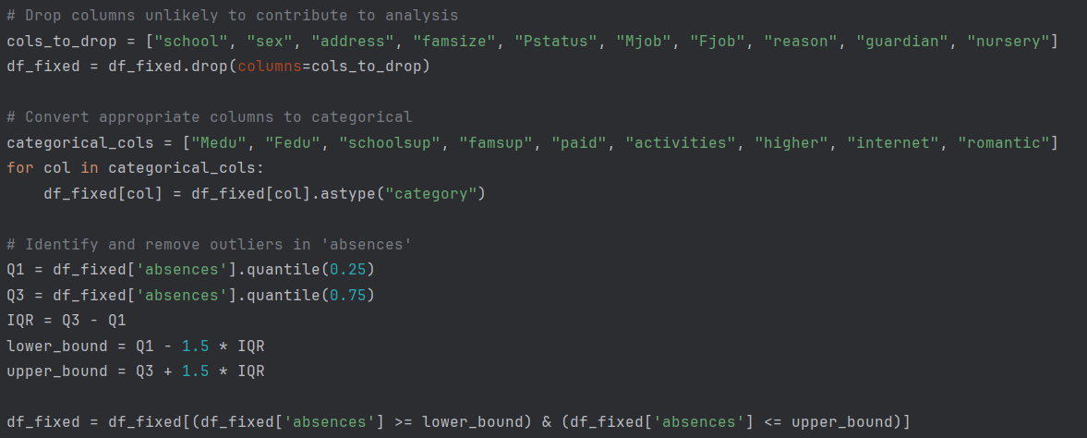
Data Quality Fixes
Drop columns unlikely to contribute to analysis
Convert appropriate columns to categorical
Identify and remove outliers in 'absences'

Slide 8
Modeling Suggestion and Rationale

Slide 9
Conclusions

