Slide 1

Final Project Students Performance
Analysis for Data Science
Aaron Bracho | Andres Lopez | Melissa Osorio | Lucas Nishimoto

Slide 2
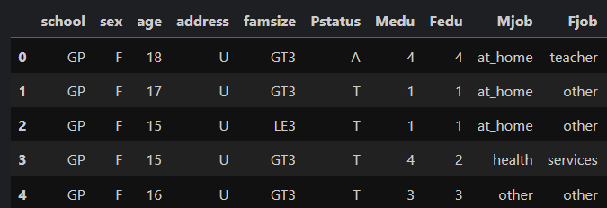
Introduction to Dataset
The Mathematics dataset contains 395 rows × 33 columns, including demographic, social, and academic variables.
Numeric variables: age, study time, number of past failures, absences, grades (G1, G2, G3), and various scales.
Categorical variables: gender, school, address type (urban/rural), family size, parents’ education and occupation, support programs, extracurricular activities, internet access, and relationship status.

Slide 3
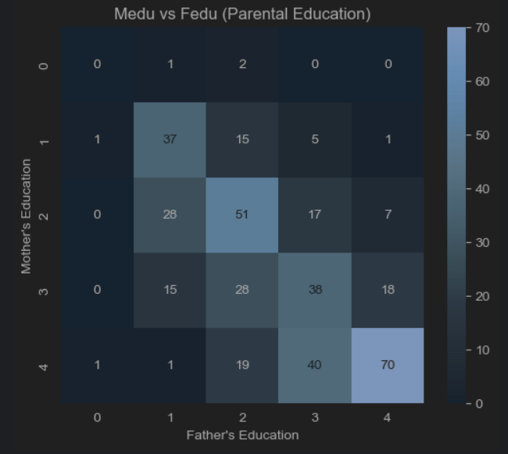
Association 1 Mother’s Education (Medu) and Father’s Education (Fedu)
Correlation: Pearson ≈ 0.62 (high), Spearman ≈ 0.63, Kendall ≈ 0.55.
Interpretation: Parents with higher education levels tend to partner with someone with a similar education level.
Why it makes sense: Educational attainment is often linked between spouses due to socioeconomic status, environment, or shared values.
Data quality check: No strong missing data here, but both are ordinal, so Spearman/Kendall are also appropriate.

Slide 4
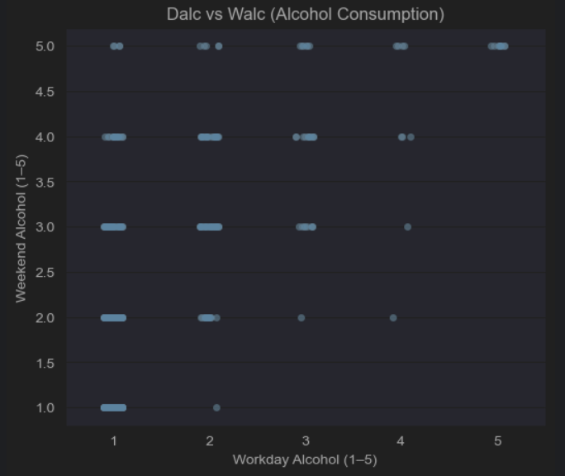
Association 2 Workday alcohol consumption (Dalc) ↔ Weekend alcohol consumption (Walc)
Correlation: Pearson ≈ 0.65, Spearman ≈ 0.64, Kendall ≈ 0.58.
Interpretation: Students who drink more on weekdays are also likely to drink more on weekends.
Why it makes sense: This reflects consistent drinking behavior — those who drink often don’t limit it only to one part of the week.
Data quality check: Both are ordinal (1–5 scale). Pearson still works but Spearman/Kendall give a better picture since the relationship is monotonic, not necessarily linear.

Slide 5
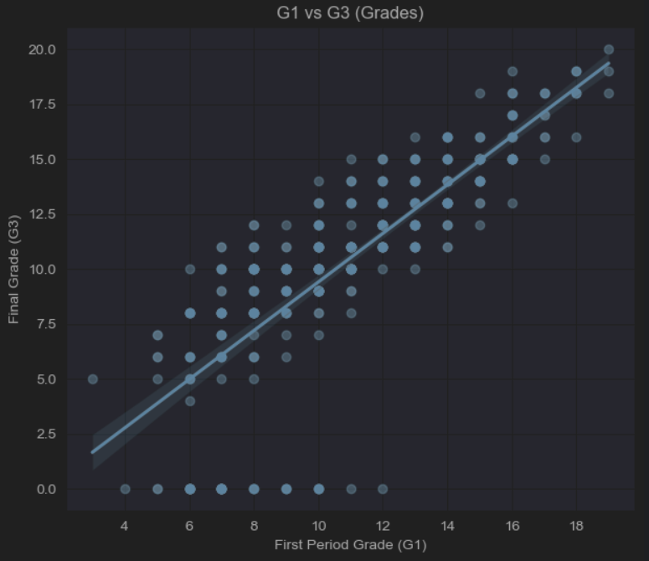
Association 3 First period grade (G1) ↔ Final grade (G3)
Correlation: Pearson ≈ 0.80, Spearman ≈ 0.88, Kendall ≈ 0.75.
Interpretation: Students who perform well in the first evaluation also tend to perform well in the final exam.
Why it makes sense: Academic performance across terms is strongly linked to prior preparation, habits, and consistency.
Data quality check: Grades are numeric and linear, so Pearson is perfectly valid here.

Slide 6
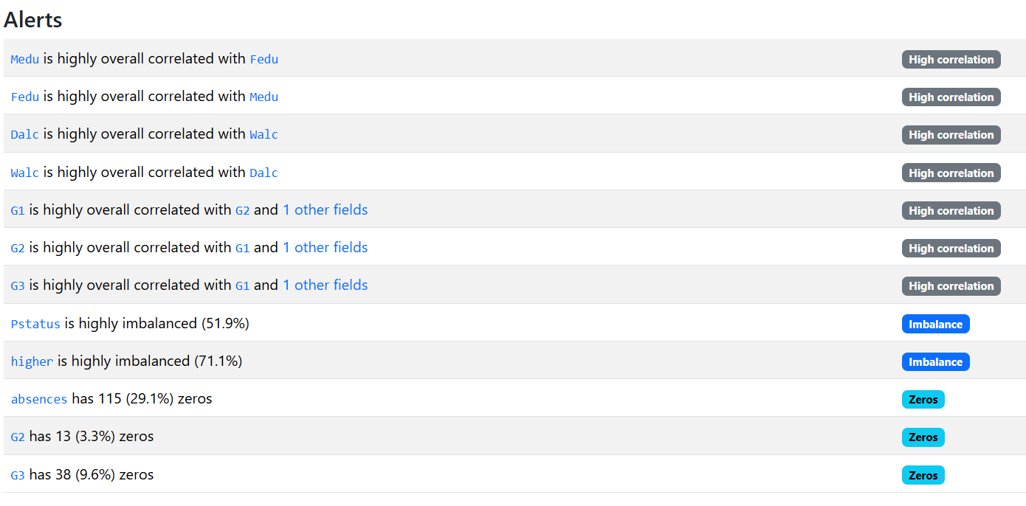
Data Quality Issues

Slide 7
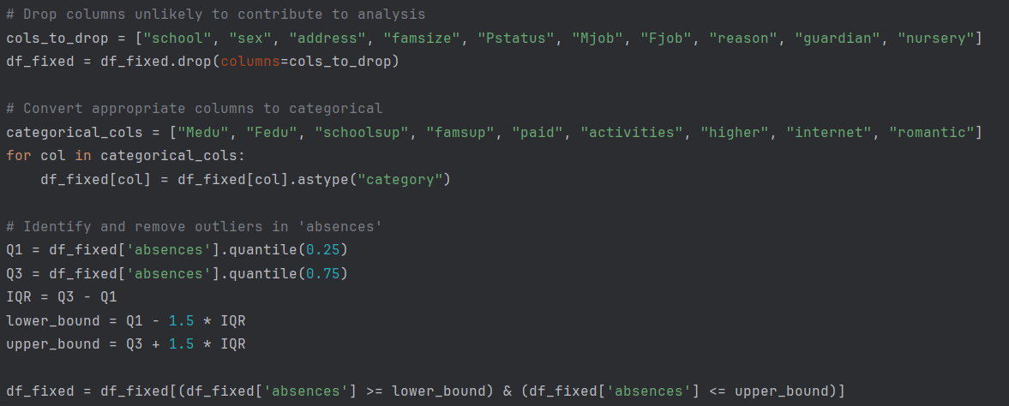
Data Quality Fixes
Drop columns unlikely to contribute to analysis
Convert appropriate columns to categorical
Identify and remove outliers in 'absences'

Slide 8
Modeling Suggestion and Rationale
Prediction example
Based on the correlation results, the most reliable predictive relationship is between the first grade (G1) and the final grade (G3). The regression analysis produced an R² value of approximately 0.64, which indicates that about two-thirds of the variance in final grades can be explained by the first grade alone. The residuals showed no major violations of linear model assumptions, supporting the validity of this model.

Slide 9

Conclusions
Medu ↔ Fedu showed a strong positive correlation (Pearson ≈ 0.62), reflecting educational alignment between parents.
Dalc ↔ Walc also showed a strong positive correlation (Pearson ≈ 0.65), representing consistent drinking behaviors across weekdays and weekends.
G1 ↔ G3 showed a very strong positive correlation (Pearson ≈ 0.80) and the highest explanatory power, with R² ≈ 0.64.
Among these, the relationship between G1 and G3 provided the strongest basis for predictive modeling. A simple linear regression model was recommended, explaining more than 60% of the variance in final grades. This result demonstrates that early academic performance is a reliable predictor of final outcomes, which has important implications for educational interventions.

