Slide 1

Contract Monthly Claims System
Luc de Marillac St Julien
PROG6212
Part 3 – Automation
Youn-Soo Kim

Slide 2

System Overview Slide
The CMCS system digitises and automates monthly Independent Contractor lecturer claims
Lecturer submit claims with supporting documents
Program Coordinators verify claims
Academic Managers approve claims
HR managers users and generates payment reports
End-to-end claim visibility makes sure transparency, accountability, and payment accuracy

Slide 3
Technology Stack
.NET 8 – ASP.NET Core MVC
Entity Framework Core (SQL Server)
ASP.NET Core Identity (Authentication and Roles)
Razor Views
JavaScript automation
Claim auto-calculation
File validation
AES-encryption document storage and secure ZIP export
MSTest unit test project

Slide 4
System Workflow / Architecture
Lecture -> Program Coordinator -> Academic Manager -> HR -> CSV Invoice Report
Automated claim amount calculation
Automated claim validation summary for Coordinator/Manager
Automated invoice generation for Human Resources (HR)

Slide 5
Part 3 Improvements
Part 2
Part 3 Improvements
Manual checks by Coordinator/Manager
Auto-fetched from Lecturer Profile
Auto amount calculation not displayed
Large file uploads caused crash
No HR automation
Basic dashboards
Automated validation via ClaimEvaluationService
Auto-Calculation displayed with JavaScript
File Size Validation (Client-side + server side)
HR Invoice generation

Slide 6
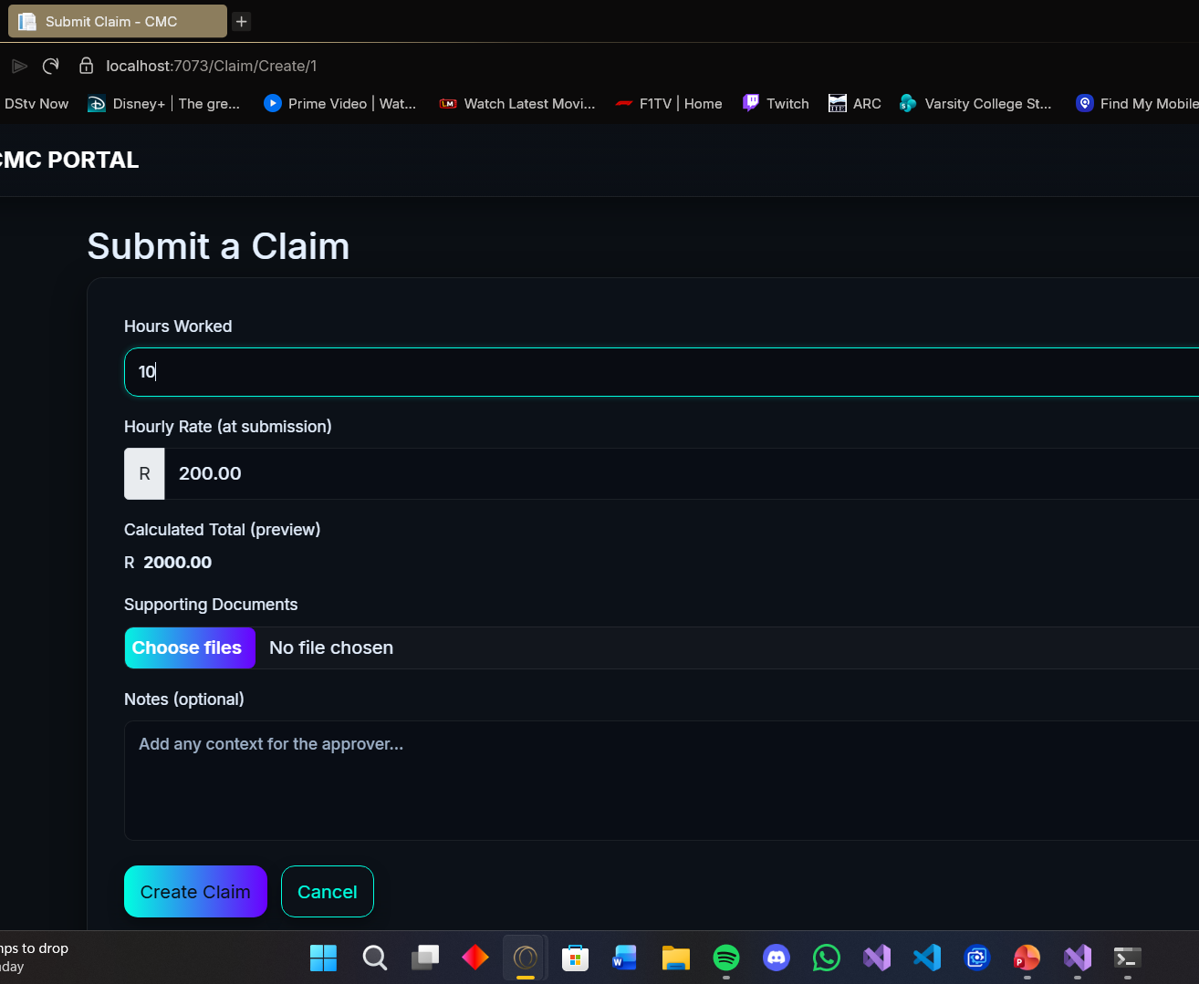
Lecturer Automation
The Lecturer Claim creation form automatically calculates the claim amount as Hours x Hourly Rate, validates hours, and applies file size/type restrictions before submission.

Slide 7
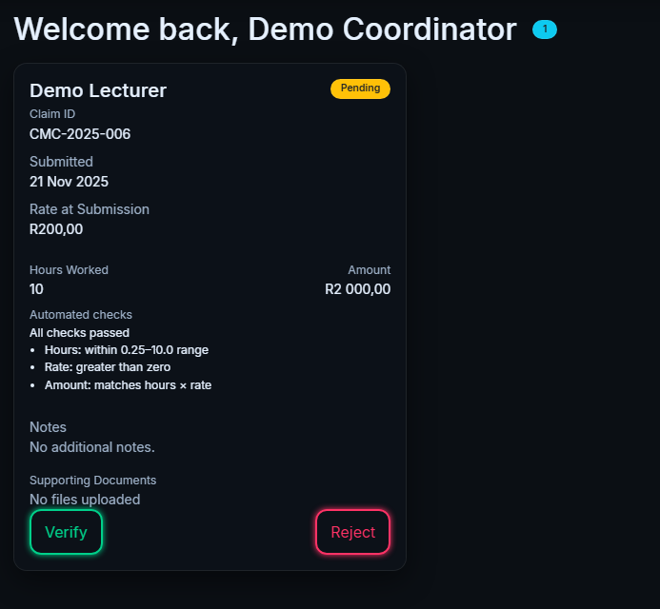
Program Coordinator Automation
Coordinator dashboard shows a list of pending claims with automated evaluation summaries

Slide 8
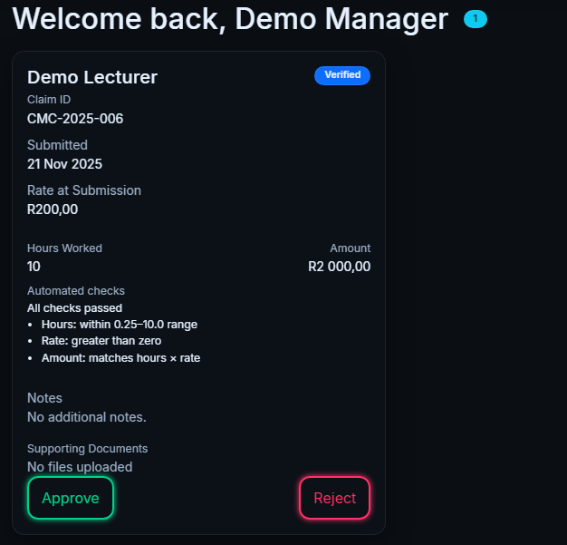
Academic Manager Claims View
Manager dashboard lists all verified claims and allows the Academic Manager to do final approve or reject with full context and document access

Slide 9
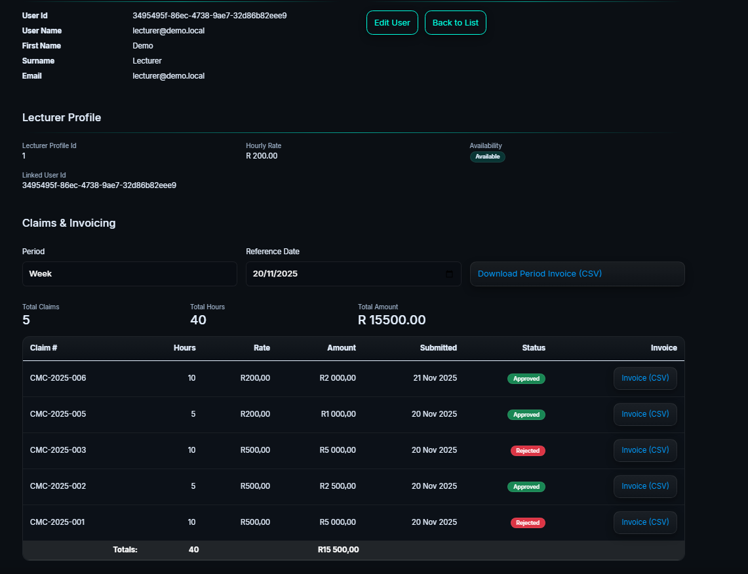
HR CSV Invoice Generation
HR can manage users, edit user info, view each lecturer individual claims, and generate CSV invoice reports for a single claim or a period

