Slide 1

Data Analytics & Data Driven Decision Data Analysis on “Facebook Comment Volume” Dataset
Cortellessa Stefano
254260
Grillo Luca
254377
Mariotti Davide
255558
DISIM - Università degli Studi Dell’Aquila

Slide 2
Introduction
May the length of a post influence its reading and consequently
also the number of comments and shares it will receive?
For answering, we walked through two different preliminary phases:
Data Cleaning of the dataset,
Exploratory analysis.
After these we performed two Machine Learning technics named Supervised Learning and Unsupervised Learning to predict which will be the shares for a post in the future.
DISIM - Università degli Studi Dell’Aquila

Slide 3
Introduction
Some important domain specific concepts are discussed below:
Public Group/Facebook Page: It is a public profile specifically created for businesses, brands, celebrities etc.
Post/Feed: These are basically the individual stories published on page by administrators of page.
Comment: It is an important activity in social sites, that gives potential to become a discussion forum and it is only one measure of popularity/interest towards post is to which extent readers are inspired to leave comments on document/post.
Share: It is another important activity in social sites, that allow people to share posts so that other people can read and comment on these posts.
DISIM - Università degli Studi Dell’Aquila

Slide 4
Data Cleaning
In this phase, the following operation have been performed:
All the columns have been checked to be sure that there are not null values in the dataset,
All the values have been checked to be sure that they are all positive, specifically Page Checkin’s, Likes, Page Talking About, C1, C2, C3, C4, Base Time, Post Length, Post Share Count columns have been controlled,
All the values in the days columns have been checked to be 0 or 1,
All the values in Base Data Time have been checked to be valid,
All values inside C1 have been checked to be correct. In particular that:
C1 >= C2 + C3
C4 <= C1
C5 = C2 - C3
All useless columns have been removed (Post Promotion Status) and
All duplicated rows have been removed.
DISIM - Università degli Studi Dell’Aquila

Slide 5
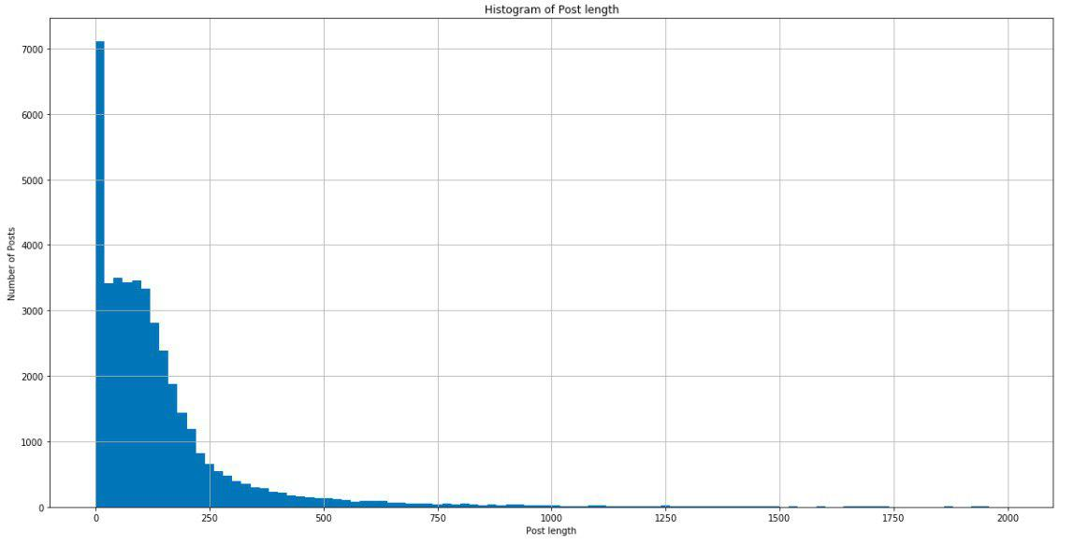
Exploratory Analysis - Post Length variable
DISIM - Università degli Studi Dell’Aquila
Notes:
What can be seen from the figure is that the post length is concentrated between 0 and 200. It Is easily visible that 7000 posts have length 0. This kind of post are photos, links or videos without any description.

Slide 6
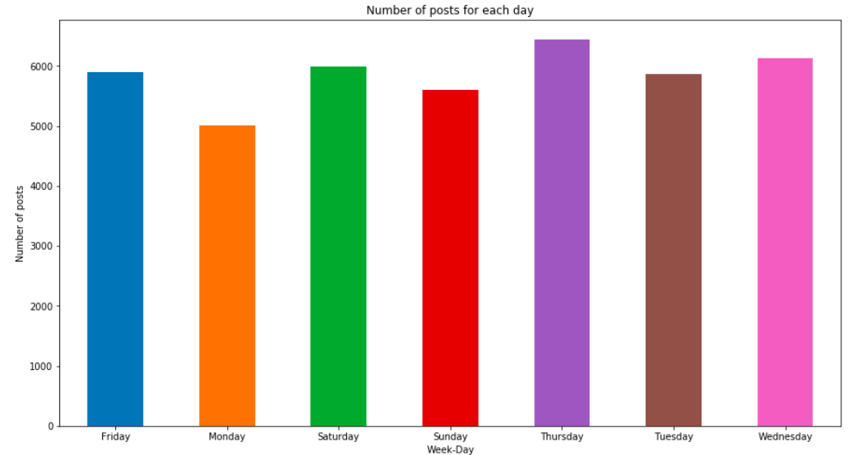
Exploratory Analysis - Number of posts published every day
DISIM - Università degli Studi Dell’Aquila
Notes:
Around 5000 are published every day as we can see from the histogram above.
It is also easy to see that Thursday is the day with the highest number of publication with around 6000 posts.

Slide 7
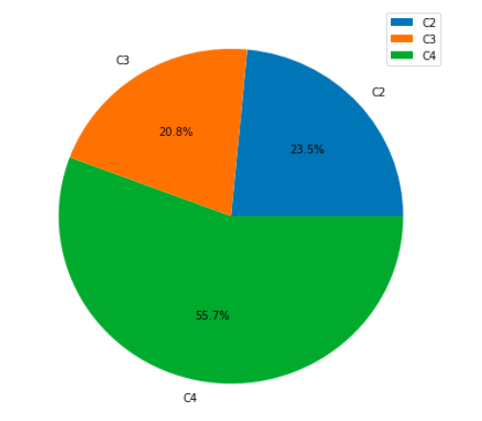
Exploratory Analysis - Number of comments of all the dataset
What can be seen from the figure is:
most of the comments are made during the period C4, so between 48 and 72 hours from the Base Date Time.
DISIM - Università degli Studi Dell’Aquila

Slide 8
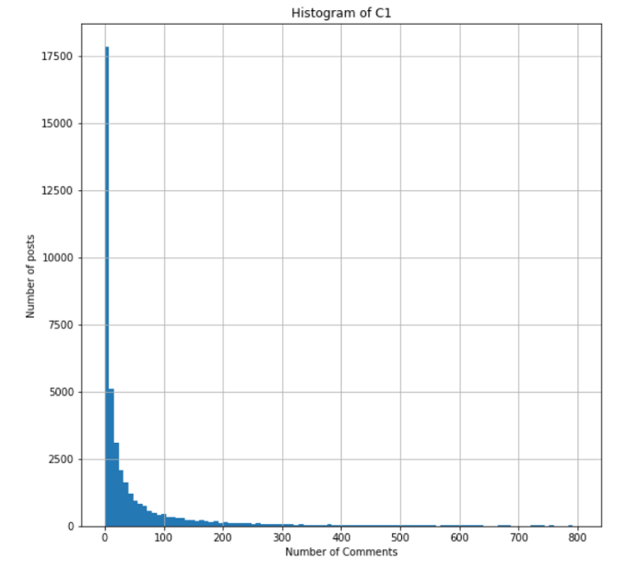
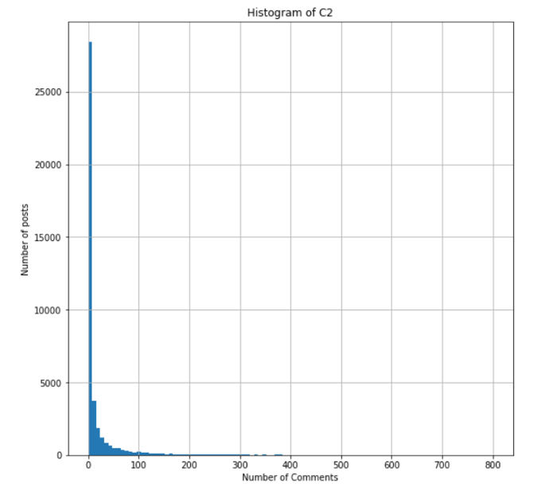
Exploratory Analysis – Trend of comments in C1, C2, C3 and C4
Histogram of C1
Histogram of C2
DISIM - Università degli Studi Dell’Aquila

Slide 9
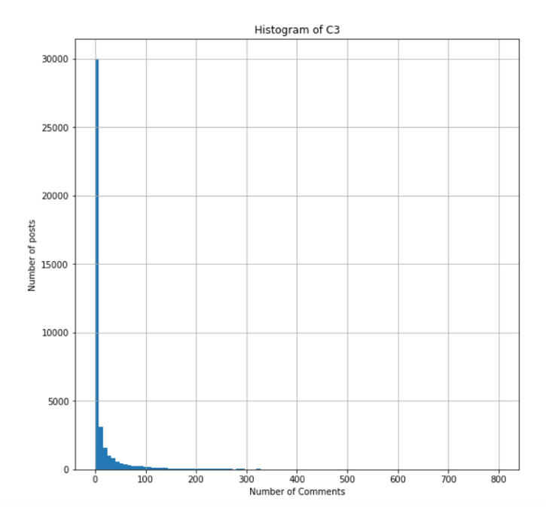
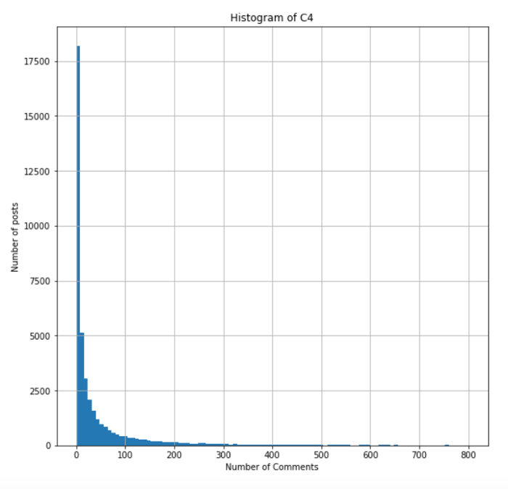
Exploratory Analysis – Trend of comments in C1, C2, C3 and C4
Histogram of C3
Histogram of C4
DISIM - Università degli Studi Dell’Aquila

Slide 10
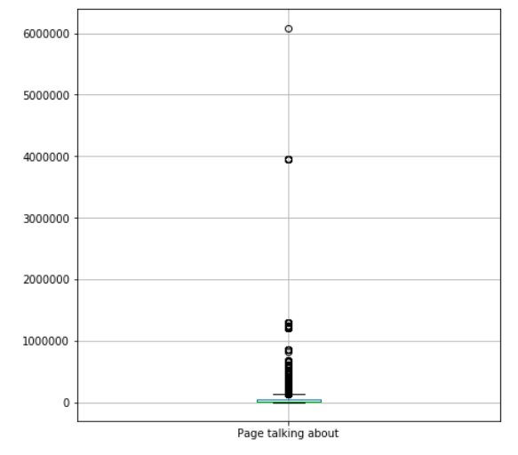
Exploratory Analysis – Variable ‘Page Talking About ‘
DISIM - Università degli Studi Dell’Aquila

Slide 11
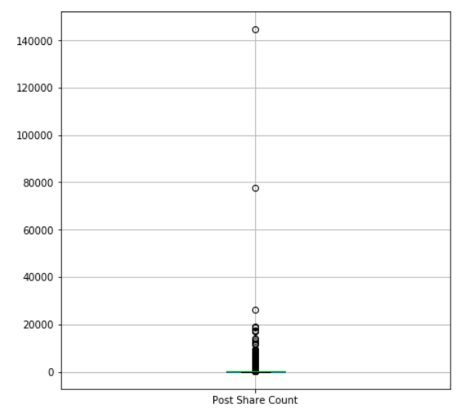
Exploratory Analysis – Variable ‘Post Share Count ‘
DISIM - Università degli Studi Dell’Aquila

Slide 12
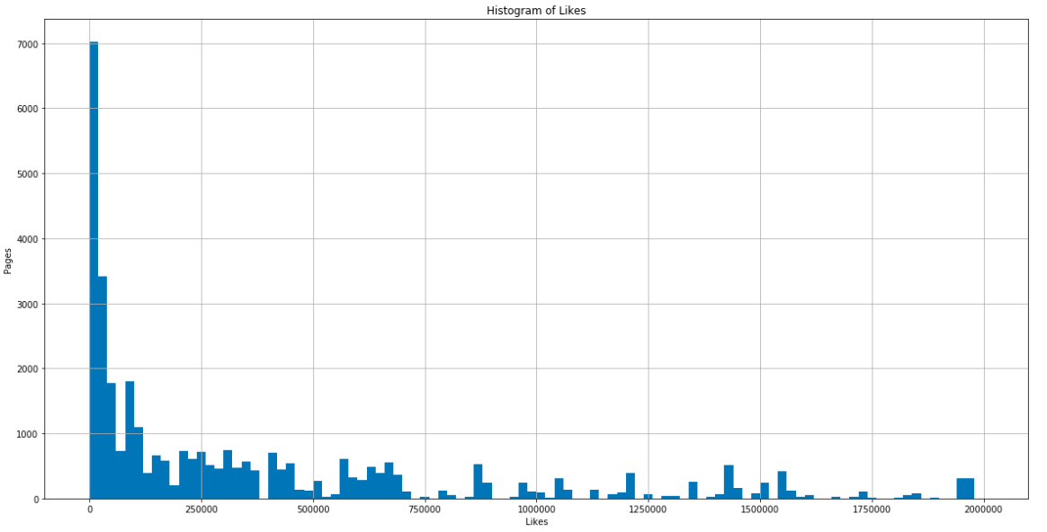
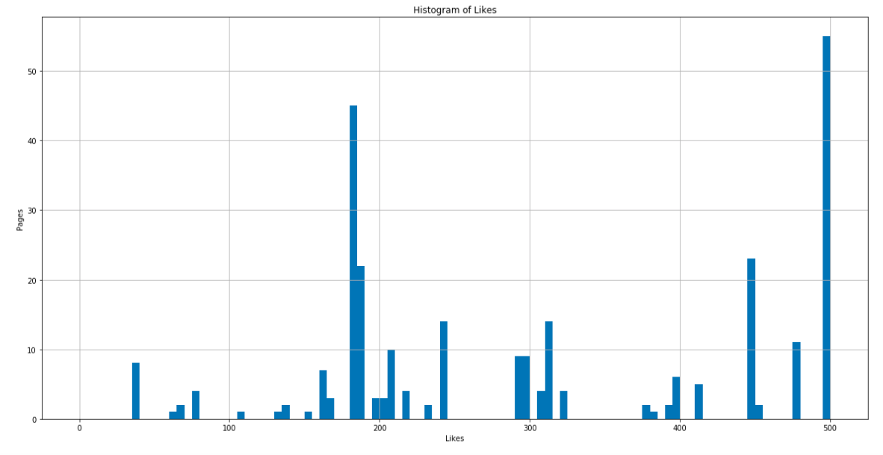
Exploratory Analysis – Likes for all pages
DISIM - Università degli Studi Dell’Aquila
Notes:
The previous histogram shows that around 7000 posts have a very small number of likes. Thus, decreasing the range between 0 and 500, we figured out the exact number of likes. Moreover, we checked that there were no pages with 0 likes, since they would not be useful for our future research. A deeper analysis is showed below.

Slide 13
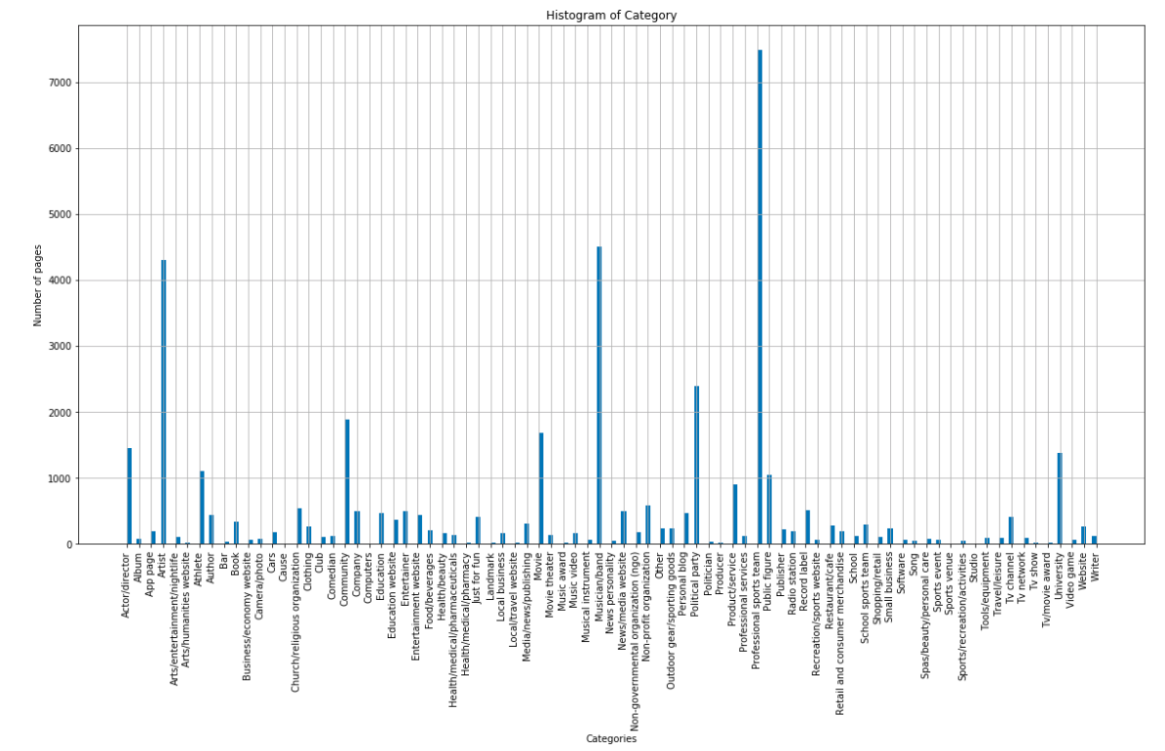
Exploratory Analysis – Post’s Category
DISIM - Università degli Studi Dell’Aquila
Notes:
As can be seen from the figure, Professional Sports Team is the most recurrent category.

Slide 14
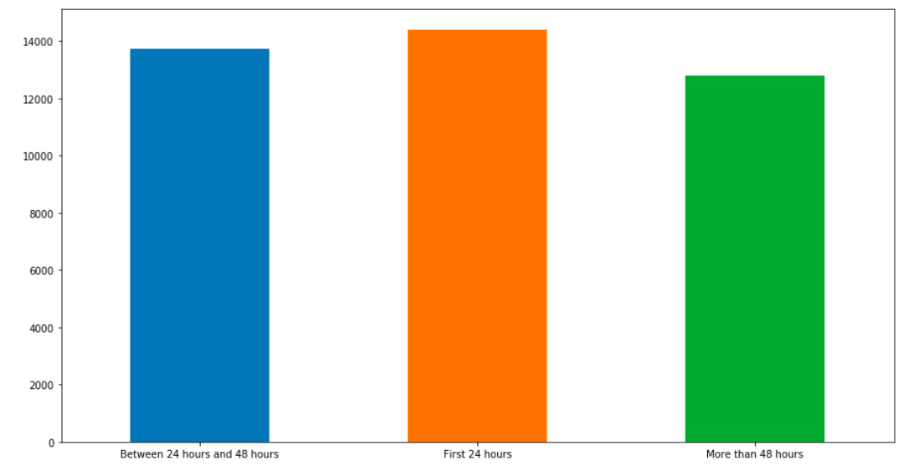
Exploratory Analysis – Posts published in the first 24h, 48h & 72h
DISIM - Università degli Studi Dell’Aquila
Notes:
Instead, from this point has been started the analysis regarding the principal goal we want to achieve. All statistics from now are made to answer to the following question (already explained in section 1).
To answer, initially the posts have been divided between short and long. Looking at several Facebook posts, short posts are those with a maximum of 400 characters. As a result, long posts will be those with at least 400 characters.

Slide 15
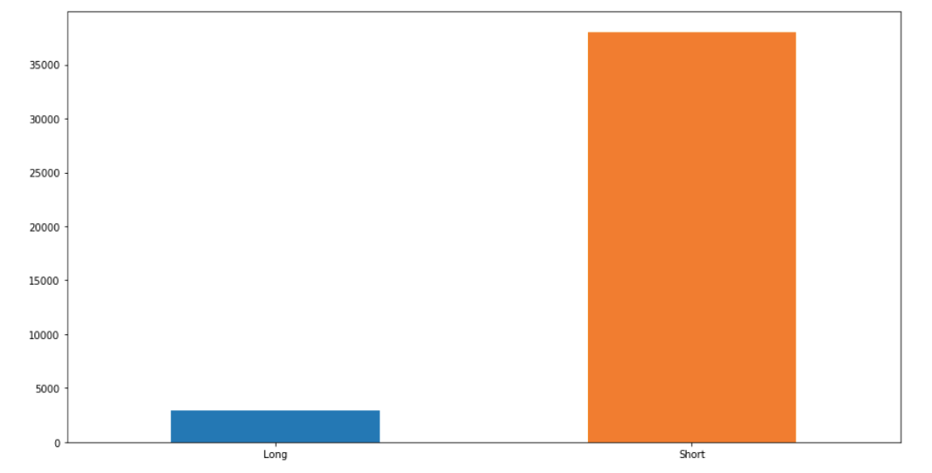
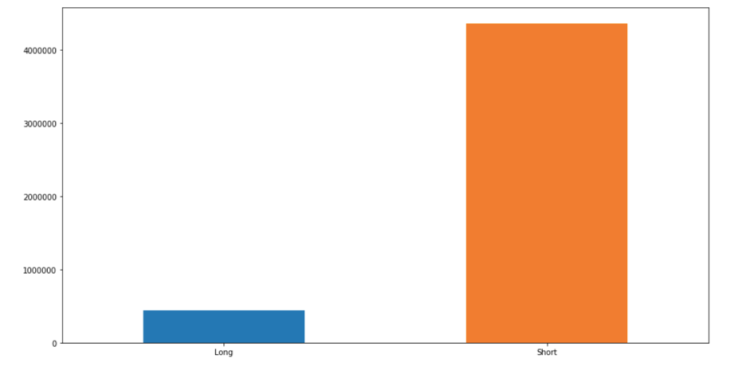
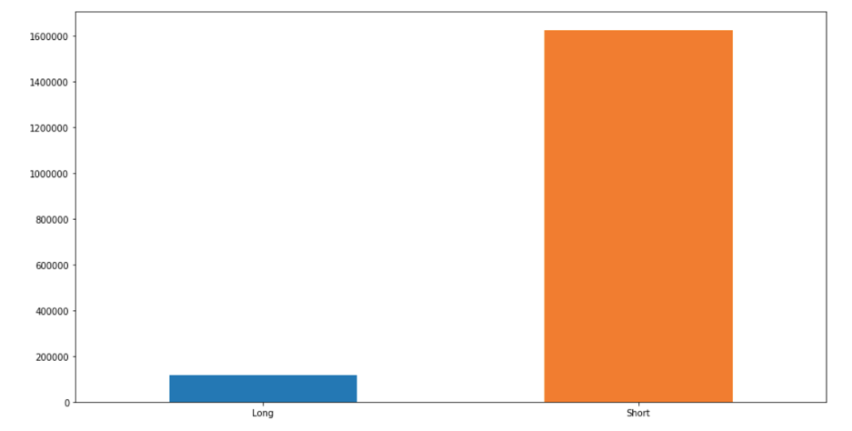
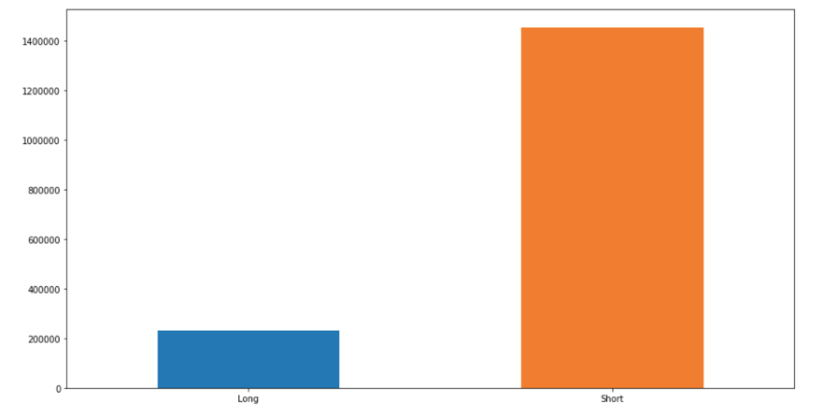
Exploratory Analysis – Long & Short Posts
Number of long and short posts
Number of shares about long and short posts
How many posts have been shared in the first 24h
How many posts have been shared between 24h and 48h
DISIM - Università degli Studi Dell’Aquila

Slide 16
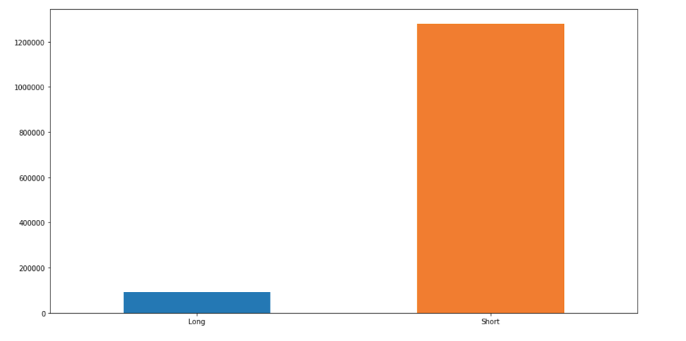
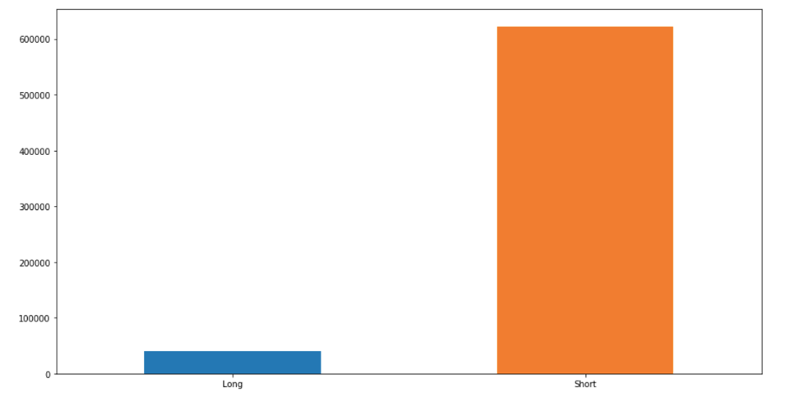
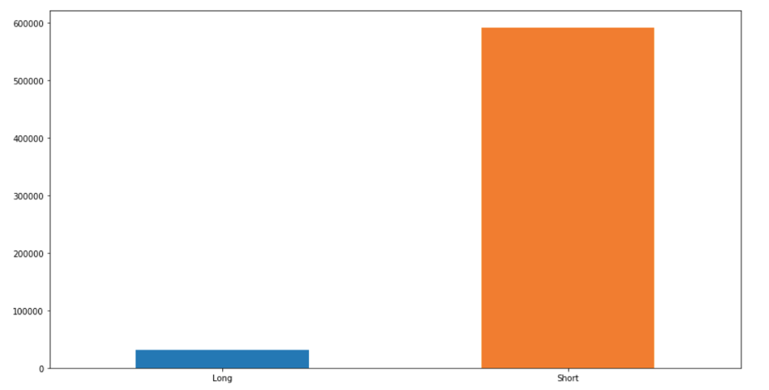
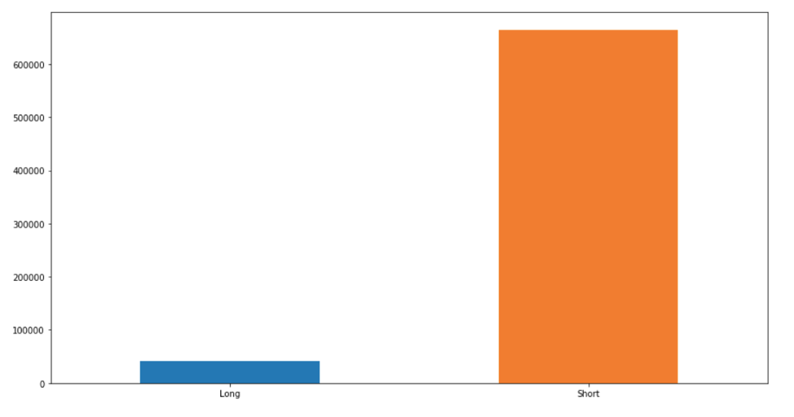
Exploratory Analysis – Long & Short Posts
How many posts have been shared between 48h and 72h
Number of comments received in the first 24h
Number of comments received between 24h and 48h
Number of comments received between 48h and 72h
DISIM - Università degli Studi Dell’Aquila
Notes:
A possible 'good' post length
We ordered in descending order the data frame based on the number of shares and we took the first 100 rows. Thereafter, we ordered again in descending order the resulting rows based on the number of all the comments and we took the first 50 rows. By averaging the length of the post between these first 50 rows, we discovered that the 'good' post length is around 107.

Slide 17
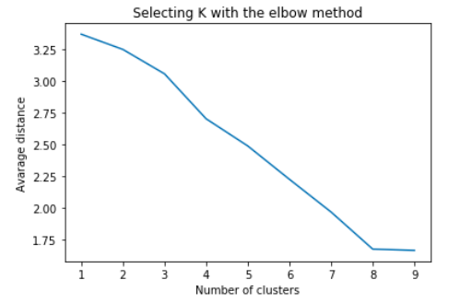
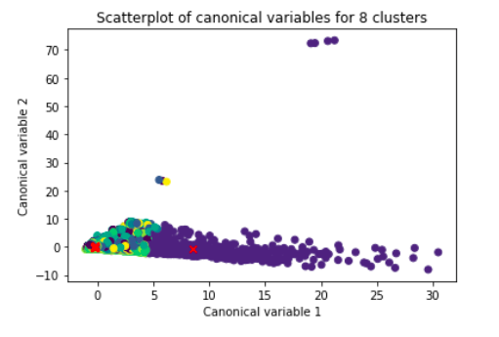
Unsupervised Learning
Since the values in the dataset are all numerical a K-means analysis can be performed.
Standardize our variables.
Split the dataset in training and test sets.
Elbow method.
Interpret the 8 cluster solution.
DISIM - Università degli Studi Dell’Aquila

Slide 18
Supervised Learning
First of all, the number of shares of a post has been divided in 4 different categories that indicate respectively:
A low number of shares that indicates a number between 1 and 49 and it is identified by the number '1'
A medium number of shares that indicates a number between 50 and 199 and it is identified by the number '2'
A good number of shares that indicates a number between 200 and 699 and it is identified by the number '3'
A high number of shares that indicates a number grater then 700 and it is identified by the number '4'
DISIM - Università degli Studi Dell’Aquila
Notes:
Supervised learning is a machine learning task, specifically it is a function that maps an input to an output based on example input-output pairs. It infers a function from labelled training data consisting of a set of training example. In supervised learning, each example is a pair consisting of an input object (typically a vector) and a desired output value. A supervised learning algorithm analyses the training data and produces an inferred function, which can be used for mapping new examples. This requires the learning algorithm to generalize from the training data to unseen situations in a "reasonable" way.

Slide 19
Supervised Learning – Decision Trees
Decision trees are a powerful prediction method and extremely popular. It works for both continuous as well as categorical output variables.
Building Phase
Pre-process the dataset.
Split the dataset from train and test using Python.
Train the classifier.
Operational Phase
Make predictions.
Calculate the accuracy.
The number of shares has been predicted and the accuracy score has been calculated to be really next to 78%.
DISIM - Università degli Studi Dell’Aquila

Slide 20
Supervised Learning - Neural Network
Neural networks are computing systems vaguely inspired by the biological neural networks that constitute animal brains.
The technic that has been used is Multi-layer Perceptron, that is a supervised learning algorithm that learns a function by training on a dataset.
Building Phase
Pre-process the dataset.
Encoding dataset using one-hot.
Split the dataset from train and test using Python.
Train the classifier.
Operational Phase
Make predictions.
Calculate the accuracy.
The number of shares has been predicted and the accuracy score has been calculated to be really next to 76%.
DISIM - Università degli Studi Dell’Aquila

Slide 21
Conclusions
At the end of our study we can conclude that:
The day when there are more publications is Thursday.
The day when there are fewer publications is Monday.
The period in which more comments are made and more likes are placed is between 48 and 72 hours after the publication of a post.
The category that shows the most interactions is 'Professional Sports Team’.
About 90% of posts have less than 400 characters.
24 hours following the sharing are the most interactive for short posts.
Between the 24h and 48h after the share are the most interactive hours for long posts.
Short length posts are:
preferred by users,
have more interactions.
Accuracy level is really close to 76%.
DISIM - Università degli Studi Dell’Aquila

Slide 22
Thanks for
your attention!

