Slide 1


Supreme Court Decisions on ACA Preventive Care Mandates and HIPAA Rule

Slide 2

• Introduction
• Supreme Court Upholds ACA Preventive Care Mandates
• Kennedy v. Braidwood Case
• ACA’s Preventive Care List Updates
• Court Overturns 2024 HIPAA Rule on Reproductive Health Privacy
Overview

Slide 3
INTRODUCTION
CONTENT SLIDE
• Overview of Supreme Court decisions
• Impact on ACA preventive care mandates
• Changes to HIPAA Rule on Reproductive Health Privacy
• Implications for employers

Slide 4
SUPREME COURT UPHOLDS ACA PREVENTIVE CARE MANDATES
CONTENT SLIDE

Slide 5

TRANSITION
SLIDE

Slide 6
KENNEDY V. BRAIDWOOD CASE
CONTENT SLIDE

Slide 7
ACA’S PREVENTIVE CARE LIST UPDATES
CONTENT SLIDE
TEXT | TEXT | TEXT | TEXT | TEXT | TEXT
Add text here | Add text here | Add text here | Add text here | Add text here | Add text here
Add text here | Add text here | Add text here | Add text here | Add text here | Add text here
Add text here | Add text here | Add text here | Add text here | Add text here | Add text here
Add text here | Add text here | Add text here | Add text here | Add text here | Add text here
Add text here | Add text here | Add text here | Add text here | Add text here | Add text here

Slide 8


TRANSITION SLIDE

Slide 9
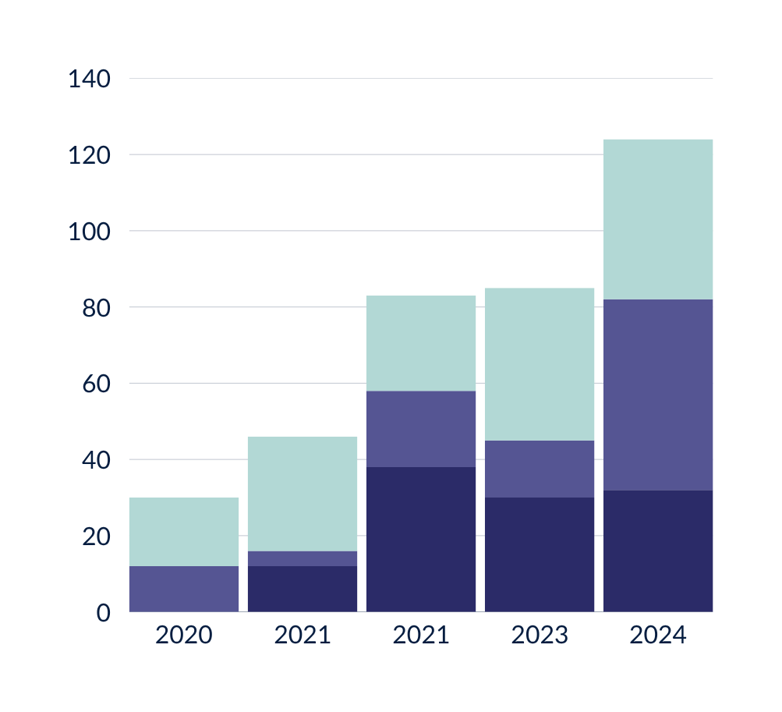
COURT OVERTURNS 2024 HIPAA RULE ON REPRODUCTIVE HEALTH PRIVACY
CONTENT SLIDE
Statistics
• Introduction of the new HIPAA Privacy Rule in June 2024
• Extra privacy protections for reproductive health care information
• June 18, 2025 ruling by the U.S. District Court
• Implications for employers sponsoring a self-insured health plan
80%
10%
Revenue Growth
Return on Investment
20%
75%
Customer Acquisition Cost
Customer Satisfaction

Slide 10
CONTENT SLIDE
Heading
[Content]
[Content]

Slide 11

THANK YOU!
Q&A
The material presented here is for general educational purposes only and is subject to changes in laws, rules, and interpretations. BCS does not provide legal or tax opinions or advice.

