Slide 1
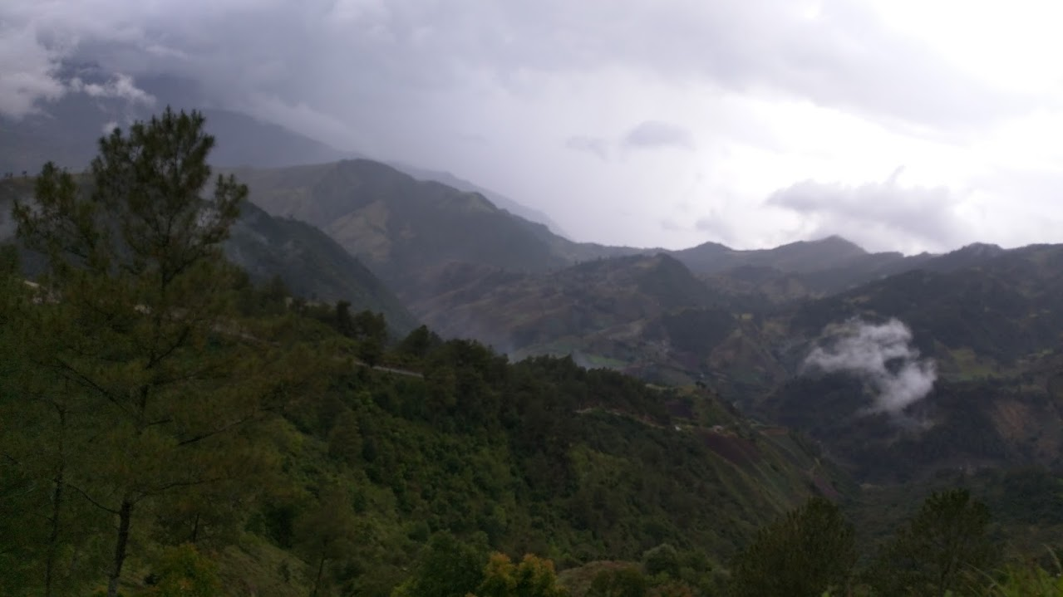
Let’s go on and adventure
Search

Slide 2
Let’s go on and adventure
Current Weather and Forecast next 3 days
Map with Location searched
List of places with more info

