Slide 1

Machine Learning
Introduction
Tech Lead Data Science
Master en Data Science
2022-2023

Slide 2
Index
1
Introduction
2
Types of ML
3
Phases of ML

Slide 3
Introduction
What is Machine Learning ?

Slide 4
INTRODUCTION
Definition of Machine Learning
Machine Learning is a discipline in the field of Artificial Intelligence in which, through massive data (Big Data), computers learn to identify patterns to offer prediction, all through algorithms.
Artificial Intelligence
Machine Learning
Deep Learning

Slide 5

Everything is Artificial Intelligence
Machine Learning
Artificial Intelligence
Machine Learning requires the training of algorithms to provide a computer with "intelligence", in addition, this learning is carried out from experience (understanding as experience the data and parameters of an algorithm)
Artificial Intelligence, on the other hand, is simply that a computer imitates a human capacity, or makes it appear intelligent, this intelligence may require Machine Learning, Big Data, Statistics or Mathematics or simply programming.

Slide 6
ML OVERVIEW
Rules
Classical programming
Answers
Data
⭐️
Answers
Machine Learning
Rules
Data

Slide 7
ML OVERVIEW
Classification
Regresssion
Supervised
Semisupervised
ML MODELS
Clustering
Dimension reduction
Unsupervised
Reinforcement

Slide 8
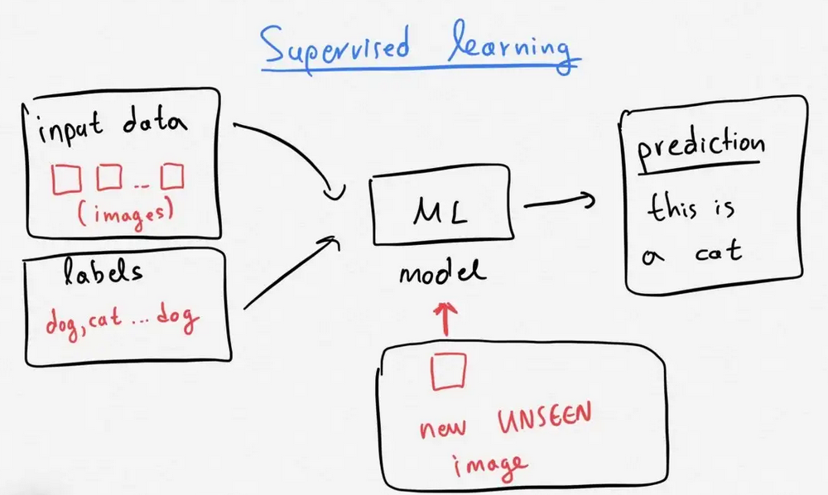
ML OVERVIEW
Supervised
We have a data set with a response variable (target) previously labeled.
Learning the algorithm will return one of the possible values of the target variable.
They can be further grouped into:
Classification: A classification problem is when the output variable is a category e.g. “disease” / “no disease”.
Regression: A regression problem is when the output variable is a real continuous value e.g. stock price prediction

Slide 9
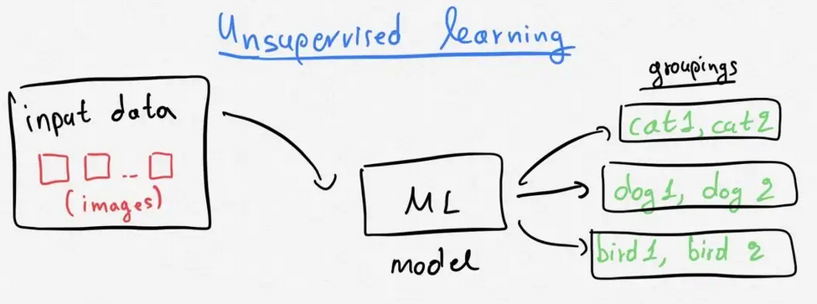
ML OVERVIEW
Unsupervised
We do not have a target variable with the response data previously labeled
The algorithm will be in charge of grouping the data by their similarity (or distance)
The output of the algorithm will be a variable that labels the data sets.
They can be further grouped into:
Clustering: Clustering involves grouping sets of similar data (based on defined criteria). It’s useful for segmenting data into several groups and performing analysis on each data set to find patterns.
Dimension reduction: Dimension reduction reduces the number of variables being considered to find the exact information required.

Slide 10
ML OVERVIEW
Semisupervised
There are some labeled data and a large amount of unlabeled data.
The algorithm tries to predict the labels of the unlabeled data with the aim of improving the quality of the data and improve the quality of the algorithms.

Slide 11
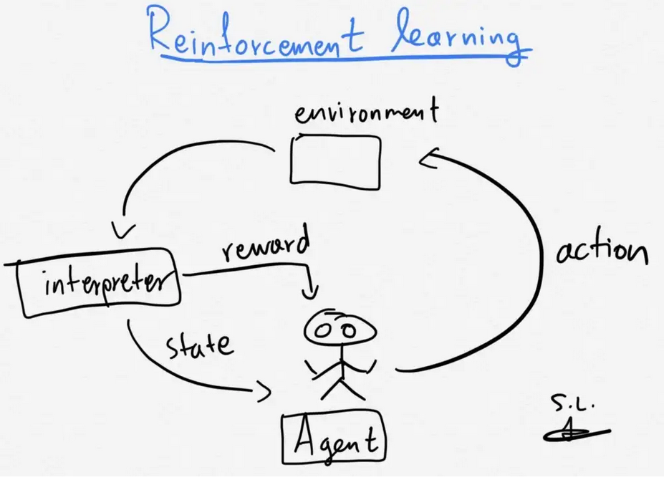
ML OVERVIEW
Reinforcement learning
It does not have a target variable (so it is not supervised)
The algorithm does not return a classified data set (so it is not unsupervised).
This family of models consists of algorithms that use the estimated errors as rewards or penalties.
If the error is big, then the penalty is high and the reward low.
If the error is small, then the penalty is low and the reward high.
Reward feedback is required for the model to learn which action is best and this is known as “the reinforcement signal”.

Slide 12
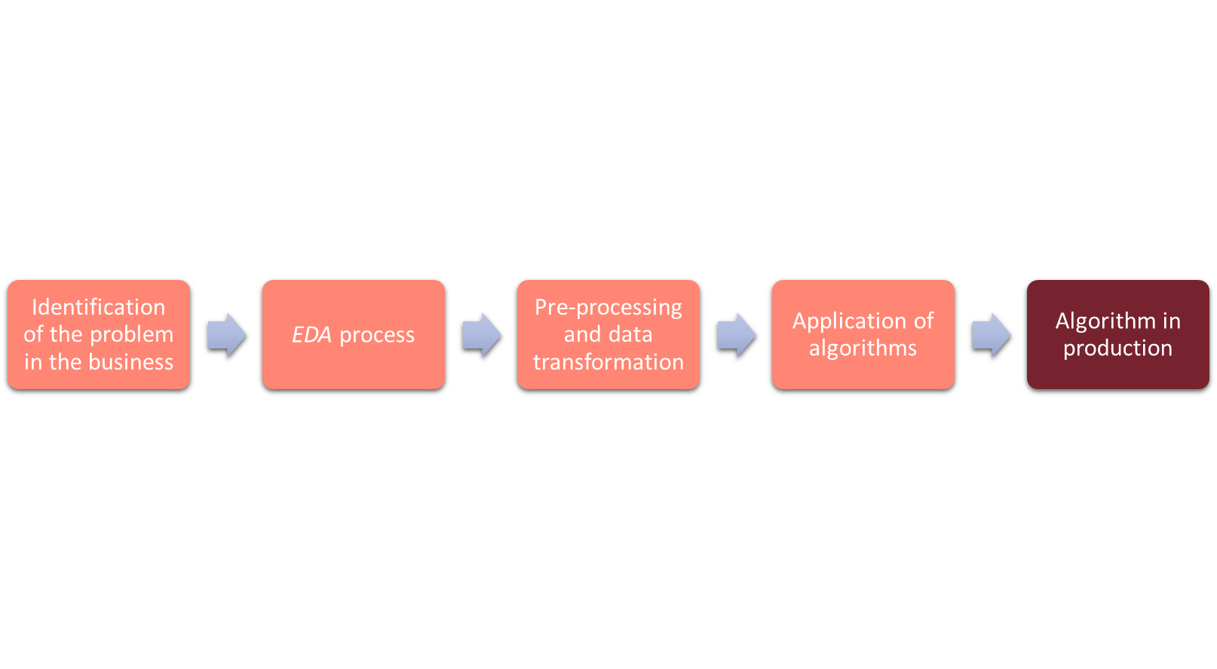
ML OVERVIEW
Phases of ML Project

Slide 13

ML OVERVIEW
Phases of ML Project

Slide 14
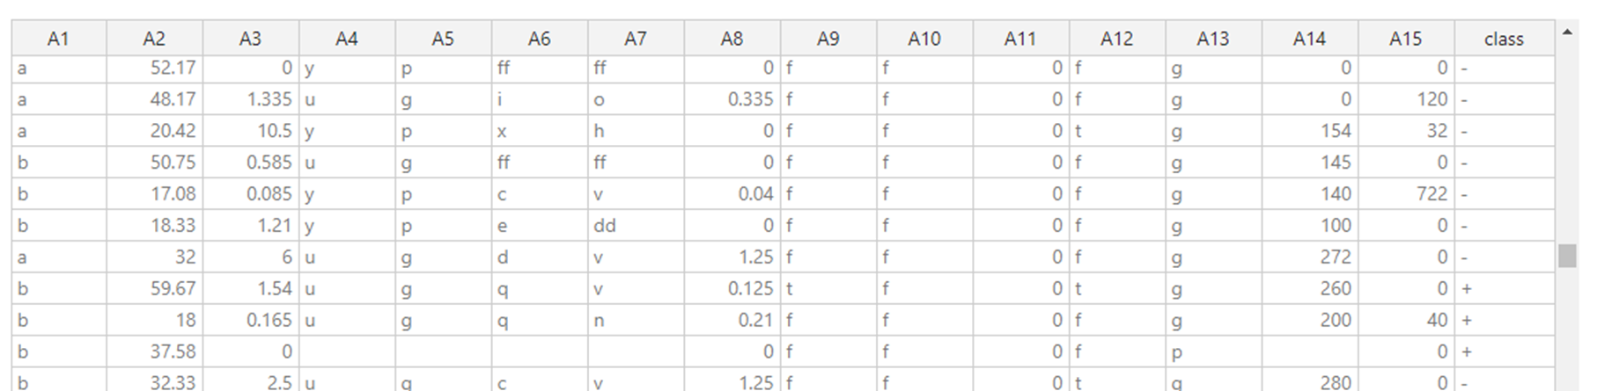
ML OVERVIEW
Modeling Phase
We’ll have a series of characteristics, attributes, columns or simply variables. They will be the X variables and they are called independent variables.
In supervised learning, they will also be accompanied by a dependent variable Y.

Slide 15
ML OVERVIEW
Modeling Phase
The goal of machine learning models is to find the function that best estimates an output from some new data inputs.
As algorithms learn (by imitating) they need to be trained first, before they can predict any event.
The first thing we will do is divide the dataset into:
Training set:
The set to which the machine learning model fits
Test set:
The one that is not used throughout the process until the final part, simply to check that the model generalizes correctly. It is left aside until the end, as if it were new data.
Validation set:
It is almost always used. This set allows you to compare different models and choose the one that performs best.
Notes:
Generally, several models are fitted to the training set, some metrics are obtained on the validation set and the one with the best metric obtained in validation is chosen.
Subsequently, this model is applied to Test and the final metric is obtained.

Slide 16
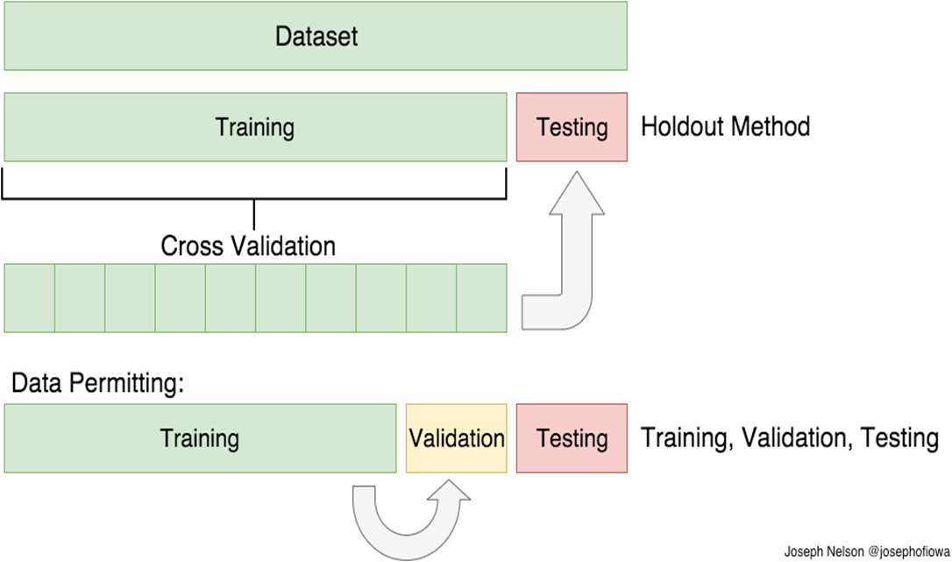
ML OVERVIEW
Modeling Phase
Notes:
Cross-validation or ‘k-fold cross-validation’ is when the dataset is randomly split up into ‘k’ groups. One of the groups is used as the test set and the rest are used as the training set. The model is trained on the training set and scored on the test set. Then the process is repeated until each unique group as been used as the test set.

Slide 17
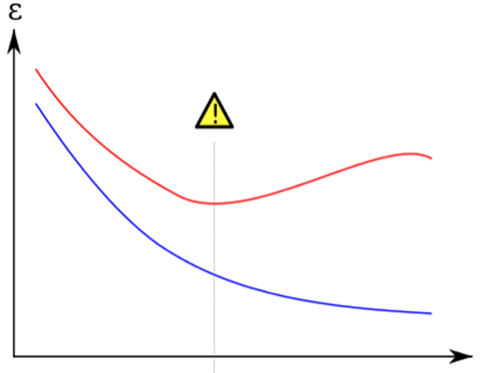
ML OVERVIEW
Modeling Phase
These splits of the data are done to avoid the most important problem in machine learning, which is called overfitting.
Overfitting is the act of making a model that fits the training data so well that it does not generalize correctly to the test data. That is, it fits correctly to the past, but not to the future, which is the objective of the models.

