Slide 1

Expected Value
Tech Lead Data Science
Master en Data Science
2022-2023

Slide 2

Index
1
Introduction to Expected Value
2
Properties

Slide 3
Introduction to Expected Value

Slide 4

Expected value
X=xi | 0 | 1 | 2 | 3
P(X=xi) | 0.4 | 0.3 | 0.2 | 0.1
1 2 3 3 0 0
What is the mean you would expect for a sequence of 90 integers?

Slide 5


Expected value
X=xi | 0 | 1 | 2 | 3
P(X=xi) | 0.4 | 0.3 | 0.2 | 0.1
1 2 3 3 0 0
What is the mean you would expect for a sequence of 90 integers?

Slide 6

Expected value
X=xi | 0 | 1 | 2 | 3
P(X=xi) | 0.4 | 0.3 | 0.2 | 0.1
1 2 3 3 0 0
What is the mean you would expect for a sequence of 90 integers?

Slide 7
Expected value
X=xi | 0 | 1 | 2 | 3
P(X=xi) | 0.4 | 0.3 | 0.2 | 0.1
1 2 3 3 0 0
What is the mean you would expect for a sequence of 90 integers?

Slide 8
Expected value
X=xi | 0 | 1 | 2 | 3
P(X=xi) | 0.4 | 0.3 | 0.2 | 0.1
1 2 3 3 0 0
What is the mean you would expect for a sequence of 90 integers?

Slide 9
Expected value
X=xi | 0 | 1 | 2 | 3
P(X=xi) | 0.4 | 0.3 | 0.2 | 0.1
1 2 3 3 0 0
What is the mean you would expect for a sequence of 90 integers?

Slide 10
Expected value
X=xi | 0 | 1 | 2 | 3
P(X=xi) | 0.4 | 0.3 | 0.2 | 0.1
1 2 3 3 0 0
What is the mean you would expect for a sequence of 90 integers?

Slide 11
Expected value
X=xi | 0 | 1 | 2 | 3
P(X=xi) | 0.4 | 0.3 | 0.2 | 0.1
1 2 3 3 0 0
What is the mean you would expect for a sequence of 90 integers?

Slide 12
Expected value
X=xi | 0 | 1 | 2 | 3
P(X=xi) | 0.4 | 0.3 | 0.2 | 0.1
1 2 3 3 0 0
What is the mean you would expect for a sequence of 90 integers?

Slide 13
Expected value
X=xi | 0 | 1 | 2 | 3
P(X=xi) | 0.4 | 0.3 | 0.2 | 0.1
1 2 3 3 0 0
What is the mean you would expect for a sequence of 90 integers?

Slide 14
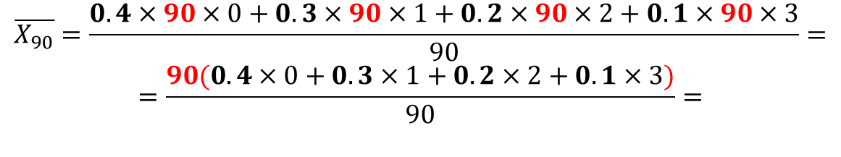
Expected value
X=xi | 0 | 1 | 2 | 3
P(X=xi) | 0.4 | 0.3 | 0.2 | 0.1
1 2 3 3 0 0
What is the mean you would expect for a sequence of 90 integers?

Slide 15
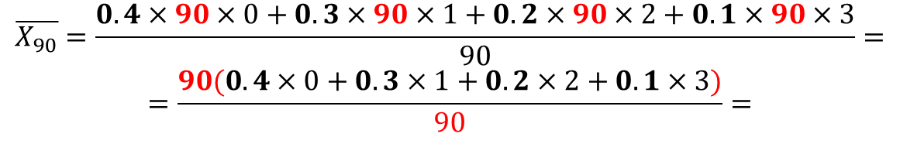
Expected value
X=xi | 0 | 1 | 2 | 3
P(X=xi) | 0.4 | 0.3 | 0.2 | 0.1
1 2 3 3 0 0
What is the mean you would expect for a sequence of 90 integers?

Slide 16
Expected value
X=xi | 0 | 1 | 2 | 3
P(X=xi) | 0.4 | 0.3 | 0.2 | 0.1
1 2 3 3 0 0
What is the mean you would expect for a sequence of 90 integers?

Slide 17
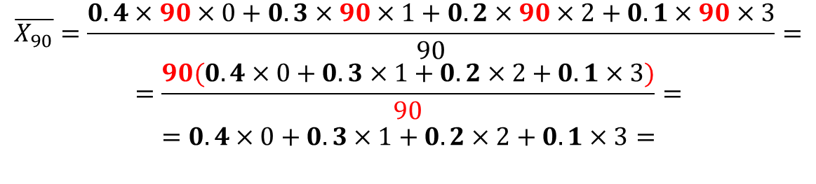
Expected value
X=xi | 0 | 1 | 2 | 3
P(X=xi) | 0.4 | 0.3 | 0.2 | 0.1
1 2 3 3 0 0
What is the mean you would expect for a sequence of 90 integers?

Slide 18
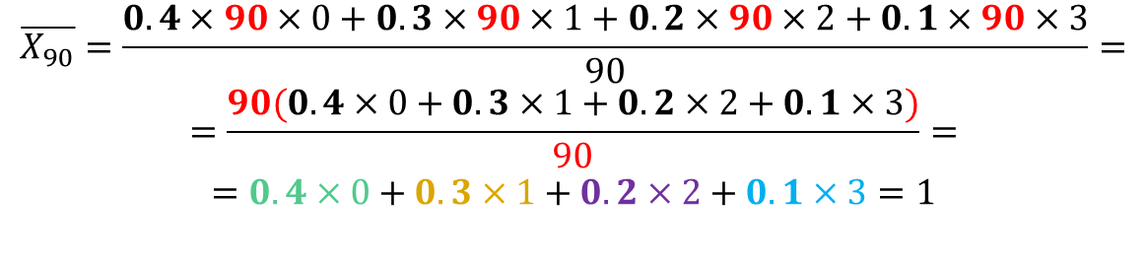
Expected value
X=xi | 0 | 1 | 2 | 3
P(X=xi) | 0.4 | 0.3 | 0.2 | 0.1
1 2 3 3 0 0
What is the mean you would expect for a sequence of 90 integers?

Slide 19
Expected value
X=xi | 0 | 1 | 2 | 3
P(X=xi) | 0.4 | 0.3 | 0.2 | 0.1
1 2 3 3 0 0
What is the mean you would expect for a sequence of 90 integers?

Slide 20
Expected value
X=xi | 0 | 1 | 2 | 3
P(X=xi) | 0.4 | 0.3 | 0.2 | 0.1
1 2 3 3 0 0
What is the mean you would expect for a sequence of 90 integers?
¡No importó el largo de la secuencia!

Slide 21









Expected value
X=xi | 0 | 1 | 2 | 3
P(X=xi) | 0.4 | 0.3 | 0.2 | 0.1
1 2 3 3 0 0
What is the mean you would expect for a sequence of 90 integers?
¡No importó el largo de la secuencia!

Slide 22

Expected value
X=xi | 0 | 1 | 2 | 3
P(X=xi) | 0.4 | 0.3 | 0.2 | 0.1
1 2 3 3 0 0
What is the mean you would expect for a sequence of 90 integers?
¡No importó el largo de la secuencia!

Slide 23
Expected value
X=xi | 0 | 1 | 2 | 3
P(X=xi) | 0.4 | 0.3 | 0.2 | 0.1
1 2 3 3 0 0
What is the mean you would expect for a very, very long sequence?

Slide 24
Expected value
X=xi | 0 | 1 | 2 | 3
P(X=xi) | 0.4 | 0.3 | 0.2 | 0.1
1 2 3 3 0 0
What is the mean you would expect for a very, very long sequence?

Slide 25

Expected value
X=xi | 0 | 1 | 2 | 3
P(X=xi) | 0.4 | 0.3 | 0.2 | 0.1
1 2 3 3 0 0
What is the mean you would expect for a very, very long sequence?

Slide 26
Expected value
X=xi | 0 | 1 | 2 | 3
P(X=xi) | 0.4 | 0.3 | 0.2 | 0.1
1 2 3 3 0 0
What is the mean you would expect for a very, very long sequence?
Expectation or
Expected value

Slide 27
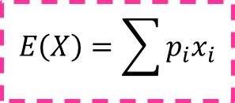
Expected value
X=xi | 0 | 1 | 2 | 3
P(X=xi) | 0.4 | 0.3 | 0.2 | 0.1
1 2 3 3 0 0
What is the mean you would expect for a very, very long sequence?
Expectation or
Expected value

Slide 28
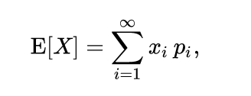
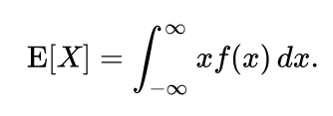
Expected value
In probability theory, the expected value is a generalization of the weighted average. Informally, the expected value is the arithmetic mean of a large number of independently selected outcomes of a random variable.
The expected value of a random variable with a finite number of outcomes is a weighted average of all possible outcomes.
In the case of a continuum of possible outcomes, the expectation is defined by integration. In the axiomatic foundation for probability provided by measure theory, the expectation is given by Lebesgue integration.
Notes:
(also called expectation, expectancy, mathematical expectation, mean, average, or first moment)

Slide 29
Properties

Slide 30
PROPERTIES
Non-negativity: If X ≥ 0 (a.s.), then E[ X ] ≥ 0 .
Linearity of expectation:The expected value operator (or expectation operator) E ⁡ [ ⋅ ] is linear in the sense that, for any random variables X and Y , and a constant a:
E [X + Y] = E ⁡[ X ] + E [ Y ]
E[ a X ] = a E [ X ]
Monotonicity: If X ≤ Y, and both E[ X ] and E⁡[ Y ] exist, then E⁡[ X ] ≤ E[ Y ]
Constant: If X is a random variable and P(X=c)=1, then E[X]=c

