Slide 1

Classification
Logistic regression
Tech Lead Data Science
Master en Data Science
2022-2023

Slide 2
ÍNDICE
1
Introduction to classification problems
2
Logistic regression
3
Evaluation metrics

Slide 3
CLASSIFICATION

Slide 4

CLASSIFICATION
Classification problems have an independent categorical variable Y.
They are processes that consist on identifying to which category or class belongs a determined object, according to their dependent variables.
Examples:
Fraud detection
Definition of a target in a marketing campaign
Medical diagnosis
Image classification

Slide 5
CLASSIFICATION
STEPS
Training:
We build a classifier (model) learning from a labeled train set.
Classification:
We use the model to classify.
Evaluation:
We evaluate the model. This step can be included in the previous one.

Slide 6
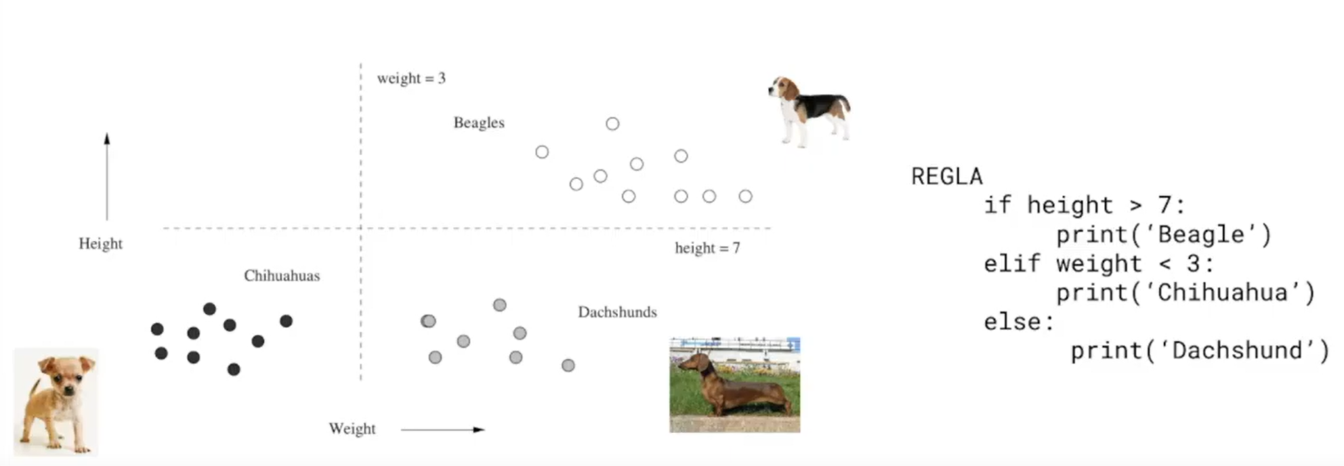
CLASSIFICATION

Slide 7
CLASSIFICATION
Life is not so easy: we cannot always develop clear rules☹️
To solve this kind of problem, we have machine learning models that predict the probability of a given observation to belong to a particular class:
Bayesian models
Logistic regression
Decision Trees - Random forests
Neural networks
And more!!

Slide 8
CLASSIFICATION
Life is not so easy: we cannot always develop clear rules☹️
To solve this kind of problem, we have machine learning models that predict the probability of a given observation to belong to a particular class:
Bayesian models
Logistic regression ⭐️
Decision Trees - Random forests
Neural networks
And more!!

Slide 9
LOGISTIC REGRESSION

Slide 10
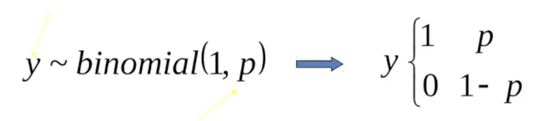
LOGISTIC REGRESSION
Logistic Regression is a classification model, which is very easy to realize and achieves very good performance with linearly separable classes.
Assumption about y:
The predictor variables must be linearly independent.
It is necessary to standardize the variables.
It is a very sensitive model to atypical values or outliers .
Logistic regression can be generalized to problems of more than two classes.

Slide 11
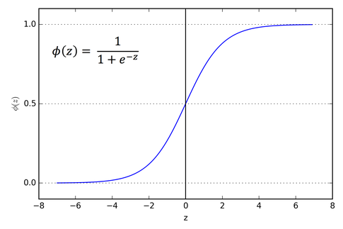
LOGISTIC REGRESSION
It uses a logistic function

Slide 12
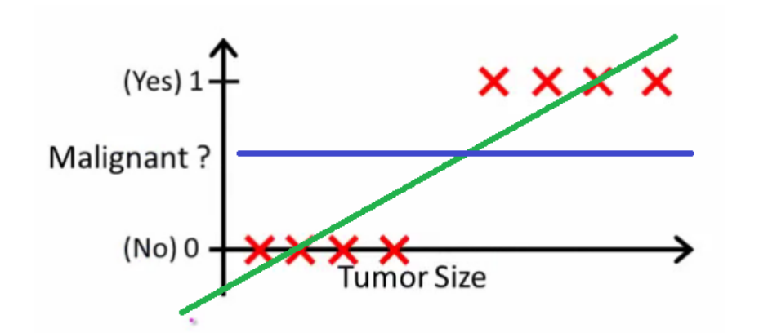
LOGISTIC REGRESSION

Slide 13
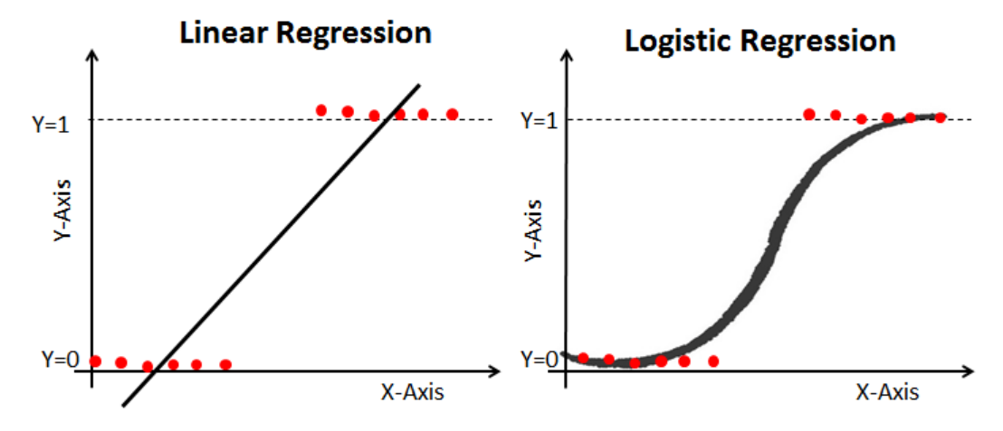
LOGISTIC REGRESSION

Slide 14
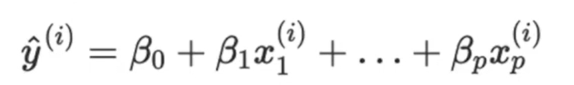
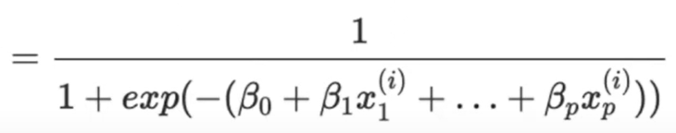
LOGISTIC REGRESSION

Slide 15
EVALUATION METRICS

Slide 16
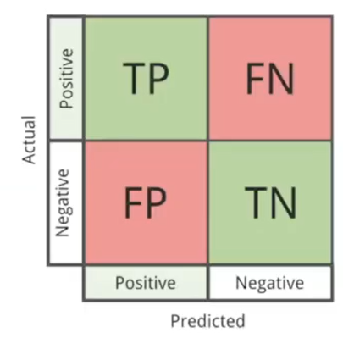
EVALUATION METRICS
CONFUSION MATRIX
There are 4 possible values:
True Positives (TP)
True Negatives (TN)
False Positives (FP)
False Negatives (FN)

Slide 17


EVALUATION METRICS
EVALUATION METRICS
CONFUSION MATRIX
TYPE 2 ERROR
True positive
False negative
CAT
NOT CAT
False positive
True negative
CAT
NOT CAT
TYPE 1 ERROR

Slide 18
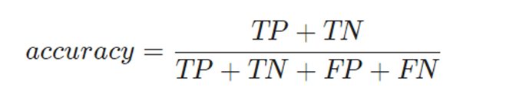
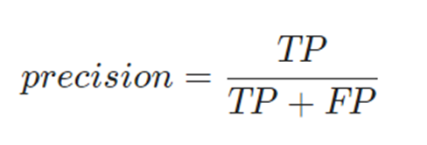
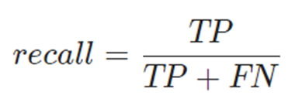
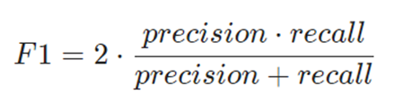
EVALUATION METRICS
METRICS
Accuracy : Percentage of cases in which our model was correct
Precision : Percentage of values that have been classified as positive are actually positive
Recall : Percentage of positive values that are identified
F1 Score : Combines accuracy and comprehensiveness

Slide 19
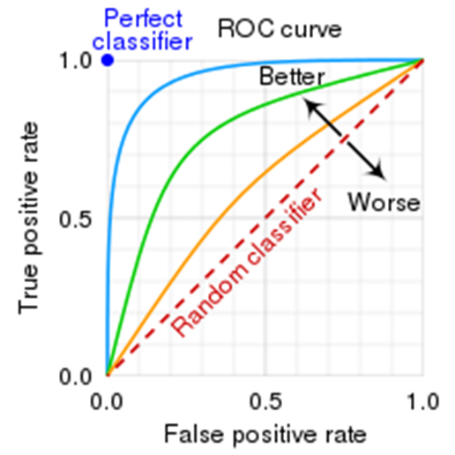
EVALUATION METRICS
ROC CURVE
Represents the percentage of true positives (TPR or Recall) against the false positives ratio (FPR).
Its values range from 0 to 1.

